Slide 1
Jesus
Jesus Christ Course
Document # TX001261

Slide 2
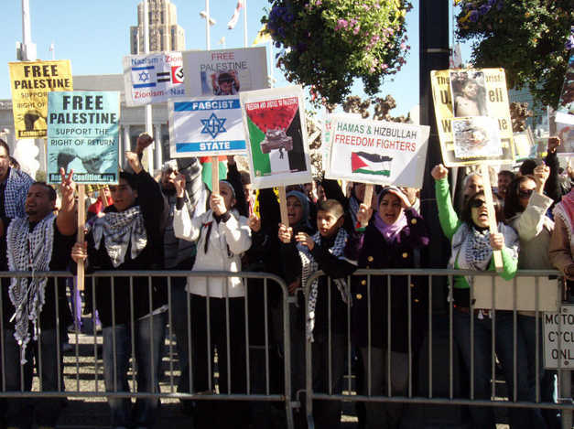
Salvation, Redemption, and the Lord
© i.ehow.com
© blog.adolescenttoolbox.com
Image in public domain
Notes:
Notes: Ask the students to identify what is going on in each photo. What is sinful about the situation? Is there a way to resolve the situation? Lead the discussion to a point where you can introduce the word salvation. Once the word is introduced, move to slide 3.

Slide 3
Salvation, Redemption, and the Lord
Salvation
from the Latin word salvare, meaning “to save”
Saved from what?
What is needed?
Notes:
Notes: Show each bullet one at a time. Allow time for the students to answer the questions. The last question should lead to the concept of savior.

Slide 4
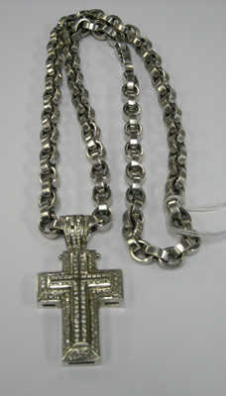
Salvation, Redemption, and the Lord
Savior
from the Latin word salvator, meaning “saver” or “preserver”
© governmentauctions.org
Notes:
Notes: Before you bring in the bullet point, ask what savior means. After some responses from the students, introduce the bullet with the definition. Proceed to the next slide for an Old Testament example.

Slide 5
Salvation, Redemption, and the Lord
Salvation for the Hebrews
exit from Egypt
freedom from slavery
mercy
forgiveness of sin
Image in public domain
Notes:
Notes: Remind the students of the Exodus story. Allow time for questions and answers.

Slide 6
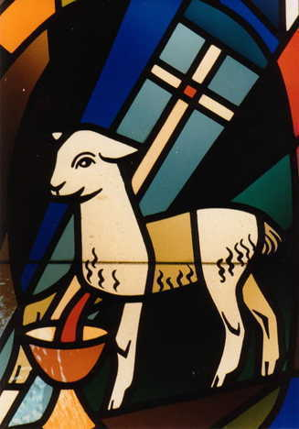
Salvation, Redemption, and the Lord
Salvation for Christians
“God saves”
forgiveness of sin
restoration of friendship with God
Image in public domain
Notes:
Notes: For the first bullet, make sure the students know the origin of the name Jesus. For the second bullet, review the concept of sin, personal and social, as a break in relationship or friendship with God. You may want to note that the name of the country of El Salvador means “The Savior.”

Slide 7
Salvation, Redemption, and the Lord
Redeemer
From the Latin redimere, meaning “to buy back.”
Notes:
Notes: Ask what is being “bought back.” Why is this necessary? Build on the discussion thus far. Lead the discussion to an acknowledgment that Jesus is the Redeemer for all of humanity.

Slide 8
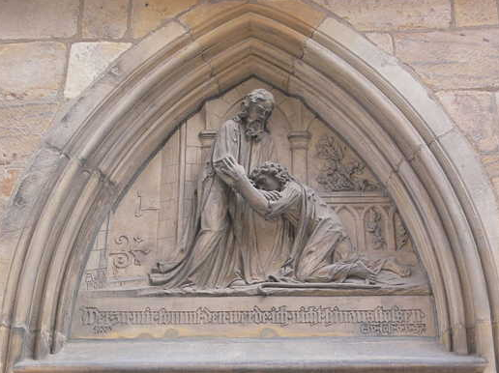
Salvation, Redemption, and the Lord
“For the Son of Man has come to seek and to save what was lost” (Luke 19:10).
Image in public domain

Slide 9
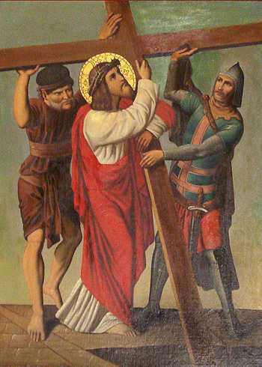
Salvation, Redemption, and the Lord
“For our sake he made him to be sin who did not know sin, so that we might become the righteousness of God in him”
(2 Corinthians 5:21).
Image in public domain

Slide 10
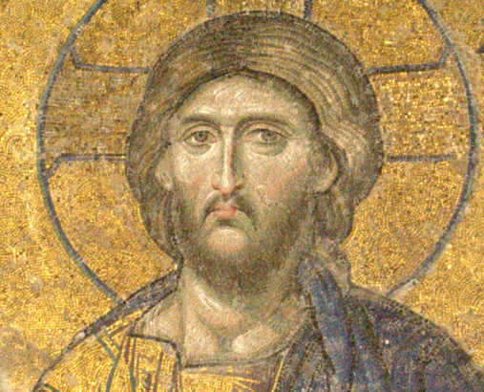
Salvation, Redemption, and the Lord
Jesus is Lord.
“The Lord is my light and my salvation” (Psalm 27:1).
Image in public domain
Notes:
Notes: Ask the students where they have heard the word Lord used. What does it mean to them? How is it used in the New Testament? Point out how the title Lord recognizes the divinity of Jesus.

Slide 11
Salvation, Redemption, and the Lord
Save us, Savior of the world, / for by your Cross and Resurrection, / you have set us free.
(Memorial Acclamation, Order of Mass)
Image in public domain

Slide 12
Image in public domain
This is the day the Lord has made;
let us rejoice in it and be glad.
(Psalm 118:24)
(Resources used for this PowerPoint presentation include Saint Mary’s Press® Glossary of Theological Terms, Saint Mary’s Press® Essential Bible Dictionary, and the Catechism of the Catholic Church.)

