Slide 1
The Fall from Grace
The Paschal Mystery
Unit 1, Chapter 2
Document #: TX005433

Slide 2
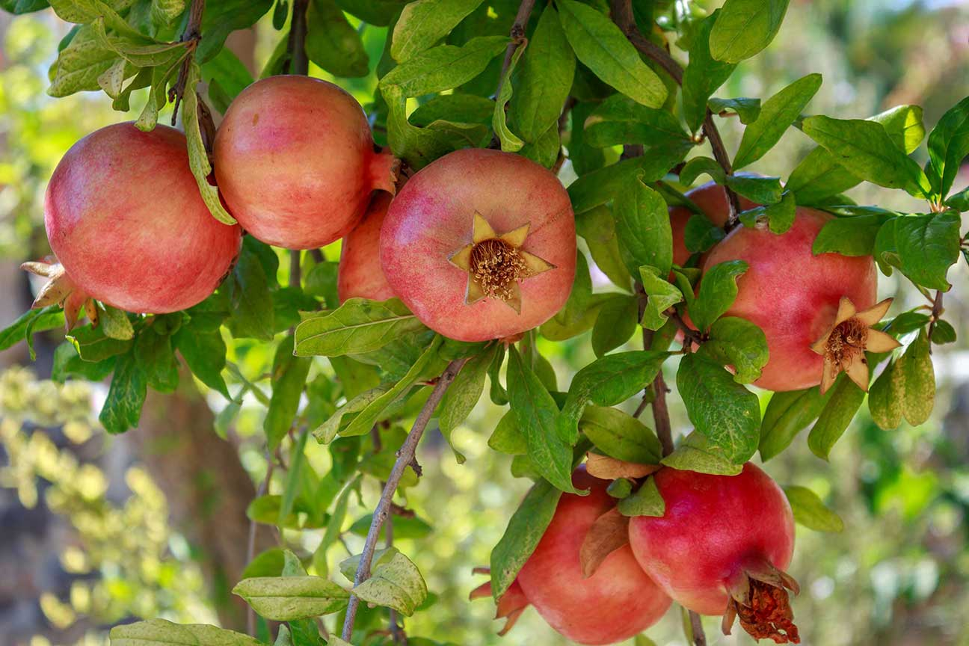
A Tragic Event
God has a plan for us, but our first parents decided not to cooperate.
They disobeyed God’s command, and this sin resulted in the Fall, . . .
. . . a loss of their original holiness and original justice.
© evadeb / Shutterstock
Notes:
Notes: Direct the students to read Romans 7:15, quoted at the beginning of article 5 of the student text. Ask for examples from books, movies, or television shows where a person did something they hated. Discuss the consequences for that person and others. Point out that Saint Paul was describing a universal human experience, a result of the Fall.
This slide corresponds to student book content in article 5.

Slide 3
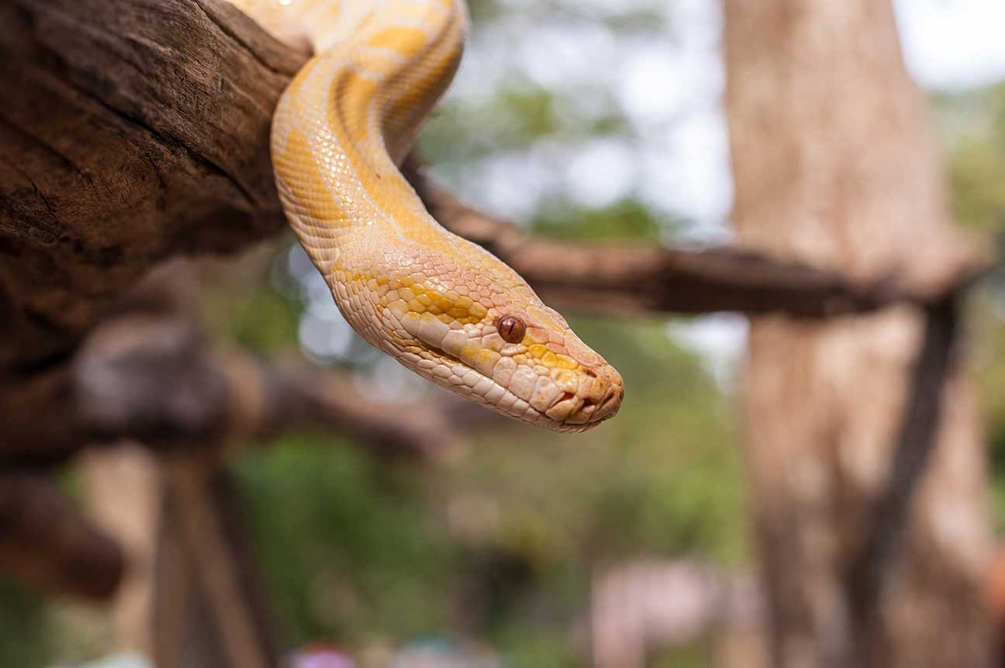
The Fall: Events
God gave Adam and Eve only one command.
The serpent deceived Eve, and she ate the forbidden fruit.
She offered it to Adam, who did the same.
© Jakrapong phaophom / Shutterstock
Notes:
Notes: With the students, review the details of the account of the Fall (Genesis 3:1–24), covered on this slide and the next. Choose a clear example from the earlier discussion, and point out parallels between the biblical and modern narratives.
This slide corresponds to student book content in article 5.

Slide 4
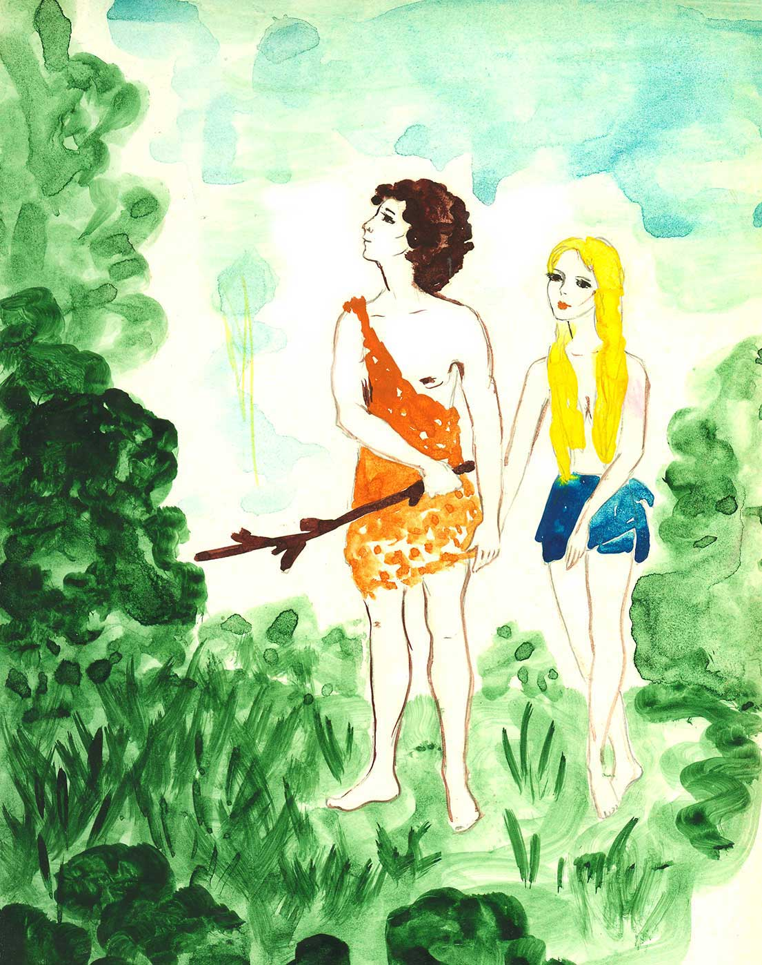
The Fall: The Aftermath
Adam and Eve felt guilt and shame. They hid from God
God confronted them.
Adam blamed Eve. Eve blamed the serpent.
© dolly / Shutterstock
Notes:
Notes: Continue to review the details of the account of the Fall in Genesis, chapter 3. Guide the students in making parallels between the biblical narrative and the example from the earlier discussion. Note that Adam and Eve’s reactions, from feeling shame and hiding from God to blaming others, are symbolic ways of showing that they had lost their original holiness and original justice.
This slide corresponds to student book content in article 5.

Slide 5
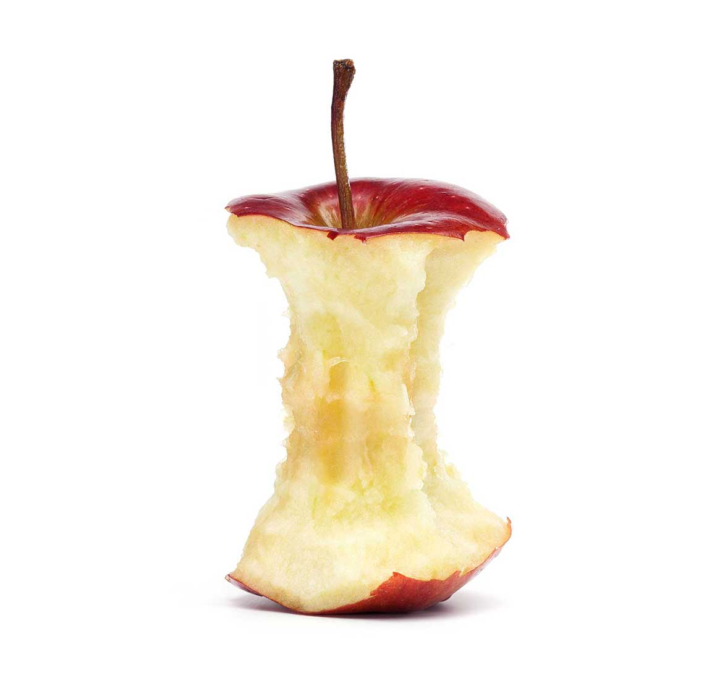
What Was the Sin?
For the writer of Genesis, the full knowledge of good and evil belongs to God alone.
Eating the fruit from that tree is a way to say, “We don’t need God . . .
“. . . we can be gods ourselves.”
© dolly / Shutterstock
Notes:
Notes: Explain that the sin of our first parents was their misuse of human freedom and their lack of trust in God. Direct the students to read the Live It! sidebar, “Think about the Consequences,” in article 5 of the student text, and ask how thinking about consequences would have changed the outcome in some of the examples discussed earlier.
This slide corresponds to student book content in article 5.

Slide 6
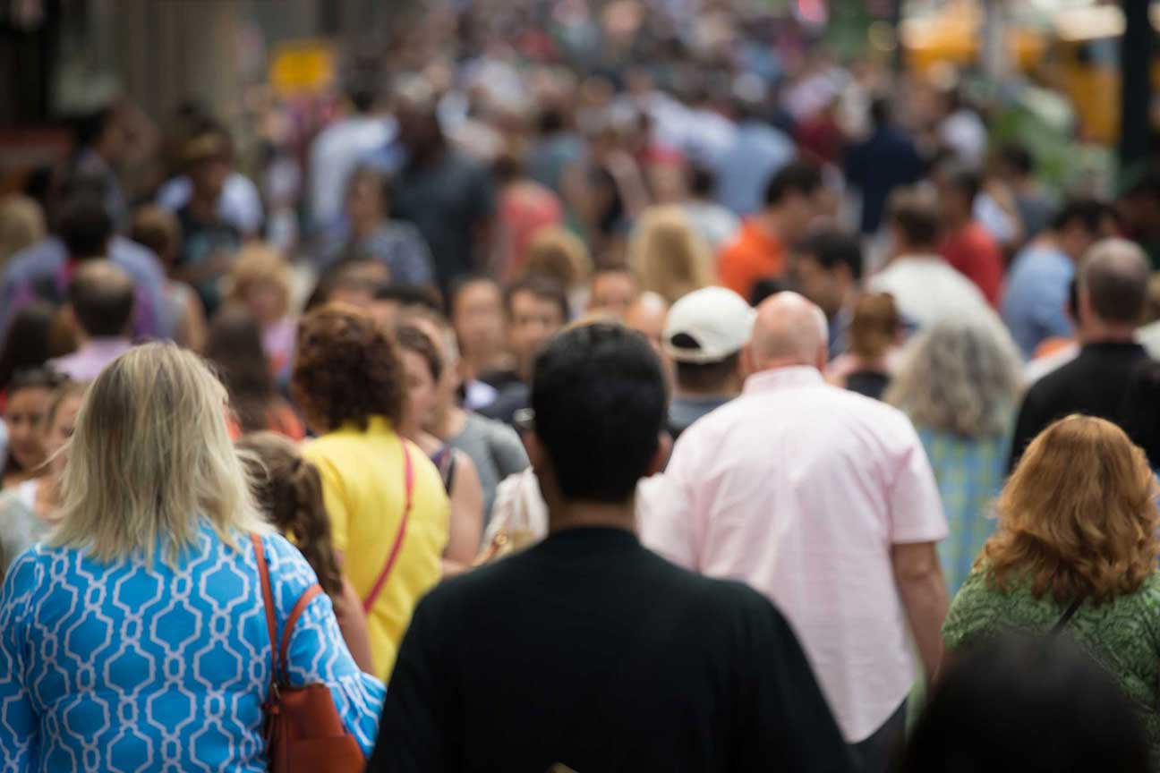
Original Sin: A Consequence
Adam and Eve were created in a state of original holiness not for themselves alone . . .
. . . but for all human nature.
When they sinned, their sin affected their human nature, which was passed on to us.
© blvdone / Shutterstock
Notes:
Notes: Explain that we didn’t do anything that resulted in Original Sin in our lives; it is part of the human condition, shared by all humanity (except Jesus, who was without sin, and his Mother, preserved from Original Sin since her conception).
This slide corresponds to student book content in article 6.

Slide 7
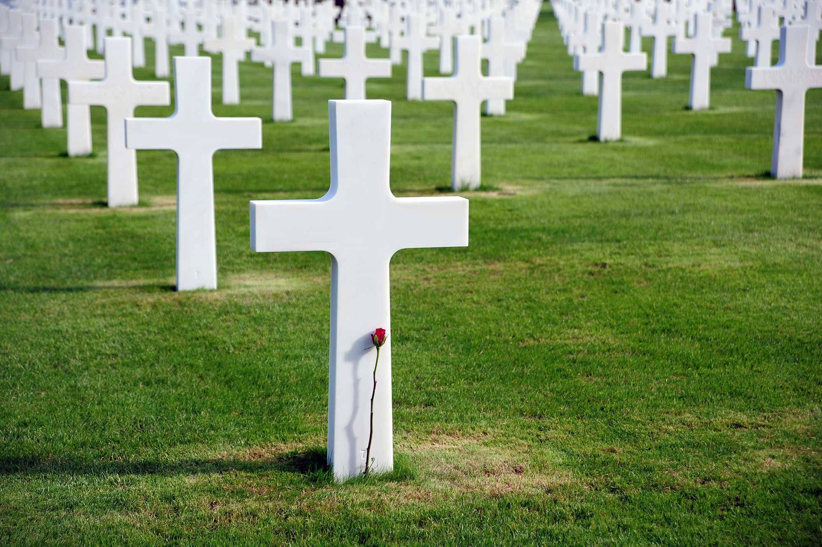
The Results of Original Sin
We are more inclined to sin.
We struggle to find God.
We now experience death.
But we do not lose our essential goodness or become spiritually corrupt.
© v.schlichting / Shutterstock
Notes:
Notes: Ask for examples of our inclination to sin and of our struggle to find God. Ask where we still see a spark of essential goodness in ourselves or in other people.
This slide corresponds to student book content in article 6.

Slide 8
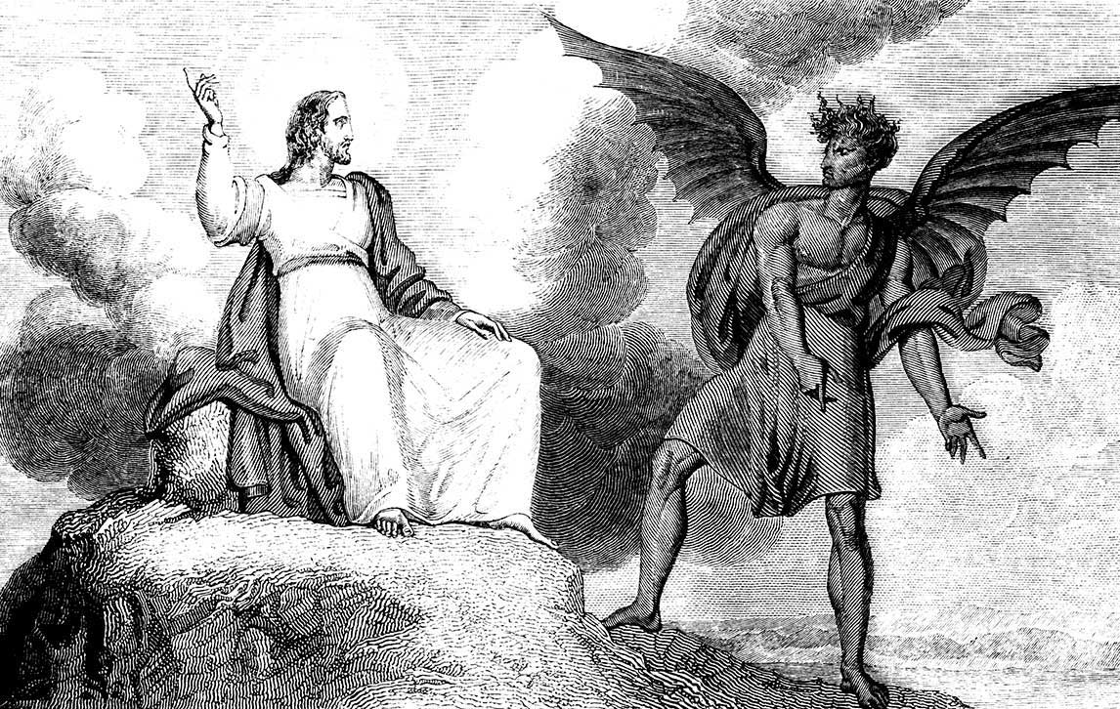
The Spiritual Battle
Since the Fall, humanity has been involved in a spiritual battle.
On one side is Satan, the evil one, who continues to tempt human beings.
On the other side is God, who has promised to help us win the battle.
© TonyBaggett / istock
Notes:
Notes: Point out that Jesus has already won the battle against evil, but that we need to decide which side we will be on. Ask how this battle has been portrayed in fantasy novels, video games, and movies.
This slide corresponds to student book content in article 6.

Slide 9
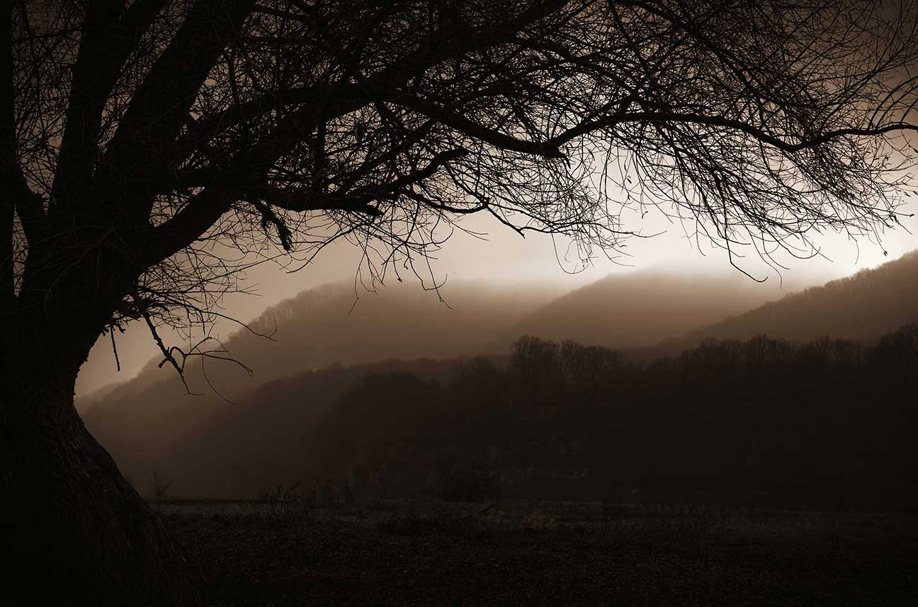
Satan and the Fallen Angels
Satan is a liar, and he is dangerous to our spiritual well-being.
The devil and his demons are fallen angels.
Satan represents the powers of evil in the world.
© andreiuc88 / Shutterstock
Notes:
Notes: Discuss what Jesus might have meant when he characterized Satan as a murderer and as the father of lies. Ask what evil we see in the world today that results in death, either physical or spiritual, that happens because of deception. You may wish to allow the students to share whether or not they believe Satan is real, and what they have been told about his influence in the world. Correct or redirect their beliefs as appropriate.
This slide corresponds to student book content in article 7.

Slide 10
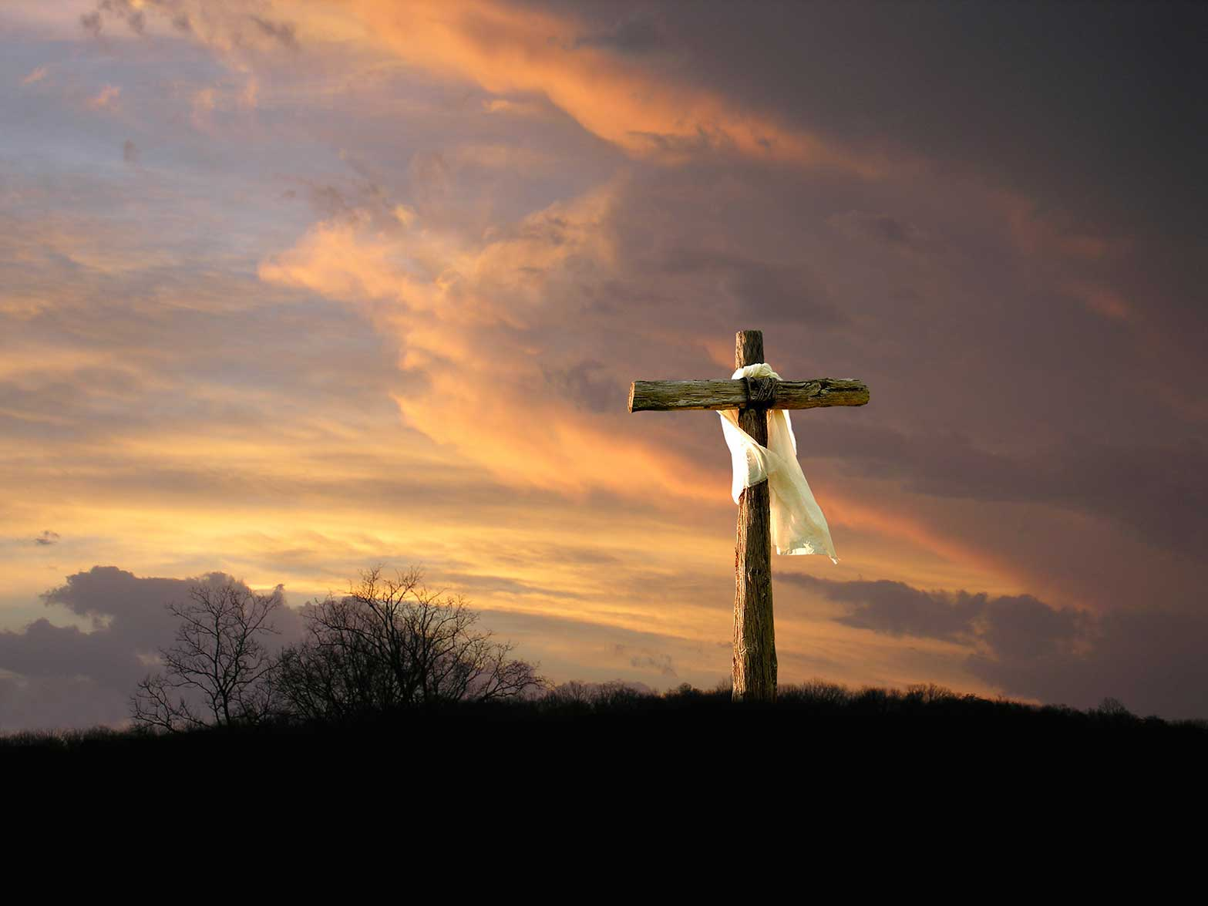
Satan’s Power Is Limited
Satan is powerful, but he is not all-powerful.
Satan continues fighting to persuade us to rebel against God . . .
. . . but he cannot force us to do anything against our will.
© Rick Schroeppel / istock
Notes:
Notes: Explain that we can be confident that good ultimately wins out over evil: Christ has won victory over Satan through his death on the Cross. Assure the students that we can also be confident that Christ will protect us against the power of Satan, strengthening us against his lies and temptations. Ask how Christ can help us resist temptation.
This slide corresponds to student book content in article 7.

