Slide 1
The Social Justice Principles Found in the
Creation Accounts
Catholic Social Teaching
Document #: TX001943

Slide 2

God’s original plan was to create a just community.
Image in shutterstock
Notes:
Music: Introduction music such as “We Are the World” or another appropriate song with the theme of unity.

Slide 3
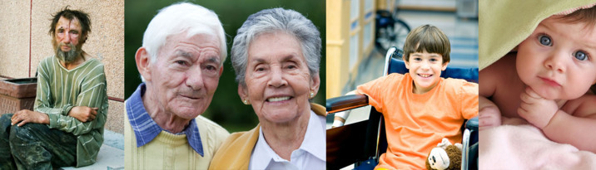
This just community is based on a foundational religious truth:
Every person is created in the image of God.
Image in shutterstock

Slide 4
The Creation accounts in the first chapters of the Book of Genesis reveal three important truths about the role that justice plays in God’s plan for human beings.
Image in shutterstock

Slide 5
The first truth revealed in the Creation accounts is that God has given human beings a share of his divine life, creating us “in the divine image” (Genesis 1:27).
Image in shutterstock
Justice requires that we recognize and respect the divine presence in every human being
(see Matthew 25:37–40).

Slide 6

A second truth revealed in the Creation accounts is that human beings were created to live in communion with God, who alone is the source of our true happiness.
Image in shutterstock

Slide 7

A third truth revealed in the Creation accounts is that God created human beings to live in loving communion with one another.
Image in shutterstock
According to the Catechism of the Catholic Church:
“The human person needs to live in society.
Society is not for him [or her] an extraneous addition,
but a requirement of his [or her] nature” (1879).

Slide 8

Adam and Eve’s disobedience, their failure to live according to God’s original plan to create a just community, led to the loss of the state of original holiness and justice for all human beings.
Image in shutterstock

Slide 9
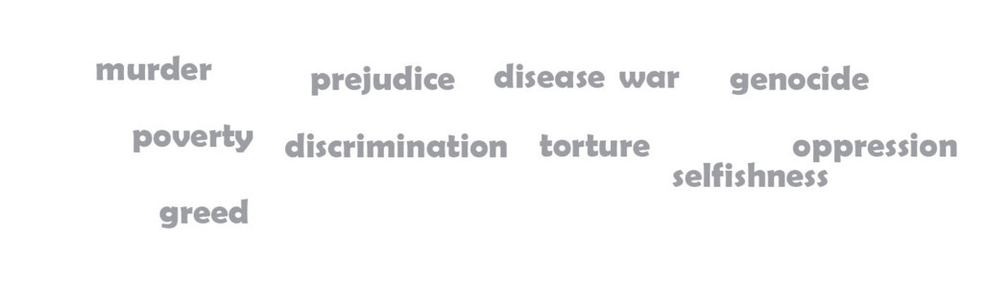
This is Original Sin:
the wounded human nature that is transmitted to all people as a result of Adam and Eve’s first sin

Slide 10
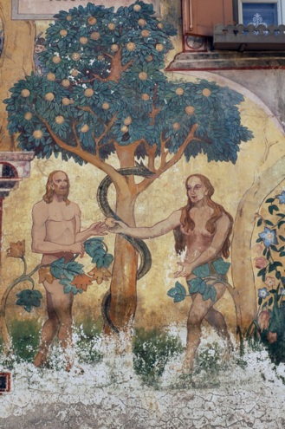
Because of Original Sin, the power of our human nature is weakened. We are subject to ignorance, suffering, and death, and it is harder to resist the temptation to sin.
Image in shutterstock

Slide 11
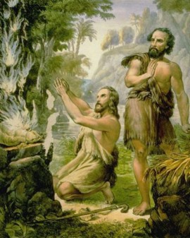
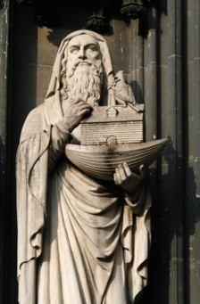
We see examples of this in two stories from the Old Testament.
WikiMediaCommons
Image in shutterstock
The story of Cain and
Abel—the first murder.
The story of Noah and the ark—due to the sinful ways of the people, God destroyed all life except for Noah, his family, and the animals he brought on the ark.

Slide 12

We learn from Noah’s story that God’s salvation is near to those who remember him and who remain faithful to his original plan in creating humankind.
Image in shutterstock

Slide 13

These four social justice principles are found in the Creation accounts:
1. Each human life has great worth and must be protected. We must promote values that emphasize the inherent worth of each individual.
Image in shutterstock
2. As human beings we cannot find the happiness we long for by pursuing things that do not lead to God.
3. God intends that human beings form communities of love and justice to work together for the common good.
4. We must have the same concern for other people’s welfare that we do for our own.
Notes:
On final click, play music—“We Are the World” or another song—as a closing.
(The scriptural quotation in this presentation is from the New American Bible with Revised New Testament and Revised Psalms. Copyright © 1991, 1986, and 1970 by the Confraternity of Christian Doctrine, Washington, D.C. Used by the permission of the copyright owner. All Rights Reserved. No part of the New American Bible may be reproduced in any form without permission in writing from the copyright owner.
The quotation labeled Catechism of the Catholic Church is from the Catechism of the Catholic Church for use in the United States of America, second edition, number 1879. Copyright © 1994 by the United States Catholic Conference, Inc.—Libreria Editrice Vaticana. English translation of the Catechism of the Catholic Church: Modifications from the Editio Typica copyright © 1997 by the United States Catholic Conference, Inc.—Libreria Editrice Vaticana.)

