Slide 1
Biblical Exegesis
Document #: TX004702
Notes:
Notes: This PowerPoint is designed for teachers who would like to provide a more in-depth explanation of biblical exegesis.

Slide 2


What is Exegesis?
Exegesis comes from the Greek word exegeomai
Exegeomai translates as “to lead out of.”
© rasica / Shutterstock.com
Notes:
Notes: In reference to reading a biblical text, exegesis means to tease out, to interpret, or to explain the meaning of the text.

Slide 3

Exegesis is a Daily Activity
We engage in exegesis when we communicate with others.
We are constantly interpreting meaning.
Sometimes our interpretations are accurate, sometimes they are not.
© UygarGeographic / iStockphoto.com
Notes:
Notes: Invite the students to consider how they are engaging in interpretation through communication in all of its forms. Encourage volunteers to share examples. The next slide will provide further clarification.

Slide 4

What Do We Do When We Communicate?
We ask ourselves …
What is the speaker trying to communicate?
Should I take these words literally or symbolically?
In what form are these words being expressed?
Should I respond? If so, how should I respond?
© Steve Debenport / iStockphoto.com
Notes:
Notes: Explain to the students that the form words are expressed in could include: a joke, lecture, greeting, reprimand, demand, story, series of questions, or informative report. In most situations, we understand the context in which oral communication happens, and, therefore, can more readily interpret what is being said. When we are familiar with the context (i.e. when the words were spoken and under what circumstances, or who is doing the speaking and what our relationship is to that person) we can more readily analyze and interpret the words to better understand their meaning.

Slide 5

Analysis and Interpretation Questions
Who?
What?
When?
Why?
Where?
© art4all / Shutterstock.com
Notes:
Notes: Remind the students that it is important to be familiar with the context of communication. In terms of biblical exegesis, we try to get as much information as possible about who the author is, the author’s intent in writing the text, the original language of the text, the time period in which it was written, and the more subtle cultural cues that may be implied in the text.

Slide 6

Methods of Biblical Exegesis
There are three key methodologies of biblical exegesis:
Literary criticism
Socio-historical criticism
Ideological criticism
© Phatthanit / Shutterstock.com
Notes:
Notes: These three exegetical or interpretive methodologies will be explained briefly in the following slides.

Slide 7

Literary Criticism
Literary criticism enables us to analyze a scriptural text by examining:
genre
plot
characters
symbolism
© ninjaudom / Shutterstock.com
Notes:
Notes: In literary criticism, some of the questions we ask of the text include: What is the form or literary genre of the text? How would you summarize the text? Is there a plot? What is the plot? What do you notice about the placement or repetition of words? What particular words are used? What do they mean? What images or symbols are used? How are they used? What is their significance? What characters appear in the text (if any)? What do you know about them? How do the characters interact and relate in the text? What is the primary message that is being communicated in the text? What meaning does this text have for us today?

Slide 8
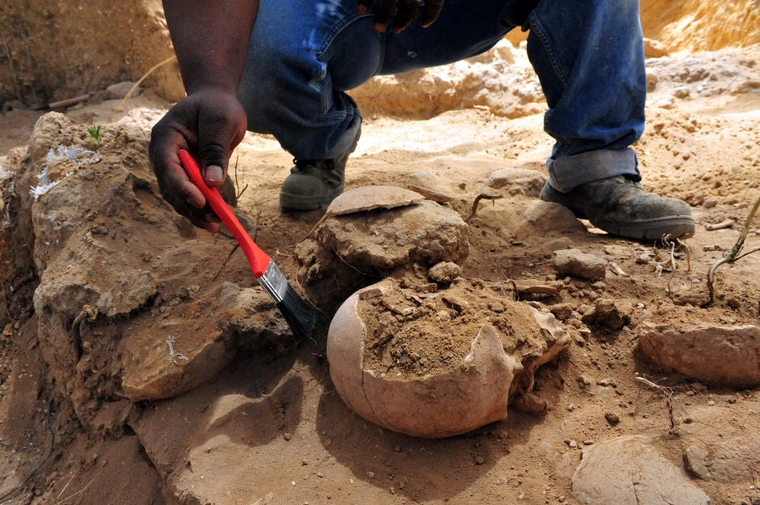
Socio-historical Criticism
Socio-historical criticism enables us to understand the world in which a scriptural text was written.
Through socio-historical criticism we try to excavate the cultural world of the text that has been hidden or covered by time.
© ChameleonsEye / Shutterstock.com
Notes:
Notes: Ask the students to imagine that they are looking out a window into the world of the scriptural text. Some of the areas to look at are: customs, traditions, culture, religious practices, and geography.

Slide 9

Ideological Criticism
Refers to the biases, assumptions, or strongly held beliefs that can underlie the interpretation of Scripture.
It seeks to illuminate how different people might interpret the scriptural text in ways that may support their own group and denigrate others.
© Marcio Jose Bastos Silva / Shutterstock.com
Notes:
Notes: Explain to the students that ideological criticism essentially asks the following kinds of questions of the text: In what way might this text be used by one group in society to dominate or oppress a particular group of people in society? In what way might this text be used by a particular group in society to support their opinions or perceptions of a particular issue?

