Slide 1
Sent with the Holy Spirit
The Church
Unit 5, Chapter 15
Document #: TX005565
© 2016 Saint Mary’s Press
Living in Christ Series

Slide 2


Salt and Light
Jesus tells us that we are sent to be salt and light for the world.
Christ calls us to bring out the true flavor and goodness of the world.
We should not hide our talents and gifts, or keep them to ourselves.
© PHOTOCREO Michal Bednarek / Shutterstock.com
© 2016 Saint Mary’s Press
Living in Christ Series
Notes:
Notes: Invite the students into silent reflection about how they might be salt and light for the world. Ask them to think about some of their different gifts and skills.

Slide 3
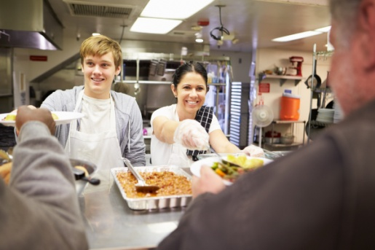
How Are You Needed?
Your gifts and talents are needed by the Body of Christ around the world . . .
in the United States . . .
and in your own parish and community.
© 2016 Saint Mary’s Press
Living in Christ Series
© Monkey Business Images / Shutterstock.com
Notes:
Notes: Discuss international, domestic, and local opportunities for service. Ask the question that concludes article 59 in the student book, “How do you already use your talents to benefit the Church and the world?”

Slide 4
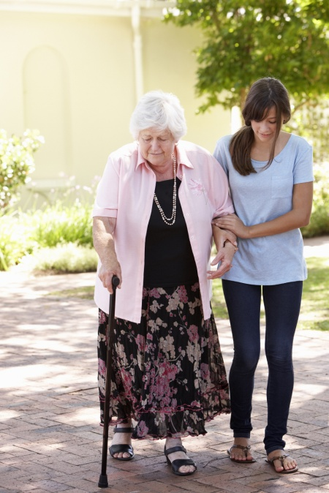
Discipleship in Daily Life
Instead of “Me first!” we serve one another.
Instead of “You are on your own!” we are one in Jesus Christ.
Instead of “Be this! Do this! Wear this!” we adhere to the Gospel.
© Monkey Business Images / Shutterstock.com
© 2016 Saint Mary’s Press
Living in Christ Series
Notes:
Notes: Discuss examples of the attitudes stated on this slide. Ask how the Gospel calls us to act in opposition to those attitudes.

Slide 5
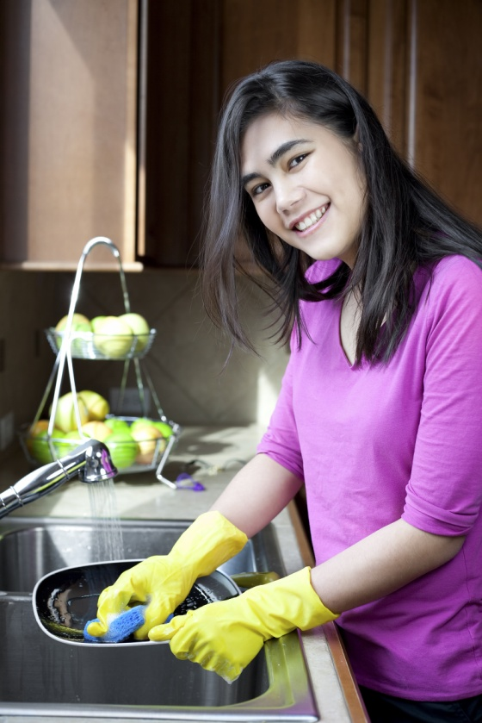
Morning
Sometimes choosing love means creating an opportunity:
an opportunity to have loving interactions with other people . . .
and avoiding situations in which you are not at your best.
© Jaren Jai Wicklund / Shutterstock.com
© 2016 Saint Mary’s Press
Living in Christ Series
Notes:
Notes: Ask for reactions to the paragraph titled “Morning” in article 60 of the student book. Ask for other examples of creating the opportunity for loving interactions.

Slide 6

School
Worrying excessively about grades can get you into trouble as a disciple.
Try to put your goals into proper perspective.
More important than grades is who you are as a child of God.
© Slonov / iStock
© 2016 Saint Mary’s Press
Living in Christ Series
Notes:
Notes: Discuss cheating, along with other temptations to ignore gospel values that might arise at school (excluding others, gossiping, seeking leadership only to enhance a college application, and so on).

Slide 7

Thoughts and Feelings
Which thoughts or feelings will you take with you in your life?
Will you calmly turn your thoughts and feelings in a positive direction?
Will you pray and hear the truth about yourself from God?
© Monkey Business Images / Shutterstock.com
© 2016 Saint Mary’s Press
Living in Christ Series
Notes:
Notes: Point out that we cannot stop thoughts and feelings from coming into our consciousness, but that we can decide what to do with them. Ask for examples from books, movies, or other media where someone has been able to overcome negative messages, feelings, or thoughts.

Slide 8
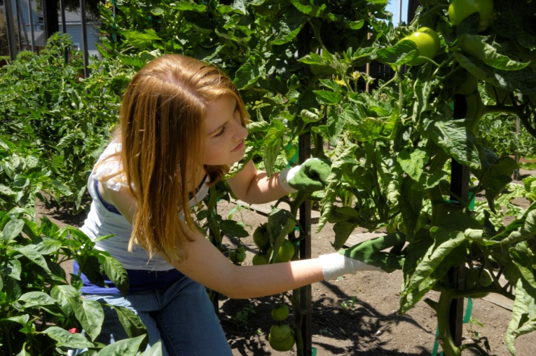
Evenings and Weekends
Life in a household means having shared responsibilities and conflicting needs.
Consciously choose to be cooperative for God’s sake.
© GomezDavid / iStock
© 2016 Saint Mary’s Press
Living in Christ Series
Notes:
Notes: Direct the students to read the sidebar that concludes article 60 in the student book, “The ‘Little Way’ of Saint Thérèse of Lisieux.” Discuss her spiritual path, the “little way.”

Slide 9
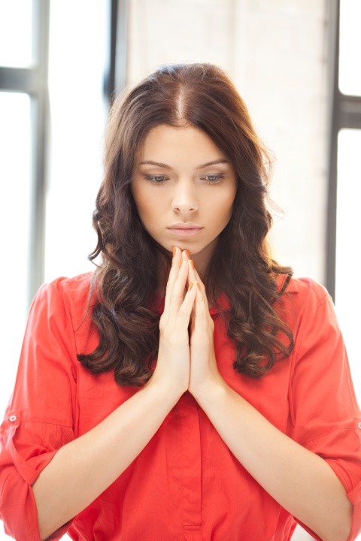
Take Responsibility for Your Faith Each Day
The life of a disciple involves participation in the celebration of the Sacraments.
Take time to pray.
© Syda Productions / Shutterstock.com
© 2016 Saint Mary’s Press
Living in Christ Series
Notes:
Notes: Read aloud the paragraph beginning, “A disciple is one who makes conscious choices . . .” at the end of article 60 in the student book. Then ask the question that follows, “What does it mean to take responsibility for your faith?”

Slide 10

Empowered by the Holy Spirit
The Holy Spirit is central to the life of the Church.
The Holy Spirit enlivens the mind as well as the heart.
The Gifts of the Holy Spirit help us to honor God through our talents.
© nautilus_shell_studios / iStock
© 2016 Saint Mary’s Press
Living in Christ Series
Notes:
Notes: Review the historical overview of the activity of the Holy Spirit in the Church, as in article 61 of the student book.

Slide 11

Live with the End in Mind
Our destination is life in communion with the Trinity for all eternity.
Throughout your life you will make many significant decisions.
Invite the Holy Spirit to help you in your decision making.
© travellight / Shutterstock.com
© 2016 Saint Mary’s Press
Living in Christ Series
Notes:
Notes: Discuss how the questions in the section “Live with the End in Mind,” in article 61 of the student book, could be helpful in making decisions about a life of discipleship.

Slide 12

Start Now
The Holy Spirit is at work within you now, calling you to the Church, to Christ.
Silence can be an opportunity for the Holy Spirit to speak with you.
© 2016 Saint Mary’s Press
Living in Christ Series
© fotofeel / Shutterstock.com
Notes:
Notes: Ask the students whether they have found silence to be helpful in their journey toward discipleship. Ask how they could carve out some silence for God.

