Slide 1
How the Bible Came to Be
Document # TX004699

Slide 2
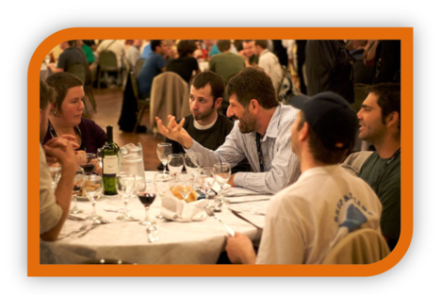
What Is an Oral Tradition?
Are there any family stories that get told when your extended family is gathered?
Are there any stories that get handed down from one generation to the next?
Public Domain
Notes:
Notes: This slide is an introduction to the topic, meant to prompt a brief class discussion. An oral tradition is a tradition that is passed on from generation to generation by word of mouth. Some families have both written and oral traditions. Ask, Why might a family oral tradition be written down?

Slide 3
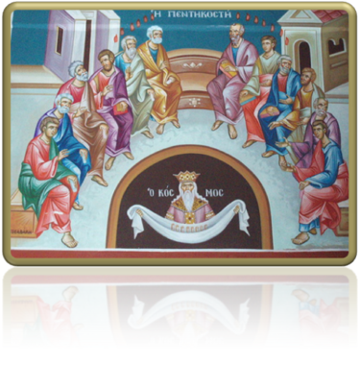
What Is an Oral Tradition?
After Jesus ascended into Heaven, his disciples continued his mission by preaching and teaching about him.
Public Domain

Slide 4
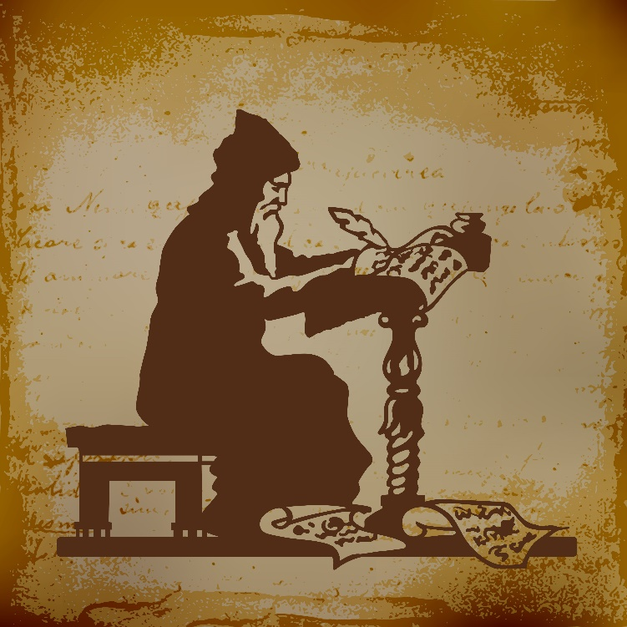
The Development of the Scriptures
The development of the oral and written traditions occurred in the following stages:
People experienced God.
These experiences were shared orally.
Inspired authors created a written version.
The successors of the Apostles, guided by the Holy Spirit, discerned the books to be included in the Scriptures (the canon).
© daseugen / iStockphoto.com

Slide 5
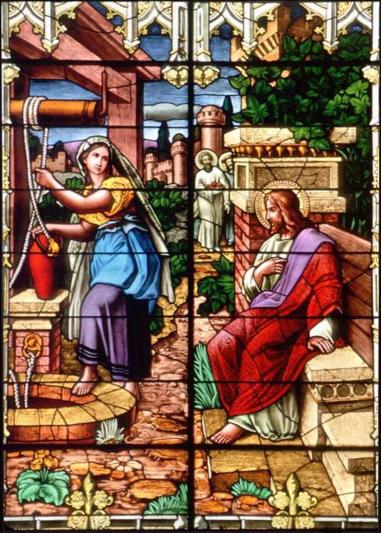
People Experienced God
Have you ever had an awesome experience that changed you as a person?
Have you ever had an experience that brought you closer to God?
© The Crosiers/Gene Plaisted, OSC
Notes:
Notes: Explain that people’s experience of God is central to the passing on of the message of the Scriptures. People experienced God through Revelation—whether over a long period of time as in the Old Testament or through the person of Jesus in the New Testament.
Lead the students into further discussion with the following from the teacher guide:
• Give three examples of stories in which people experienced God’s Revelation in the Old Testament.
• Give three examples of stories in which people experienced God’s Revelation in the New Testament.

Slide 6
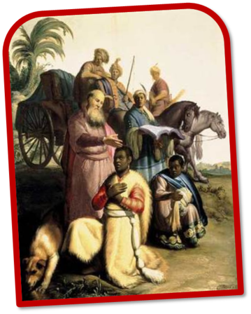
People Shared Their Experiences of God
How do you first share a story of a great experience you had with someone else?
Oral tradition: The handing on of the message of God’s saving plan, culminating in Jesus Christ, through storytelling, preaching, parables, and sacred wisdom.
Public Domain

Slide 7
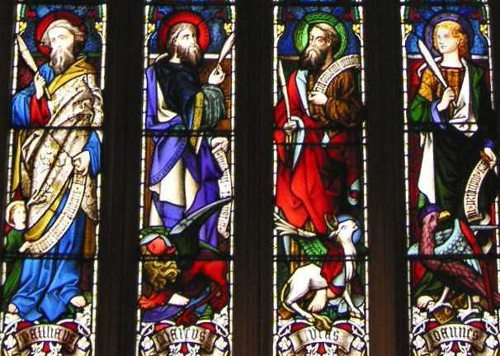
People Wrote Down the Stories
People desired to capture stories for future generations.
Written tradition: The synthesis of the oral tradition into written books, capturing Divine Revelation under the inspiration of the Holy Spirit.
Public Domain

Slide 8
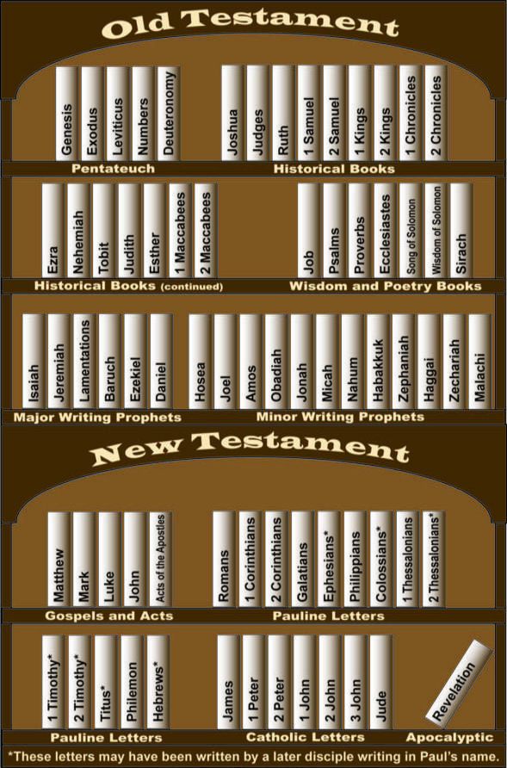
The Church Determines the Canon
The term canon comes from the Greek word meaning “rule” or “standard.”
The biblical canon is the collection of books the Church recognizes as the inspired Word of God.
The books of the Scriptures are canonical because they contain God’s Revelation to human beings.
© Paul Casper/Saint Mary’s Press
Notes:
Notes: We use the word canon in this way when we speak of Canon Law, which is the Law of the Church. When we speak of “the canon” in terms of the Scriptures, we mean the Old Testament and the New Testament books accepted by the Church as the Word of God. Here the word canonical means “accepted according to the standard” set by the Church.

Slide 9
The Development of the Canon
The successors to the Apostles were guided by the Holy Spirit in discerning the canon of the New Testament.
They looked at the following criteria as they evaluated the writings:
apostolic origin
universal acceptance
the use of the writings in liturgical celebrations
the consistency of a book’s message with other Christian and Jewish writings

Slide 10
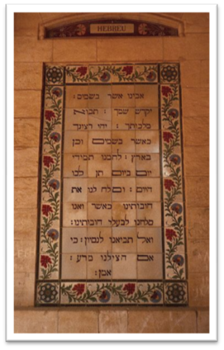
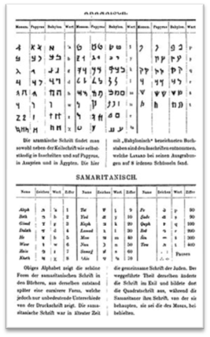
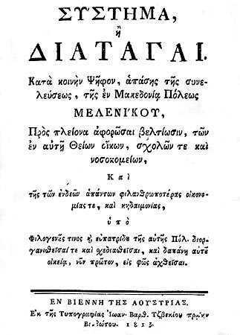
Translations of the Bible Are Created
The Bible was originally written in three languages:
Hebrew
Aramaic
Greek
Public Domain
Public Domain
Public Domain
Notes:
Notes: The Vulgate was the first common language translation. It was Saint Jerome’s translation of the Greek and Hebrew Scriptures into Latin. The Council of Trent recognized the Vulgate as authoritative. The Vulgate became the official Bible of the Roman Catholic Church for several centuries.

