Slide 1
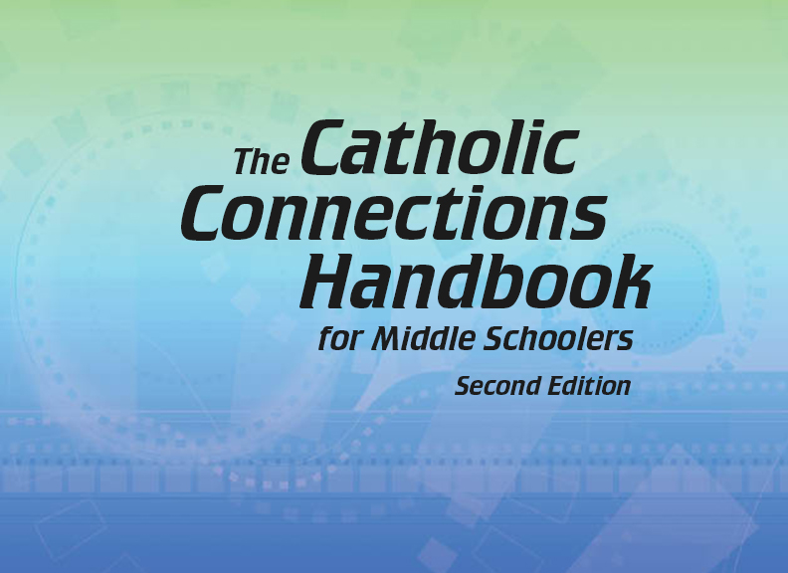

Slide 2
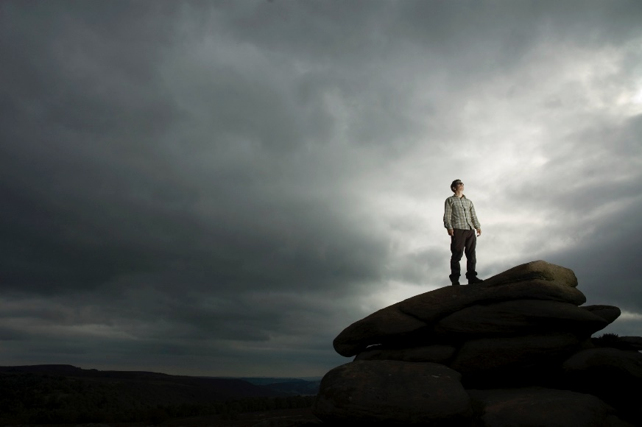
The Old Testament
and the Trinity
Chapter 1 Revelation, Sacred Scripture, and Sacred Tradition
© Kasei/www.istockphoto.com

Slide 3
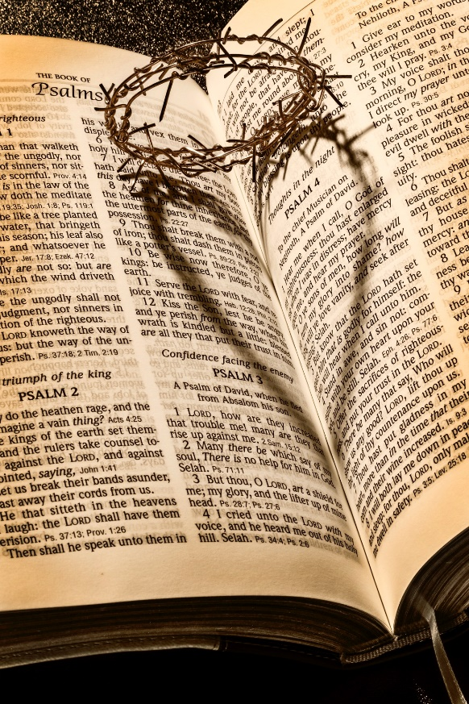
Chapter Summary Revelation, Sacred Scripture, and Sacred Tradition
God is love (1 John 4:8), and love, by its very nature, is meant to be revealed. God chooses to reveal God’s very life, love, and plan for humanity to us. We call God’s sharing of his life, love, and plan Divine Revelation. God has chosen to communicate his Revelation in two primary ways: Sacred Scripture and Sacred Tradition. These together make up the single sacred Deposit of the Word of God, preserved, protected, and passed down through the Church for the sake of the world.
© mjbs/www.istock.com

Slide 4
Introduction and “Revelation” (Handbook, pages 16–19)
Out of love, God reveals himself and his plan for humanity in two main ways: through Sacred Scripture and Sacred Tradition.
Sacred Scripture
Sacred Tradition
God’s love revealed

Slide 5
Introduction and “Revelation” (Handbook, pages 16–19)
Throughout all history, God has made himself known in many ways and continues to do so today.
GOD MADE KNOWN IN MANY WAYS
Friends and Family
Creation
The Church
Our Conscience

Slide 6
Introduction and “Revelation” (Handbook, pages 16–19)
God makes himself known to us because he loves us.
What God has made known about himself and his plan for humanity is called Revelation.
Revelation is communicated in two main ways: Sacred Scripture and Sacred Tradition.
© Bliznetsov./www.istock.com

Slide 7
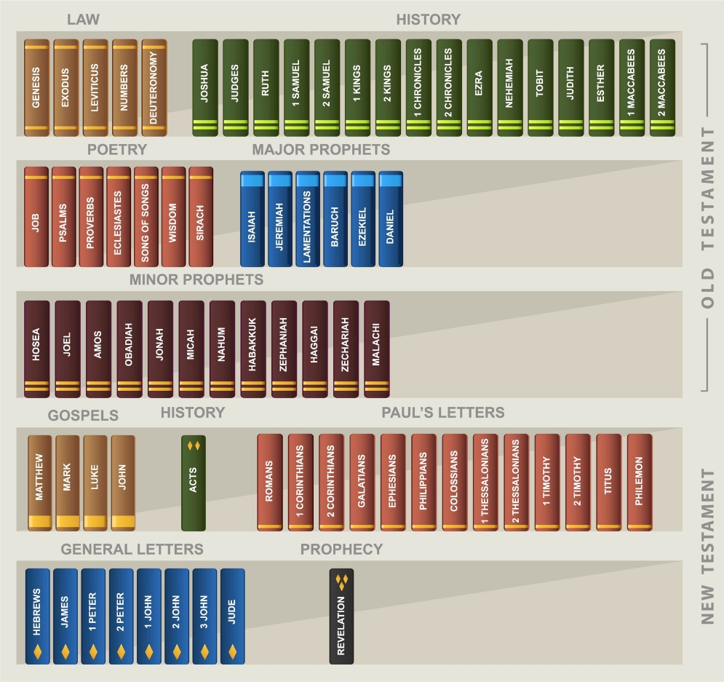
“Sacred Scripture” (Handbook, pages 19–21)
The seventy-three books that make up our Sacred Scripture are the Word of God. In these books human authors were inspired by the Holy Spirit to share the truths that will bring us our salvation.
© Tomacco/www.shutterstock.com

Slide 8
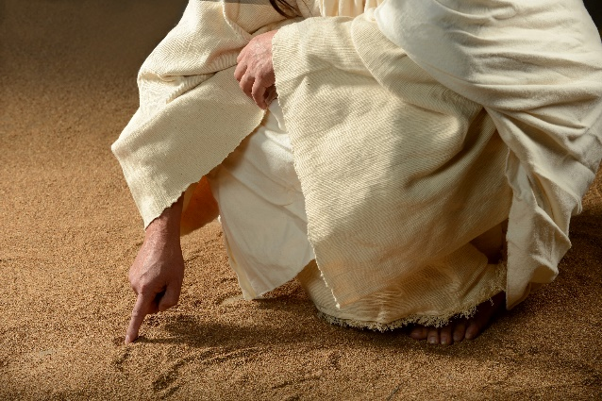
“Sacred Scripture” (Handbook, pages 19–21)
The seventy-three books of the Bible include the forty-six books of the Old Testament and the twenty-seven books of the New Testament.
God did not give us the Bible as a source of information about scientific or historical events, but rather to share with us the truths that will bring us our salvation, that is, our true happiness and friendship with him.
© CarlosE.SantaMaria/www.shutterstock.com

Slide 9
“Sacred Scripture” (Handbook, pages 19–21)
The authors of Sacred Scripture were inspired by the Holy Spirit to teach the truths of salvation using their own language, cultural images, and even their incomplete understanding of the world.
It is the work of the Pope and our bishops to provide the Church with the authentic interpretation of what God reveals through the teachings and stories of the Bible.
Sacred Scripture
Interpretation by the Pope and bishops
The Church (God’s people)
God
Sharedwith
Sacred Tradition

Slide 10
“Sacred Tradition” (Handbook, pages 21–22)
Sacred Tradition consists of those truths that will bring us our salvation and that have been handed down to us through the centuries through the Church under the guidance of the Holy Spirit.
Holy Spirit
Beginning of time
Truths to bring us salvation
End of time

Slide 11
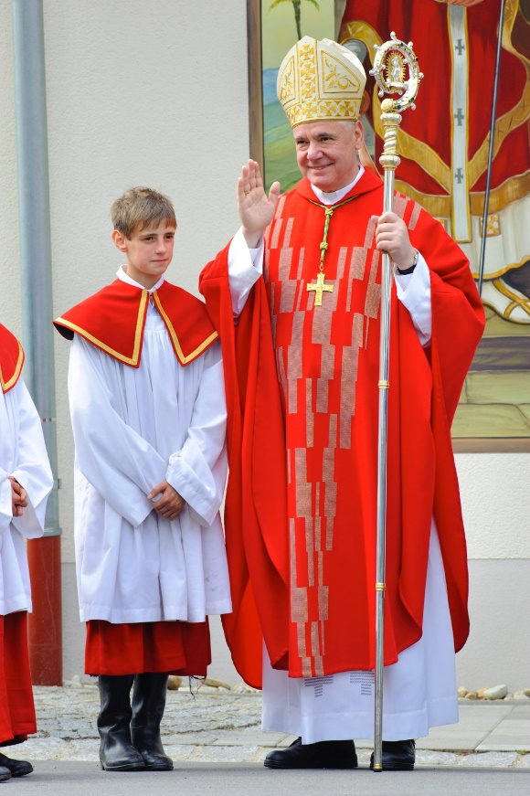
“Sacred Tradition” (Handbook, pages 21–22)
Sacred Tradition means both the central beliefs of our faith as well as the way in which those beliefs have been handed down through the centuries.
To learn the truths that God wants to reveal to us for our salvation, we must look to both Sacred Tradition and Sacred Scripture.
© flimfoto/www.istockphoto.com

Slide 12
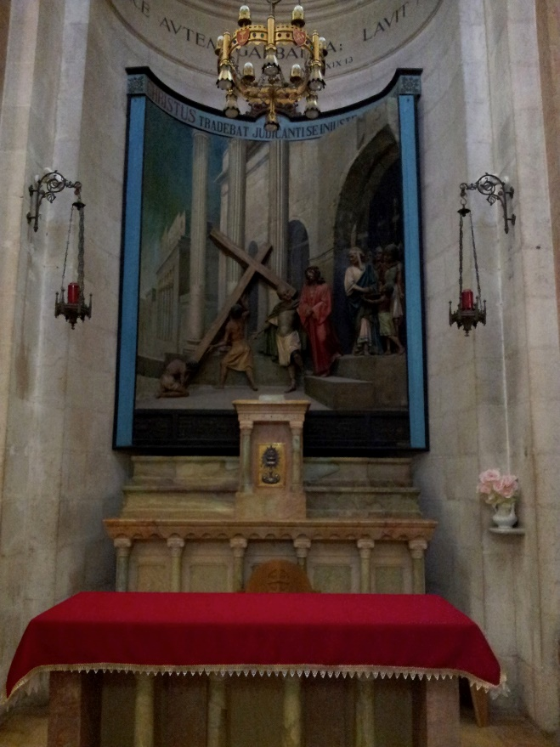
“Sacred Tradition” (Handbook, pages 21–22)
Sacred Tradition started with the preaching of the Apostles and includes our belief in the following:
The Trinity
The Incarnation of Jesus
The Seven Sacraments
Many other matters revealed over time through the Church
Some of the truths revealed through Sacred Tradition are not explicitly revealed in the Bible.
© JanieMaki/SaintMary’sPress

Slide 13
“God’s Mystery” (Handbook, page 23)
Although God has made himself known to us, our human understanding cannot completely grasp him.
© Ig0rZh/istockphoto.com

Slide 14
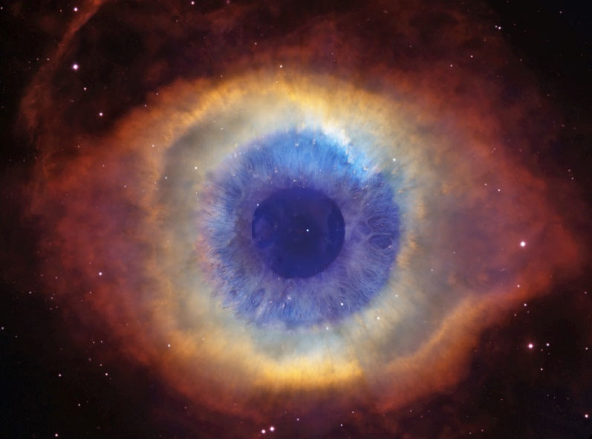
“God’s Mystery” (Handbook, page 23)
We cannot expect to fully understand all of God’s ways.
Our human intellect allows us to know God, but God remains a mystery that is always able to surprise us with truth we could never have known otherwise.
© BillFrische/shutterstock.com

Slide 15
Let’s Review!
1. How many of these questions can you answer correctly?
What are four ways God makes himself known to the world?
What inspires God to do this?
What are the two main ways God reveals himself?
2. Now try to complete these statements:
There are _____ books in the Bible.
The purpose of the Bible is to provide humans with the truths that will bring about our ____________________.
Sacred Tradition is passed down through the __________ under the guidance of the _____________..
3. True or false?
Every truth about our salvation is written in the Bible.
We can fully and completely understand God and all of his ways.
Notes:
God makes himself known through creation, the Church, our conscience, and friends and family.
73; salvation; Church; Holy Spirit
False; False

