Slide 1
The Greatest Commandments
Jesus Christ Course
Document # TX001256

Slide 2
The Greatest Commandments
Add the following:
Examples of how Jesus lived
+ Jesus’ parables
+ Jesus’ teachings
??

Slide 3
The Greatest Commandments
The Answer:
The Greatest Commandments
The three synoptic Gospels (Matthew, Mark, and Luke) each describe the Greatest Commandments slightly differently, but with the same message.
Review the passages on each one of the next three slides.
As you review, write down a summary of the passage. After you have reviewed all three, summarize in your own words what you learned.

Slide 4
The Gospel of Matthew
Matthew 22:34–40
When the Pharisees heard that he had silenced the Sadducees, they gathered together, and one of them [a scholar of the law] tested him by asking, “Teacher, which commandment in the law is the greatest?” He said to him, “You shall love the Lord, your God, with all your heart, with all your soul, and with all your mind. This is the greatest and the first commandment. The second is like it: You shall love your neighbor as yourself. The whole law and the prophets depend on these two commandments.”
Notes:
Notes: This is a great time to “break open the Word” with the students. You may need to offer some information about the context of the times. Be prepared to answer questions about this passage. Allow a few minutes for the students to summarize in their own words.

Slide 5
The Gospel of Mark
Mark 12:28–34
One of the scribes, when he came forward and heard them disputing and saw how well he had answered them, asked him, “Which is the first of all the commandments?” Jesus replied, “The first is this: ‘Hear, O Israel! The Lord our God is Lord alone! You shall love the Lord your God with all your heart, with all your soul, with all your mind, and with all your strength.’ The second is this: ‘You shall love your neighbor as yourself.’ There is no other commandment greater than these.” The scribe said to him, “Well said, teacher. You are right in saying, ‘He is One and there is no other than he.’ And ‘to love him with all your heart, with all your understanding, with all your strength, and to love your neighbor as yourself’ is worth more than all burnt offerings and sacrifices.” And when Jesus saw that [he] answered with understanding, he said to him, “You are not far from the kingdom of God.” And no one dared to ask him any more questions.
Notes:
Notes: Allow a few minutes for the students to summarize in their own words. You may need to remind the students why the passages in each Gospel are different (such as literary devices of author, audience, themes).

Slide 6
The Gospel of Luke
Luke 10:25–28
There was a scholar of the law who stood up to test him and said, “Teacher, what must I do to inherit eternal life?” Jesus said to him, “What is written in the law? How do you read it?” He said in reply, “You shall love the Lord, your God, with all your heart, with all your being, with all your strength, and with all your mind, and your neighbor as yourself.” He replied to him, “You have answered correctly; do this and you will live.”
Notes:
Notes: Allow a few minutes for the students to summarize in their own words. Then ask them to collect all their notes into one statement reflecting Jesus’ Greatest Commandments. Invite a few students to share their statements aloud.

Slide 7
The Importance of the Greatest Commandments
Jesus offers these commandments to help us keep the Kingdom as our first goal.
They focus on God.
They focus on others.
They focus on agape—love.
They focus on and remind us of the Ten Commandments.
They summarize all Jesus’ teachings.
They help us to respond to our call to holiness, having a change of heart.
“And when Jesus saw that [he] answered with understanding, he said to him, ‘You are not far
from the kingdom of God’” (Mark 12:34).

Slide 8
The Kingdom of God
The Greatest Commandments help us to know that the Kingdom of God is our first goal:
Every parable tells us about the Kingdom of God.
Jesus’ central message during his earthly ministry is the Kingdom of God.
“This is the time of fulfillment. The kingdom
of God is at hand. Repent, and believe
in the gospel” (Mark 1:15).

Slide 9
Focus on God
The Greatest Commandments focus on God:
Jesus is quoting from Deuteronomy: “You shall love the Lord, your God, with all your heart, and with all your soul, and with all your strength” (6:5).
The passage is part of the Jewish prayer called the Shema:
  Uttered daily by faithful Jews
  Reminds them to put God first
  Demonstrates that professing your love of God in all you do—heart, soul, mind—keeps you from compartmentalizing your faith. It is a reflection of your very being, all that you do
  Shows Jesus’ faithfulness to God

Slide 10
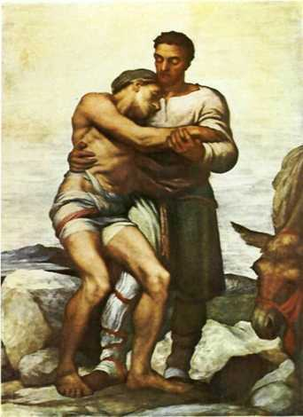
Focus on Others
The Greatest Commandments
focus on others:
Jesus is quoting from Leviticus: “You shall love your neighbor as yourself” (19:18).
All of the parables reflect how we are to treat our neighbors.
Jesus modeled how to treat others.
Image in public domain
Notes:
Notes: Ask the students to recall stories from the Gospels—parables and events—in which Jesus emphasized the right way to treat others. Encourage the students to write these down privately and to save them for an exercise near the end.

Slide 11
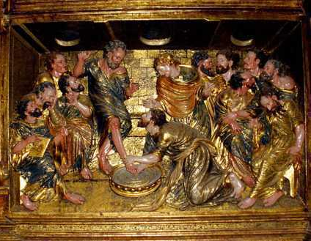
Focus on Love
The Greatest Commandments focus on love:
The Greek word for love
that Jesus used most of
the time in his teachings
is agape.
Agape refers to the kind
of love that is spiritual
and unselfish. It means
to serve freely without
reward; to suffer injury
without seeking revenge;
to act with respect, justice,
caring, and compassion.
Image in public domain
Notes:
Notes: Ask the students to recall teachings of Jesus that represent agape. Have them do this privately first by making a list in their notebooks or journals. The list will be used in an exercise toward the end.

Slide 12
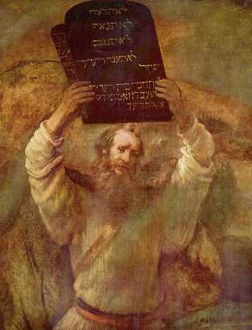
The Ten Commandments
The Greatest Commandments remind us of the Ten Commandments and help us to focus on them:
The first three commandments are about love of God . . .
  I, the Lord, am your God . . . you shall have no other gods besides me.
  You shall not take the name of the Lord, your God, in vain.
  Remember to keep holy the Sabbath.
Image in public domain

Slide 13
The Ten Commandments
The last seven commandments are about love of neighbor . . .
  Honor your father and mother.
  You shall not kill.
  You shall not commit adultery.
  You shall not steal.
  You shall not bear false witness against your neighbor.
  You shall not covet your neighbor’s house.
  You shall not covet your neighbor’s belongings.
Image in public domain

Slide 14
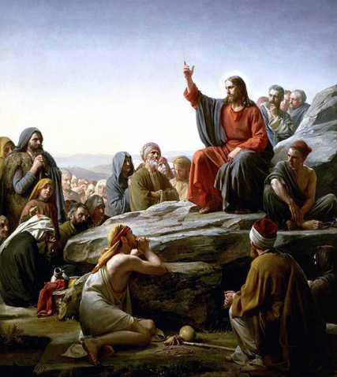
Summary of All of Jesus’ Teachings
How do the Greatest Commandments summarize all of Jesus’ teachings?
the sermon on the mount
Notes:
Notes: Invite students to respond to this question using the notes they took during the presentation. You may wish to provide prompts to guide the students in addressing how the Greatest Commandments:
Help us keep the Kingdom of God as a first goal
Focus on God
Focus on others
Focus on agape
Remind us of the Ten Commandments

Slide 15
The Greatest Commandments
The Greatest Commandments are about YOU:
Following the Greatest Commandments is our call to holiness.
When we keep these commandments, we are very near to the Kingdom of God.
“But seek first the kingdom [of God] and his righteousness, and all these things will be given you besides” (Matthew 6:33).

