Slide 1



Slide 2
The New Testament
and the Church
Chapter 24
End Things: Heaven and Hell

Slide 3
Chapter Summary
End Things: Heaven and Hell
This chapter will consider life after death, including Heaven, Hell, Purgatory, and judgment.
It will consider the possibilities of eternal life with God or without God, as well as how choices help determine one’s final state.

Slide 4

Introduction and “I Am the Resurrection”
(Handbook, pages 254–256)
The end of life is really the beginning of eternal life with God. Even though our souls leave our bodies at death, the two will be reunited and transformed on the last day.
            At every Mass, we state that we “look forward to the resurrection of the dead and the life of the world to come.” For Christians, death is not the end, but the beginning of eternal life.
© Berkomaster/www.shutterstock.com

Slide 5

Introduction and “I Am the Resurrection”
(Handbook, pages 254–256)
            At death, our souls become separated from our bodies, but will be reunited again and transformed when we rise with Christ on the Last Day.
            The choices we make during our lifetime determine our life after death.
            Activity
            Read Mark 16:12.
            What do you think appearing in a “different manner” might mean?
            Why did the Gospel writer think it was important to include this line?
© MyImages - Micha/www.shutterstock.com

Slide 6

“Heaven” and “Hell”
(Handbook, pages 257–258)
Heaven and Hell are not places, but states of being with or without God for eternity.
            Heaven is a state of being in perfect friendship with God. That friendship begins on earth in our choice to follow Jesus.
            Hell is a separation from God for eternity. It is not a place, but rather an absence of love and happiness, as it is an absence of God.
©STILLFX/www.shutterstock.com

Slide 7
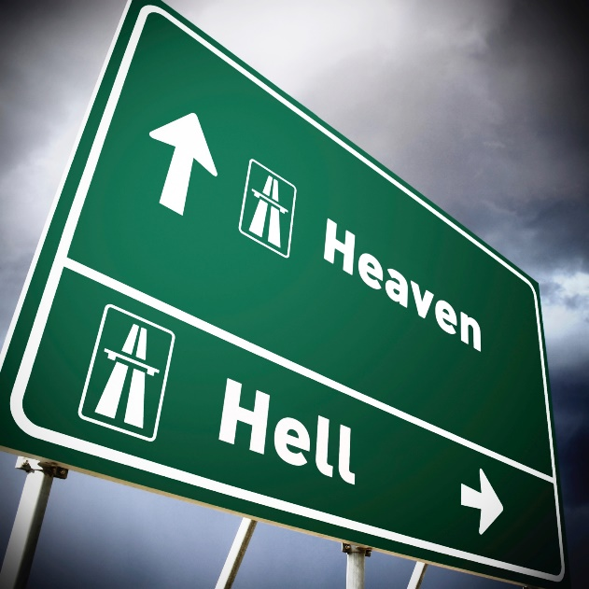
“Heaven” and “Hell”
(Handbook, pages 257–258)
            How we spend eternity, Heaven and Hell, are direct results of our choice to love or reject God in this life.
            Activity
            In your small group, identify from your assigned Bible passage what Heaven or the Kingdom of God is being compared to, what this tells us about faith, and how it gives us glimpses into eternity.
© mbbirdy/www.istockphoto.com
John 14:1–4
Matthew 13:31–32
Matthew 20:1–16
Matthew 22:1–14

Slide 8

“Judgment”
(Handbook, pages 259–261)
How does this outfit look?
Would you wear it?
How do these clothes compare to what you are wearing?
© Orla/www.istockphoto.com

Slide 9

“Judgment”
(Handbook, pages 259–261)
When we die, Christ will measure our lives in comparison to the Gospel message, which is called the particular judgment. We will experience a second judgment at the end of time.
            At the end of our lives, we will all be judged by Christ, who will compare our lives to the Gospel message. Again, this judgment is called the particular judgment.
©ptnphoto/www.shutterstock.com

Slide 10

“Judgment”
(Handbook, pages 259–261)
            A second judgment will come at the end of time when God will separate people into two groups—those who lived the Gospel message of love and those who did not.
            On the Day of Judgment, the world will be transformed. Bodies and souls will be reunited, and the whole world will be transformed by God’s presence.
© Pattie Calfy/www.istockphoto.com

Slide 11
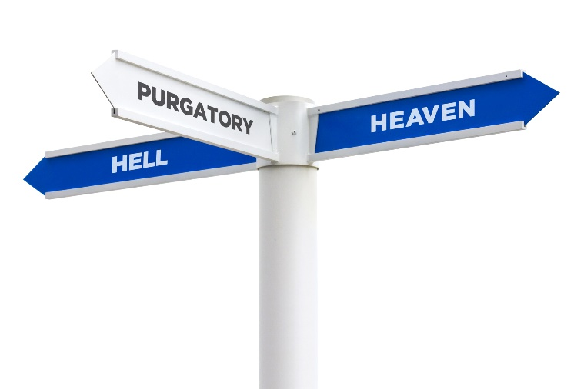
“Purgatory”
(Handbook, page 262)
Like Heaven and Hell, Purgatory is not a place, but a state of being when we are purified in preparation for Heaven.
            At the end of their lives, many people die in God’s grace and friendship, but are not quite ready for perfect union with God.
©Ryan DeBerardinis/www.shutterstock.com

Slide 12

“Purgatory”
(Handbook, page 262)
            Their souls are then purged from sin in the period called Purgatory to prepare them for perfect friendship and union with God.
            Our prayers can help those in Purgatory.
A Prayer for Those Who Have Gone before Us
“Eternal rest grant unto them, O Lord, and let perpetual light shine upon them. May the souls of the faithful departed, through the mercy of God, rest in peace. Amen.”
© Sean_Warren/www.istockphoto.com

Slide 13
Acknowledgments
The excerpt on slide 12 from Order of Christian Funerals, copyright © 1985, ICEL, number 118, is found in The Rites of the Catholic Church, volume 1, prepared by the ICEL, a Joint Commission of Catholic Bishops’ Conferences (Collegeville, MN: The Liturgical Press, 1990). Copyright © 1990 by the Order of Saint Benedict, Collegeville, MN. Used with permission of the ICEL.
During this presentation’s preparation, all citations, facts, figures, names, addresses, telephone numbers, Internet URLs, and other pieces of information cited within were verified for accuracy. The authors and Saint Mary’s Press staff have made every attempt to reference current and valid sources, but we cannot guarantee the content of any source, and we are not responsible for any changes that may have occurred since our verification. If you find an error in, or have a question or concern about, any of the information or sources listed within, please contact Saint Mary’s Press.

