Slide 1
Chapter 10: Shinto
World Religions: A Voyage of Discovery
DOC ID #: TX003947

Slide 2
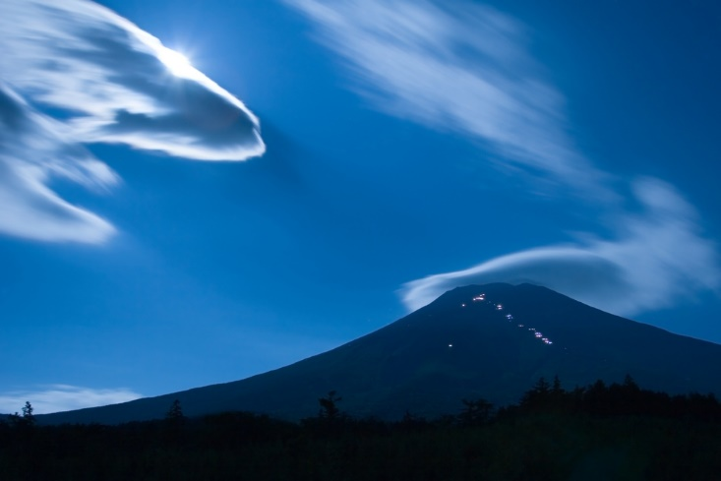
Kami: Mount Fuji and the Moon
The kami are all the entities regarded by the Japanese people as being sacred.
Kami are especially evident in nature.
Two of the most visible and most revered kami are Mount Fuji and the moon.
© Craig Hanson / www.shutterstock.com
Notes:
Notes: The student book includes Motoori Norinaga’s famous statement regarding the vast diversity of kami.

Slide 3
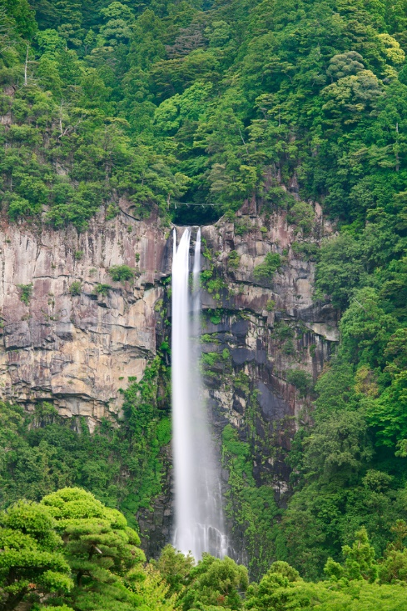
Kami: Nachi Falls
Nachi Falls, Japan’s most famous waterfall, is another example of kami.
Nachi Falls is a popular destination for pilgrims.
The waterfall is 436 feet high.
© StevanZZ / www.shutterstock.com
Notes:
Notes: Because of its beauty and popularity, Nachi Falls is often mistakenly thought to be Japan’s highest waterfall, but in fact Hannoki Falls is the highest, at over 1,600 feet.

Slide 4
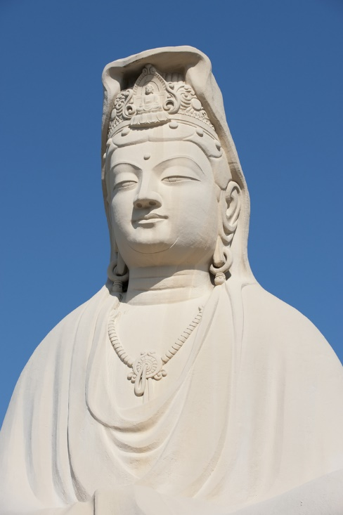
Kami: Bodhisattva Kannon
Buddhas and bodhisattvas also are considered to be kami.
Kannon is the bodhisattva of compassion.
In China, she is also worshipped by Taoists as a goddess.
© N. F. Photography / www.shutterstock.com
Notes:
Notes: Kannon (Japanese) in Chinese is Guanyin, in Sanskrit Avalokiteshvara, and in Tibetan Chenrezig. This bodhisattva is among the most popular objects of Buddhist veneration. The interaction of Buddhism with Shinto in Japan involves a complex history, beginning with a complete rejection of the Buddha as foreign and hence not relevant for the Japanese. Buddhism was fully accepted during the Nara period (AD 710 to 784), and eventually the Buddha and bodhisattvas came to be regarded as kami.
The statue shown on this slide is part of the Ryozen Kannon war memorial in Kyoto, which commemorates the Japanese who died during World War II.

Slide 5
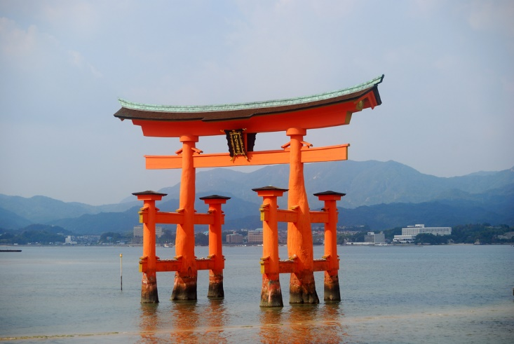
Floating Torii
The torii is Shinto’s most recognized symbol.
The waters surrounding the torii are believed to be kami.
When the tide is high, the torii appears to be floating.
© Attila JANDI / www.shutterstock.com
Notes:
Notes: This torii is part of a shrine complex located in Miyajima. In general, a torii marks the entrance to a sacred site. Given their importance and beauty, a comparative analysis with slides of the great variety of torii might be an appropriate use of class time.

Slide 6
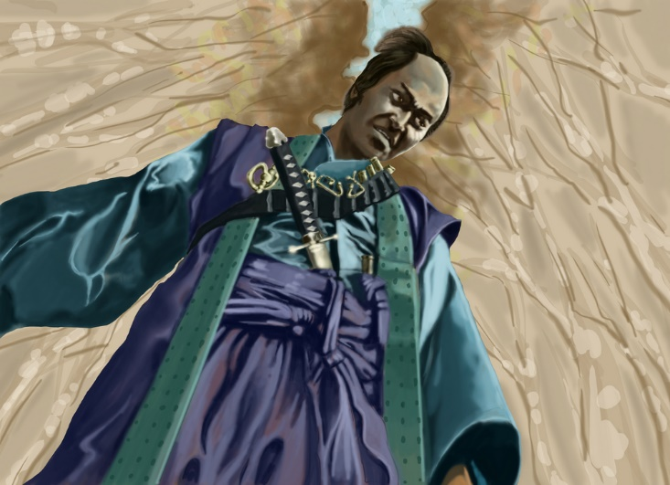
Samurai
The samurai code of conduct is traced back to the convergence of Shinto, Buddhism, and Confucianism.
The code calls for complete loyalty to one’s feudal lord, purity, and fearlessness in the face of death.
© Davi Sales Batista / www.shutterstock.com
Notes:
Notes: The Japanese term samurai means “sword-wielding warrior.” Samurai are also referred to as bushi, and the code of conduct is referred to as bushido.

Slide 7
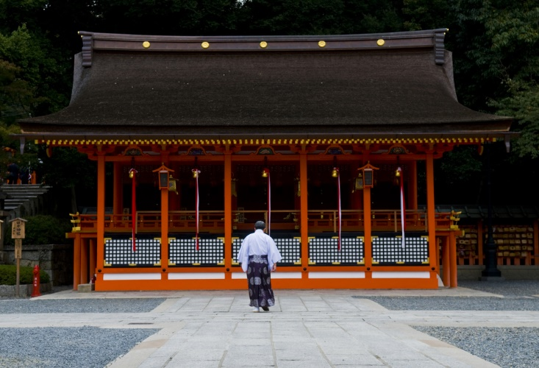
Shinto Shrine
Places of worship, believed to be dwellings of the kami.
Worshippers pay respect to the kami and sometimes pray for good fortune.
Shrines in small villages or towns are dedicated to the local kami.
© Kobby Dagan / www.shutterstock.com
Notes:
Notes: The Fushimi Inari-taisha Shrine is located in Kyoto, Japan. It is dedicated to Inari, the god of rice, who is also the patron of business (worshipped for wealth). The shrine is located at the base of a mountain that is home to other smaller shrines. Its website, http://inari.jp/, or the website of another shrine, could provide the students with a “virtual visit.”

Slide 8
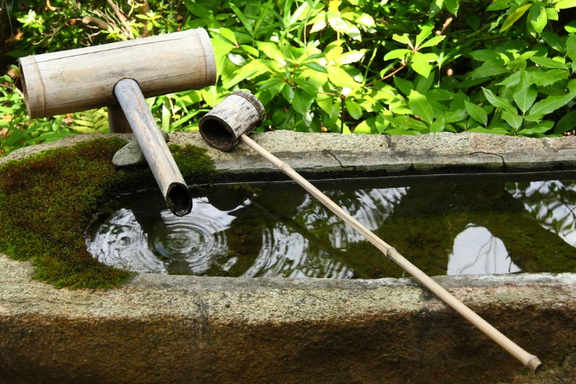
Purification Rites
The tsukubai is a basin provided at Shinto sites.
Visitors use the tsukubai to purify themselves through ritual washing.
A purification ritual performed by a Shinto priest, called harae, is intended to please and placate the kami.
© Sergii Rudiuk / www.shutterstock.com
Notes:
Notes: It is hard to overestimate the prevalence of purification in Shinto. Harae, for example, is often performed before moving into a new home or driving a new car. The ritual involves the priest waving a wand, called an onusa, on the left, the right, and then the left again.

Slide 9
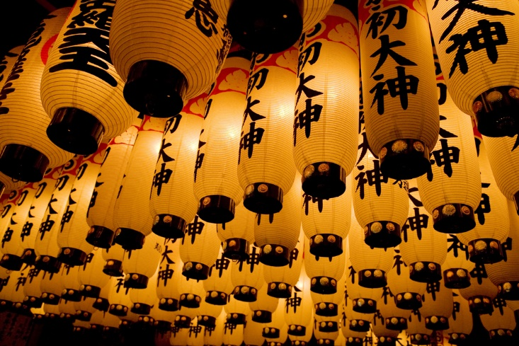
Festival Lanterns
These large lanterns are hung during the Gion Matsuri, one of Japan’s largest festivals.
It originated as a ceremony to appease the gods during an epidemic.
Festivals like this provide both spiritual and social benefits.
© littlesam / www.shutterstock.com
Notes:
Notes: The Lantern Festival, which takes place in Kyoto, lasts for the entire month of July and culminates with a parade on July 17. There are more than a dozen important Shinto festivals, for example the three-day Sanja Festival in the Asakusa district of Tokyo, attended by some half a million people.

Slide 10
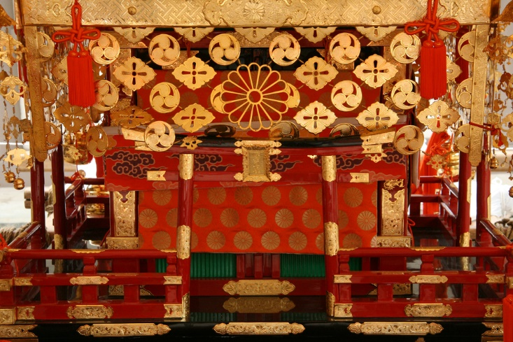
Mikoshi
A mikoshi is a portable shrine believed to carry deities.
Mikoshi are paraded through streets during Shinto festivals.
Mikoshi are made in a variety of styles and shapes, most commonly rectangles, hexagons, and octagons.
© Sam DCruz / www.shutterstock.com
Notes:
Notes: This mikoshi is at a summer festival Yokohama, Japan. The mikoshi rest on poles that rest on the shoulders of carriers, who often do not walk in step with one another, making for unpredictable and sometimes even dangerous situations. The attempt to walk in step is aided by the sound of drums and cymbals.

Slide 11
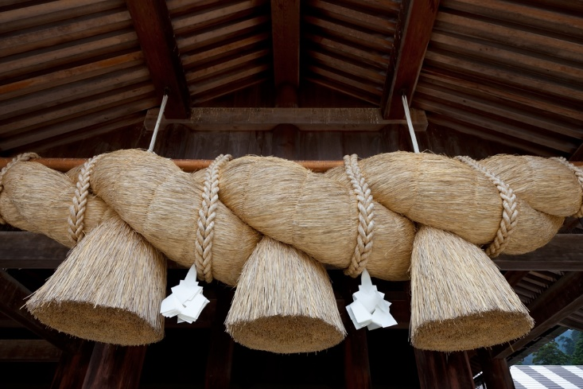
Shimenawa
Shimenawa, “enclosing rope,” marks off sacred space in Shinto shrines.
Shimenawa are made of rice stalk and thought to have purifying powers.
The space beyond the rope is believed to be inhabited by kami.
© StevanZZ / www.shutterstock.com
Notes:
Notes: Shimenawa come in a variety of shapes and sizes, some several feet thick in diameter.

