Slide 1
Introducing the Acts of the Apostles
The New Testament
Document #: TX002285

Slide 2
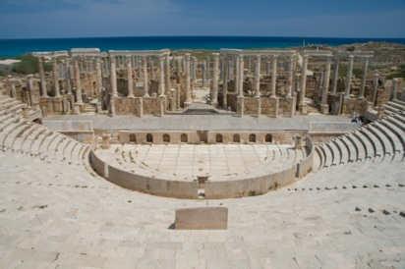
The Acts of the Apostles is a unique book of the New Testament.
Image from Public Domain - Luca Galuzzi - www.galuzzi.it
It is not a Gospel or an Epistle—it is its own unique genre, with no other book like it.
It is the only book that functions as “part 2” of a Gospel. Written by the same author as the Gospel of Luke, it picks up the story of Jesus’ saving mission where Luke leaves off.
More than the other New Testament books, Acts reads like a history of the early Church. As we study it, we will seek to understand these historical elements, as well as their deeper spiritual meaning.

Slide 3
Structure of the Acts of the Apostles
1:1—2:13 the Ascension of Jesus and the sending of the Spirit at Pentecost
2:14—8:3 the mission in Jerusalem
8:4—9:43 the mission in Judea and Samaria
10:1—15:35 the beginning of the mission to the Gentiles (non-Jews)
15:36—28:31 the mission of Paul “to the ends of the earth,” represented by the city of Rome
Notes:
Notes: Invite the students to notice that the structure of Acts mirrors the geographic spread of Christianity: beginning in Jerusalem, moving outward to the regions immediately surrounding it, and then spreading throughout the ancient Mediterranean world and finally to Rome.

Slide 4
The Chronology of Acts
Q. When was Acts written?
A. Approximately AD 85, that is,
• after the Epistles
• after Mark’s, Matthew’s, and Luke’s Gospels
• before John’s Gospel
Q. When did the events that Acts describes take place?
A. Approximately AD 30 to 65, that is, during the early Church’s missionary campaign. During the missionary campaign, the Epistles began to be written, but neither the Gospels nor Acts was yet written.
Notes:
Notes: You may wish to remind the students of their unit 3 study of the development of the Gospels. Ensure that the students understand that Acts recounts the missionary campaign or oral tradition stage, but that it was written more than 20 years after that stage ended.

Slide 5
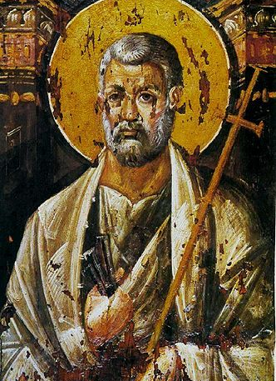
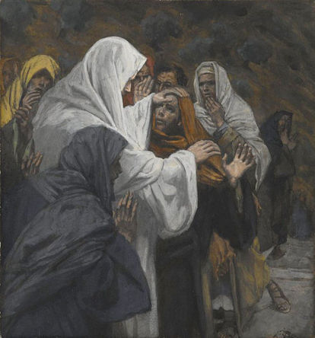
Key People in Acts
Peter
Peter: quickly emerges as a key leader in the early Church, despite his earlier denials of Jesus
Philip: the first Apostle to preach the Gospel message in Samaria
Phillip

Slide 6
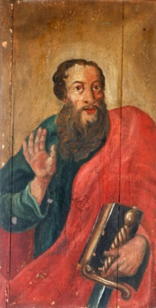
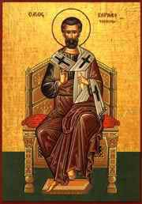
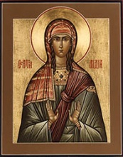
Key People in Acts (continued)
Paul
© Zvonimir Atletic/shutterstock.com
Paul: Embraces belief in Jesus after an encounter with the Risen Lord on the road to Damascus; his three missionary journeys bring the Gospel message throughout the Mediterranean world.
Barnabas: Paul’s travel companion
Lydia: Paul’s first European convert to Christianity, in the city of Philippi in Macedonia (present-day Greece)
Barnabas
Lydia

