Slide 2
The Old Testament
and the Trinity
Chapter B
The Bible:
The Exodus
© CourtneyJohnson/www.shutterstock.com

Slide 3
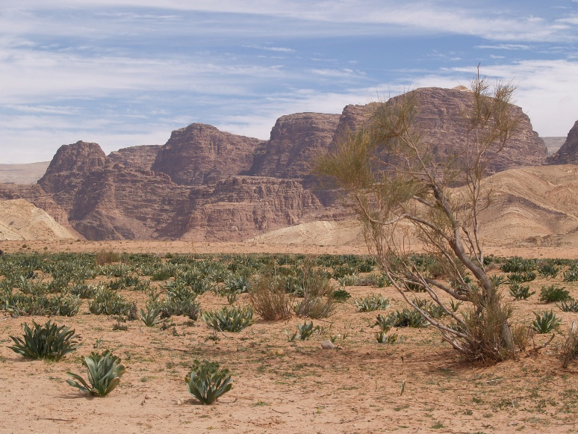
Chapter Summary The Bible: The Exodus
God’s concern for his people’s suffering is without end or limit. God called Moses and Aaron to lead his people out of Egypt, he fought for his people against their oppressors, he protected the Israelites as they fled Egypt, and he gave his people his Law to guide them to truth and happiness.
© DeanRobertson/www.istockphoto.com

Slide 4
“God’s Voice Heard in Burning Bush” (Exodus 3:1—4:17)
God heard the cry of his people suffering in Egypt and called and equipped Moses to lead the Israelites out.
© TeusRenes/www.shutterstock.com

Slide 5
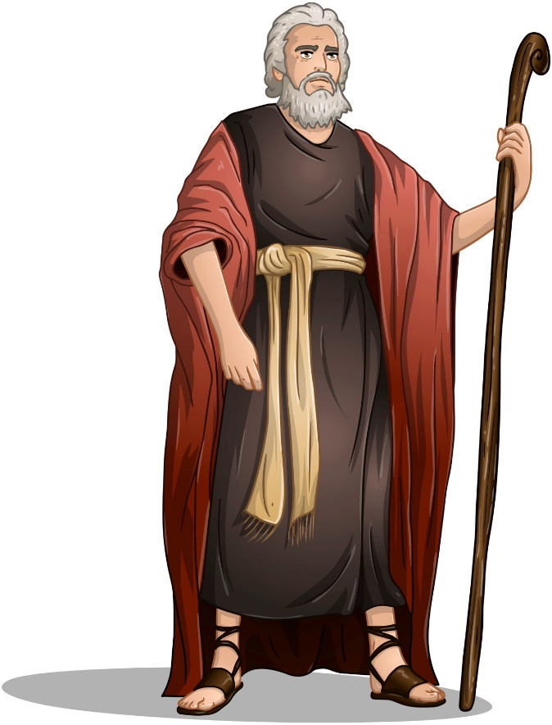
“God’s Voice Heard in Burning Bush” (Exodus 3:1—4:17)
God heard the cry of his people, Israel, suffering at the hands of the Egyptian slave masters.
God revealed himself to Moses in a burning bush and called upon him to lead God’s people out of Egypt to worship their God.
© LironPeer/www.shutterstock.com

Slide 6
“God’s Voice Heard in Burning Bush” (Exodus 3:1—4:17)
Moses did not believe himself qualified to lead the people, but God gave him the gifts he needed to fulfill the task.
Reflection
Have you ever found yourself feeling completely unprepared for something, and there was nothing you could have done to prepare yourself? Maybe you find yourself in that position right now. How does it feel? What is it like to be in this situation?
How might the story of Moses help us trust in God more?

Slide 7
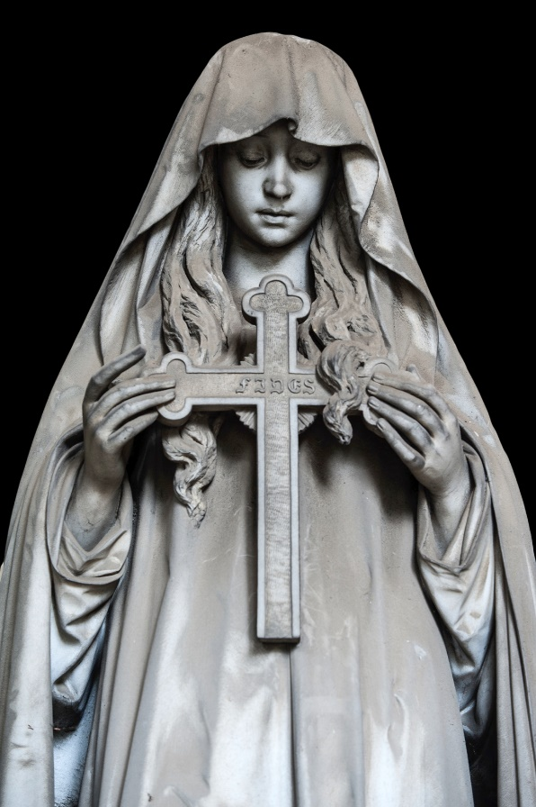
“Angel of Death Passes Over” (Exodus, Chapter 12)
The Israelites were saved from the tenth and final plague, the death of the firstborn sons, by the blood of the Passover lamb.
© fotonazario/www.istockphoto.com

Slide 8
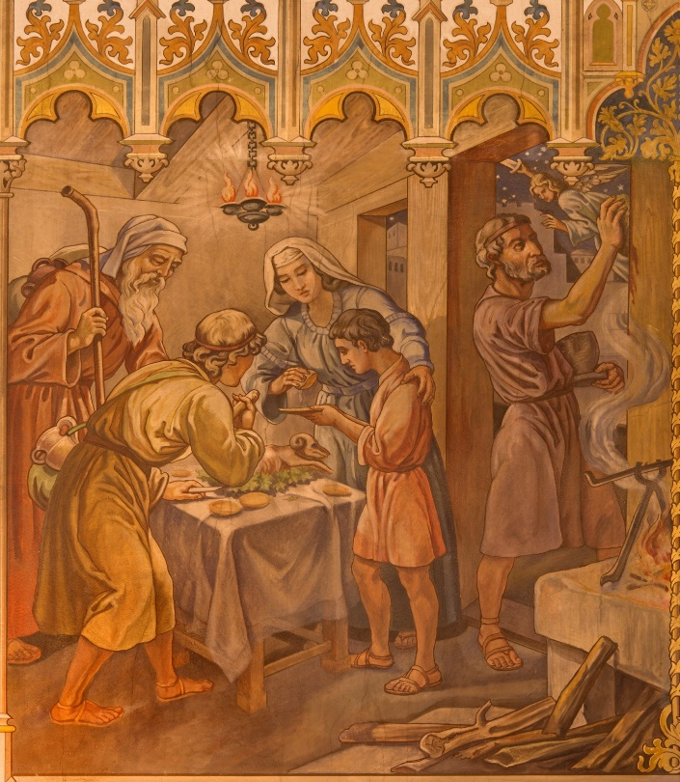
“Angel of Death Passes Over” (Exodus, Chapter 12)
Pharaoh refused to let the Israelites leave to worship their God, so God sent an angel of death over the land of Egypt.
The Israelites were to kill a lamb and sprinkle its blood on their doorways, eat its roasted flesh, and prepare to leave Egypt.
© RenataSedmakova/www.shutterstock.com

Slide 9
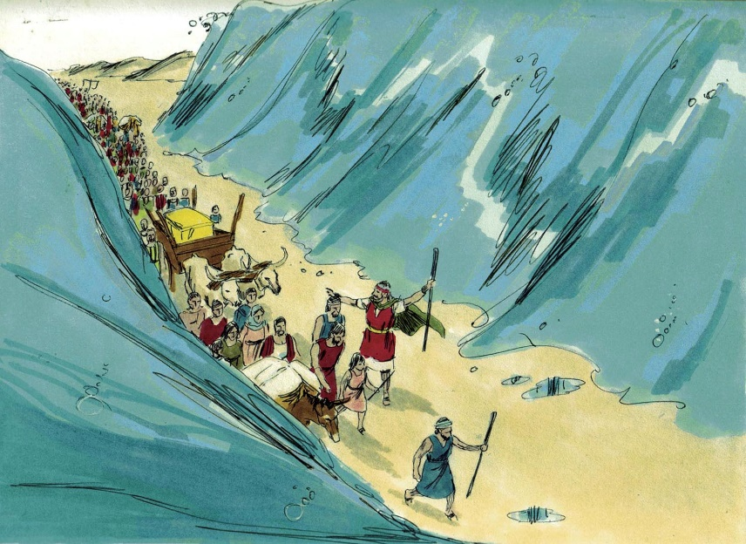
“Angel of Death Passes Over” (Exodus, Chapter 12)
When the angel of death killed all of the firstborn sons of Egypt, it passed over all of the houses that had the blood of the lamb on their doorways.
The Israelites left Egypt and took the wealth of the Egyptians with them.
© BibleArtLibrary/www.istockphoto.com

Slide 10
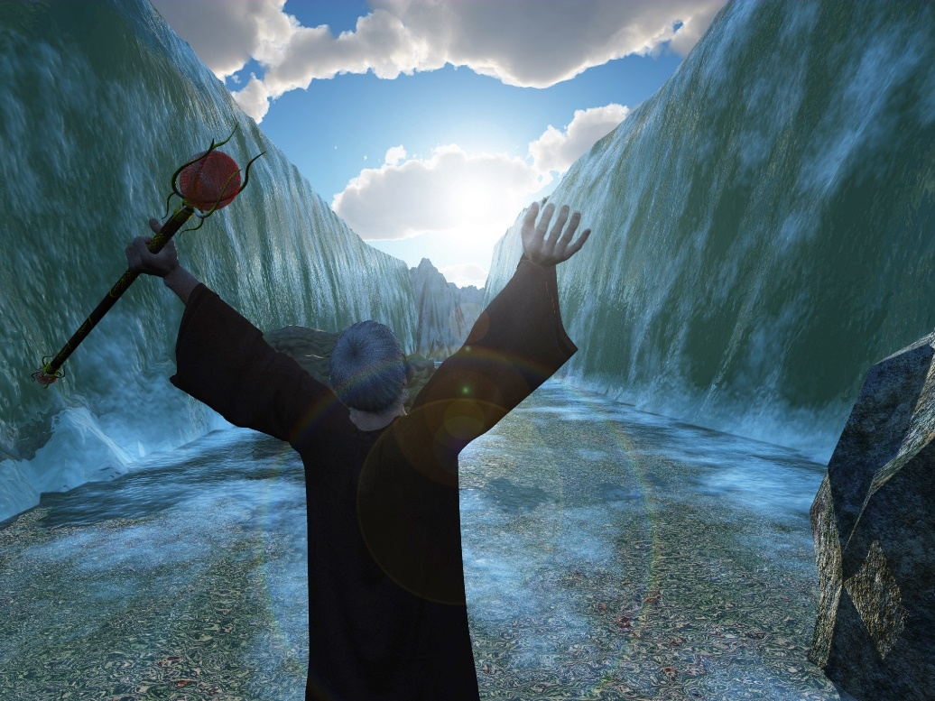
“Red Sea Parts for Israelites” (Exodus, Chapter 14)
God destroyed the Egyptians and saved the Israelites through the waters of the Red Sea.
© MikeH/www.shutterstock.com

Slide 11
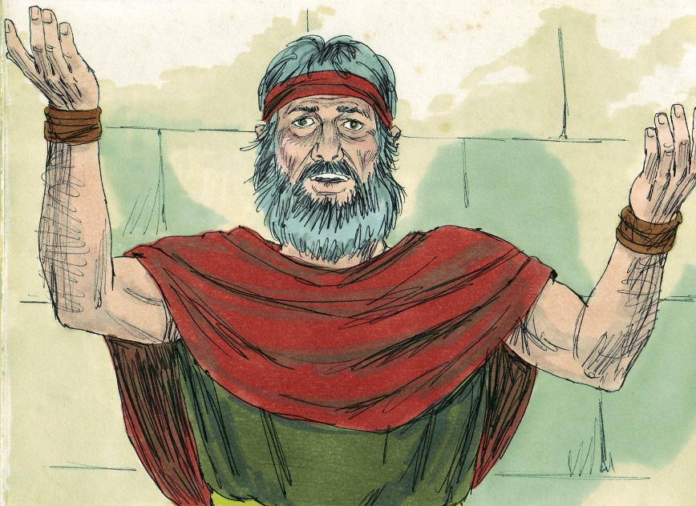
“Red Sea Parts for Israelites” (Exodus, Chapter 14)
The Israelites were pursued by the Egyptians, and the Israelites were afraid that the Egyptians would catch them and bring them back or kill them.
Moses reassured the Israelites of God’s great power to save them.
© BibleArtLibrary/www.istockphoto.com

Slide 12
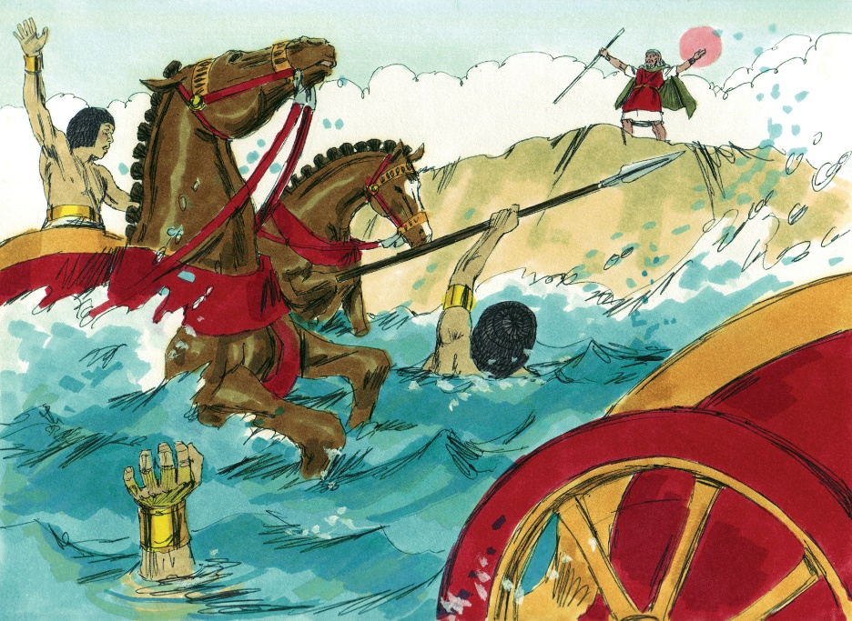
“Red Sea Parts for Israelites” (Exodus, Chapter 14)
God used Moses to part the Red Sea so that the Israelites could pass through. Once they had passed through the sea, God brought the water crashing down upon the Egyptian soldiers.
© BibleArtLibrary/www.istockphoto.com

Slide 13
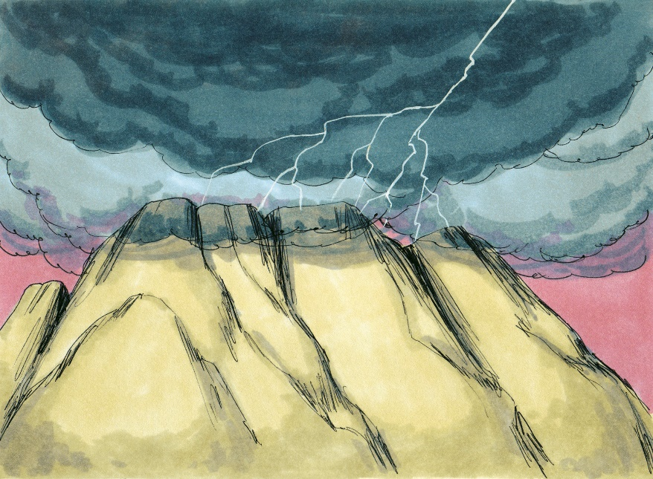
“God Lays Down the Laws” (Exodus, Chapters 19–20)
Moses received the Commandments of God on behalf of the people, and the people agreed to observe them.
© BibleArtLibrary/www.istockphoto.com

Slide 14
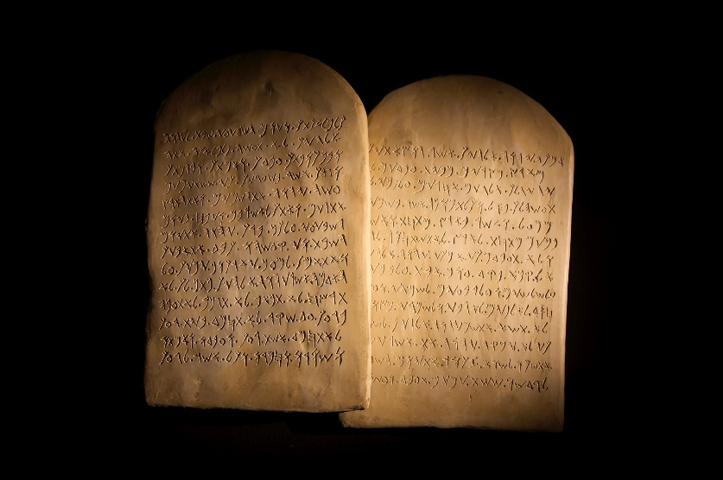
“God Lays Down the Laws” (Exodus, Chapters 19–20)
God appeared to the Israelites at Mount Sinai with a dramatic display of lightning, thunder, trumpet blasts, and earthquakes.
The Israelites set up camp at the base of Mount Sinai as Moses spoke to God on behalf of the people.
God gave Moses the Commandments, and the people agreed to follow them.
© jsp/www.istockphoto.com

Slide 15
Let’s Review!
Fill in the blanks:
The Israelites were suffering in Egypt, so God called _______________ to lead them out.
God first revealed himself to Moses through a _________________. Though afraid, Moses agreed to do what God asked.
The tenth and final plague was the _____________. The Israelites were saved from this by _________________. After this, the Israelites left Egypt by crossing the __________________, which Moses parted for them to cross.
Once the Israelites crossed, God brought the water back down upon the ________________, allowing the Israelites to safely escape.
Once out of Egypt, God appears to Moses on ____________________ and gave him a list of rules called ____________________________, which Moses and the Israelites agreed to follow.

Slide 16
How Did You Do?
Here are the completed sentences:
The Israelites were suffering in Egypt, so God called Moses to lead them out.
God first revealed himself to Moses through a burning bush. Though afraid, Moses agreed to do what God asked.
The tenth and final plague was the death of the firstborn sons. The Israelites were saved from this by sprinkling the blood of their best lamb on their doors. After this, the Israelites left Egypt by crossing the Red Sea, which Moses parted for them to cross.
Once the Israelites crossed, God brought the water back down upon the Egyptians, allowing the Israelites to safely escape.
Once out of Egypt, God appeared to Moses on Mount Sinai and gave him a list of rules called the Ten Commandments, which Moses and the Israelites agreed to follow.

