Slide 1
The Human Person
The Catholic Faith Handbook for Youth, Third Edition
Chapter 6
Document #: TX003137
Notes:
Use this presentation to introduce or review the key points in chapter 6 of the student handbook.

Slide 2
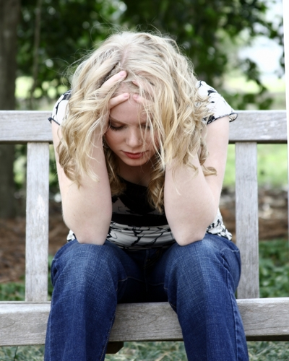
God’s Infinite Love
God loves every person without exception.
Every human person has infinite value in God’s plan.
God’s love doesn’t depend on what we’ve done or how we feel.
Copyright: Kevin Carden / www.shutterstock.com
Notes:
Ask the students to reflect on why people may feel unlovable at times. Reiterate that God’s love and forgiveness are available to all.

Slide 3
Made in the Image of God
Human beings are the crown of God’s Creation.
Made in the image of God, we have special gifts and capabilities that go beyond all other creatures.
Humans have self-awareness and self-knowledge.
Humans are capable of knowing God and freely returning God’s love.
Copyright: Monkey Business Images / www.shutterstock.com
Notes:
Explore with the students other gifts that we may have because we are created in God’s image.

Slide 4
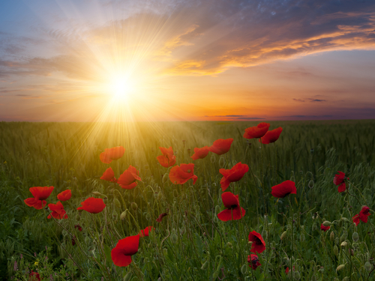
Created with a Soul
Our soul is the spiritual principle that animates our spiritual lives and makes us truly human.
Our soul is immortal.
We are a unity of body and soul.
Copyright: firewings / www.shutterstock.com

Slide 5
Created Male and Female
We are not meant to be alone.
Copyright: Monkey Business Images / www.shutterstock.com
Like the Trinity, we must live in loving community with others in order to be all that God created us to be.
The partnership of men and women is the primary form of human community.
Notes:
Share a personal experience of the enrichment you’ve gained from the experience of community, perhaps in family or parish life. Explain that our need for community reflects our likeness to God, who is the communion of the Father, Son, and Holy Spirit.

Slide 6
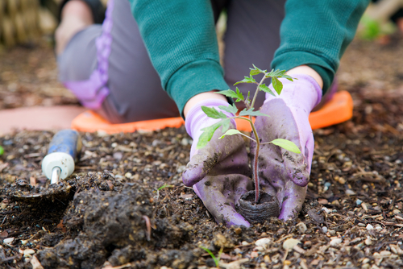
Responsible for Caring for Creation
Copyright: Alexey Stiop / www.shutterstock.com
Our choices either help preserve the web of life or destroy it.
We should not misunderstand the biblical terms “have dominion over” and “subdue.”
We are called to stewardship, to honor and protect all of creation.
Notes:
Ask the students about some of their own efforts to be good stewards of creation.

Slide 7
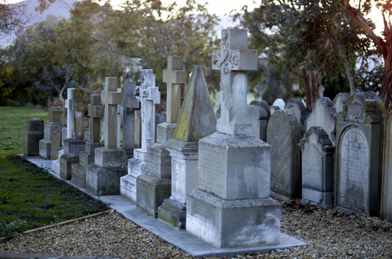
The Fall
The Garden of Eden symbolizes the ideal relationship that God intended to have with human beings.
Copyright: Steve Lovegrove / www.shutterstock.com
Adam and Eve disobeyed God and committed the first sin.
They felt shame and blamed others for their sin.
God tells them they will now experience pain, and their lives will become hard.
They will now also experience death.
Notes:
Point out that each of these effects of sin is drawn from the account of the Fall in Genesis. Tell the students that our first parents did not trust God, choosing instead to trust the serpent. Ask the students what it means to trust God, and to be aware of our own human limitations.

Slide 8
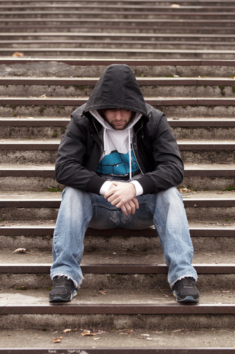
Original Sin
Adam and Eve’s sin has consequences for all of us.
The harmony that should exist between people, between human beings and nature, and between people and God has been wounded.
Much of the Old Testament shows the continuing influence of sin.
Copyright: Aleksandar Mijatovic / www.shutterstock.com
Notes:
Explain that when we speak of human nature as “fallen,” we mean it is deprived of its original holiness and justice.

Slide 9
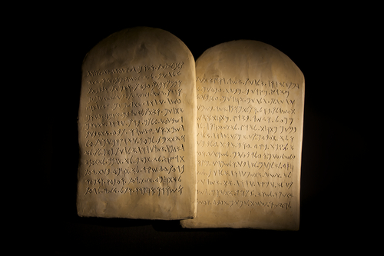
Fallen, not Evil
Original Sin does not cause us to lose our goodness or make us completely spiritually corrupt.
It weakens our natural powers for relating to God and for choosing to do good.
We are more influenced by ignorance, suffering, and the knowledge of our own death.
Copyright: John Said / www.shutterstock.com
We are more inclined to sin.
Notes:
Ask the students where they see a battle between good and evil being played out today, on a global scale and in the personal lives of individuals.

Slide 10
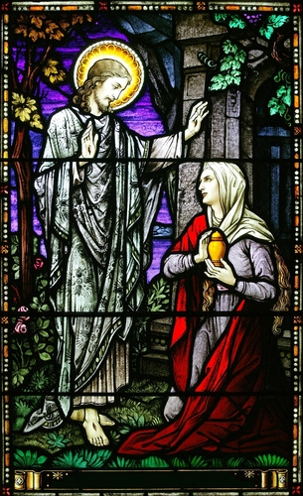
God Triumphs
God gave humans the freedom to choose our own destiny.
God has destined us for glory and will not be stopped by our sin.
We can choose to give and receive love.
Sin will never be stronger than God’s love.
Copyright: Keith McIntyre / www.shutterstock.com
Notes:
Reflect with the students on how God has already triumphed in the work and mission of Jesus and the Church, and how God will ultimately triumph when all evil and sin are finally destroyed.

