Slide 1
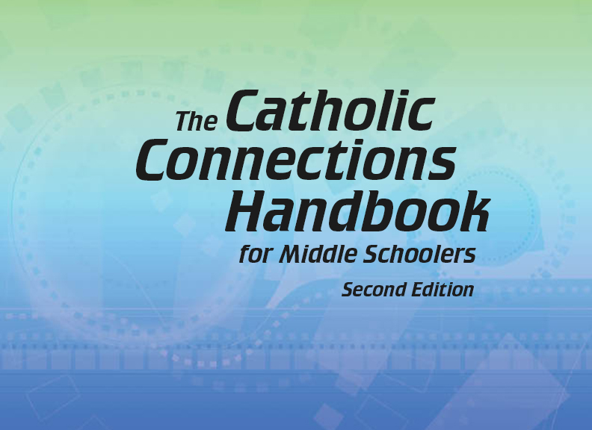


Slide 2
Christian Morality
and Social Justice
Chapter 44
Respecting Sexuality

Slide 3

Chapter Summary
Respecting Sexuality
In the first half of chapter 44, you will consider what it means to respect yourself and others. The Handbook offers information on the strong temptations you face from the media, peers, and society in general as you seek to live in sexual wholeness (that is, chastity). The lessons encourage you to view yourselves and one another not as objects but as valuable gifts from God.
© Curioso/www.shutterstock.com

Slide 4
Introduction and “The Sixth Commandment: Sexuality Is a Gift”
(Handbook, pages 478–481)
Sexuality is about more than sexual relationships. It is a gift from God.
© freesoulproduction/www.shutterstock.com

Slide 5
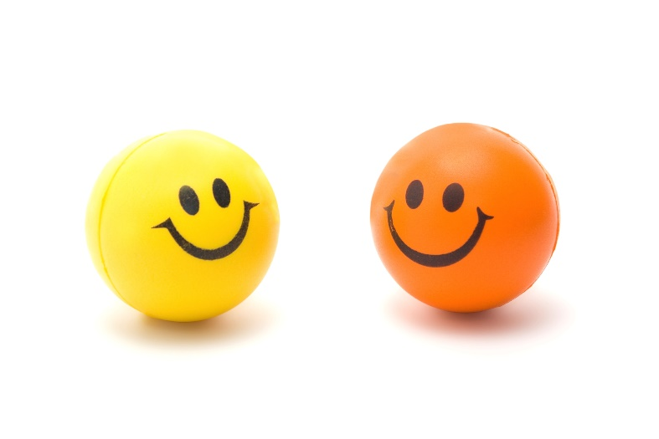
Introduction and “The Sixth Commandment: Sexuality Is a Gift”
(Handbook, pages 478–481)
Activity: “A Chaste Person Acrostic Poem”
Write the phrase “A CHASTE PERSON” down the left side of your paper.
Using the letters in this phrase, create an acrostic poem describing qualities of a chaste person.
© baydavn0211/www.istockphoto.com

Slide 6
Introduction and “The Sixth Commandment: Sexuality Is a Gift”
(Handbook, pages 478–481)
The world constantly uses the gift of sexuality in a nonsacred manner.
God created men and women, body and soul, to complement each other as male and female and to create new life.
God calls us to be honest and healthy by respecting the gift of our sexuality and the sexuality of others.

Slide 7

“Sexual Integrity” (Part 1)
(Handbook, pages 481–483)
God created sexual relationships to express a loving union between husband and wife and to bring new life into the world.
© tmcphotos/www.shutterstock.com

Slide 8
“Sexual Integrity” (Part 1) (Handbook, pages 481–483)
God created sexual relationships for two purposes: to make new life and to express a loving union between a husband and a wife.
There are obstacles to sexual integrity: lust, fornication, masturbation, and pornography. These are the obstacles that hold our minds hostage, cloud our thinking, and eventually poison our spirits.
Sexuality should never be treated casually. Sex is not just about our bodies. We are people in both body and spirit, and our feelings depend on our thoughts.

Slide 9

“Sexual Integrity” (Part 1) (Handbook, pages 481–483)
Quick Quiz!!
What are the two reasons God created sexual relationships?
© file404/www.shutterstock.com

Slide 10
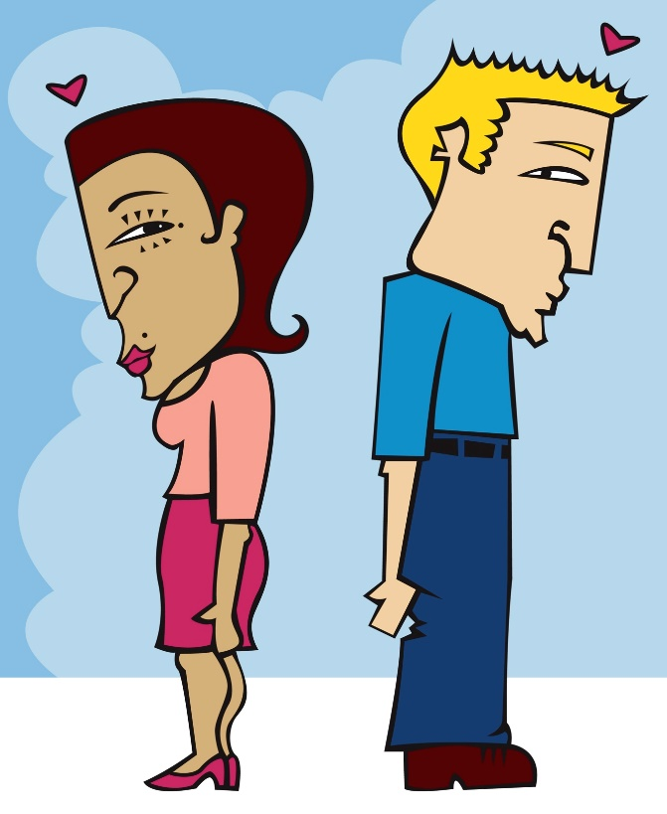
“Sexual Integrity” (Part 2)
(Handbook, pages 481–483)
We are called to stay away from sexual immorality. Modesty can help us show respect for ourselves and others.
© velusariot/www.istockphoto.com

Slide 11
“Sexual Integrity” (Part 2)
(Handbook, pages 481–483)
Fornication weakens our sexual wholeness and integrity.
Masturbation challenges our call to chastity.
Pornography mocks our human dignity and distorts our sense of sexuality as a gift.
Something as basic as modesty can help us express our self-worth in our everyday lives, steering us clear of sexual immorality.

Slide 12

“Sexual Integrity” (Part 2)
(Handbook, pages 481–483)
© KIaraDohnalova/www.shutterstock.com
Grab a dictionary and find the word modesty. Be the first one to find a synonym for this word, and write it on the board! Ready, set, GO!

Slide 13

Let’s Review!
(Handbook, pages 478–483)
Review what you have learned in this chapter.
© iQoncept/www.shutterstock.com

Slide 14

Let’s Review!
(Handbook, pages 478–483)
Activity
You will find a name tag on your desk.
On that name tag, write four words that describe you. For the last word on the name tag, write Beloved. Wear your name tag for the rest of this class!
3. Volunteer to share the words on your name tag.
4. The takeaway:
You are beloved of God. God invented love. God invented sexuality. God loves you, and he wants you to use your sexuality in the best way possible, to bring you happiness and not sorrow and disappointment.
© romrf/www.shutterstock.com

Slide 15
Let’s Review!
(Handbook, pages 478–483)
Sexuality is about more than sexual relationships; it is a gift from God.
God created sexual relationships to express a loving union between husband and wife and to bring new life into the world.
We are called to stay away from sexual immorality. Modesty helps us show respect for ourselves and others.

