Slide 1
The Seven Catholic Sacraments
The Sacraments
Document #: TX002087
Notes:
Notes: Explain to the students that the more they know about the Sacraments, the more fully they can celebrate them. Encourage them to write down any questions that might occur to them during the slideshow, saying that you will have time for questions and answers at the end.

Slide 2
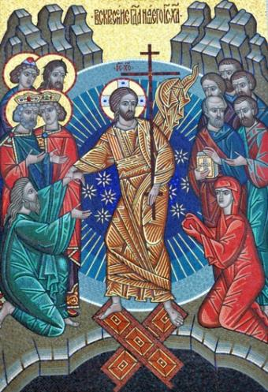
Signs and Instruments
The Latin word sacramentum means “a sign of the sacred.”
The Seven Sacraments are ceremonies that point to what is sacred, significant, and important for Christians.
They are special occasions for experiencing Christ’s saving presence.
© Oleg Golovnev/shutterstock.com
Notes:
Notes: Explain to the students that the Sacraments are Christ’s own gifts that strengthen our relationship with him, a relationship we call grace.
Alternate Image Option: an image of Christ, colorful and compelling

Slide 3
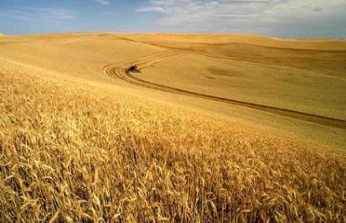
Sacraments: A Definition
© Image in Public Domain
The Sacraments are signs of God’s love.
Sacrament: “An efficacious and visible sign of God’s grace.” Or, “An outward sign instituted by Christ to give grace.”
Notes:
Notes: Grace is a deeper relationship with God. It is not a quantifiable “thing.”

Slide 4
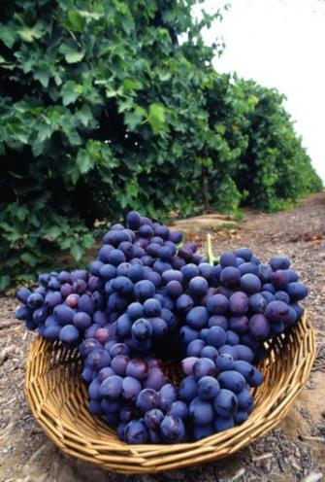
Outward Sign
God draws us closer to him through material symbols that our physical bodies can perceive—things and words and gestures.
Two parts: the “thing” itself, and the words or gestures that give significance to what is being done.
© Image in Public Domain
Notes:
Notes: The outward signs of the Sacraments have two parts: the “thing” itself that is used (water, oil, bread, and so on) and the words or gestures that give significance to what is being done.

Slide 5
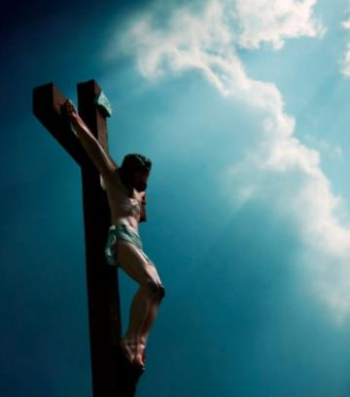
Instituted by Christ
No human power could attach an inward grace (a closer relationship with God) to an outward sign.
Only God can do that.
© langdu/shutterstock.com

Slide 6
No New Sacraments
The Church cannot institute new Sacraments.
As declared at the Council of Trent, there can never be more than Seven Sacraments, the Sacraments Jesus has given us.
Notes:
Alternate Image Option: an image or symbol of each of the Seven Sacraments

Slide 7
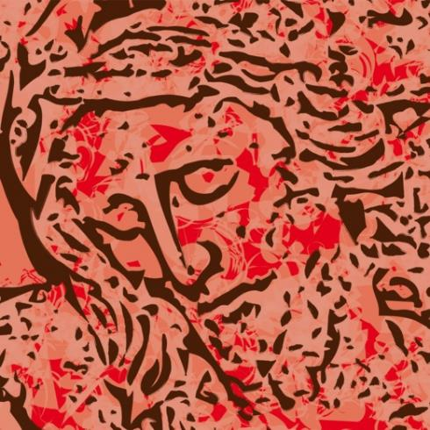
To Give Grace, to Strengthen Relationship with God
Sacraments give sanctifying grace.
Sacraments are necessary for salvation.
Sacraments are the vehicles for the graces they convey.
© robodread/shutterstock.com
Notes:
Notes: Remind the students that grace is not a thing; rather, grace is a relationship with God and a participation in his life.

Slide 8
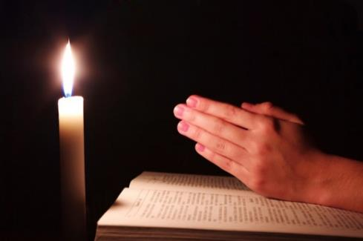
Proper Disposition
A Sacrament gives grace of and by itself, by its own power.
Jesus attached grace to the outward sign, so that the sign and grace always go together.
But attitude does matter. Faith matters.
© irin-k/shutterstock.com
Notes:
Notes: Tell the students that our interior dispositions have an effect on our relationship with God through grace. The more perfect our sorrow in the Sacrament of Penance and Reconciliation, the more ardent our love in receiving the Holy Eucharist, the more lively our faith in receiving Confirmation, then the stronger our relationship with God will be. Our relationship with God, called grace, like our other relationships, is a two-way street. But our relationship with God began with his love for us.

Slide 9
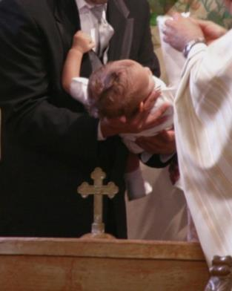
Special “Marks” on the Soul
There is a “character” imprinted on the soul by the Sacraments of Baptism, Confirmation, and Holy Orders.
In these Sacraments the anointing with oil is a symbol of this mark or seal. We are marked as belonging to Christ, and nothing will ever change that.
© J. McPhail /shutterstock.com
Notes:
Notes: These marks are permanent qualities of the soul, an alteration in the soul that will forever be visible to God, the angels, and the saints. The permanent character of Baptism gives us the power to absorb the grace of the other six Sacraments and participate in the Mass. The character of Confirmation gives us the power to profess the faith fearlessly and to spread the faith. And the character of Holy Orders gives the priest the power to celebrate Mass and to administer the other Sacraments.
Alternate Image Options: images of all three Sacraments that imprint a character: Baptism, Confirmation, and Holy Orders

Slide 10
Baptism
The Sacrament of Baptism is the first Sacrament of Christian Initiation.
This Sacrament is the basis of the entire Christian life.
We become members of Christ and of the Church and sharers in her mission.
© Brian Lasenby/shutterstock.com
Notes:
Alternate Image Options: adult, child, or baby being baptized

Slide 11
Baptism frees us from Original Sin.
Baptism opens us to the flow of God’s love.
Baptism establishes the union between God and us.
© lafoto/shutterstock.com

Slide 12
Reconciliation
The Sacrament of Penance and Reconciliation has three elements: conversion, confession, and celebration.
In it we find God’s unconditional forgiveness.
As a result, we are called to forgive others.
© Icons Jewelry/shutterstock.com
Notes:
Alternate Image Option: priest and penitent during the Sacrament of Penance and Reconciliation

Slide 13
Reconciliation restores the sanctifying grace that has been lost through sin.
Reconciliation removes the barrier to the action of the Holy Spirit in us and once again gives entrance to God’s life-giving love.
© Péter Gudella/shutterstock.com
Notes:
Alternate Image Option: group of teens smiling and being friendly

Slide 14
Increase in Sanctifying Grace
The other five Sacraments—Confirmation, the Eucharist, Anointing of the Sick, Holy Orders, and Matrimony—give an increase in sanctifying grace.
God’s love does not increase, but our capacity to absorb his love increases.
© Vaclav Volrab/shutterstock.com

Slide 15
Confirmation
Confirmation is a Catholic Sacrament that deepens and strengthens baptismal gifts.
It is one of the three Sacraments of Christian Initiation.
It is most often associated with the Gifts of the Holy Spirit.
© Mitar Vidakovic /shutterstock.com
Notes:
Alternate Image Option: bishop and group of confirmands at Confirmation (perhaps when bishop is raising his arms in prayer)

Slide 16
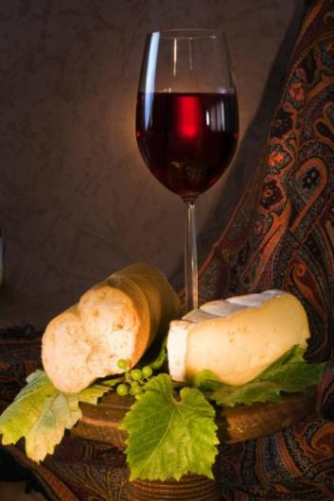
The Eucharist
The Eucharist is the culminating Sacrament of Christian Initiation.
The Eucharist, or Communion, is both a sacrifice and a meal. We believe in the Real Presence of Jesus. As we receive Christ’s Body and Blood, we are also nourished spiritually and brought closer to God.
© Anneka/shutterstock.com
Notes:
Notes: In reality, Baptism, Confirmation, and the Eucharist are one movement, inserting us into the Paschal Mystery of Christ. In the Eucharist, God acts to make us holy.
Alternate Image Option: an assembly receiving the Eucharist, or a photo of the Body and Blood (Chalice) of Christ

Slide 17
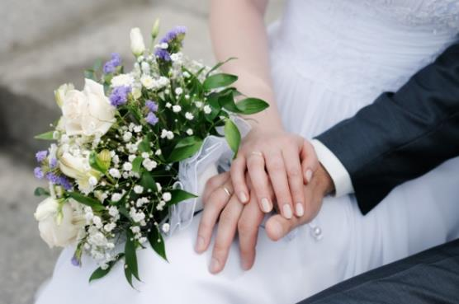
Marriage
The Sacrament of Marriage, or Holy Matrimony, is a sign of God’s covenant with his people, a covenant of love and grace in Jesus Christ.
The loving union of husband and wife speaks of family values and also God’s values.
© Maria Sbytova/shutterstock.com
Notes:
Alternate Image Option: a wedding in church, with bride and groom standing before priest

Slide 18
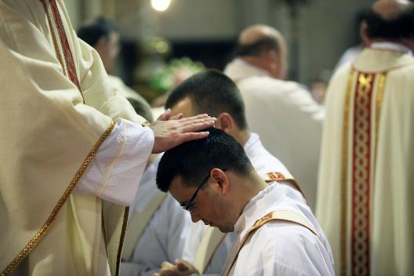
Holy Orders
In the Sacrament of Holy Orders, or Ordination, the priest being ordained vows to lead other Catholics by bringing them the Sacraments (especially the Eucharist), by proclaiming the Gospel, and by providing other means to holiness.
© Zvonimir Atletic/shutterstock.com
Notes:
Alternate Image Option: image of bishop and priest at an ordination

Slide 19
Anointing of the Sick
The Catholic Sacrament of Anointing of the Sick, formerly known as Last Rites or Extreme Unction, is a ritual of healing appropriate not only for physical ailment but also for mental and spiritual sickness.
Notes:
Alternate Image Option: priest administering Anointing of the Sick, in church, in retirement center, or at bedside

Slide 20
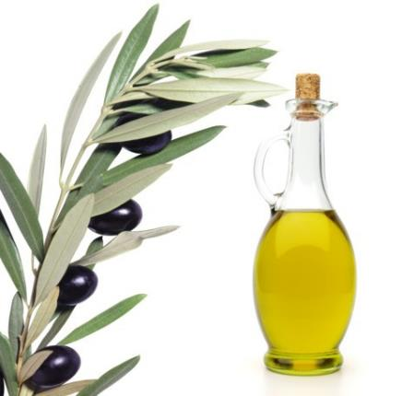
Extraordinary through the Ordinary
The Catholic Sacraments are quite extraordinary: they are ordinary signs that do God’s work.
In his Sacraments, Christ continues to provide tremendous gifts to us, beyond measure, whenever we need them.
© M. Unal Ozmen /shutterstock.com
Notes:
Alternate Image Option: an image of the Holy Spirit, in stained-glass window or mosaic, etc.
The following sources were helpful in creating this PowerPoint:
www.beginningcatholic.com/sacraments.html
www.americancatholic.org/features/special/default.aspx?id=29
www.catholic.org/clife/prayers/sacrament.php
www.newadvent.org/cathen/13295a.htm

