Slide 1
Being Human
Jesus Christ Course
Document # TX001259

Slide 2
Being Human
What does it mean . . .
to be human?
to be a person?
to be fully alive?
Notes:
Notes: Pause after each question to allow the students to give an initial response.

Slide 3
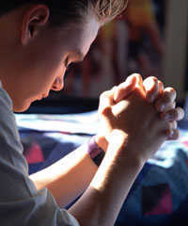
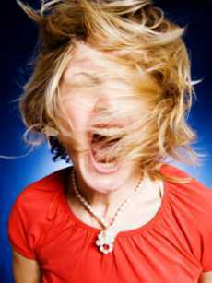
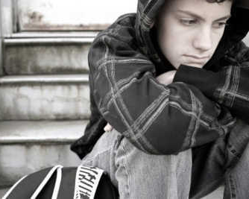
What do you see?
© becoming-selfaware.org
© edconsult.org
© arivacaboysranch
© westside-church-of-christ
© kevinfell.ca
Notes:
Notes: Show slide long enough so the students can look at and reflect on what they observe. Click to bring in question. Allow time for the students to identify and discuss characteristics they consider specifically human.

Slide 4
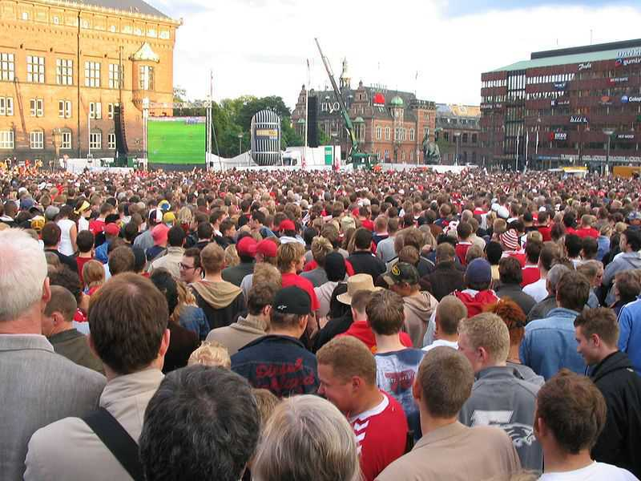
What have you heard people say about being human?
Image in public domain
Notes:
Notes: Student responses will vary and may include the following: “After all, I’m only human.” “I’m not perfect.” “Mistakes are natural.” “It’s hard to always do the right thing.”
Discuss responses in light of the characteristics identified with the previous slide. End the discussion of this slide with the observation that we learn about what it means to be human from many different people.

Slide 5
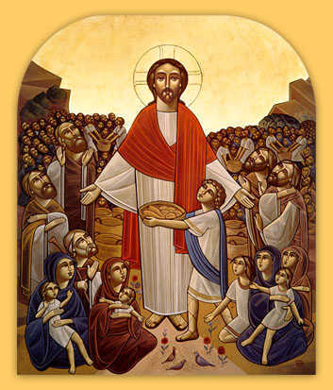
Jesus shows us how to live . . .
by his actions.
by his words.
Image in public domain
Notes:
Notes: Allow for student reflection and response after each bullet.

Slide 6
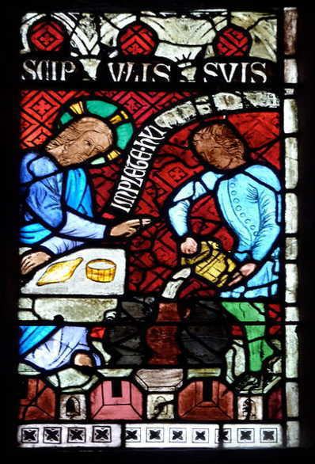
Life is good.
God loves us.
God wants us to be happy.
Image in public domain

Slide 7
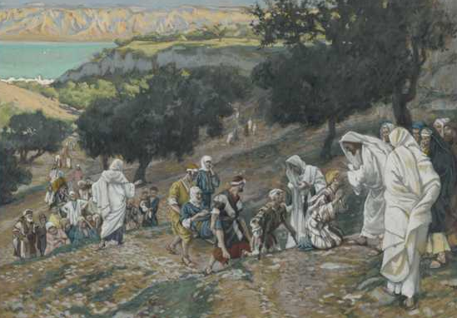
Jesus heals . . .
physically.
spiritually.
Jesus heals by forgiving sin.
Image in public domain
Notes:
Notes: After “physically,” ask the students to name one or two healing miracles, in addition to the miracle pictured on the slide. After “spiritually,” remind the students that Jesus healed more than people’s bodies. Ask them to name examples of how he healed people spiritually. Conclude the “spiritual healing” discussion by bringing in the final sentence: “Jesus heals by forgiving sin.”

Slide 8
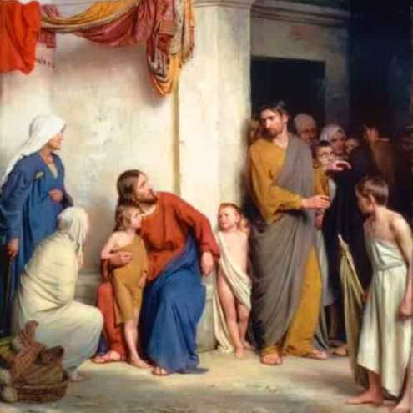
Jesus accepted everyone:
tax collectors
sinners
women and children
Image in public domain
Notes:
Notes: For each bullet, ask the students why it was significant that Jesus accepted that group, in his time and culture.

Slide 9
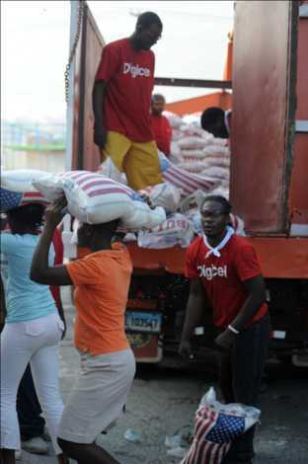
Jesus teaches us to choose what is good.
“The Son of Man did not come to be served but to serve and to give his life as a ransom for many”
(Matthew 20:28).
Image in public domain

Slide 10
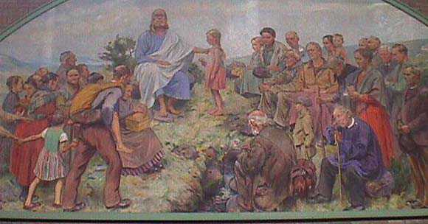
Jesus teaches us how to be fully alive.
Depend on God.
Accept who we are becoming.
Create an inclusive community.
Care for others.
Work for justice.
Grow in relationship with God.
Image in public domain

Slide 11
“I came so that they might have life and have it more abundantly” (John 10:10).

Slide 12
Being Human
What does Jesus teach me about being human?
What is my biggest challenge in being a good person?
How does Jesus give me hope?
What will I remember in the days ahead that will help me?
Notes:
Notes: Use this slide to conduct a concluding discussion. Bring in each bullet one at a time, and invite the students to reflect. Alternately, you may wish to have the students reflect on one or more questions in their journals. Close the reflection by asking if anyone wants to share anything, or conclude with a simple prayer.

