Slide 1
Visible and Spiritual Church
The Church
Unit 3
Document #: TX005569

Slide 2
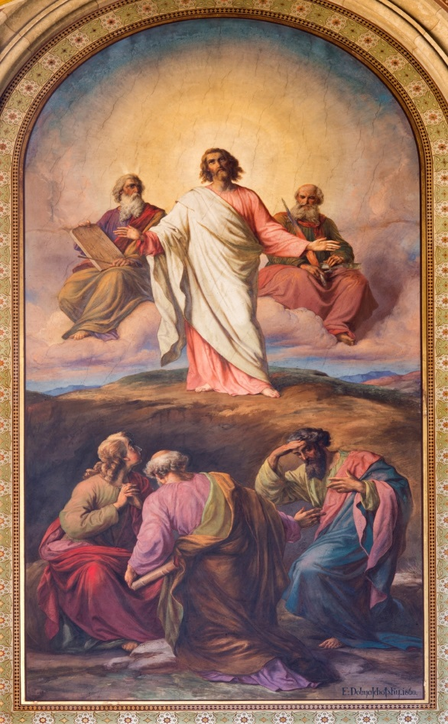
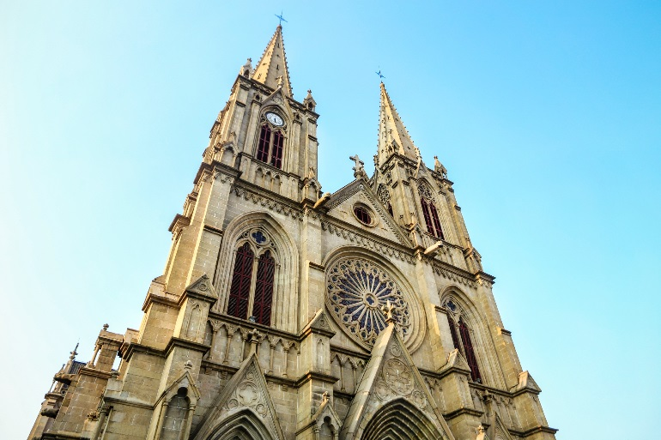
Visible and Spiritual
The Church is both visible and spiritual, a hierarchical society and the Mystical Body of Christ.
She is one, yet formed of two components, human and divine.
That is her mystery, which only faith can accept.
© sedmak / iStock.com
© GoodLifeStudio / iStock.com
Notes:
Notes: Explain to the students that though they can see the physical dimension of Church, the spiritual or invisible dimension must be taken on faith.

Slide 3
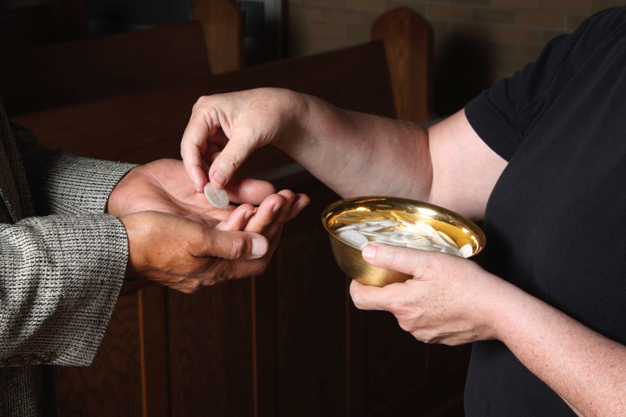
Visible
The visible Church consists of the People of God, the physical structures of the Church, the liturgies, and the Sacraments.
Can you name other visible elements of the Church?
© princessdlaf / iStock.com
Notes:
Notes: Examples: liturgy, service organizations, the People of God, the Church hierarchy, prayer books, hymnals, sacred art and music, the Church community, prayer groups

Slide 4
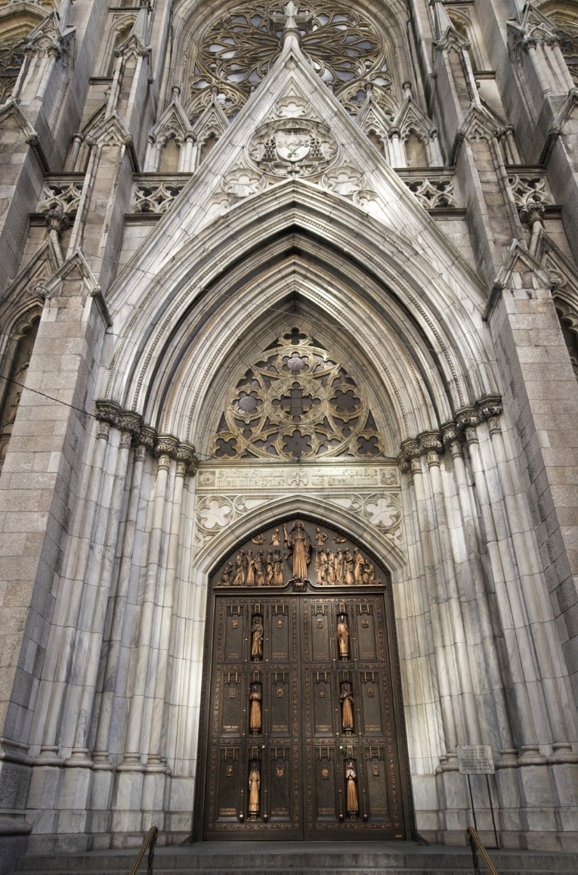
Visible Elements
The Church is a society with a hierarchical structure.
This hierarchy guides the People of God and protects the faith.
The physical churches are centers of prayer and worship for the People of God.
The human is directed toward, and subordinated to, the divine, the visible to the invisible.
© messenjah / iStock.com

Slide 5
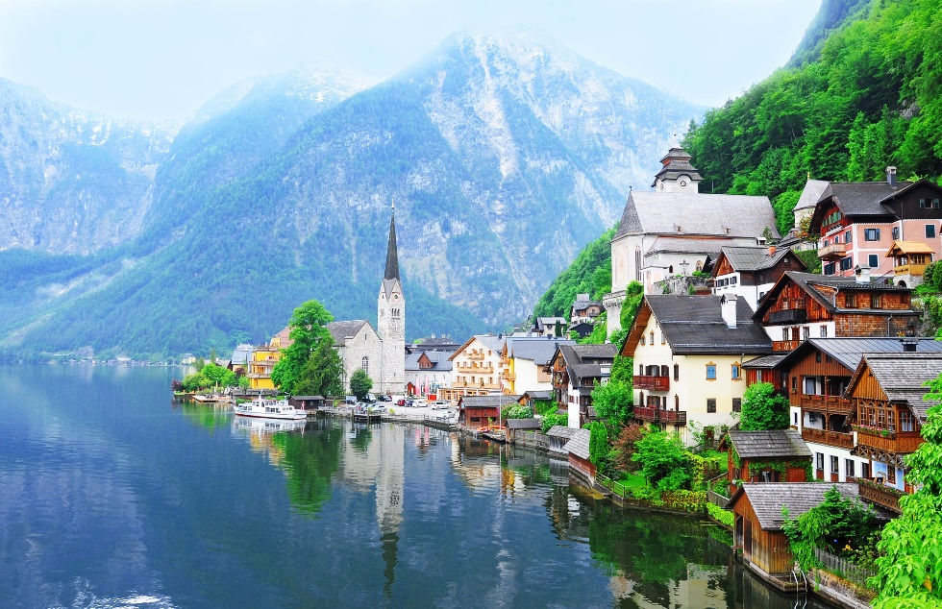
Endowed with Riches
The Church consists of the earthly Church (which we see) and the Church endowed with heavenly riches (which we don’t see).
The Church in this world is the sacrament of salvation, the sign and instrument of the communion of God and man.
©littlewormy / Shutterstock.com

Slide 6
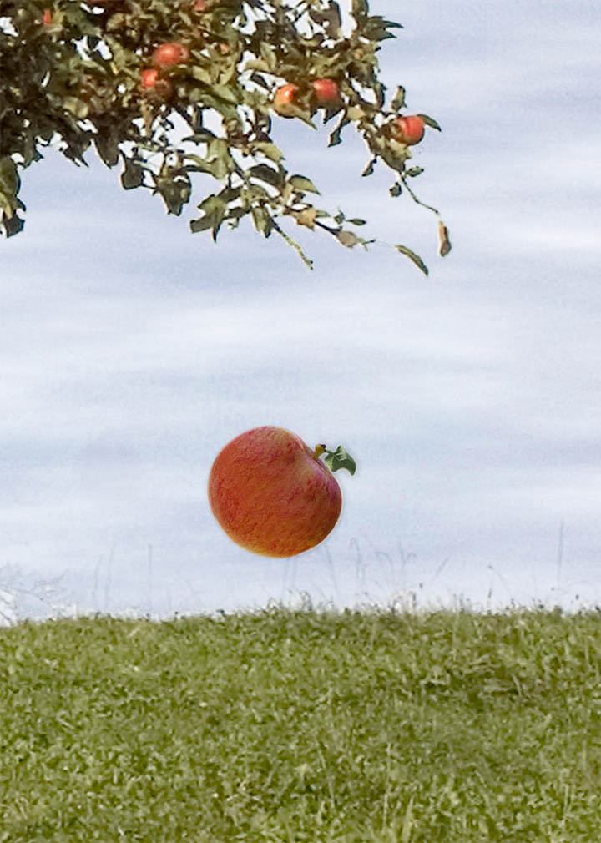
Invisible
If you can’t see it, it can’t be true. Do you agree or disagree?
What are some examples of things that are invisible yet real?
© Saint Mary's Press
Notes:
Notes: Examples: wind, air, gravity, time, surface tension

Slide 7
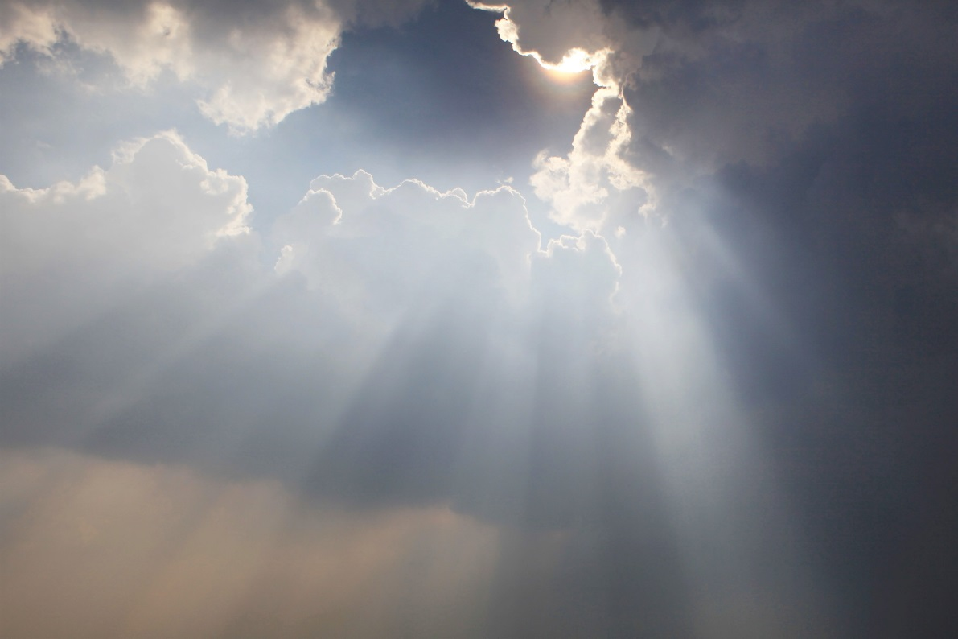
Invisible Church
What elements of the Church are invisible?
©Twinster photo / Shutterstock.com
Notes:
Notes: Examples: faith, grace, holiness, forgiveness, the Holy Spirit, God the Father, Transubstantiation, the Communion of Saints, the intercession of saints, angels. Explain that the following slides are going to present elements of the Church that are invisible, yet very real.

Slide 8
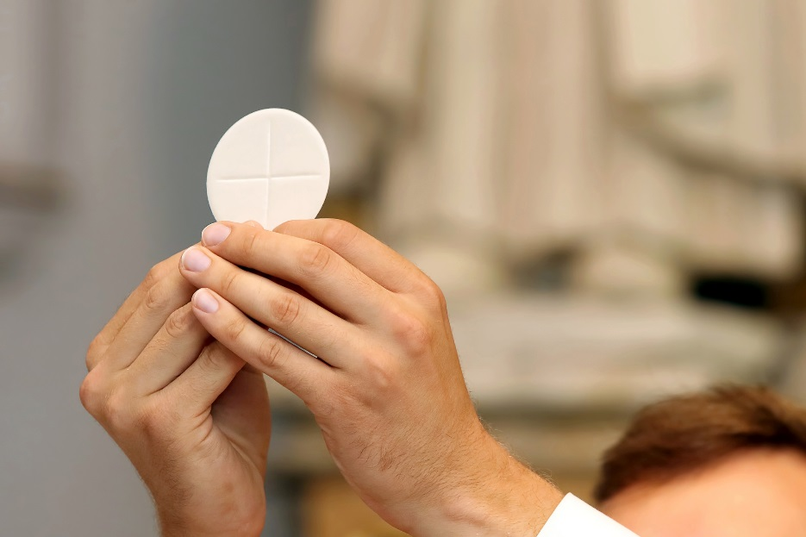
Transubstantiation
At the moment of consecration, the bread and wine become the Body and Blood of Jesus Christ.
We take this on faith, having been told by Christ, “This is my body, . . . This is my blood” (Matthew 26:26–28).
©wideonet / Shutterstock.com

Slide 9

Grace
Grace is God’s unmerited favor.
Grace is divine assistance.
God continues to gift us with grace, freely given and never earned.
God causes grace in the soul when the Sacraments are received.
©Anest / Shutterstock.com

Slide 10
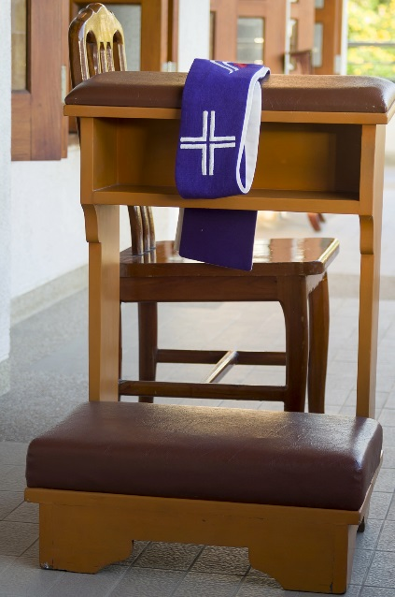
Forgiveness
Christ instructed his disciples to forgive sins. Those sins they forgive on earth are forgiven in Heaven; those sins that are not forgiven remain.
With his death, Christ opened the gates of Heaven, allowing for the redemption of humanity after the advent of Original Sin.
Forgiveness cannot be seen but must be accepted in faith.
Because sin is an offense against God, only God can forgive it.
©boy13 / Shutterstock.com

Slide 11

Holiness
God calls us to be holy.
To be holy is simply to live as someone who belongs to God, living by the vision of the Kingdom of God.
Without the presence of the Holy Spirit, we cannot know God.
The Holy Spirit’s presence leads us to God.
This is a tenet of faith. The presence of the Holy Spirit cannot be seen.
© Pavel Vakhrushev / Shutterstock.com

Slide 12
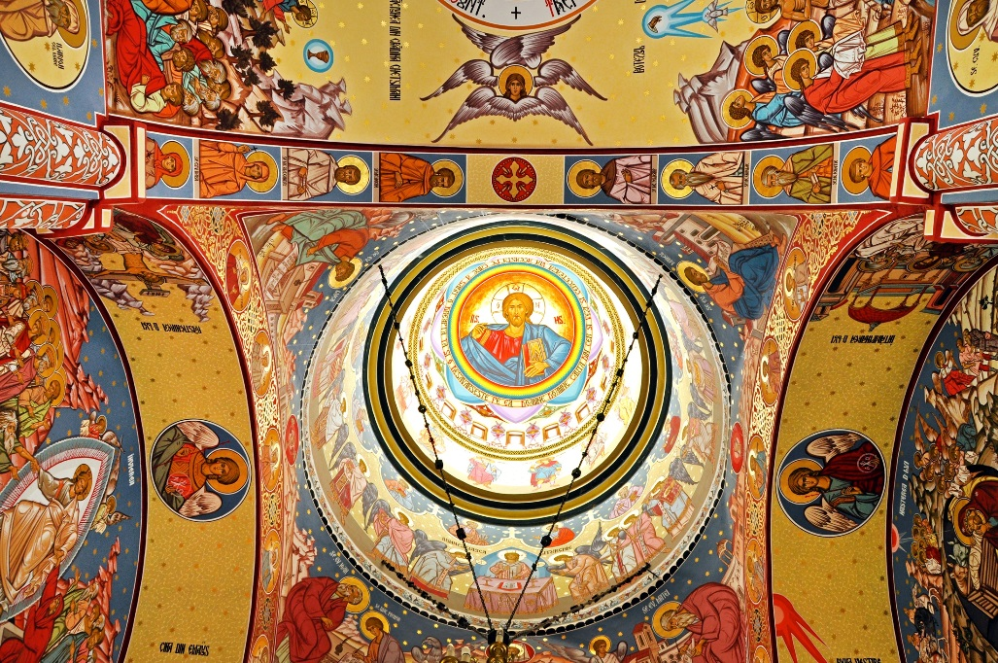
Intercession of the Saints
“Being more closely united to Christ, those who dwell in heaven fix the whole Church more firmly in holiness. . . . So by their fraternal concern is our weakness greatly helped.”¹ (CCC, 956)
©salajean / Shutterstock.com
Notes:
1. Lumen Gentium 49; cf. 1 Timothy 2:5
Notes: This would be a good time to discuss with the students the reality of the saints. Explain that we look to the saints as models of holy life and appeal to them for their help in attaining our own holiness, overcoming temptations and life’s struggles.

Slide 13
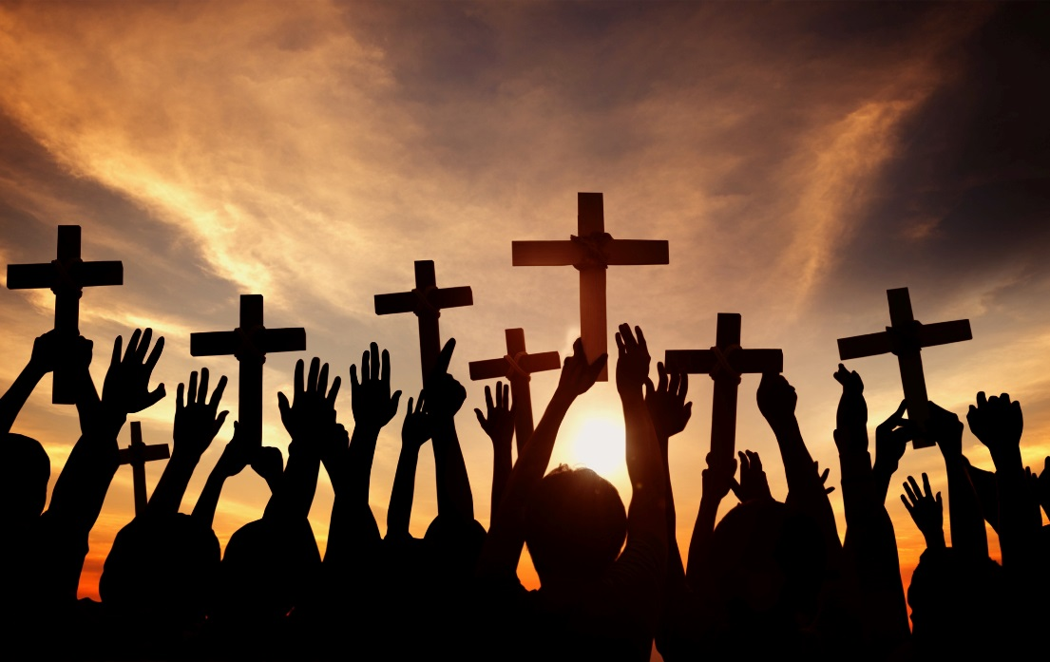
Communion with the Saints
“Exactly as Christian communion among our fellow pilgrims brings us closer to Christ, so our communion with the saints joins us to Christ, from whom as from its fountain and head issues all grace, and the life of the People of God itself.”¹ (CCC, 957)
©Rawpixel.com / Shutterstock.com
Notes:
1. Lumen Gentium 50; cf. Ephesians 4:1–6.

Slide 14
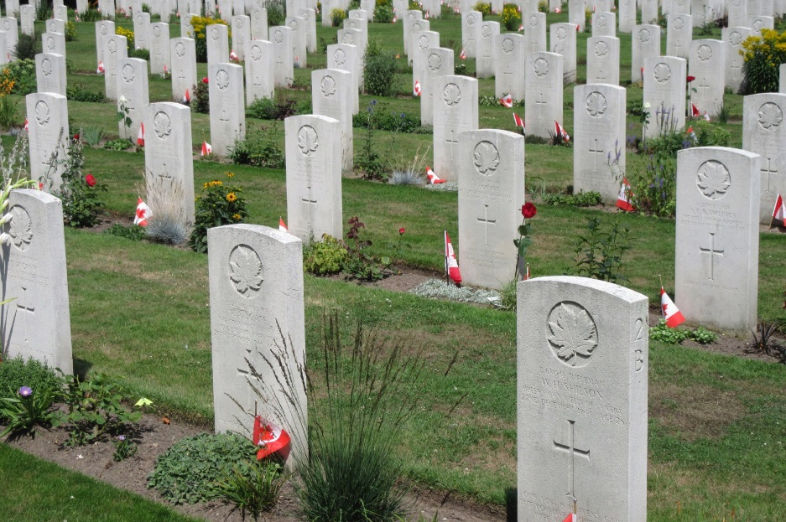
Memory of the Dead
The Church has always honored those who have gone before us in faith. We look to them as examples of the Christian way of life. We also pray for them, that they may be forgiven of any sin. We ask them to pray for us who still struggle here on earth.
© Peter Topp Enge Jonasen / iStock.com
Notes:
Notes: Share with the students that our prayer for the dead is capable not only of helping them, but also of making their intercession for us effective.
This is an excellent time to speak of the power of prayer as requests for intercession from those in Heaven and those who have gone before us. You may need to speak to the existence of Purgatory as well, another tenet taken on faith.

Slide 15

Salvation
Salvation comes from God, through the gift of Jesus Christ to us. The Word of God became visible in the person of Jesus Christ, in order to lead us to the divine realities of peace, joy, love, and freedom—in this life, and forever.
©Alex Emmanuel Koch / Shutterstock.com

Slide 16
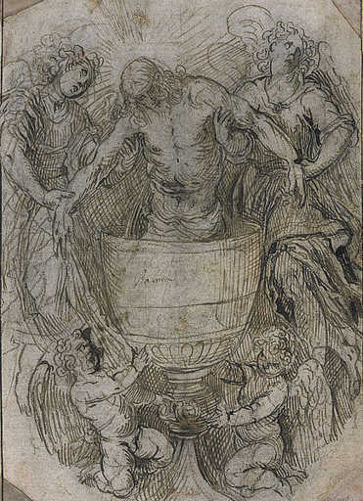
From Visible to Invisible
The visible elements of the Church are meant to guide us to an understanding of, and belief in, the invisible (spiritual) elements of the Church, from the sign to the thing signified, from the Sacraments to the mysteries.
Image in public domain

Slide 17
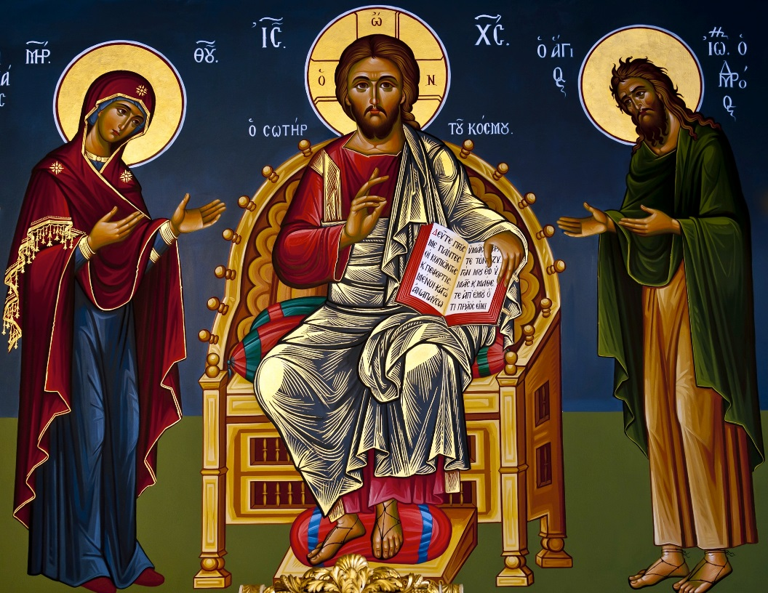
Visible Leads to Invisible
“To be sure, it is Christ who is seen, the visible image of the invisible God, but it is the Spirit who reveals him.” (CCC, 689)
© Oleg Golovnev/Shutterstock.com

Slide 18
Acknowledgments
The Scripture quotation on slide 8 is from the New American Bible, revised edition © 2010, 1991, 1986, 1970 Confraternity of Christian Doctrine, Inc., Washington, D.C. All Rights Reserved. No part of this work may be reproduced or transmitted in any form or by any means, electronic or mechanical, including photocopying, recording, or by any information storage and retrieval system, without permission in writing from the copyright owners.
The quotations on slides 12, 13, and 17 are from the Catechism of the Catholic Church for use in the United States of America, second edition, numbers 956, 957, and 689, respectively. Copyright © 1994 by the United States Catholic Conference, Inc.—Libreria Editrice Vaticana. English translation of the Catechism of the Catholic Church: Modifications from the Editio Typica copyright © 1997 by the United States Catholic Conference, Inc.—Libreria Editrice Vaticana.

