Slide 1
Biblical Exegesis
The Bible Course
Document #: TX001069

Slide 2
A Look at Biblical Exegesis
If you found a letter written by one person to another person, what would you need to consider in order to truly understand it?
Biblical exegesis: The critical interpretation and explanation of a biblical text.
© Danylchenko Iaroslav /Shutterstock.com
Notes:
Notes: The opening question is to get the students to brainstorm. If time permits, you could even create a mock letter or note including some slang terms. Guide the students to understand that slang makes sense within a particular culture—the slang words probably make no sense to someone outside of that culture. The handouts “Biblical Exegesis Chart” (Document #: TX001090) and “Practicing Biblical Exegesis” (Document #: TX001091) in the teacher guide help to engage the students in biblical exegesis and to grasp this content. These two handouts would work well after this presentation.

Slide 3
A Look at Biblical Exegesis (cont.)
Critical in this sense means doing a thoughtful and thorough review of a particular biblical text, taking all aspects and senses into consideration.
What does biblical exegesis do?
It looks to understand the language, symbols, culture, and history that influenced the human author. It seeks to understand the intention the human author had in writing the book and what God is revealing through the human author’s words.
© Danylchenko Iaroslav /Shutterstock.com

Slide 4
Why Engage in Biblical Exegesis?
Have you ever had someone take something you said out of context?
It is never good to look at something someone has said or written without looking at the whole context.
This is what biblical exegesis does for us.
A particular story or passage in the Bible can be fully understood only within the complete picture of both the Old and New Testaments.
It also needs to be understood in relationship to the life, teachings, death, and Resurrection of Jesus Christ.
© Jason Stitt/Shutterstock.com
Notes:
Notes: Use the opening discussion bullet to guide the students to the concept of needing to take the whole context into consideration to truly understand a particular piece of writing. This slide ties this concept to biblical exegesis.

Slide 5
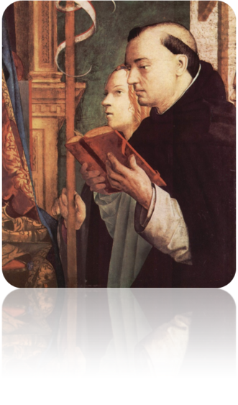
An Authentic Interpretation of the Scriptures
Biblical exegesis ensures an authentic interpretation of the Scriptures when done under the guidance of the Magisterium.
The Church looks at the interpretation of a particular text in light of the whole of Revelation and in light of the doctrines and teachings of the Church. God’s truth never contradicts itself.
This is known as the analogy of faith.
Image in Public Domain
Notes:
Notes: Following this slide, ask the students what problems could arise if people interpreted biblical texts without considering how their particular interpretation is in line with the whole of Revelation or with the teachings of the Church.

Slide 6
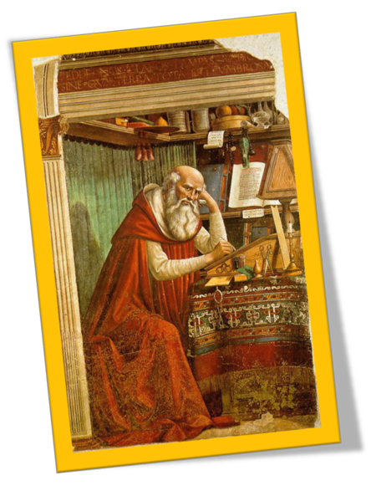
Types of Biblical Criticism
Biblical criticism: Another term for biblical exegesis.
Textual criticism: Deals with the text itself; it is concerned with finding the most original texts written by the human authors and with creating authentic translations of these ancient texts.
Historical criticism: Considers the historical setting of the text.
Image in Public Domain
Notes:
Notes: The students will get a chance to practice these forms of criticism with the handouts “Biblical Exegesis Chart” (Document #: TX001090) and “Practicing Biblical Exegesis” (Document #: TX001091). Practicing these forms of criticism will help the students to get a better grasp of the concept. Help the students to understand that biblical criticism is a full-time ministry and career for some people.

Slide 7
Types of Biblical Criticism
Literary criticism: Considers the literary forms utilized in the text and how those are used to convey the deeper meaning of the text.
Source criticism: Concerns itself with other writings the human author drew on in writing his book and how the Bibles stories compare to other ancient writings.
Image in Public Domain
Notes:
Notes: The students will get a chance to practice these forms of criticism with the handouts “Biblical Exegesis Chart” (Document #: TX001090) and “Practicing Biblical Exegesis” (Document #: TX001091). Practicing these forms of criticism will help the students to get a better grasp of the concept. Help the students to understand that biblical criticism is a full-time ministry and career for some people.

