Slide 1
The Fourth Commandment and the Decalogue
Christian Morality
Document #: TX001173

Slide 2

Shutterstock/CREATISTA

Slide 3

Shutterstock/Monkey Business Images

Slide 4

Shutterstock/Goodluz

Slide 5

shutterstock-sonya etchison

Slide 6
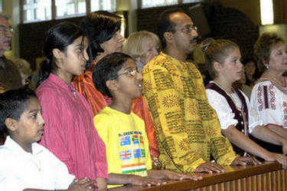
wpwittman.com

Slide 7
“Children, obey your parents [in the Lord], for this is right. ‘Honor your father and mother.’
This is the first commandment with a promise, ‘that it may go well with you and that you may have a long life on earth’”
(Ephesians 6:1–3)
Shutterstock/CREATISTA

Slide 8
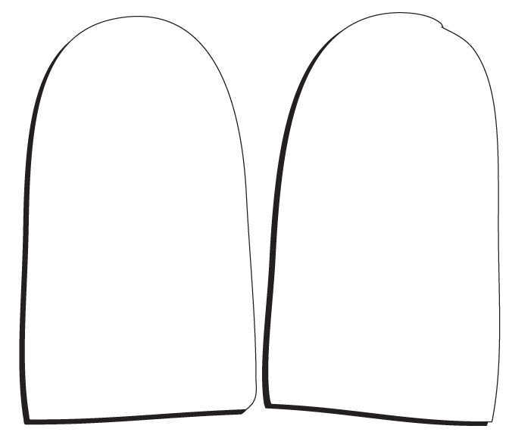
I am the Lord your God: you shall not have strange gods before me.
You shall not take the name of the Lord, your God, in vain.
Remember to keep holy the Lord’s Day.
Honor your father and your mother.
You shall not kill.
You shall not commit adultery.
You shall not steal.
You shall not bear false witness against your neighbor.
You shall not covet your neighbor's wife.
You shall not covet your neighbor’s goods.
Notes:
Click to add notes

Slide 9
How is the Fourth Commandment distinct from the first three commandments?
I am the Lord your God: you shall not have strange gods before me.
You shall not take the name of the Lord, your God, in vain.
Remember to keep holy the Lord’s Day.
Honor your father and your mother.
You shall not kill.
You shall not commit adultery.
You shall not steal.
You shall not bear false witness against your neighbor.
You shall not covet your neighbor's wife.
You shall not covet your neighbor’s goods.
Notes:
Note: Discuss this question as a class. Direct the students to refer to their written answers on the handouts.

Slide 10
The Fourth Commandment opens the second tablet of the Decalogue. It is not focused on God but on other people. Its placement after the first three commandments shows that love of God is the basis for our love of neighbor.
Shutterstock/Goodluz

Slide 11
Because it directly follows the first three commandments, the Fourth Commandment has a unique significance. What does this placement imply about the significance of love within a family?
I am the Lord your God: you shall not have strange gods before me.
You shall not take the name of the Lord, your God, in vain.
Remember to keep holy the Lord’s Day.
Honor your father and your mother.
You shall not kill.
You shall not commit adultery.
You shall not steal.
You shall not bear false witness against your neighbor.
You shall not covet your neighbor's wife.
You shall not covet your neighbor’s goods.
Notes:
Note: Discuss this question as a class. Direct the students to refer to their written answers on the handouts.

Slide 12
The love within family flows from the love of God. Our family passes on to us the love and knowledge of God.
wpwittman.com

Slide 13
How is the Fourth Commandment distinct from the six commandments that follow it?
I am the Lord your God: you shall not have strange gods before me.
You shall not take the name of the Lord, your God, in vain.
Remember to keep holy the Lord’s Day.
Honor your father and your mother.
You shall not kill.
You shall not commit adultery.
You shall not steal.
You shall not bear false witness against your neighbor.
You shall not covet your neighbor's wife.
You shall not covet your neighbor’s goods.
Notes:
Note: Discuss this question as a class. Direct the students to refer to their written answers on the handouts.

Slide 14
This commandment is a positive statement and is focused on the family. Honor and love for parents is the model for how we are to treat others; it is the basis for the remaining six commandments.
Shutterstock/Monkey Business Images

Slide 15
Why does the Church extend the meaning of this commandment to also include obedience to and respect for other people in authority (not just parents)?
I am the Lord your God: you shall not have strange gods before me.
You shall not take the name of the Lord, your God, in vain.
Remember to keep holy the Lord’s Day.
Honor your father and your mother.
You shall not kill.
You shall not commit adultery.
You shall not steal.
You shall not bear false witness against your neighbor.
You shall not covet your neighbor's wife.
You shall not covet your neighbor’s goods.
Notes:
Note: Discuss this question as a class. Direct the students to refer to their written answers on the handouts.

Slide 16
The relationship between parent and child is the most universal of relationships. The commandment teaches us to regard God as the source of all authority and extends our obedience and respect to all who have been given authority for our greater good.
Shutterstock/CREATISTA

