Slide 1
Overview of Late First-Century New Testament Writings
The New Testament
Document #: TX002310

Slide 2
Review—Timeline: Writing the Books of the New Testament
The earliest book of the New Testament is Paul’s First Letter to the Thessalonians, written around AD 50.
Paul and his companions continue to write letters, or Epistles, throughout the missionary campaign period (approximately 30–65).
The Gospels are written from approximately 65 to 95, beginning with Mark’s Gospel and ending with John’s Gospel.
Various other writings, which came to be included in the New Testament canon, continue to be written during the late first century and even into the early second century.
In this unit we will refer to all of these other writings as “late first-century New Testament writings.”

Slide 3
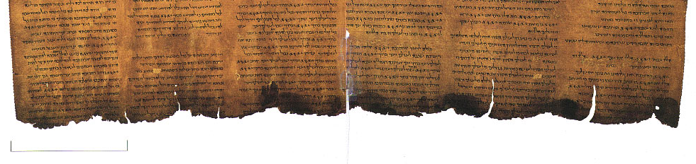
Review—Canon Formation
The late first-century New Testament writings were the latest writings to be included in the canon.
These writings represent the end of the apostolic age; some may even have been written during the generation after the Apostles.
People continued to write about Jesus well into the second and third centuries. However, because these writings lacked a direct connection to the Apostles, they were determined not to have been inspired by the Holy Spirit. Therefore, they were not included in the New Testament canon and are referred to as “noncanonical” writings.
Notes:
Notes: Refer the students to their unit 3 materials if they need further review of this process of canon formation.

Slide 4
Classification of Late First-Century New Testament Writings
Book of Revelation: A single book of apocalyptic literature | Letter to the Hebrews: a single book that is more like a sermon than a letter | the pastoral epistles (1 Timothy, 2 Timothy, and Titus): addressed to the pastors, or leaders, of various early Christian communities | the catholic epistles (1 and 2 Peter, Jude, James, and 1, 2, and 3 John): addressed to a universal, or “catholic,” audience rather than to one geographically specific Christian community

Slide 5

Approximate Dating of Late First-Century
New Testament Writings
Hebrews: 80 to 90
Revelation: 95
pastoral epistles: 90 to 100
catholic epistles:
1 Peter: 70 to 90
Jude: 90 to 100
James: 90 to 100
1, 2, and 3 John: 100
2 Peter: 100 to 125
Notes:
Notes: All of these writings were composed against the backdrop of the Roman Empire: the sociocultural and political reality of the time. Some, but not all, were written during periods in which Christians were persecuted by Roman authorities.

