Slide 1
The Organization of the Catholic Church
The Catholic Faith Handbook for Youth, Third Edition
Chapter 14
Document #: TX003145
Notes:
Use this presentation as a game to introduce or review the roles in the Catholic Church, on pages 150–156 of the student handbook.

Slide 2
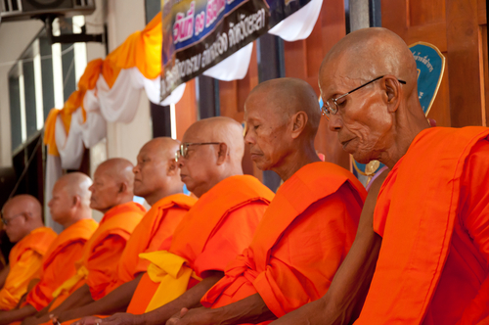
Other Religions
Copyright: ngarare / www.shutterstock.com
People in other religions are also children of God.
The Catholic Church recognizes the authentic search for God in other religions.
Others also may attain eternal salvation.
Notes:
Remind the students that the Catholic Church affirms that those people who through no fault of their own do not know Christ or his Church, but who seek God with a sincere heart and try to do his will, may also achieve eternal salvation.

Slide 3
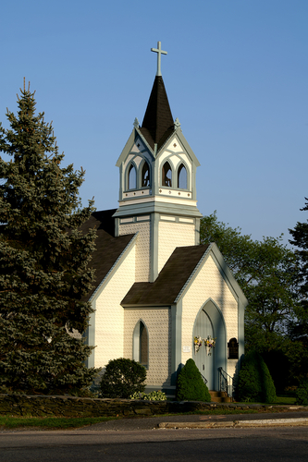
Other Christian Churches
Understood to be Catholics’ brothers and sisters in Christ
Share the common understanding that salvation comes through Christ
The goal is to strengthen the communion and ultimately restore unity
Copyright: Mary Terriberry / www.shutterstock.com
Notes:
Read, or have the students read, through some of the areas of disagreement between the different Christian churches on pages 149–150.

Slide 4
God calls us each to take on different roles within the Church. Each role is important and necessary.
Copyright: jimmi / www.shutterstock.com
Notes:
After showing this slide, explain the game to the students. Direct them to write a guess as each clue appears. Provide the answer after the fourth clue, and have the students note the number of clues they needed in order to get the correct answer for each question. At the end they will add their numbers: the lowest number wins.

Slide 5
Who Am I?
My life is fully dedicated to a life with God.
I am not ordained.
I may live alone or with others in community.
I take vows of poverty, chastity, and obedience.
Copyright: Vitaly Korovin / www.shutterstock.com
Notes:
(A person in the consecrated life.) Students may have questions about the diverse forms of consecrated life. Refer to pages 152–153 of the student handbook for more information. You may want to have the students submit their questions in writing so you can research the answers, or you could assign the research to students.

Slide 6
Who Am I?
I am responsible for ordaining priests and deacons and for Confirmations.
I make sure all churches in the diocese work together as a whole.
My official church in the diocese is called the cathedral.
I am one of the successors of the Apostles, and I help the Pope lead the Church.
Copyright: Lightspring / www.shutterstock.com
Notes:
(A bishop.) Ask the students if they can name some general information about their local bishop.

Slide 7
Who Am I?
I share in the priestly, prophetic, and kingly office of Christ by living a holy life.
I bring Christ to the everyday world.
I am not ordained or in a consecrated state of life.
I may remain single, or I may marry.
Copyright: inxti / www.shutterstock.com
Notes:
(The lay faithful, or the laity.) Allow a few minutes for the students to journal on this question.

Slide 8
Who Am I?
Copyright: Sergey Andrianov / www.shutterstock.com
I am called to be a coworker with the bishop of my diocese.
I am ordained through the Sacrament of Holy Orders.
Often, I am assigned to a parish.
I celebrate Sacraments, particularly the Eucharist.
Notes:
(A priest.) Point out the difference between a diocesan priest and a religious priest (see page 153 of the student handbook), and ask the students if they know priests in these categories.

Slide 9
Who Am I?
I am the visible sign of Christ’s presence on earth.
Copyright: fpdress / www.shutterstock.com
I am Bishop of Rome, the successor of Saint Peter.
I am called the Vicar of Christ.
I am pastor of the entire, worldwide Church.
Notes:
(The Holy Father, the Pope.) Ask the students to share any information they know about the current Pope. Give them more information as necessary.

Slide 10
Who Am I?
Copyright: huibvisser / www.shutterstock.com
My life is oriented toward works of charity.
I have a liturgical role, assisting a priest.
I am ordained by a bishop.
I may be a single, widowed, or married man.
Notes:
(A deacon.) Ask the students if they know any deacons. Invite them to share what they know about his role in the Church.

