Slide 1
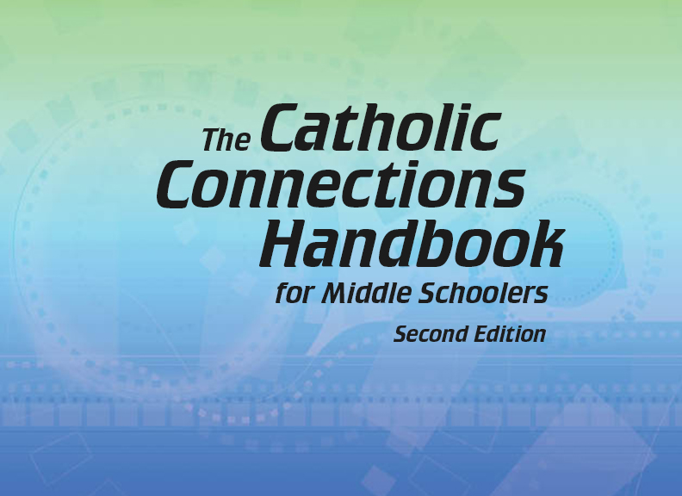
Document #: TX005850

Slide 2
The Prophets, Jesus Christ, and the Holy Spirit
Chapter 12
The Birth of Jesus

Slide 3
Chapter Summary
Jesus’ birth was miraculous.
This chapter will examine Mary’s important role in bringing Jesus into the world by the power of the Holy Spirit.
Mary’s “yes” to God provides an example for every believer to follow.
We will also study the life of Saint Nicholas, the inspiration for Santa Claus.

Slide 4
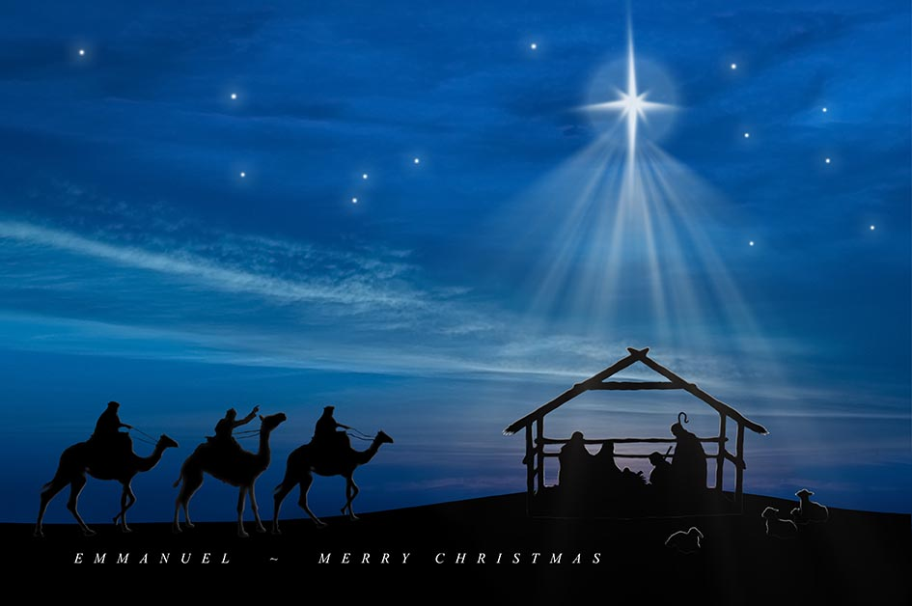
Share It!
What is your favorite Christmas song that is connected to the birth of Jesus?
Sing or say a verse or two.
© mastapiece/Shutterstock.com

Slide 5
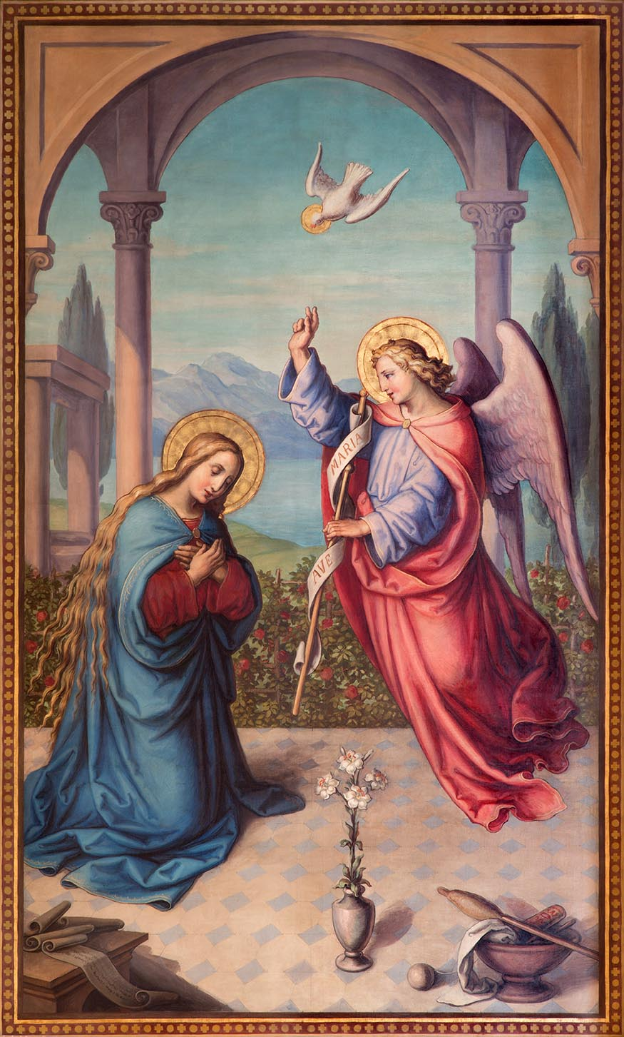
Introduction (Handbook, Pages 130–133)
Annunciation describes the event where God sent the angel Gabriel to ask Mary to become the mother of Jesus.
The Gospel of Luke shows us that God is one with those who seem to be the poorest of people.
The Gospel of Matthew shows us that Jesus is like the great leaders of the Old Testament and is the promised Savior of God.
© Renata Sedmakova / Shutterstock.com

Slide 6
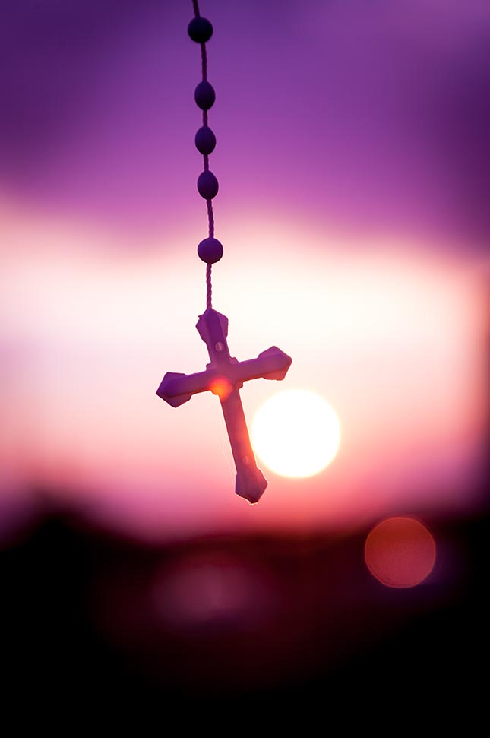
Think About It!
What common prayer or devotion requires us to pray the Hail Mary 53 times?
What other prayers are part of this prayer?
Pray the Hail Mary together right now!
© Gordan/Shutterstock.com

Slide 7
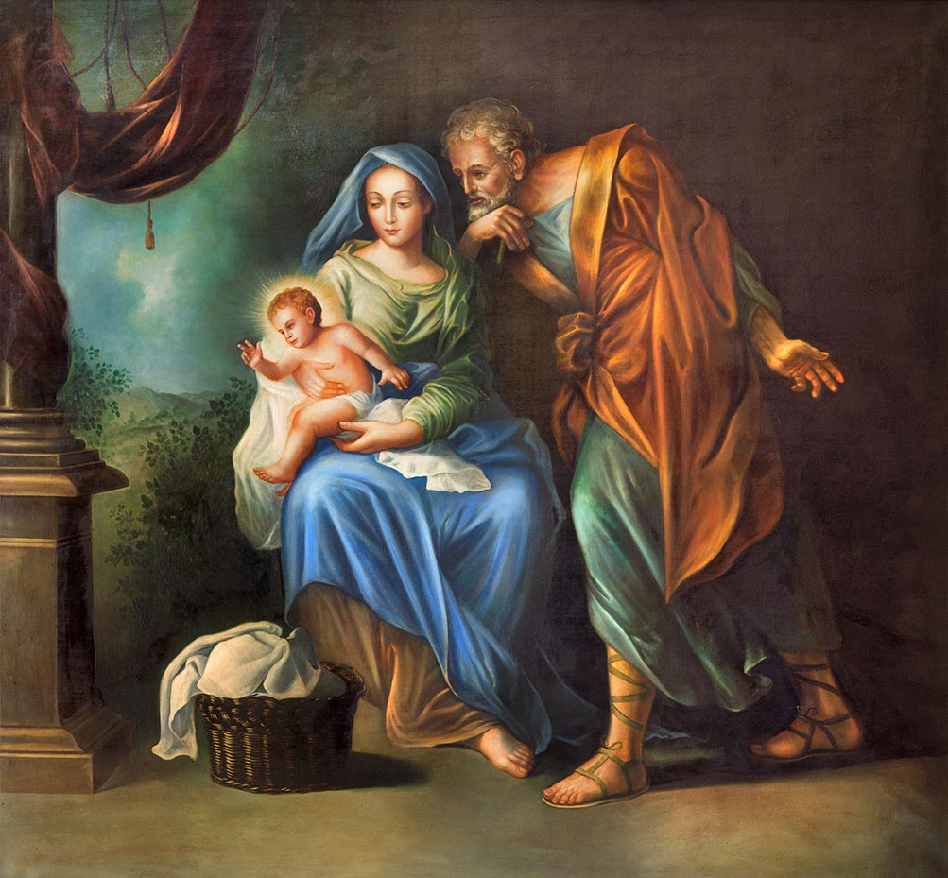
“Mary, the Mother of Jesus” (Handbook, Pages 133–135)
God chose Mary, a human being like us, to be the mother of the Savior.
Mary is called the Mother of God, because Jesus is God and she gave birth to him.
God prepared Mary for her role as the Mother of God by keeping her free from Original Sin from the moment of her conception. We call this truth the Immaculate Conception.
© Renata Sedmakova / Shutterstock.com

Slide 8
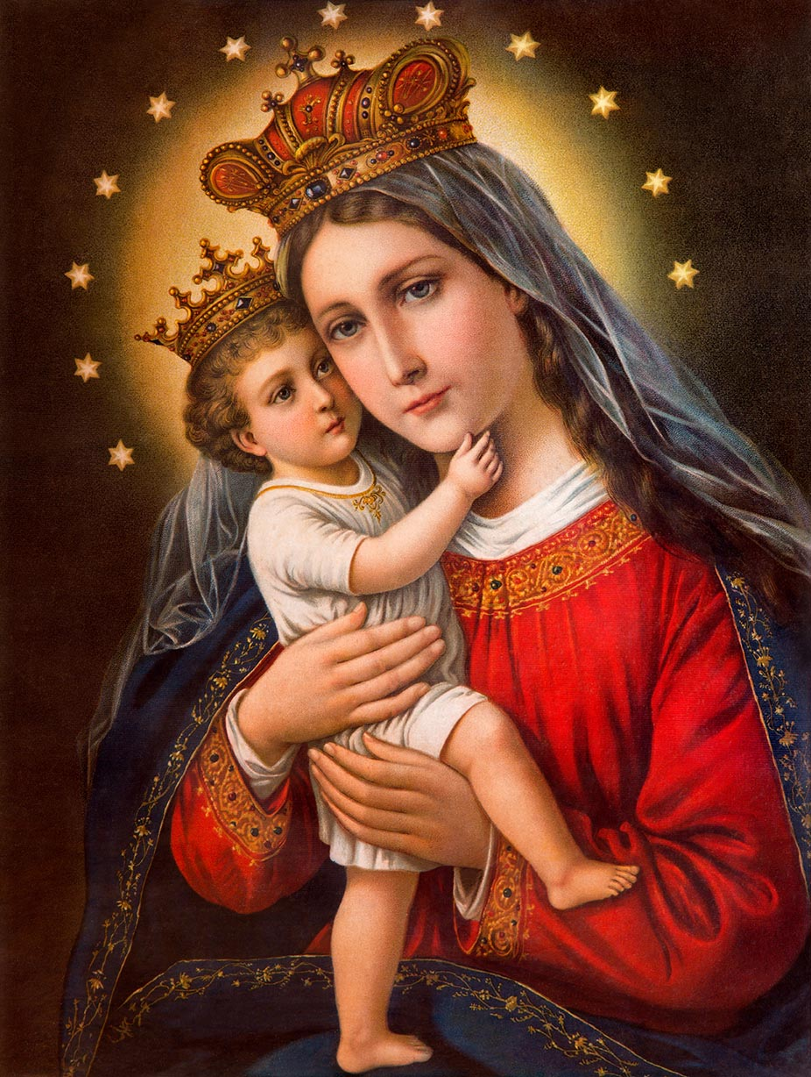
Mother of God
Think-Pair-Share
Think: What do you think the artist of this painting is trying to tell you about Mary? about Jesus? about their relationship?
Pair: Find a partner.
Share: Discuss this painting with your partner and what the artist was saying and what it says to you.
© Renata Sedmakova / Shutterstock.com

Slide 9
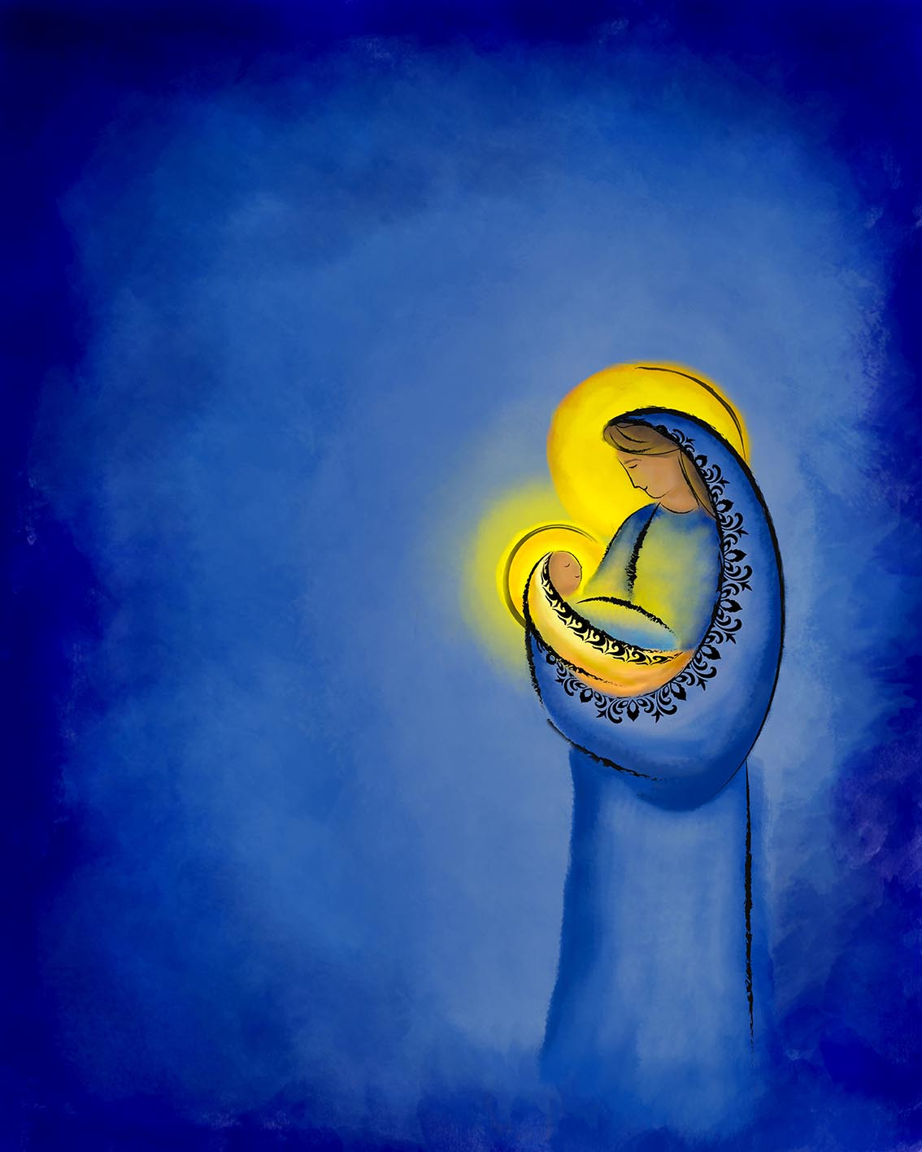
“Mary’s Example” (Handbook, Pages 135–136)
Mary is an example for obeying God and following Jesus Christ.
Mary is the one most closely united with her Son’s saving actions.
© Thoom/Shutterstock.com

Slide 10
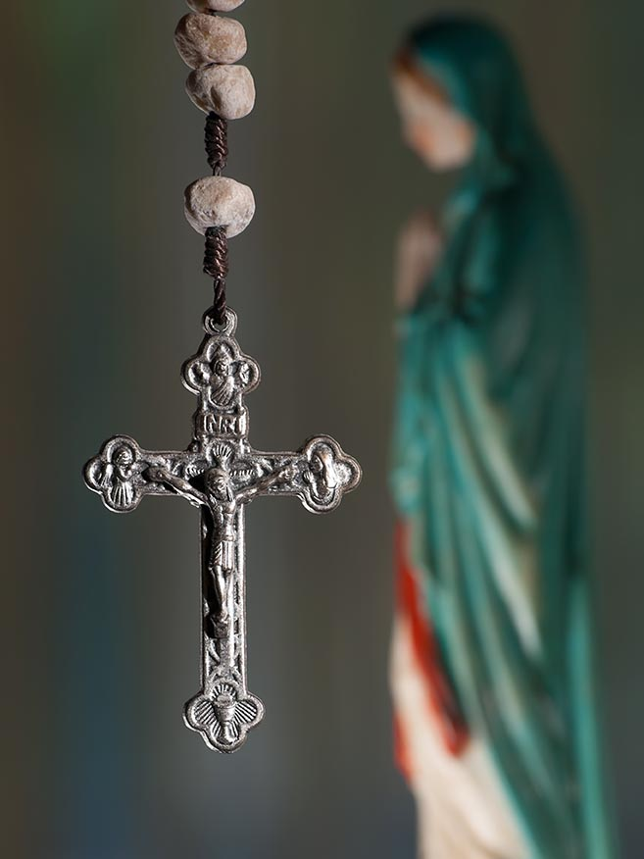
Mary’s Obedience
Through her perfect obedience to God’s plan, Mary helps reverse the effects of Original Sin and our disobedience to God.
She teaches us to be humble and to rely on God.
© Vladimir Koletic / Shutterstock.com

Slide 11
“People of Faith: Saint Nicholas of Myra” (Handbook, Page 137)
Discussion Question:
What does Santa Claus have to do with Jesus or the Catholic faith?
© Milles Studio / Shutterstock.com

Slide 12
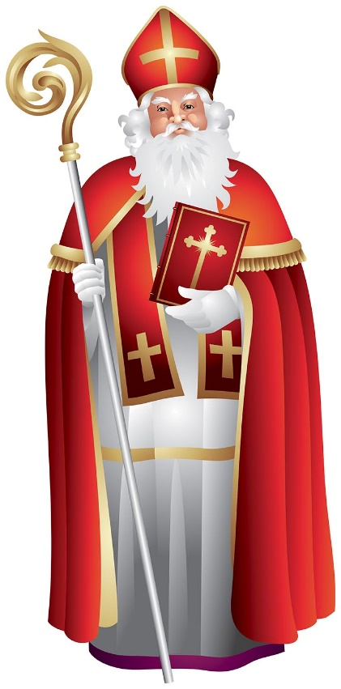
A Generous Saint
Saint Nicholas, sometimes known as Saint Nick, was a fourth-century bishop of Myra, in Asia Minor (present-day Turkey and Greece).
Many stories of Saint Nicholas’ generosity were preserved and passed down over the years.
Stories about his generosity have inspired others over the centuries to give gifts in his name. This is how he became the inspiration for Santa Claus.
© elmm/Shutterstock.com

