Slide 1
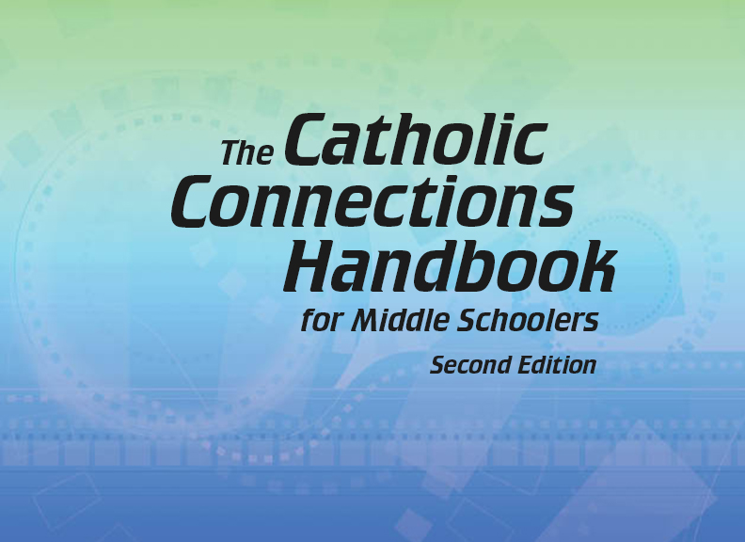


Slide 2
The New Testament
and the Church
Chapter E
The Bible: The Catholic Letters

Slide 3
Chapter Summary
The Bible: The Catholic Letters
This chapter will continue to build upon themes and ideas found in the New Testament letters by exploring the Catholic letters.
These unique letters, named after their senders (not the recipient communities), address the needs of the universal Church.
They explore familiar themes such as persecution, justification, and theological disputes, but on a broader scale and with greater depth.
In reading these letters, we come to better understand the hopes and challenges of the early Christians and see our story in theirs.

Slide 4

“Peter, a Good Shepherd”
(1 Peter 1:13–25, 5:5–7)
Peter calls each to a life of humility and obedience to God.
Despite Peter’s human weaknesses, Jesus chose him to lead the Christian flock.
Peter knew it was hard for Christians to avoid distractions and be obedient to God.
The First Letter of Peter is an open letter to the Church. It encourages the early Christians, and us, to remain strong and be holy in the face of distraction and persecution.
©Bernardo Ramonfaur/www.shutterstock.com

Slide 5

“Peter, a Good Shepherd”
(1 Peter 1:13–25, 5:5–7)
Activity
Read 1 Peter 1:13–16.
Peter calls the Church to not be distracted by our desires, but to be obedient to God.
Based on what we know about Peter, was he able to overcome his distractions?
©AntonioDiaz/www.shutterstock.com

Slide 6
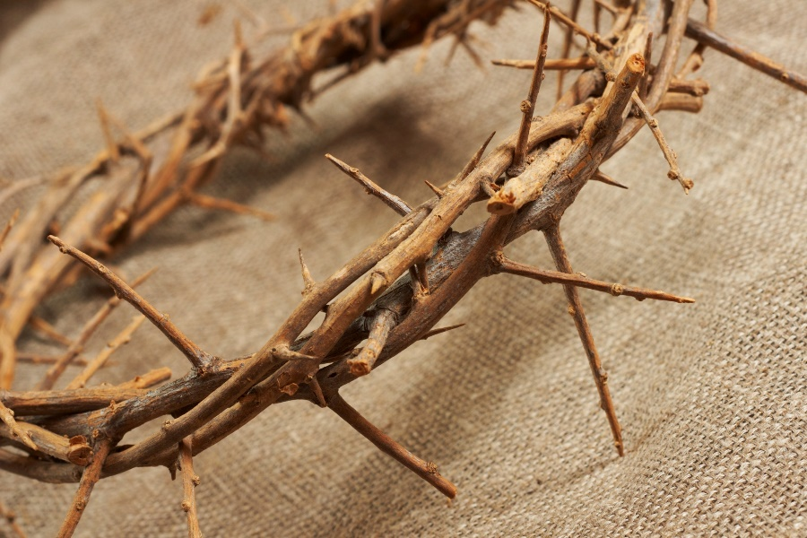
“Strength under Pressure”
(1 Peter 4:12–17, 2 Peter 3:3–9)
Peter encourages Christians to rejoice when they are persecuted, because they share in the suffering of Christ and will know the Day of the Lord, in God’s time.
Jesus told his followers that they should be happy when they are persecuted for their faith, for they will be rewarded with the Kingdom of Heaven.
©Dr. Cloud/www.shutterstock.com

Slide 7

“Strength under Pressure”
(1 Peter 4:12–17, 2 Peter 3:3–9)
The Second Letter of Peter encourages the Church, which faced persecution in many places, to remain strong.
When we suffer as Christians, we should be joyful, because we share in the suffering of Christ.
©Christopher Futcher/www.istockphoto.com
Discussion Question
What personality traits should you strive to have in order to be the kind of positive and joyful person Peter encourages us to be?

Slide 8
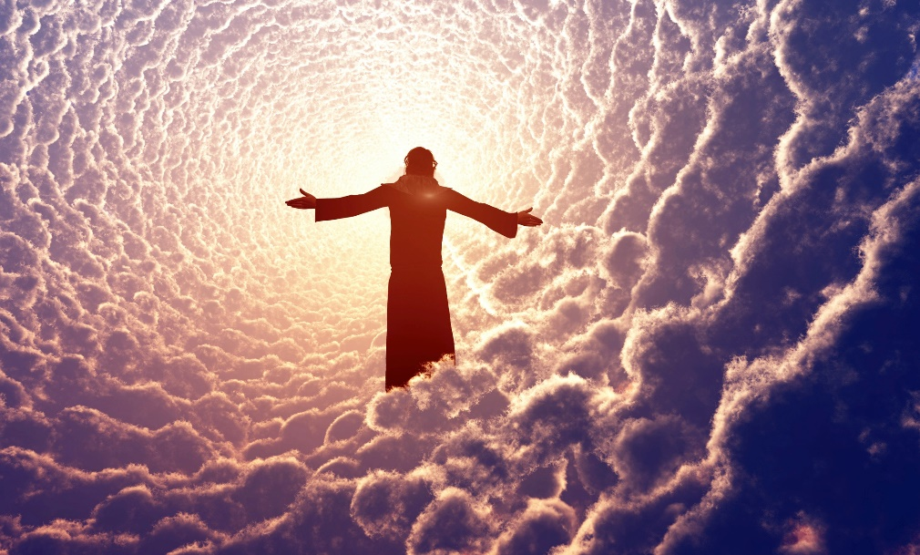
“Great Debate”
(1 John 4:1–6, 3:16–18)
John’s letters insist that
Jesus is both human and God, addressing a dispute that was dividing the Church.
A dispute over whether Jesus is human split John’s faith community.
©1971yes/www.istockphoto.com

Slide 9
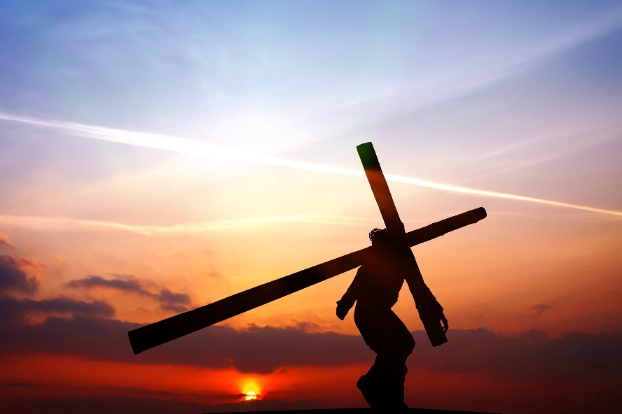
“Great Debate”
(1 John 4:1–6, 3:16–18)
John’s first letter makes clear that Jesus is God who became man and died for our salvation.
Jesus is true God and true man, like humans in all things but sin.
Activity
Read 1 John 4:2–3.
Why is it so important to believe that Jesus is true God and true man?
©WDG Photo/www.shutterstock.com

Slide 10

“Strong Feelings”
(1 John 4:7–21, 2 John 7–11)
John reminds us that God is the source of love. Because God loved us, we must love others. And when we love, we know God.
God is love and is the source of all love.
God loves us and sent his Son, Jesus, to be the means by which our sins are forgiven.
We are called to love one another, and in doing so, we make perfect our knowledge of God.
©Genotar/www.shutterstock.com

Slide 11

“Strong Feelings”
(1 John 4:7–21, 2 John 7–11)
Activity
Read 2 John 4–11.
A large piece of John’s first letter, along with verse 5 of this second letter, reminds us that we are called to love one another. Does the passage we just read surprise you?
It seems there are exceptions to this “love one another” thing. Why do you think the writer shuts the doors to the enemies of Christ, who at one time were his friends?
©Brian A Jackson/www.shutterstock.com

