Slide 1
Paul’s Journeys
The Church
Unit 1
Document #: TX005566

Slide 2
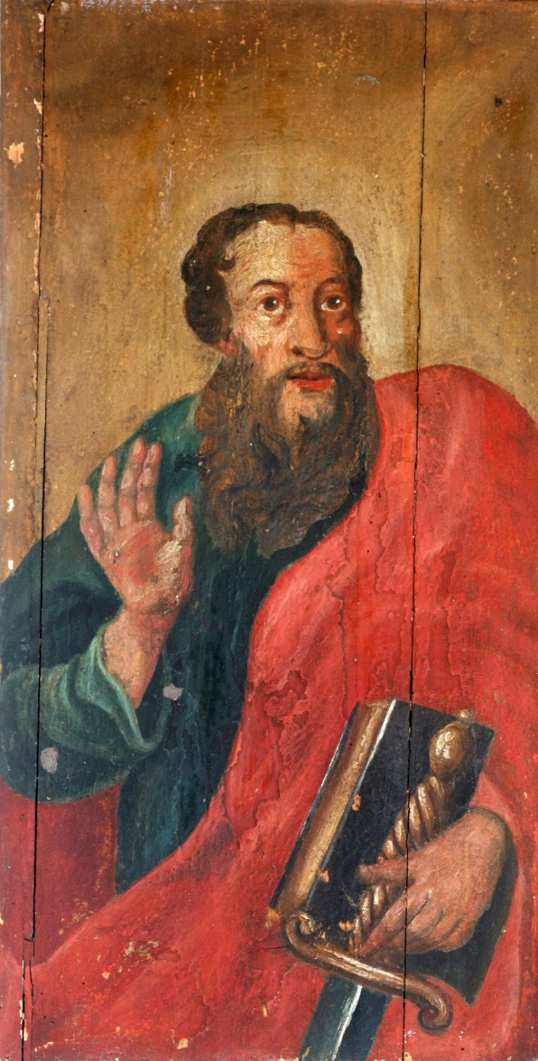
Spreading the Word
Saint Paul made three major missionary journeys throughout the Mediterranean region.
These journeys were largely made on foot or by small coastal boat.
Travel was very dangerous at that time.
©Zvonimir Atletic / Shutterstock.com
Notes:
Notes: Acts of the Apostles 13:1–3

Slide 3
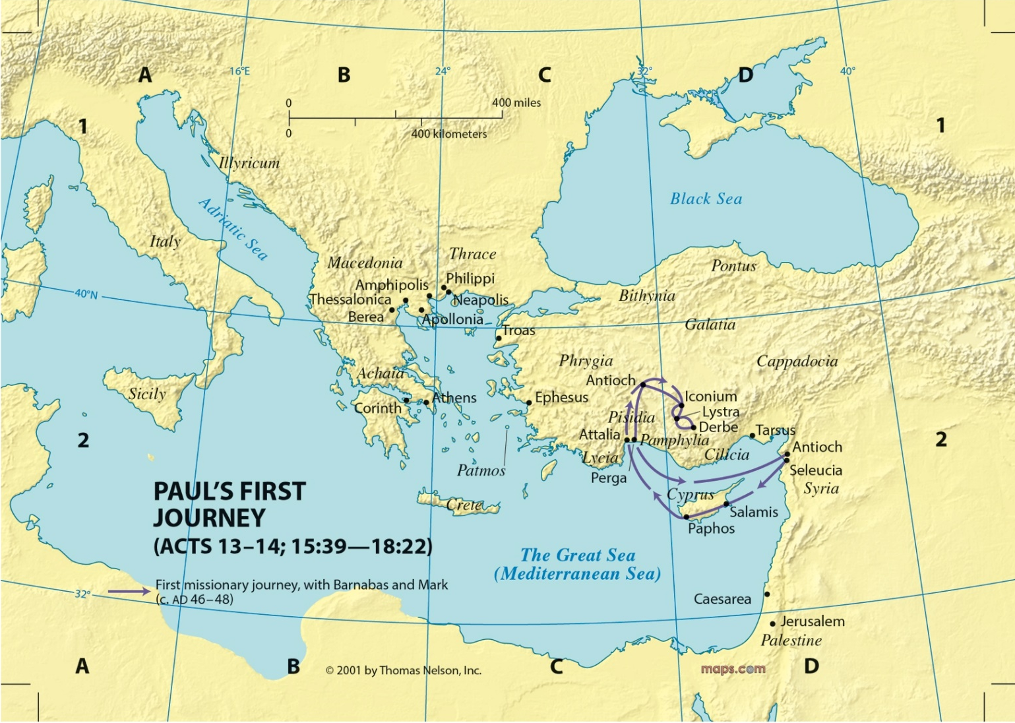
Map of the First Journey
© Saint Mary’s Press

Slide 4
Paul’s First Journey
Paul, Barnabas, and John Mark begin their first journey from Antioch in Syria.
They travel to Cyprus (Barnabas’s home), where Saul begins to use his Gentile name, Paul.
In many places, they meet opposition. They are beaten and stoned, but this does not stop them from preaching the Gospel. They end their journey in Jerusalem.

Slide 5

Map of the Second Journey
© Saint Mary’s Press

Slide 6
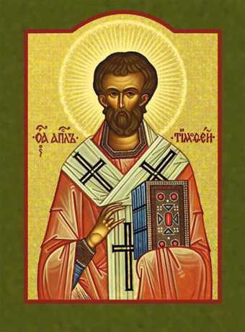
Paul’s Second Journey
In late AD 49, Paul, determined to strengthen the churches in Galatia, sets out with Silas for Tarsus.
In Lystra, Paul meets a young believer named Timothy, who becomes a frequent traveling companion, a fellow missionary, and his closest friend.
Image in Public Domain
Notes:
Notes: Acts of the Apostles 16:1–5; 1 Timothy 1:2

Slide 7
Prison Conversion in Philippi
Paul and Silas are imprisoned for helping a female slave, but escape through the miraculous events of an earthquake.
Thessalonica and Berea
Paul preaches in Thessalonica and moves on to Berea. Because of trouble, he immediately leaves for the coast and sails for Athens. Timothy and Silas remain in Berea.
Notes:
Notes: Acts of the Apostles 16:25–40

Slide 8
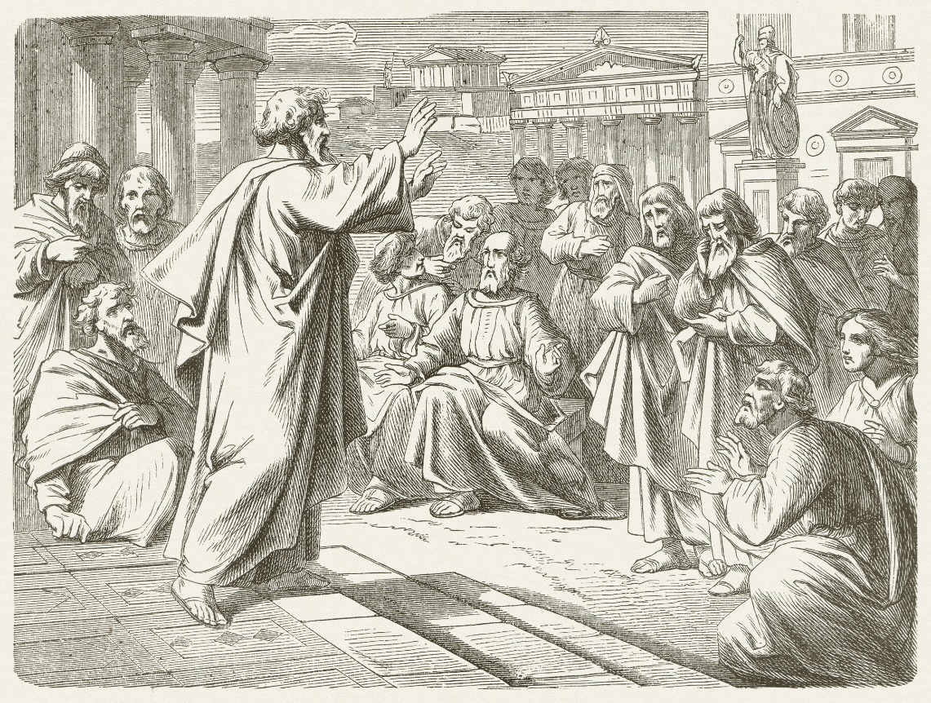
In Athens
In Athens, Paul
writes to Silas and
Timothy, asking
them to come to
Athens, where the
city is full of idols.
Paul’s preaching
leads to an invitation
by the Athenians to elaborate on the Gospel.
© ZU_09 / iStock.com
Notes:
Notes: Acts of the Apostles 17:16,22–34

Slide 9
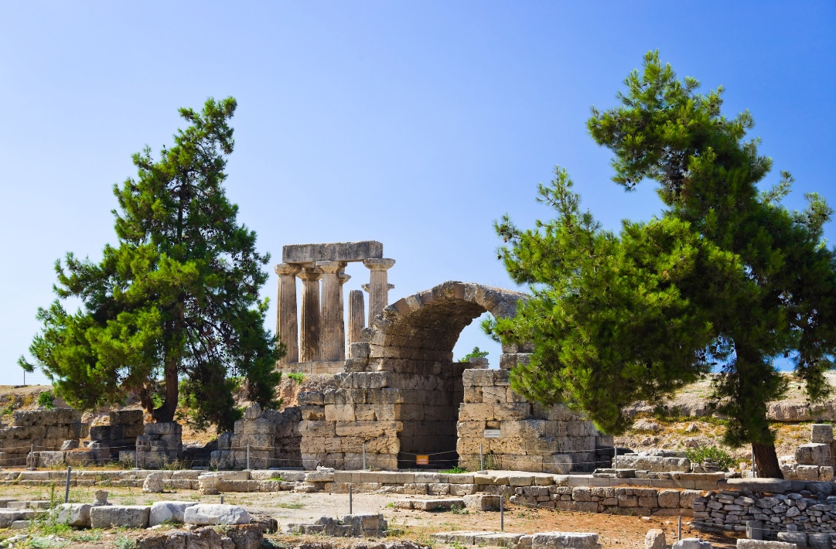
Among the Corinthians
In AD 50 Paul leaves Athens and travels south to Corinth, where he works as a tentmaker with Aquila and Priscilla.
Silas and Timothy
join him in Corinth.
Paul stays there for
a year and a half.
© Tatiana Popova / Shutterstock.com
Notes:
Notes: Acts of the Apostles 18:1–10

Slide 10
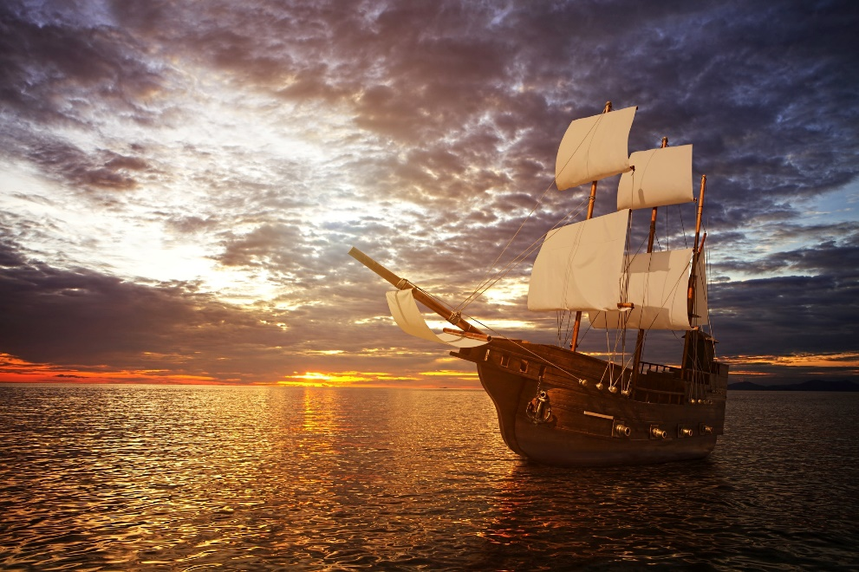
Ephesus to Caesarea
The Jews eventually raise another riot against Paul and bring him before the Roman governor. Paul is set free when the governor refuses to hear the Jews’ accusations.
Paul sails with Priscilla and Aquila to Ephesus.
Paul then sails to Caesarea and on to Antioch.
© zhu difeng / Shutterstock.com
Notes:
Notes: Acts of the Apostles 18:12–16,18–22

Slide 11
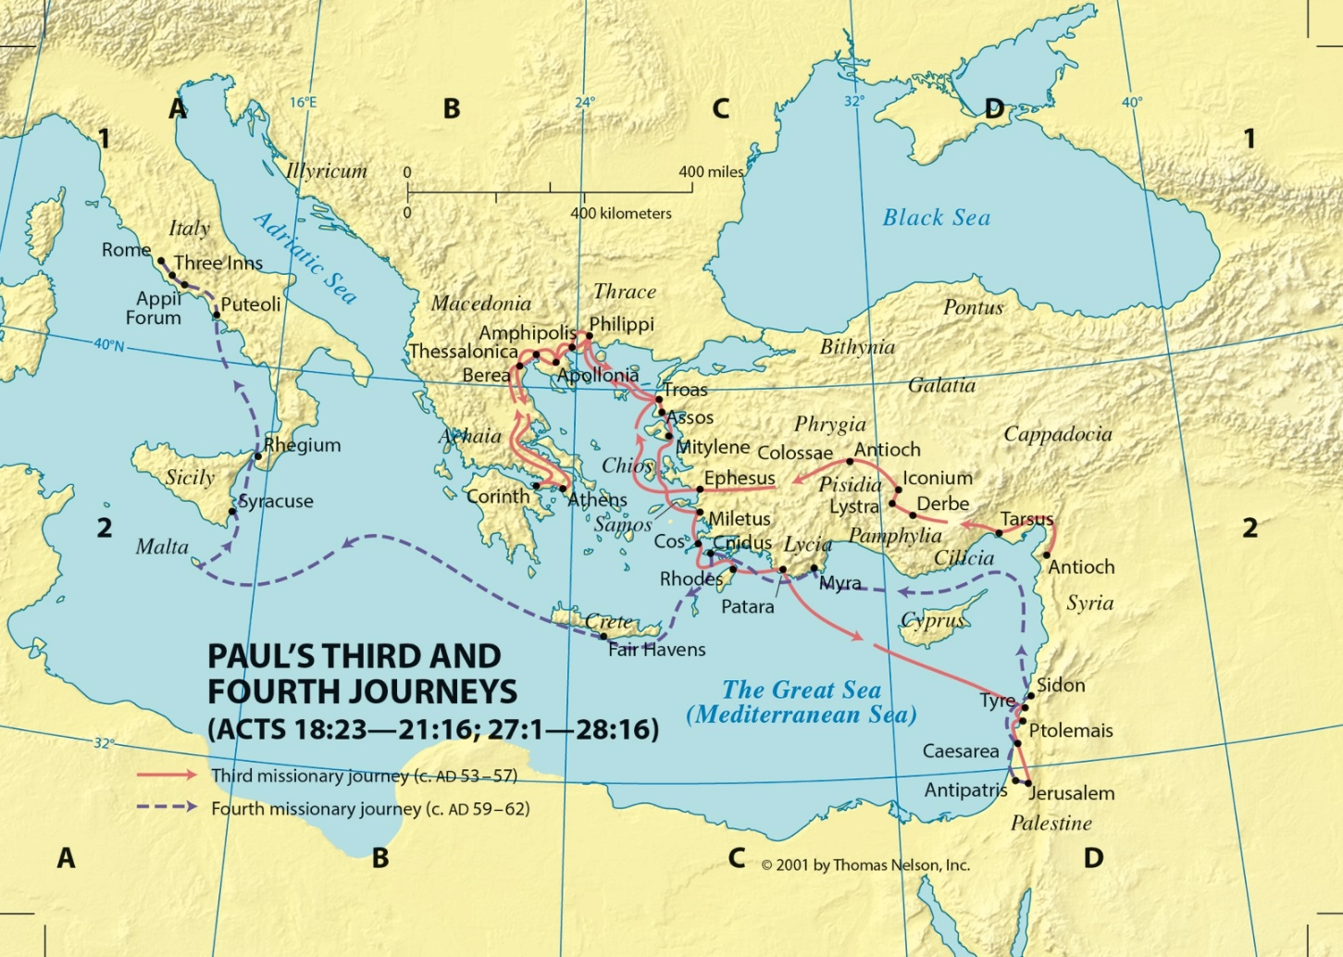
Map of the Third Journey
© Saint Mary’s Press

Slide 12
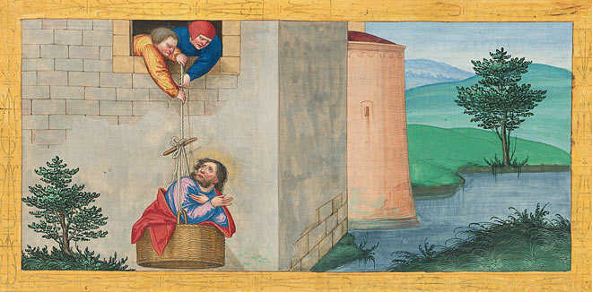
Paul’s Third Journey
Paul and Timothy journeyed through Asia to the fourth largest city in the Empire.
At Ephesus the Lord worked many miracles through Paul. Paul escapes a riot by Ephesian merchants.
Paul then moves to Macedonia, Troas, Mitylene, Melitus, and Caesarea.
Image in public domain
Notes:
Notes: Acts of the Apostles 18:23

Slide 13
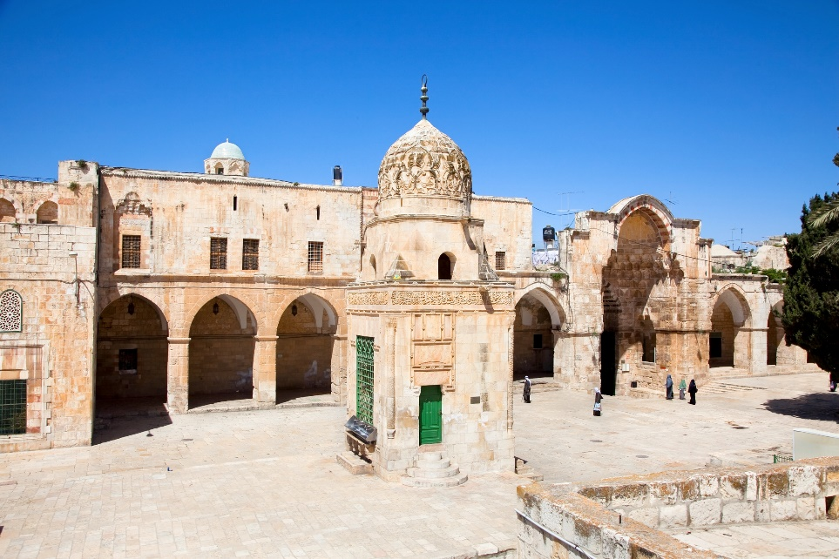
Jerusalem
In Jerusalem, Paul visits James and goes to the Temple with four Jewish converts.
Jews from Asia who hate Paul, believing he has brought Gentiles into the Temple area, cause a riot.
Roman troops hear
of the riot and race to
the scene, saving Paul
from certain death.
©Aleksandar Todorovic / Shutterstock.com
Notes:
Notes: Acts of the Apostles 21:18,23–32

Slide 14
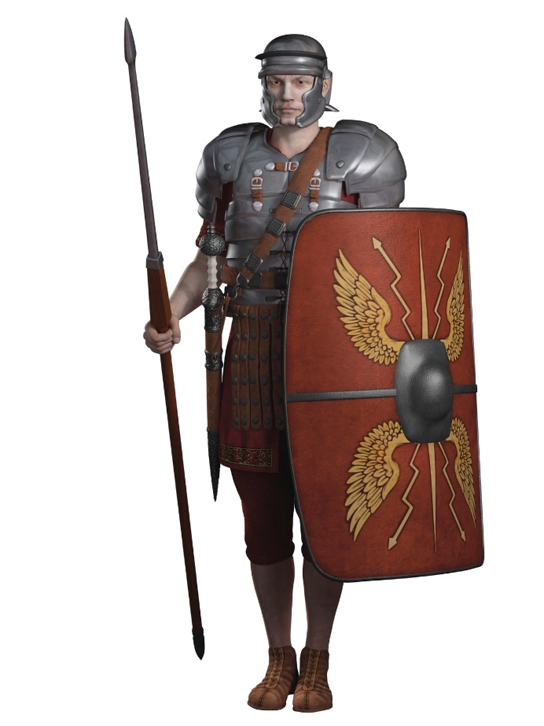
Before the Sanhedrin
The Romans take Paul away and decide to scourge him to find out what crimes he has committed.
Paul is saved from being scourged when he declares that he is a Roman citizen.
Paul is escorted out of the city at night by Roman soldiers so that he won’t be killed.
©Algol / Shutterstock.com
Notes:
Notes: Acts of the Apostles 22:25–29, 23:1–10

Slide 15
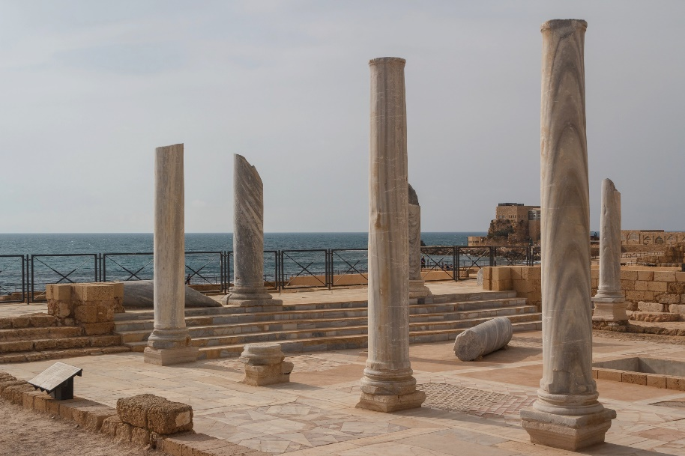
Prisoner in Caesarea
The soldiers take Paul to Caesarea, to the Roman governor of Judea, so that
he can decide Paul’s fate.
Paul is a Roman prisoner
for two years, during which time he defends himself three times.
©Lev Levin / Shutterstock.com
Notes:
Notes: Acts of the Apostles 24:24–27, 25:1–12

Slide 16
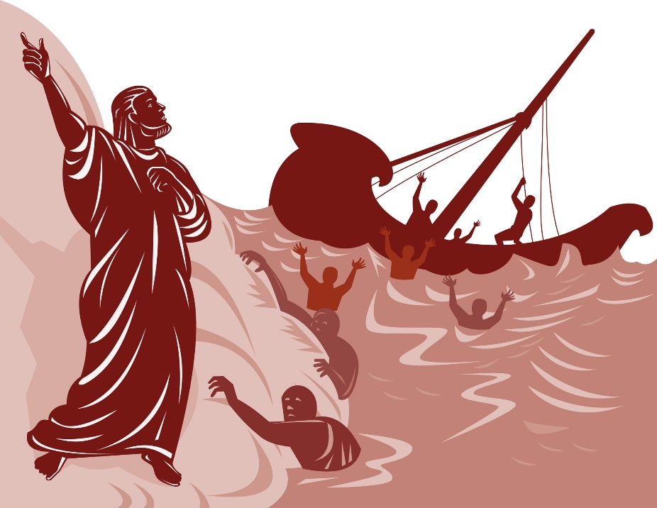
On the Seas
In late AD 60, Paul and other prisoners board a ship for Rome.
The ship encounters a fierce storm and is shipwrecked near the island of Malta.
All those on the ship either swim or grab boards from the wreck and make their way to the island.
©patrimonio designs ltd / Shutterstock.com
Notes:
Notes: Acts of the Apostles 27:1–2,7,9–12

Slide 17
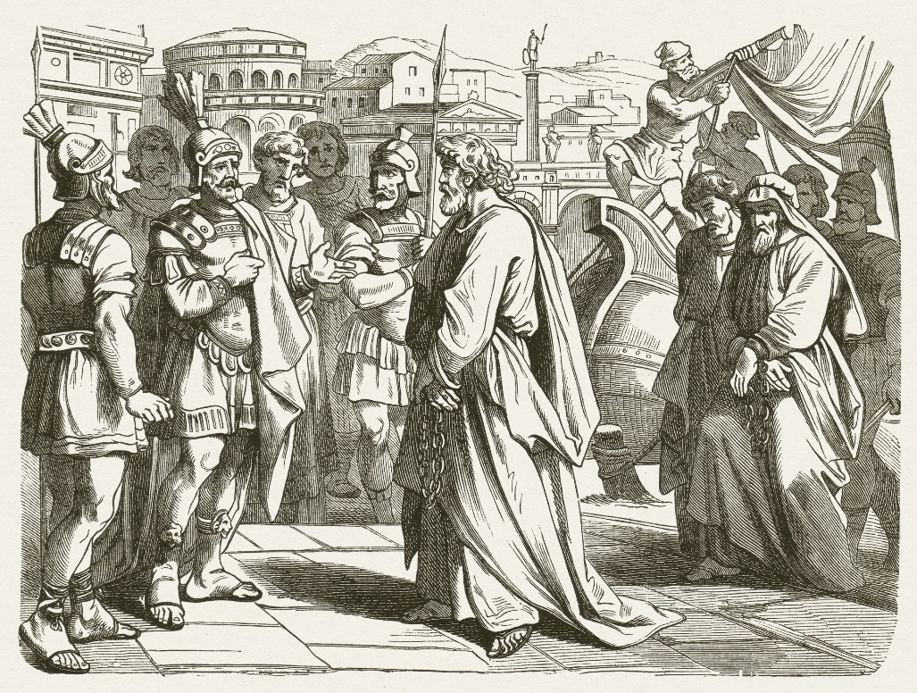
Prisoner in Rome
The group stays on
Malta for three months,
during which time Paul
works miracles with the
sick.
Paul is then delivered
to the captain of the
guard in Rome and
allowed to live by himself, guarded only by a soldier.
For two years Paul is able to receive visitors and continue his preaching of the Gospel.
© ZU_09 / iStock.com
Notes:
Notes: Acts of the Apostles 28:16,23–31

Slide 18
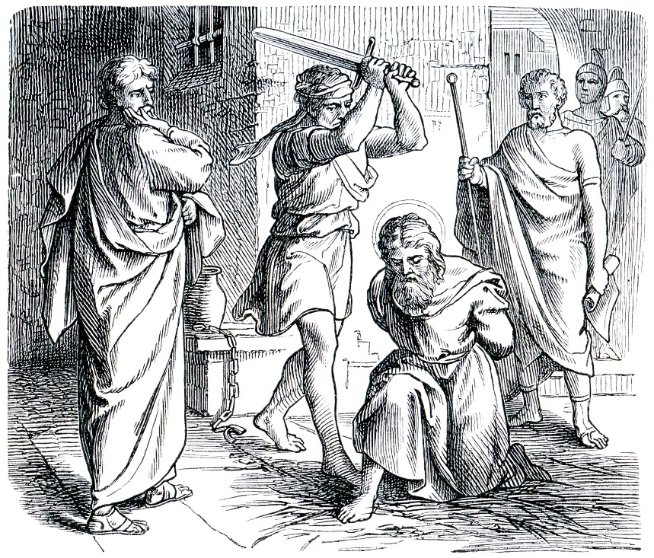
A Martyr’s Death in Rome
Paul is released from prison in AD 63, but then is imprisoned, once again, in Rome after some time.
Paul writes a letter to his friend Timothy. It is Paul’s last writing before he dies a martyr’s death around the middle of AD 68.
According to Christian tradition, Paul was beheaded in Rome.
©Sergey Kohl / Shutterstock.com
Notes:
Notes: Romans 15:28; Titus 1:5, 3:12

