Slide 1



Slide 2
The New Testament
and the Church
Chapter 21
The Bible: The Letters

Slide 3
Chapter Summary The Bible: The Letters
This chapter will explore the growth and challenges of the early Church through the New Testament letters.
These twenty-one letters provide helpful insights about the problems the Church faced and how it grew and developed.
In reading the advice and encouragement of Saint Paul and other writers, we discover guidance as we try to live as Christians today.

Slide 4

Introduction (Handbook, pages 222–223)
The New Testament letters provided important guidance to the early Christian communities.
Letters sent via messengers
were the only way to
communicate over long
distances when the Church
was young.
© IPGGutenbergUKLtd/www.istockphoto.com

Slide 5

Introduction (Handbook, pages 222–223)
Saint Paul and other leaders used letters to deal with problems in the communities of faith they founded.
These leaders’ letters are an important part of the New Testament, and their wisdom has meaning even for today’s Church.
© Vadim Sadovski/www.shutterstock.com

Slide 6

Introduction (Handbook, pages 222–223)
Questions from the Reading
Name two main ways early Church leaders traveled to spread the faith.
How did early Church leaders communicate with distant communities?
In what part of the Bible do we find these early communications?
© kaarsten/www.shutterstock.com

Slide 7

“Understanding the New Testament Letters” (Handbook, pages 224–225)
Let’s begin class by reciting this prayer out loud together:
Dear God:
It’s me, (Name).
I’m okay, though I’m never quite sure what to expect from you during this class.
Please help our class to be open to whatever comes, trusting that it will bring us closer to you.
I love you, I thank you, and I praise you.
Your Friend,
(Name)
© pastorscott/www.istockphoto.com

Slide 8
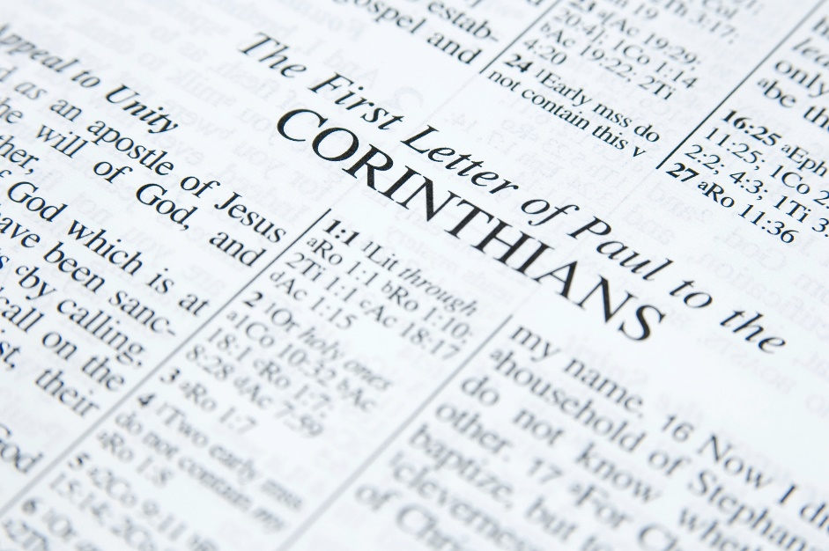
“Understanding the New Testament Letters” (Handbook, pages 224–225)
The twenty-one letters can help us to live as Christians today.
Most of the twenty-one New Testament letters begin with a greeting, continue with a message addressing the writer’s concerns, and end with personal messages and a blessing.
© Fadyukhin/www.istockphoto.com

Slide 9

“Understanding the New Testament Letters” (Handbook, pages 224–225)
We must often make educated guesses about the concerns to which the New Testament responds.
The values found in the New Testament letters help us to live as Christians today.
© nautilus_shell_studios/www.istockphoto.com

Slide 10

“Themes in the Letters of Saint Paul” (Handbook, pages 225–228)
Saint Paul addressed many concerns that confused and divided early Christian communities, including his important teaching that God’s plan of salvation is for all people.
Saint Paul’s letters
emphasize the importance
of Jesus’ death on the cross
because through it our
sins were forgiven.
© enter89/www.istockphoto.com

Slide 11
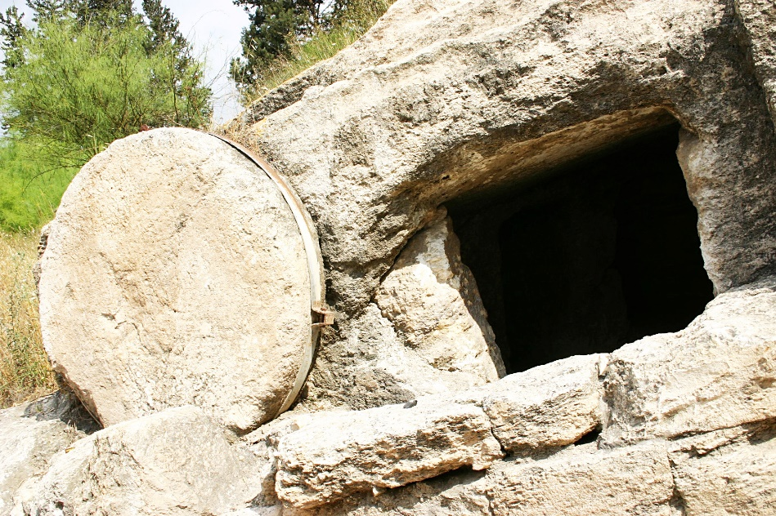
“Themes in the Letters of Saint Paul” (Handbook, pages 225–228)
Paul’s letters also emphasized that everyone who believes in Christ will be raised —body and soul— to new life.
Paul’s letters teach that
Jesus came to save all people,
Jews and Gentiles alike.
Discussion Question
What spiritual concern or question today would cause you to ask your community’s founder for advice?
© doulos/www.istockphoto.com

Slide 12

“Themes in the Other Letters” (Handbook, pages 229–231)
Writers of the New Testament letters guided early Christians through many misunderstandings and conflicts, focusing on the importance of love. These messages were and continue to be transformational.
© gunnar3000/www.istockphoto.com
The letter writers of the New Testament helped the early Christians understand and respond to challenges within and beyond their faith communities.

Slide 13

“Themes in the Other Letters” (Handbook, pages 229–231)
The letters of Peter, James, and John helped Christians make sense of diverse topics such as suffering, integrity, and love.
The New Testament
letters tell people of every
time and culture how
to live as Christians.
© stuartmiles99/www.istockphoto.com

Slide 14

“Themes in the Other Letters” (Handbook, pages 229–231)
Activity
What are the opposites of these three words?
1. Darkness
2. Hate
3. Christian
Find and read 1 John 2:9–11 in your Bible. What does the writer connect “hate” to? What does the writer connect “love” to?
© PushishDonhongsa/www.istockphoto.com

