Slide 1
Ignatian Gospel Meditation
The Paschal Mystery
Unit 5, Chapter 11
Document #: TX005801
Notes:
Notes: Use this PowerPoint to guide your students in practicing Ignatian Gospel meditation (as described in article 46 of the student book). Each student will need a Bible, or a copy of the passage. This presentation uses Luke 2:1­–20. The notes on each slide offer more general prompts and questions for each step if you would like to allow each student to use a Gospel passage of her or his choosing instead.

Slide 2
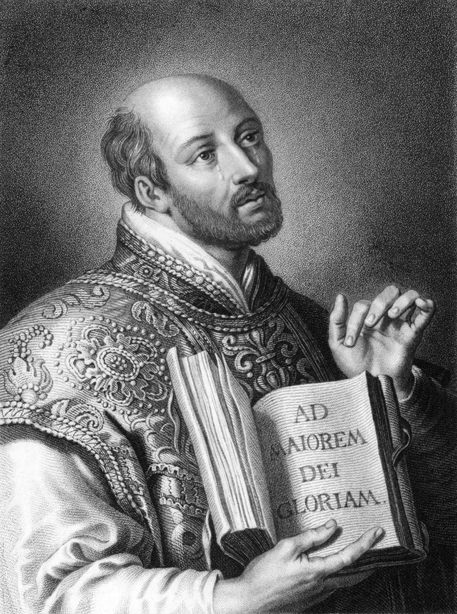
Saint Ignatius Loyola discovered that using your imagination to put yourself in a Gospel story can be a powerful method of prayer. Let’s try it!
Use Your Imagination!
© Georgios Kollidas / Shutterstock.com

Slide 3
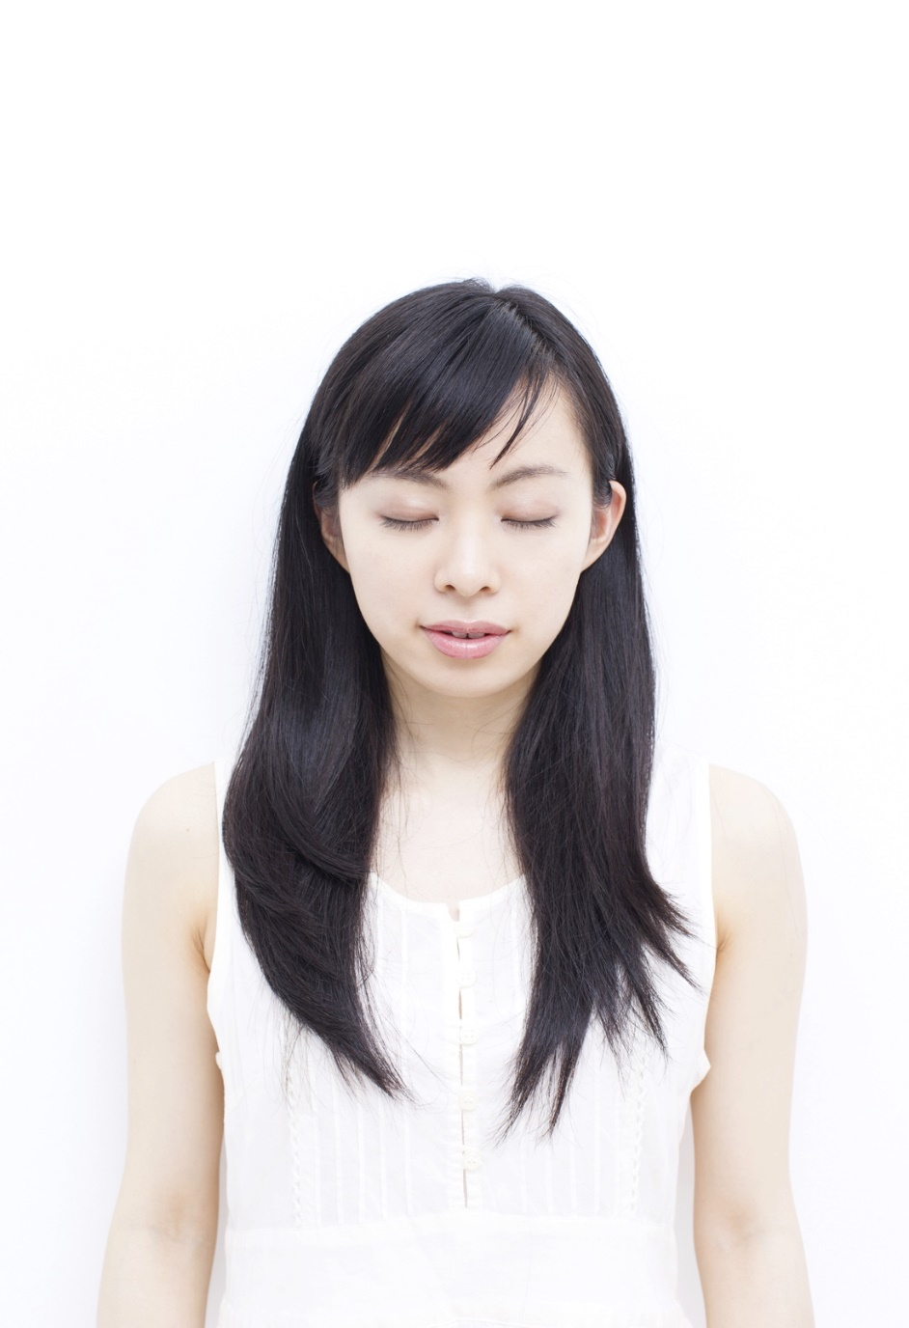
Step 1: Prepare
Open your Bible to Luke 2:1­–20.
Find a comfortable position.
Take time to become silent.
© violetblue / Shutterstock.com
Notes:
Notes: Create a prayerful atmosphere in the classroom, possibly by dimming the lights (but keep enough light on for the students to read). Encourage the students to sit comfortably, in their chairs or on the floor, as long as they will be able to listen and read. Allow them time to settle in and become silent, externally and internally. Consider saying something like, “Let go of everything you’re planning to do, everything you’re worried about, everything you’re excited about—all your thoughts,” to help the students quiet their minds.

Slide 4
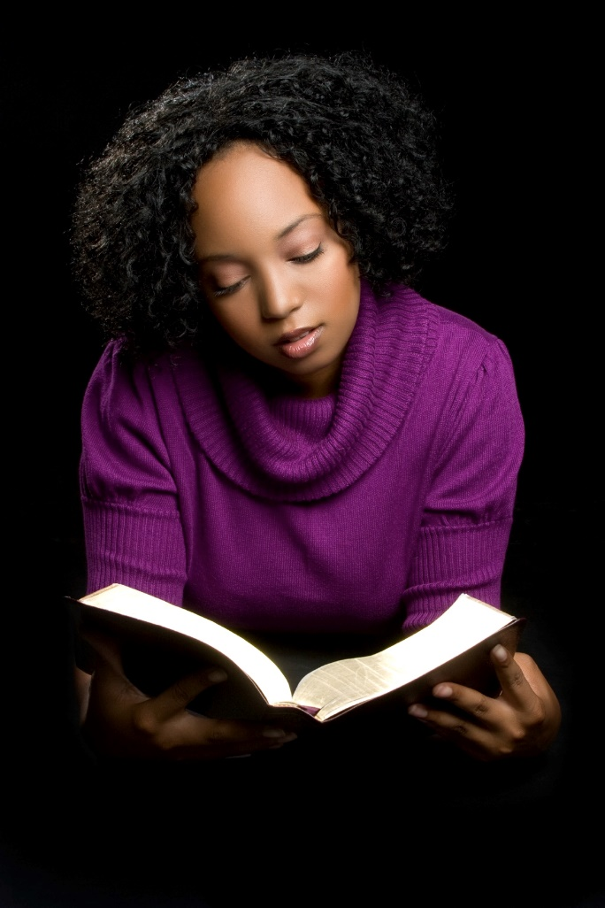
Step 2: Read . . . and Read Again
What did Joseph and Mary feel as they traveled?
What was the stable like?
What was it like for Mary to place her baby in a feed trough?
What did Mary and Joseph think of the shepherds?
What did the shepherds say to each other as they returned to the fields?
© Jason Stitt / Shutterstock.com
Notes:
Notes: Allow time for the students to read the passage at least twice during this step. After a few minutes (when most students have finished reading it once), read the questions aloud and offer sample answers if needed, based on your knowledge of your students. For example, “Were Joseph and Mary excited on the journey? Worried? Was the stable warm or cold, dry or damp?”
If you allowed the students to choose their own passages to meditate on, direct them to begin by looking for details such as the action and plot of the story, the characters’ reactions to it (whether stated explicitly or not), and the environment in which it takes place.

Slide 5
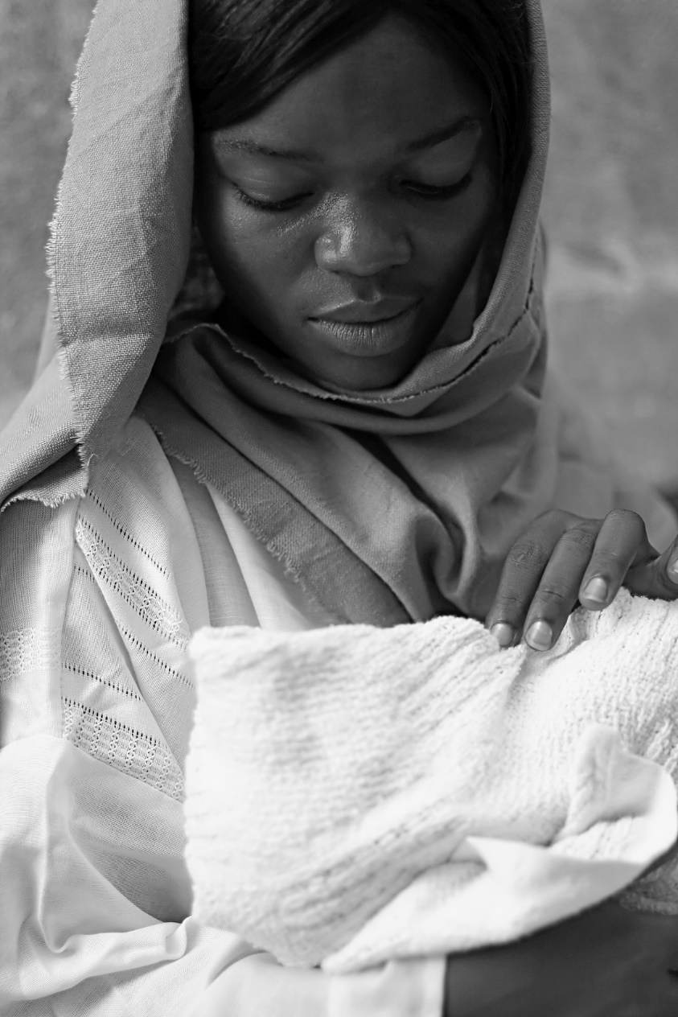
Step 3: Enter the Story
As one of the characters, or as yourself, what do you notice? think? feel? say?
© MissHibiscus / iStock
Notes:
Notes: Encourage the students to reread the story during this step if they need to prompt their imagination. Consider offering these or similar examples of what each character—or a student in the story—might ponder:
Mary: How did you make the stable ready before you gave birth? As you look at the baby in your arms and remember what the angel told you, what are you thinking? What are you feeling?
Joseph: How do you react to these shepherds coming in, saying angels told them to come see your baby? How do you take care of Mary and Jesus?
Shepherd: What do you think of the angels’ message? What are you thinking as you look at the newborn baby? Maybe you kneel next to Mary to see Jesus better, or you ask if you can hold him.
Student: What do you want to say to Mary and Joseph? How did the shepherds describe the angels and their message? What does the newborn Messiah look like?
If the students are all meditating on different passages, you might prompt them with questions such as, “Who is closest to you in the scene? What do they say or do? How do you respond?”

Slide 6
Step 4: Reflect
What are you thinking?
What are you feeling?
© fatihhoca / iStock
Notes:
Notes: Encourage the students to simply notice what they are thinking and feeling about (and in) the scene. They don’t have to try to think or feel certain things, or feel bad about their instinctive reactions to what happens in the scene. If needed to maintain a prayerful atmosphere, ask the students to close their eyes during this step.

Slide 7
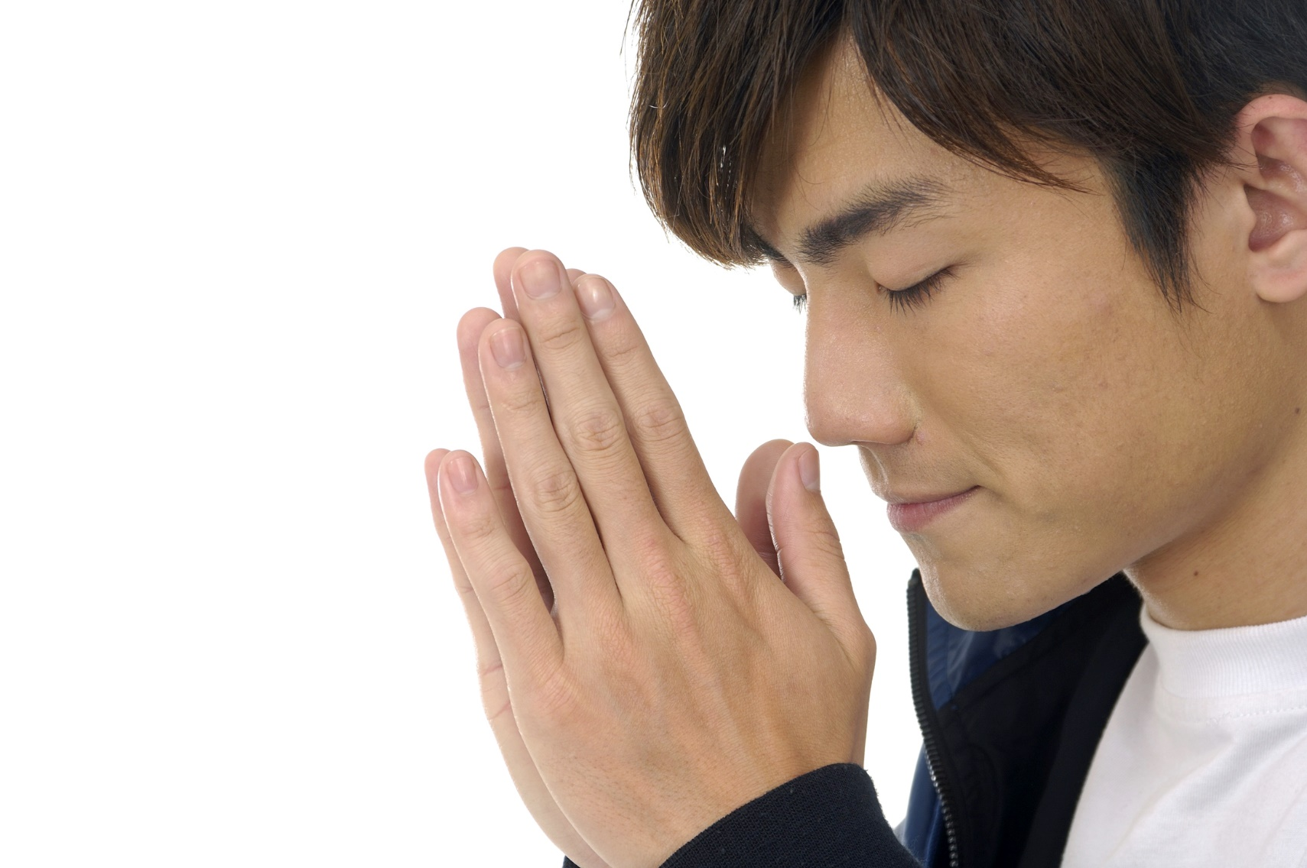
Step 5: Respond
Talk to Jesus
Listen
© East / Shutterstock.com
Notes:
Notes: Encourage the students to reach out to Jesus in praise, thanksgiving, asking a question, etc., in relation to the Bible passage and/or their thoughts during the meditation. Allow a few minutes for these silent prayers, and then encourage the students to quiet their minds and simply listen for what Jesus wants to tell them. Remind them that since prayer is ultimately a relationship, it is important to allow God time to speak to us.

Slide 8
Reflecting Together
What do you want to remember from your meditation?
What did you learn or hear from God that might help others grow in their faith too?
© Aldo Murillo / iStock
Notes:
Notes: If the students have been keeping journals, have them jot down a few thoughts from their experience, including, for example, the passage they meditated on, the most powerful moment of the experience for them, the character they imagined themselves to be, or what they felt Jesus saying to them. Depending on your students’ level of comfort with one another, you may want to ask them to share some of their experience aloud, either before or after journaling.

Slide 9
Apocalyptic Literature
Descriptions of the end times
Prophecies of catastrophic upheavals on earth
Promises of a New Creation
Notes:
Notes: Ask the students for examples: Revelation and parts of Daniel and Ezekiel. Remind them that apocalyptic literature does not literally predict what will happen at the end of time (nor does it promise a rapture of believers). Instead, it offers hope and expresses belief in God’s justice and his victory over evil.

Slide 10
Gospels
Accounts of real events and teachings from Jesus’ life
Give deeper insight into the meaning of his life and mission
Notes:
Notes: Ask the students to name the four Gospels; hopefully they can all do this together! Consider discussing some of the differences between the synoptic Gospels of Matthew, Mark, and Luke, and the Gospel of John, and conclude by observing that even though all four Gospels don’t have the same details, they all tell us the truth about Jesus as the Son of God and Savior of the world.

