Slide 1
Defining Justice
Catholic Social Teaching
Document #: TX001966
Notes:
Intended Use: The instructor will present the PowerPoint and students will take notes.

Slide 2

Justice is a concept that has many definitions. The definitions in this presentation all have their roots in biblical justice.
Image in shutterstock

Slide 3

Scriptural Justice
According to Scripture, a just or righteous person is first in right relationship with God and second in right relationship with other human beings.
Image in shutterstock

Slide 4
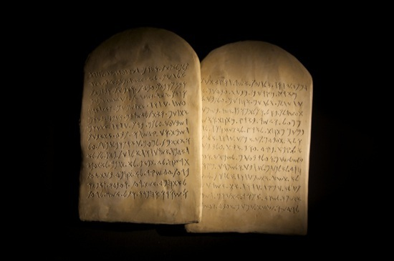
Image in shutterstock
Old Law
In the Old Testament, justice is primarily about treating members of one’s own community fairly and equally.

Slide 5

New Law
In the New Law of Christ, justice means “extending God’s compassion, forgiveness, and mercy to all people, even when that means sacrificing one’s own comfort and material wealth.”
Image in shutterstock

Slide 6
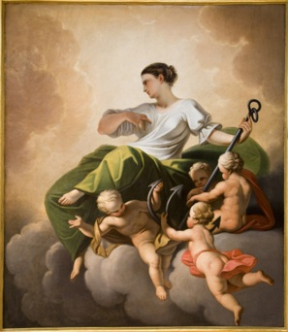
The Four Cardinal Virtues
Image in shutterstock
The four cardinal virtues―prudence, justice, temperance, and fortitude―play a pivotal role in our moral life.
All other human virtues can be grouped around the cardinal virtues.
As we develop the cardinal virtues in our lives, we become persons of moral character—meaning we will do the right thing, even under difficult circumstances.

Slide 7
Justice as a Cardinal Virtue
As a cardinal virtue, justice is the virtue concerned with the rights and duties within relationships and societies.
Image in shutterstock
Justice guides us in giving both God and neighbor what is their due and in working for the common good.
Justice takes into account the needs of others as much as our own needs.
Justice is about more than simple fairness; it asks us to bring God’s compassionate and merciful love to those who are most in need.

Slide 8
Justice as a Cardinal Virtue
Image in shutterstock
The virtue of justice recognizes that some people have greater physical and spiritual needs than others and require a greater sharing of material goods and spiritual support.
It takes determination and dedication to be a person who lives the virtues of justice.

Slide 9

Commutative Justice
Commutative justice is the fairness that should exist when exchanging goods and services among individuals and institutions.
It requires that both parties receive exactly what they agreed to; in this way the human dignity of everyone involved in the exchange is protected.
Image in shutterstock
It is the most fundamental form of justice in societies; without it all other forms of justice are impossible.

Slide 10
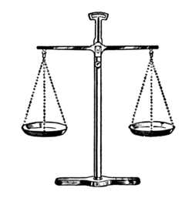
Legal Justice
Legal justice is concerned with the responsibilities that individuals have to society.
It is called “legal” justice because these responsibilities are usually spelled out in laws or other legal documents.
Our country and community organizations cannot fulfill their responsibilities unless we fulfill our obligations to society.

Slide 11
Distributive Justice
In 1986, the U.S. Catholic bishops provided this explanation of distributive justice in Economic Justice for All:
“Distributive justice requires that the allocation of income, wealth, and power in society be evaluated in light of its effects on persons whose basic material needs are unmet” (70).

Slide 12
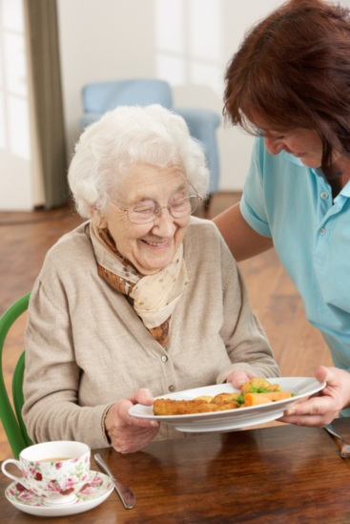
Distributive Justice
• Distributive justice is concerned with the responsibilities that society has to its members.
• It is called “distributive” because it calls for the just distribution of the earth’s resources to all people.
Image in shutterstock

Slide 13
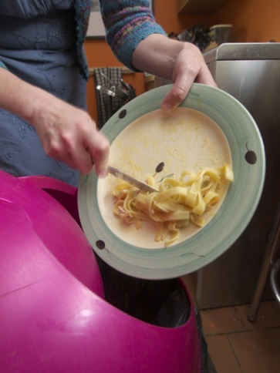
Distributive Justice
Thus the principle of distributive justice means, for example, that it is a social sin for people to go hungry in a country that can produce enough food for all its citizens.
Image in shutterstock

Slide 14

Social Justice
The Catechism of the Catholic Church states:
“Society ensures social justice when it provides the conditions that allow associations or individuals to obtain what is their due, according to their nature and their vocation. Social justice is linked to the common good and the exercise of authority” (1928).
Image in shutterstock

Slide 15


Image in shutterstock
Social Justice
The primary responsibility for social justice rests with the social institutions that make up society—governments, businesses, and other civic organizations.
But it is individuals who make the decisions that determine the policies and practices of these organizations. They are the leaders, or authorities, of these institutions.

Slide 16
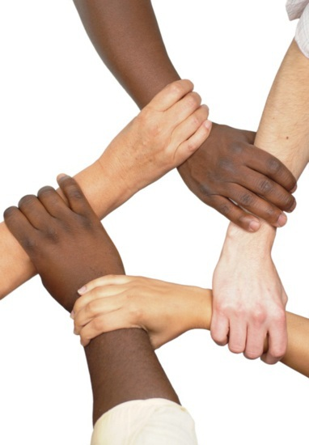
Social Justice
The Catechism says that social justice is linked to the exercise of authority or leadership.
In the United States and many other democratic countries, citizens have a say in the country’s decisions and policies.
Therefore we all share some responsibility for ensuring social justice.
Image in shutterstock

Slide 17
Image in shutterstock
Social Justice
Thus the principle of social justice applies to all of God’s people.
Notes:
(USCCB documents cited in this presentation are from the United States Conference of Catholic Bishops, and available at www.usccb.org. Copyright © USCCB, Washington, D.C. All rights reserved. No part of this work may be reproduced or transmitted in any form or by any means, electronic or mechanical, including photocopying, recording, or by any information storage and retrieval system, without permission in writing from the copyright owner.
The quotation from the Catechism of the Catholic Church is from the English translation of the Catechism of the Catholic Church for use in the United States of America, second edition, number 1928. Copyright © 1994 by the United States Catholic Conference, Inc.—Libreria Editrice Vaticana. English translation of the Catechism of the Catholic Church: Modifications from the Editio Typica copyright © 1997 by the United States Catholic Conference, Inc.—Libreria Editrice Vaticana.)

