Slide 1
Matthew’s Christology
The New Testament
Document #: TX002253
Notes:
Notes: The author of the Gospel of Matthew was most likely a Jewish Christian writing for Jewish Christians. The author wanted to demonstrate that one could be both a disciple of Christ and a faithful Jew, showing that Jesus was the fulfillment of God’s Covenant to the people of Israel. At the same time, the author of Matthew’s Gospel was trying to help the Jewish Christians recognize that Gentiles could also be faithful disciples of Jesus Christ.

Slide 2
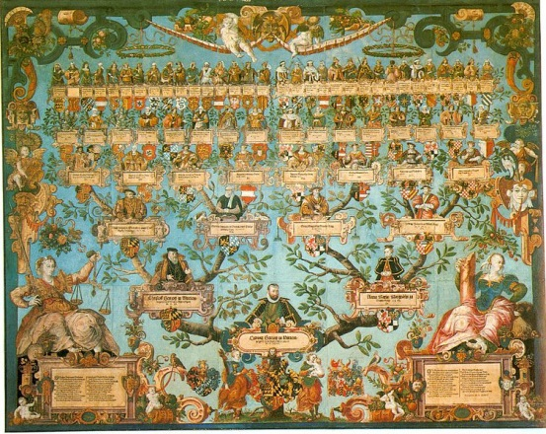
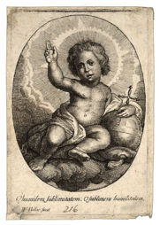
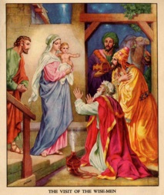
Infancy Narrative: Matthew 1:1—2:23
What did you learn about Matthew’s infancy narrative from the student book article and from reading Matthew 1:1—2:23?
Notes:
Notes: The Gospels of Matthew and Luke both begin with an infancy narrative. An infancy narrative is simply an account of Jesus’ birth and early life.
Direct the students to discuss with their small groups the following question: What did you learn about Matthew’s infancy narrative from the student book article and from reading Matthew 1:1—2:23? Tell them to list at least three responses from their conversation. Allow 2 to 3 minutes for the students to work in pairs. After the allotted time, invite the pairs to share their responses with the large group. The following slides are meant to reinforce what the students have shared, as well as cover any material that was not mentioned.

Slide 3
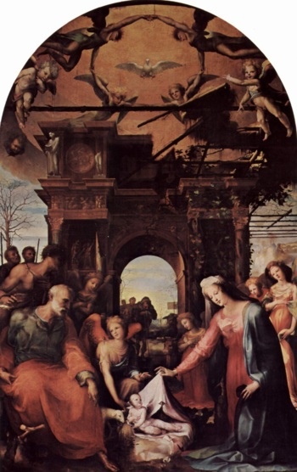
Infancy Narrative Structure
Notes:
Notes: Matthew’s infancy narrative is meant to set up the reader to understand how Jesus is truly the New Moses, who fulfills God’s promise to the people of Israel. The infancy narrative is meant to help us understand Jesus’ birth in light of his Resurrection. The following slides help to parse aspects of Matthew’s infancy narrative and how the narrative helps to establish Jesus as the New Moses.

Slide 4
Genealogy of Jesus (1:1–17)
Notes:
Notes: The author of Matthew draws a direct link between Jesus and Abraham (the father of Judaism) and David (Israel’s greatest king). By establishing that Jesus is of the house of David, the author emphasizes that Jesus is the fulfillment of God’s promise to Abraham, David, and the people of Israel. Matthew’s Gospel is the only one to list five female ancestors of Jesus: Tamar, Rahab, Ruth, Bathsheba (Uriah’s wife), and Mary. Tamar, Rahab, and Ruth were all Gentiles, and Bathsheba was married to a Gentile. In addition, the first four ancestors (from the Old Testament) gave birth to their sons in circumstances that were unusual or unexpected. This prepares us for the most unusual circumstances of Jesus’ birth.

Slide 5
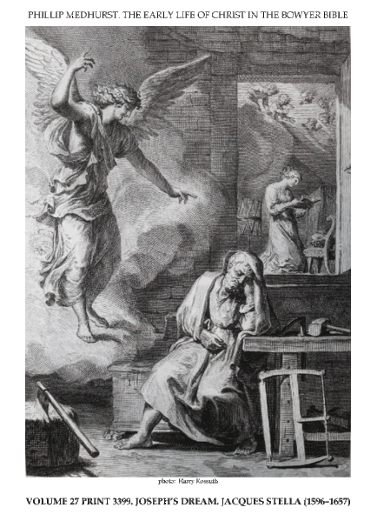
Annunciation to Joseph and the Birth of Jesus (1:17–25)
Notes:
Notes: Because Joseph is observant of Mosaic Law, he decides to divorce Mary quietly, because he finds out that she was “with child through the holy Spirit” (1:18). An angel appears to him in a dream (reminding us of Joseph, son of Jacob) and tells Joseph to take Mary as his wife and to call their son Jesus, which is translated as “God saves.” The angel then quotes the prophet Isaiah (7:14): “The young woman, pregnant and about to bear a son, shall name him Immanuel.” The reader is reminded in Matthew 1:23 that Immanuel means “God is with us.”

Slide 6
Visit of the Magi (2:1–12)
Notes:
Notes: When the Magi inquire about the birth of the Messiah, and when King Herod becomes unsettled by this, he asks his chief priests and scribes where the Messiah will be born. They respond by quoting to him from the prophet Micah (5:1), demonstrating again the fulfillment of ancient promises. The Magi themselves are an allusion to Isaiah 60:1,3,5,6,16—reminding us of God’s promise to the Israelites during the Babylonian Exile that people from all nations will stream to them to pay homage.

Slide 7
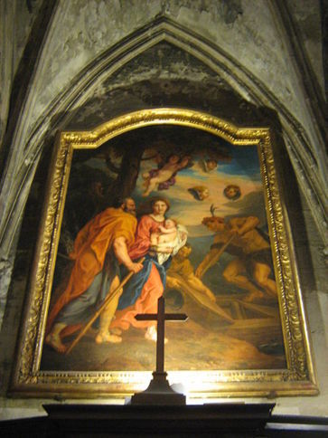
Flight to Egypt (2:13–15)
Image from Public Domain
Notes:
Notes: Again, the reader is reminded of Joseph, son of Jacob, who was sold into slavery and who later saved his family from starvation during a time of famine (see Genesis, chapters 37–50). In the same way, Jesus’ father, Joseph, flees with his family to Egypt to save them.

Slide 8
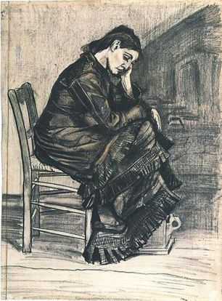
Massacre of the Infants (2:16–18)
Notes:
Notes: The massacre of the infants (also known as the “Slaughter of the Innocents”) reminds us of the massacre of the children at the time of Moses’ birth (see Exodus, chapter 1—2:10). The author reminds us of the words of Jeremiah 31:15: “In Ramah is heard the sound of sobbing, / bitter weeping! / Rachel mourns for her children, / and she refuses to be consoled / for her children—they are no more!”

Slide 9
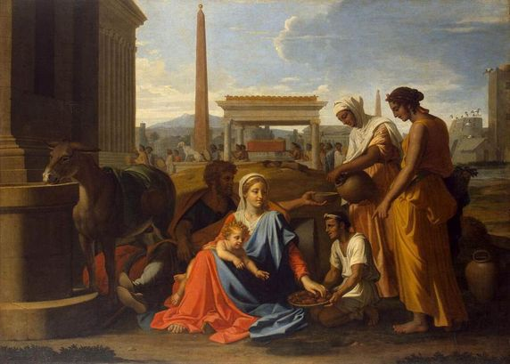
Return from Egypt (2:19–23)
Notes:
Notes: Quoting from Exodus 4:19, when Moses is summoned to return to Egypt, because “all those who sought your life are dead,” the author of Matthew’s Gospel tells us that Joseph, Mary, and Jesus were summoned out of Egypt to Israel with the same words. In Matthew 2:15, the words of the prophet Hosea are quoted in reference to Jesus, “Out of Egypt I called my son.” The return from Egypt fulfills these words of the prophet Hosea. Matthew reiterates that God’s Covenant with the people of Israel has been fulfilled through the birth of Jesus.

Slide 10
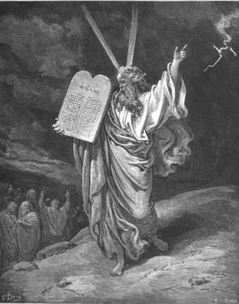
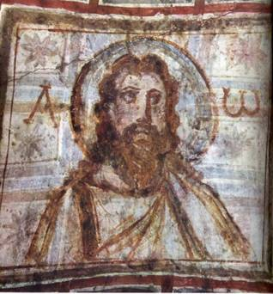
“Do not think that I have come to abolish the law or the prophets. I have come not to abolish but to fulfill” (Matthew 5:17).
Notes:
Notes: What is the author of Matthew’s Gospel trying to communicate? As the New Moses, Jesus has come to fulfill Mosaic Law. There are several examples in Matthew’s Gospel in which Jesus addresses questions or issues related to Mosaic Law.

