Slide 1
The Domestic Church
The Church Course
Document # TX001510

Slide 2
What Is the Domestic Church?
“The Christian home is the place where children receive the first proclamation of the faith. For this reason, the family home is rightly called ‘the domestic Church,’ a community of grace and prayer, a school of human virtues and of Christian charity.”
© shutterstock/wavebreakmedia ltd
Notes:
(Notes: Catechism of the Catholic Church, 1666)

Slide 3
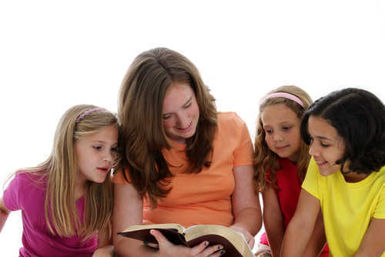
Church Mission
The Church’s people share a common mission.
What is this mission?
To share the Good News of Jesus Christ
The family is the place where children learn the Good News.
© shutterstock/Rob Marmion
Notes:
(Notes: Guide the students to an understanding of their baptismal call to evangelization: sharing the Good News of Jesus Christ.)

Slide 4
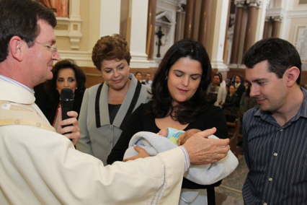
Our Commission
“Go, therefore, and make disciples of all nations, baptizing them in the name of the Father, and of the Son, and of the Holy Spirit, teaching them to observe all that I have commanded you” (Matthew 28:19–20).
Image in public domain
Notes:
(Notes: This is the Great Commission, which, through our Baptism, we all share.)

Slide 5
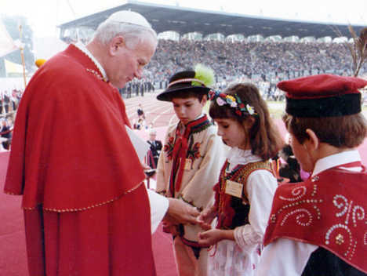
First Ideas
Pope Saint John Paul II repeatedly referred to the Catholic family as “the domestic Church,” for it is within family that we form our first ideas about life and love, and about God and his Church.
© thepapalvisit.org.uk

Slide 6
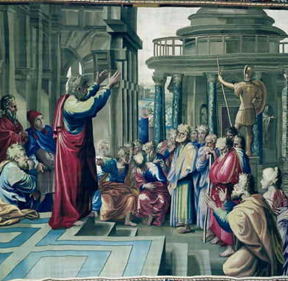
Early Church
The early Church began in house churches, where families were the heart of the communities.
The Church was formed from believers and their whole household. New believers wanted their entire family to be saved.
© omarcharter.com
Notes:
(Notes: See Acts of the Apostles 18:8.)

Slide 7
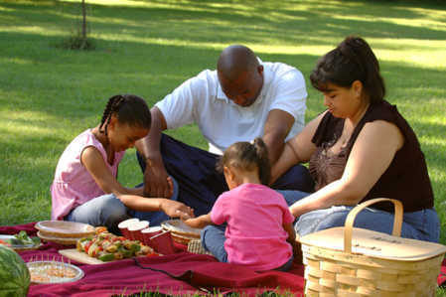
Family Church
The family is the most intimate experience of Church, the place where love, forgiveness, and trust should first be encountered.
This is the family Church, whose members are called to embody Christ in everyday life.
© elev8.com

Slide 8
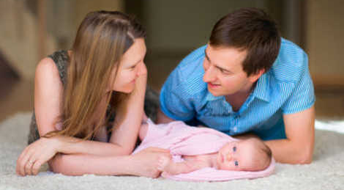
Dignity of Marriage
Vatican II recognized the dignity of Marriage by declaring that families are genuinely “Church.”
The Council restored the ancient concept of domestic Church as it declared:
“The parents are to be the first preachers of the faith for their children, by word and example.”
© shutterstock/BlueOrange Studio
Notes:
(Notes: Dogmatic Constitution on the Church, [Lumen Gentium, 1964], 11.)

Slide 9
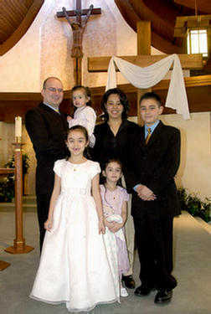
Role in Salvation
The family was created to play a specific role in God’s plan of salvation.
The family is deeply associated with the Church, both in its nature and in its structure.
© wpwittman

Slide 10
Family Is Central
In the Old Testament, the family was so central that without it, there simply was no covenant.
In the New Testament, the family reached its fulfillment in Christ.
The family became the place where the Holy Spirit works out the salvation of each member and provides stability and structure for life’s journey.

Slide 11
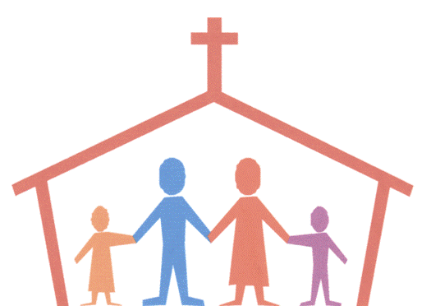
Church in Miniature
The baptized family is the first place where essential teaching in faith, prayer, and morality are carried out.
The Christian family is the Church in miniature, sharing the nature of Christ.
Image in public domain

Slide 12
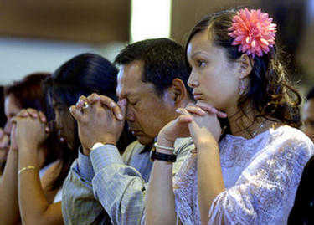
Christ as Head
The true head of the Catholic home is Jesus, just as he is head of the Church.
The family’s week should be centered on the Mass, and faith growth in the family should continue in the home.
© wpwittman.com

Slide 13
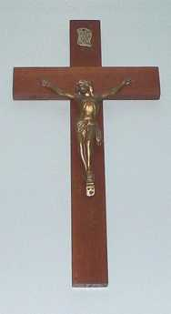
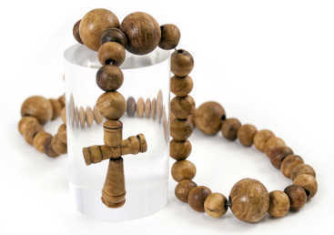
Signs of the Domestic Church
Bible
Rosary beads
Crucifix
Pictures of saints
Picture of Mary, Mother of God
Holy cards
Images in public domain
Notes:
(Notes: As you list these items, you can ask the students to raise their hand if they have the items in their house; alternatively, you can ask them to note to themselves whether these items are present in their homes.)

Slide 14
More Signs
Bulletin from your parish
Art with a Scripture verse on it
Christian newspaper or magazine
Books about Christian spirituality or history
Baptismal candle
Memorial of First Communion
Image in public domain

Slide 15
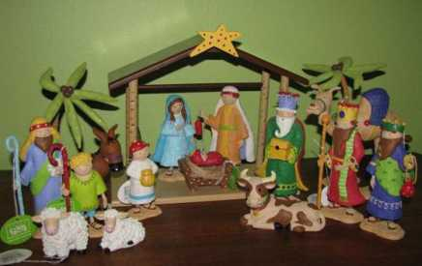
Yet More Signs
Nativity scene at Christmas
Advent wreath
Christian Advent calendar
Blessed palms from Palm Sunday
Saint Christopher medal in your car
themonogrammerchant.com

Slide 16
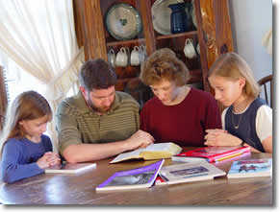
Prayers in the Family
Prayers every child should know:
Sign of the Cross
Lord’s Prayer
Hail Mary
Glory Be
Bedtime prayer
Meal blessing
Prayer to Guardian Angel
Act of Contrition
© illinoisfamily.org
Notes:
(Notes: Take the time now to tell the students where to find these prayers if they don’t know them.)

Slide 17
You Can Make the Change
If you feel that your home doesn’t quite meet the definition of domestic Church . . .
You can make the change.
© bcnn4youth.com

Slide 18
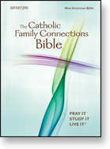
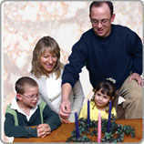
Things to Suggest at Home
Talk to your parents about the need for family prayer (start with a grace at meals).
Find any Christian books around the house and read them.
Ask to celebrate the liturgical seasons (Advent, Christmas, Easter, Pentecost).
© Saint Mary’s Press
© loyolapress.com

Slide 19
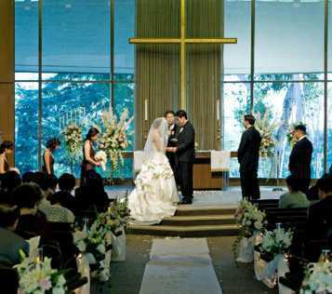
One Step
It takes just one step to build a domestic Church.
When the time comes to build your own family, remember this: If you invite Jesus into your family, you will be domestic Church.
© hillcrest-church.org
Notes:
(Notes: Resources used in this presentation include the Catechism of the Catholic Church for use in the United States of America, second edition, number 1666. Copyright © 1994 by the United States Catholic Conference, Inc.—Libreria Editrice Vaticana. English translation of the Catechism of the Catholic Church: Modifications from the Editio Typica copyright © 1997 by the United States Catholic Conference, Inc.—Libreria Editrice Vaticana.)

