Slide 1
The Catholic Church and the Bible
The Bible Course
Document #: TX001068

Slide 2
A Look at the Source
What would you say is the difference between the writings found in the Scriptures and other forms of spiritual writing?
What is inspiration?
Who is the ultimate source of inspiration for the Scriptures?
How is God as the source of inspiration different from a human as the source of inspiration?
© Danylchenko Iaroslav /Shutterstock.com
Notes:
Notes: Use these questions to initiate a classroom discussion. For the first question, it would be ideal if the students identified the concepts inspiration and revelation, which will be discussed in this presentation.

Slide 3
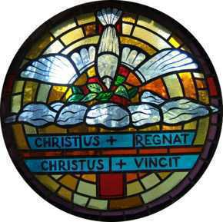
A Look at Inspiration
Image in public domain
God is the ultimate source of inspiration.
Inspiration: To breathe into.
The Holy Spirit inspired the human authors of the Bible as they compiled, recorded, or wrote the different books of the Bible.
Divine Inspiration is the assistance the Holy Spirit gave the human authors of the Bible so they could write in human words the message of salvation that God wanted to communicate.
Because the Holy Spirit guided the authors’ written words, God is the supreme author of all that is communicated and taught in the Sacred Scriptures.

Slide 4
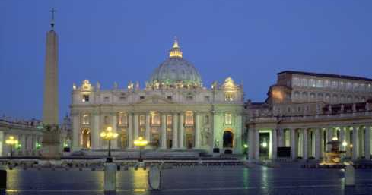
The Scriptures and the Catholic Church
The Catholic Church venerates “the Scriptures as she venerates the Lord’s Body” (Catechism of the Catholic Church, 103).
“Sacred Scripture and Sacred Tradition make up a single sacred deposit of the Word of God” (DV, 10).
Tradition refers to the process of passing on what God reveals for our salvation.
Image in public domain

Slide 5
The Scriptures and the Catholic Church (cont.)
Tradition began with the communication of the entire Gospel message by the Apostles.
Much of the Apostolic Tradition was written down in the Scriptures, and all of it is handed down and lived out in the life of the Church.
Sacred Tradition is interpreted by the Magisterium under the guidance of the Holy Spirit.
Image in public domain

Slide 6
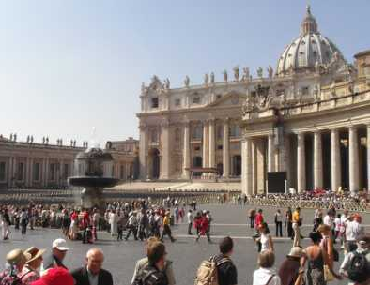
The Role of the Magisterium
The Magisterium is the Church’s teaching office, consisting of the bishops in communion with the Pope.
The role of the Magisterium of the Church is to define and articulate dogma and liturgical practices that empower people to encounter God.
The doctrine taught by the Magisterium is a primary way God’s Revelation is communicated to us.
Image in public domain

