Slide 1
Sources of Moral Truth
The Catholic Faith Handbook for Youth, Third Edition
Chapter 25
Document #: TX003156
Notes:
Use this presentation to introduce or review the key points in chapter 25 of the student handbook.

Slide 2
When we face a decision, we can rely on . . .
our natural ability to tell right from wrong.
the laws and teachings revealed by God.
Copyright: wavebreakmedia / www.shutterstock.com
Notes:
Explain that this presentation lists the sources of moral truth, that is, our manual or flow chart for doing the right thing.

Slide 3
Natural Moral Law
Part of our human nature
The ability to use reason to do good and avoid evil
An example: the Golden Rule
Copyright: Vankad / www.shutterstock.com
Notes:
Tell the students that a version of the Golden Rule exists in most organized religions. Encourage them to search online for examples from Buddhism, Confucianism, Islam, and other religions.

Slide 4
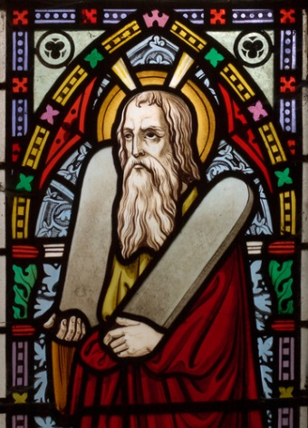
The Old Law
Law of Moses
Decalogue, or Ten Commandments
The first stage on the way to the Kingdom of God
Copyright: Sybille Yates / www.shutterstock.com
Notes:
Ask the students if they can list all the Ten Commandments. A list is found on page 439 of the student handbook.

Slide 5
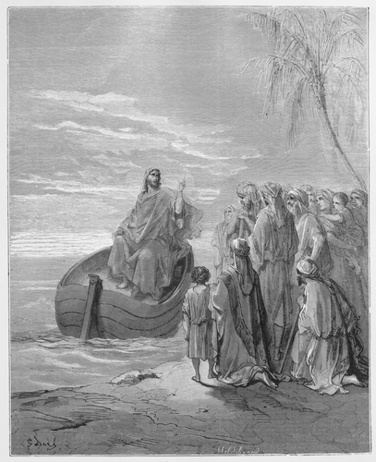
The New Law
Law of the Gospel
Perfection of the Old Law
Summarized in the two Great Commandments
Copyright: Nicku / www.shutterstock.com
Notes:
Ask a student to read the two Great Commandments, found on page 438 of the student handbook.

Slide 6
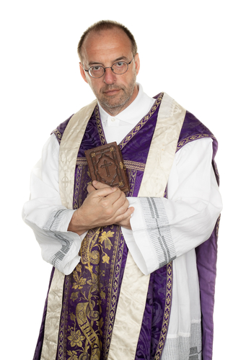
Church Law
Precepts of the Church
Catholics are obligated to follow them.
An example: participate in Mass every Sunday
Copyright: Lisa S. / www.shutterstock.com
Notes:
Ask the students to read the Precepts of the Church listed on page 280 of the student handbook.

Slide 7
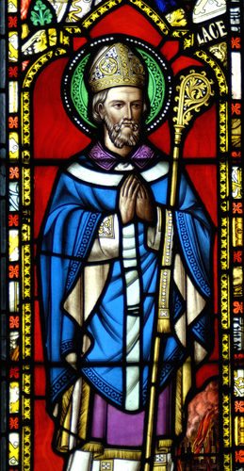
The Magisterium of the Church
Bishops of the world united with the Pope
Applies Christ’s New Law to modern situations
Examples: genetic testing, abortion, the death penalty
Copyright: Alistair Scott / www.shutterstock.com
Notes:
Tell the students that the United States Conference of Catholic Bishops publishes pastoral statements on current topics such as those listed here. Explain that their own bishop also issues statements, as does the Pope.

Slide 8
Conscience
The ability to make a judgment based on practical reason, to recognize what is moral and what is not, according to God’s Law
Copyright: Roman Gorielov / www.shutterstock.com
This needs to be formed in the light of Scripture and Tradition.
It needs to be fed and exercised.
Notes:
Ask for volunteers to take turns reading the Live it! sidebar “Top Ten Ways for Forming Your Conscience,” on page 284. Ask the students how each point could be helpful. You may wish to share some of your own views about the importance of informing one’s conscience.

