Slide 1
Finding Your Way
Christian Morality
Document # : TX001866

Slide 2
Reason and Revelation tell us that a longing for God is written in our hearts.
Shutterstock/CSKN

Slide 3
We know that we seek God because we long for happiness, love, goodness, acceptance, mercy, or forgiveness.
Shutterstock/CSKN

Slide 4
In God’s plan for our salvation, one good choice leads to another.
Image in public domain

Slide 5
To choose God is to choose freedom from the negative consequences of sin, from fear, from a web of deceit, from self-centeredness, or from an inauthentic self.
Indiana.edu

Slide 6
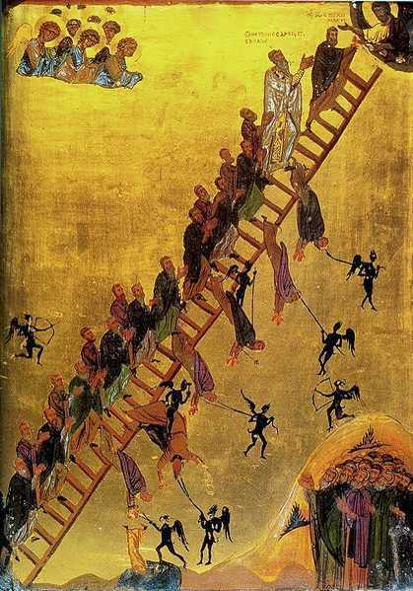
To refuse to accept God’s love is to refuse to grow toward moral goodness.
Image in public domain

Slide 7
To accept God’s love is to live in a covenant relationship that guides us on a path to goodness in this life and that will lead to our eternal union with God in Heaven.
Image in public domain

Slide 8
To acknowledge sin is to regain sight of the goal of happiness in this life and the next.
Image in public domain

Slide 9
God’s Law is a moral guide to our greatest happiness.
Shutterstock/Benis Arapovic

Slide 10
To put faith in God alone is to avoid the false god of material possessions.
Shutterstock/Alexander Todorenko

Slide 11
To keep God as the focus of our heart’s desire is to properly orient our regard for material possessions.
Shutterstock/ jean schweitzer

Slide 12
A sense of honor and reverence orients our lives toward a regard for the rights of others and toward the sharing of resources.
Image in public domain

Slide 13
The pursuit of truth keeps us honest about our relationship to God, others, and creation.
Shutterstock/Galyna Andrushko

Slide 14
To choose what is good is to choose God.
To choose God is to live justly.
Shutterstock/mangostock

