Slide 1
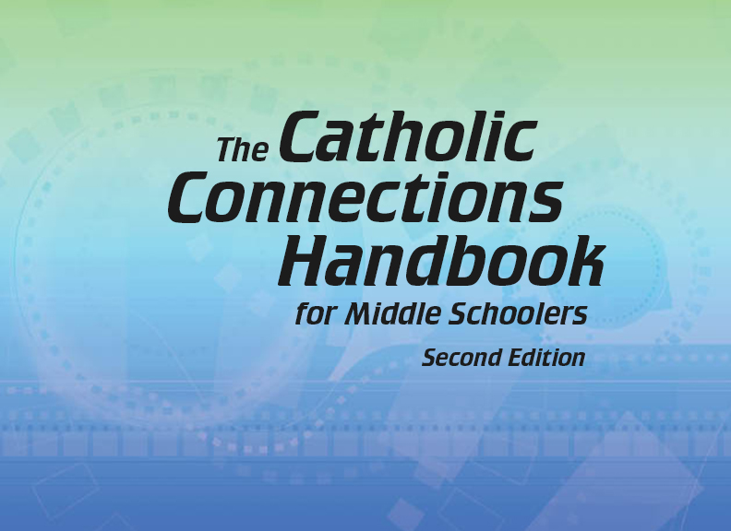

Document #: TX005838

Slide 2
Prayer and Church History
Chapter E
The Early Church

Slide 3
Chapter Summary
The Church is made up of both sinners and saints.
In the midst of struggles, the early Church was formed.
The faith of the early martyrs and saints are models and examples for us today.

Slide 4
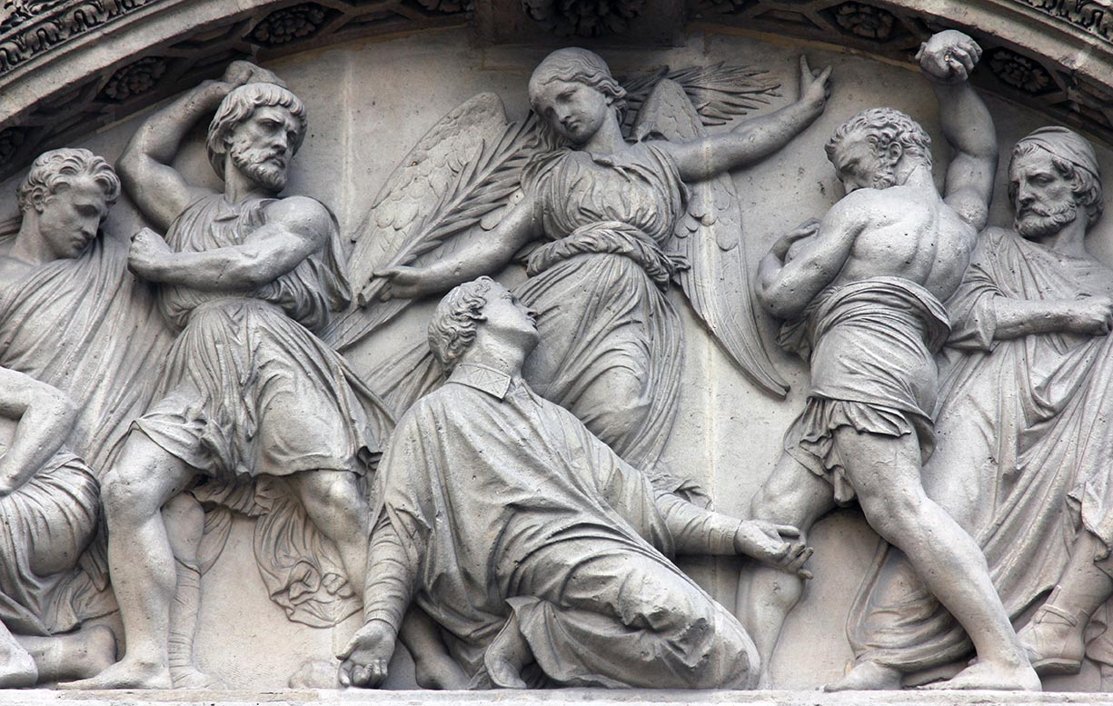
Introduction: “Why Study Church History?” and “Life in the Early Church” (Church History, pages 2–5)
Life in the early Church was a time of both persecution and growth.
(This is a sculpture of the martyrdom of the first deacon, Saint Stephen. See Acts 7:54–60.)
© Zvonimir Atletic / Shutterstock.com

Slide 5
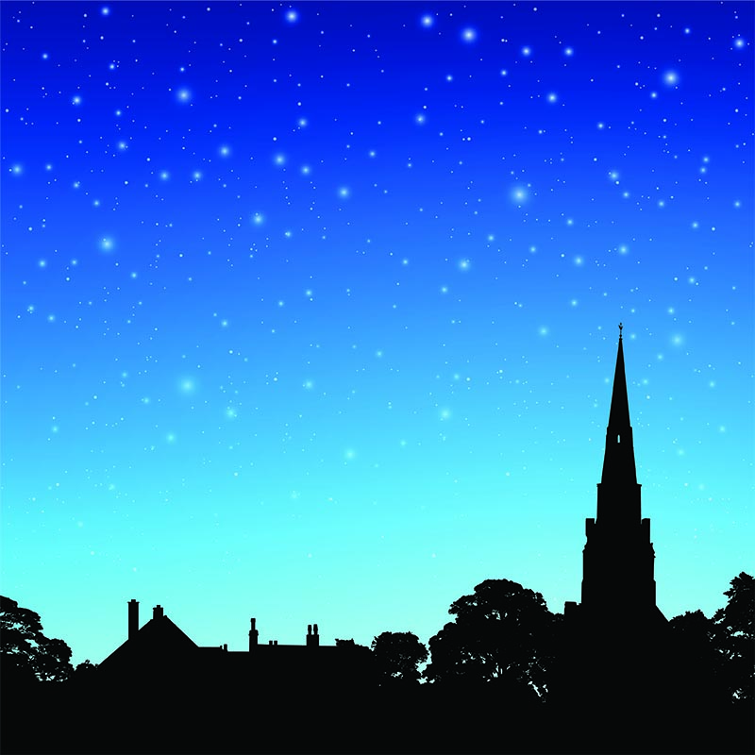
Why Study Church History?
The people who lived before us were human, like we are. This means that they were capable both of doing good and of making mistakes, and even of sin.
The Church has two aspects: a visible reality and a spiritual reality.
© Binkski/Shutterstock.com

Slide 6
Think About It!
Gather in groups of three and consider the following questions:
The history of the Church is not a perfect history of living by Gospel values. Why not?
What does God’s gift of freedom have to do with the history of the Church?
How will you be “a light of Christ” today?

Slide 7
Life in the Early Church
At some times, Christians live peacefully with their neighbors.
At other times, including our own, Christians are persecuted and sometimes killed because of their faith. This was true in the early days of the Church.
Times of persecution were also times of growth.

Slide 8
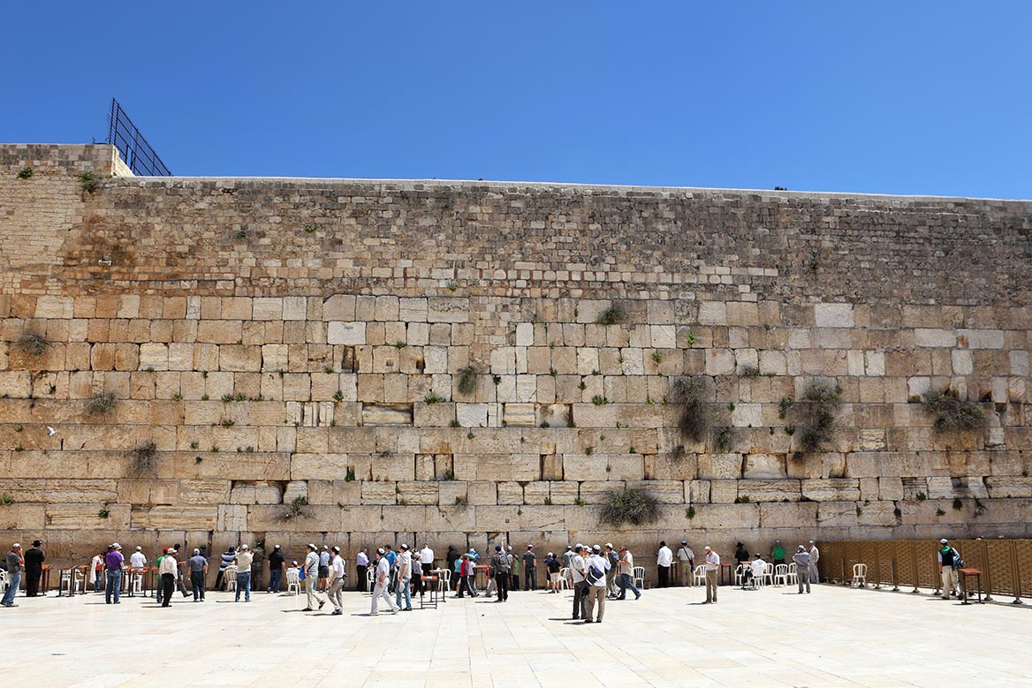
“The Jewish Beginnings of the Church” (Church History, pages 5–7)
The first Christians were Jewish, but soon there were non-Jewish (Gentile) converts who contributed to the growth of the Church.
(This is the “Western Wall” in Jerusalem. It supported the high ground on which the Temple was built and is now a place of prayer. There is nothing left of the Temple that Jesus knew.)
© WDG Photo / Shutterstock.com

Slide 9
Search It!
Jews today celebrate the same principal feasts that Jesus and his disciples celebrated.
Gather in pairs. Find and read the biblical sources of the following Jewish feasts: the Passover (Exodus 12:21–28); Pentecost or Harvest Festival (Deuteronomy 16:9–12); and the Feast of Shelters (also called Tabernacles or Booths, Deuteronomy 16:13–17).

Slide 10

The Feast of Booths
Jesus celebrated the Feast of Booths.
Look up Jesus’ proc- lamation on the last day of this feast in John 7:37–39. What are the “streams of life- giving water”?
© Daimond Shutter / Shutterstock.com

Slide 11

A Modern-Day Booth
Today Jews celebrate the Feast of Booths by recalling their history of living in tents in the desert. They build and decorate tent-like structures in their yards and on patios. This photo shows a modern- day decorated “booth” or tent in a back yard. The family will eat their
meals inside the booth during the seven-day feast.
© denisgo/Shutterstock.com

Slide 12
“The Risk of Following Jesus” (Church History, pages 7–14)
Following Jesus means conflict, risk, and possible martyrdom.
The early Christians suffered rejection and death for their beliefs. In this way they followed Jesus himself.
Some early Christian saints who died for their faith include Saint Stephen, Saint Paul, and Saint Peter.

Slide 13
Journal It!
Choose one of the early martyrs (Saint Stephen, Saint Paul, or Saint Peter).
As that saint, write a “last letter” to your friends, explaining why you are willing to die for your faith in Jesus and in his message.
Be sure to include your hope in the Resurrection of Jesus and eternal life.

Slide 14
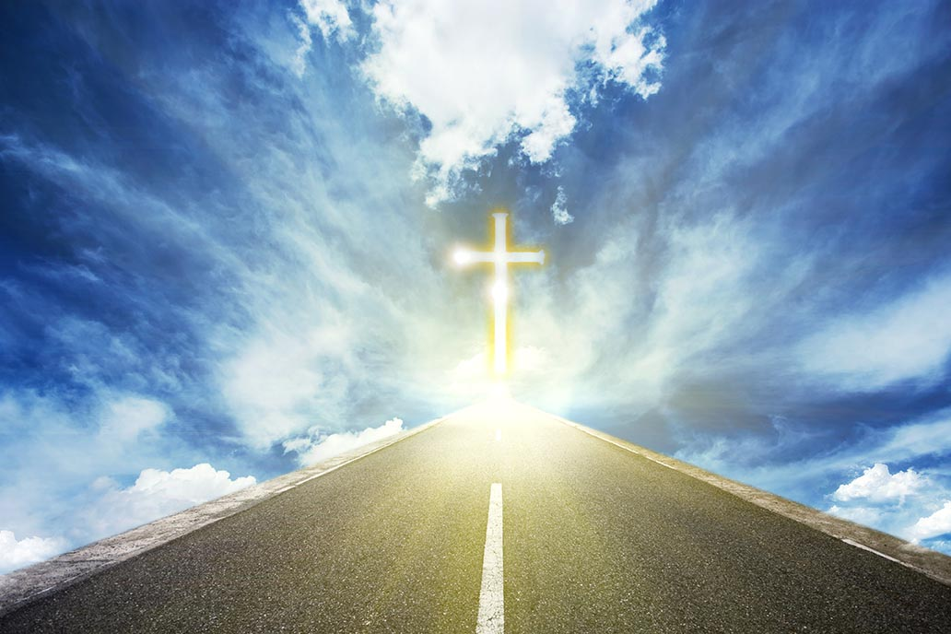
“The Roman Persecutions” and “Martyr-Saints to Know” (Church History, pages 14–21)
We look to the martyrs as examples of courage and faith as we follow Jesus in our own time.
© Lyu Hu / Shutterstock.com

Slide 15
You Are There: The Roman Persecutions
Gather in groups of three.
Assign one person to be a Roman leader, one person to be the Christian, one person to be a Roman judge.
The Roman leader starts by accusing the Christian of being an enemy of Rome (see chapter). He can do this several times.
The Christian responds by defending himself or herself against these accusations.
At the end the judge decides whether or not to sentence the Christian to death.

Slide 16
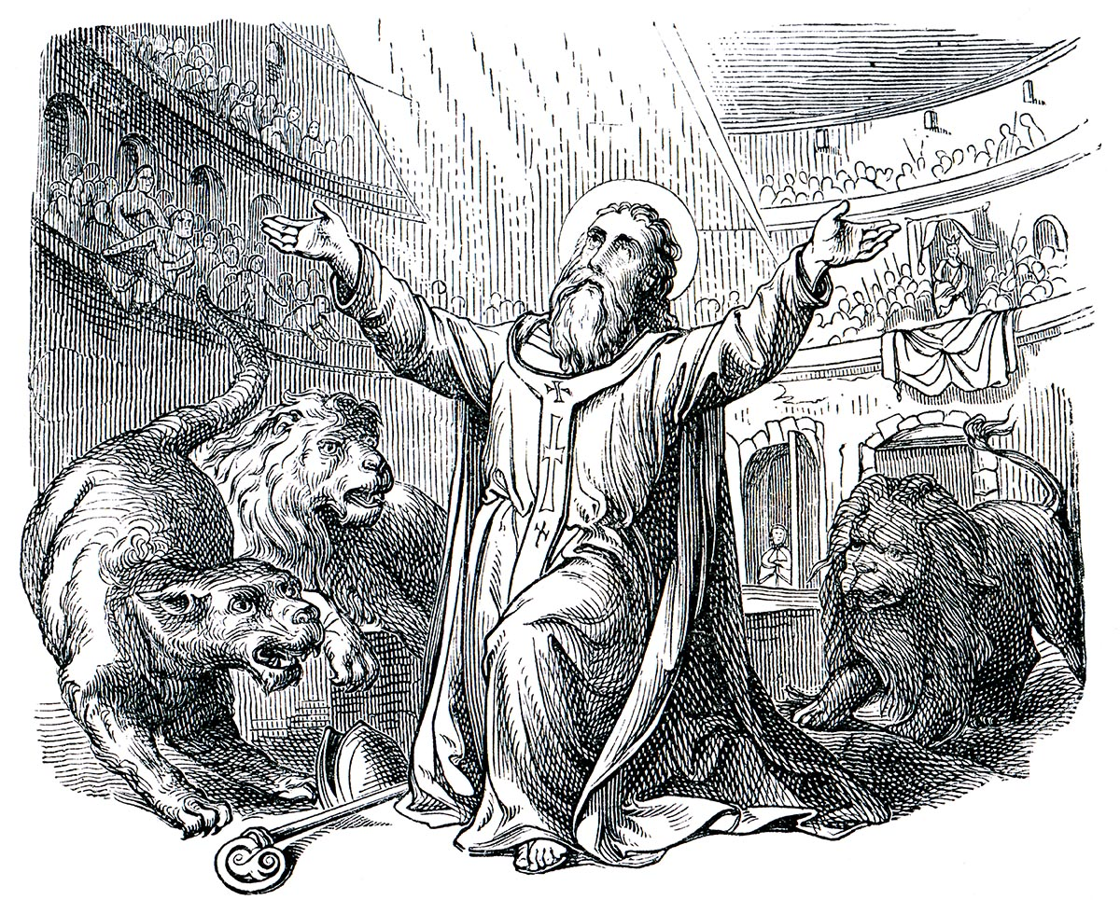
Saint Ignatius of Antioch
The letters of Saint Ignatius of Antioch bear witness to his love for the Eucharist.
He was the first Christian writer to describe the Church as catholic, or universal.
© Sergey Kohl / Shutterstock.com

Slide 17
Saints Perpetua and Felicity
Both of these saints were catechumens (preparing for Baptism) when they were arrested.
Both were mothers of infants.
They were martyred together in Carthage (Tunisia, North Africa) and share the same feast day, March 7.

Slide 18
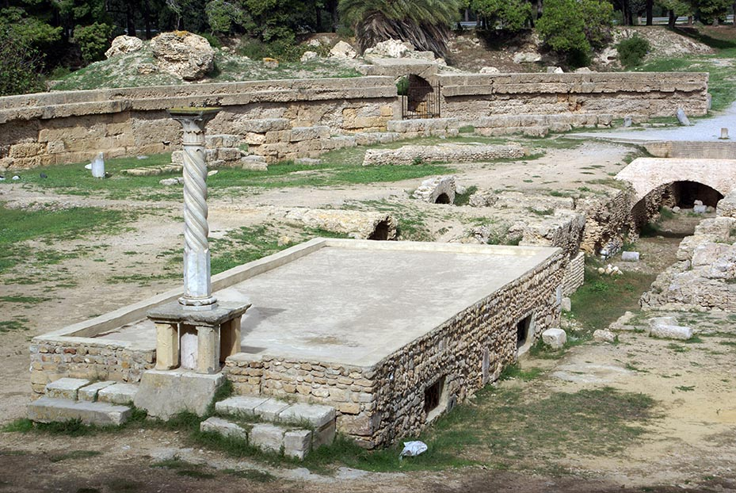
Ancient Ruins of Carthage
This is the Roman stadium at Carthage where Saints Perpetua and Felicity were put to death.
The entire site of the ancient city of Carthage is now uninhabited.
© Valery Shanin / Shutterstock.com

Slide 19
Pray It!
Pray for the martyrs of our own day who are suffering for their faith.
Gather in groups of two or three. Write a prayer, asking the Holy Spirit to grant strength and courage to those who, like the martyr-saints of the early Church, are following in the footsteps of Jesus today.

