Slide 1
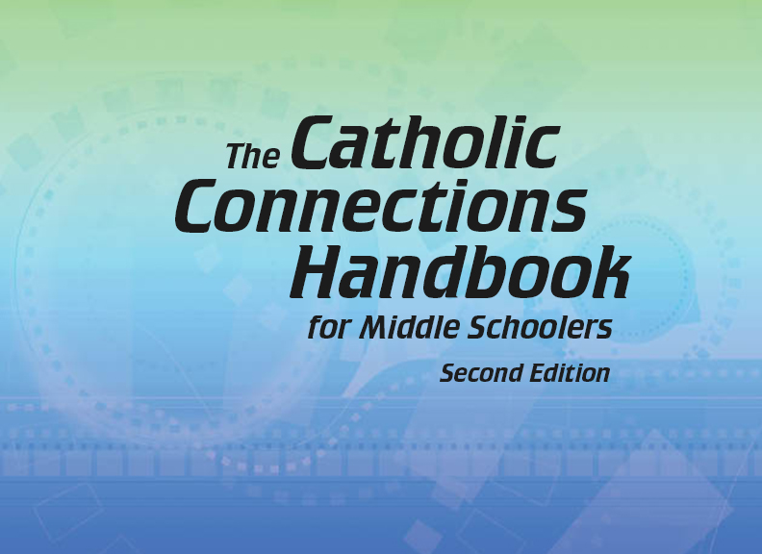


Slide 2

The Old Testament
and the Trinity
Chapter 7
The Human Person
© popcic/www.istockphoto.com

Slide 3


Chapter Summary
The Human Person
To be a human person means to be created body and soul in God’s image. There are both positive and negative aspects of being human. While we have the ability to love and care for one another, sin often keeps us from loving entirely as we should. Our human condition, while good, is affected by the sin of our first parents, Adam and Eve. As a result we are tempted to do what is contrary to God’s will. By following our model, Jesus Christ, we can find happiness as we journey toward our true home with God.
© Rawpixel /www.istockphoto.com

Slide 4
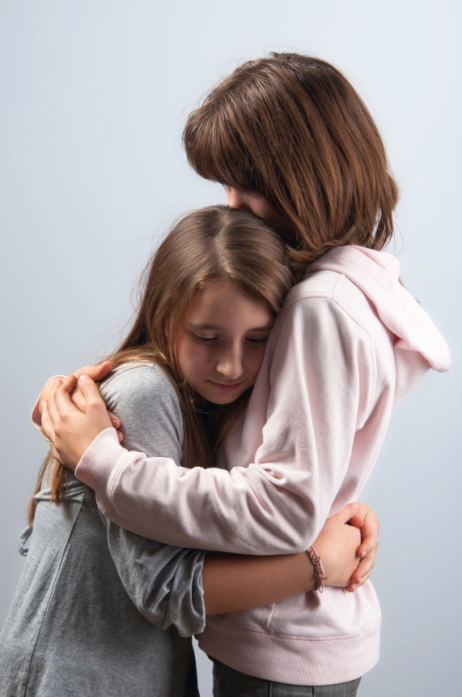
Introduction and “Being Human”
(Handbook, pages 78–80)
Being human means that we have been created in God’s image and have the ability to love and care for one another.
© prudkov /www.shutterstock.com

Slide 5

Introduction and “Being Human”
(Handbook, pages 78–80)
What being human means:
We are not perfect and sometimes make bad decisions.
We don’t often understand why things happen the way they do.
We are not alone and have many people in our lives.
© Rawpixel /www.shutterstock.com

Slide 6
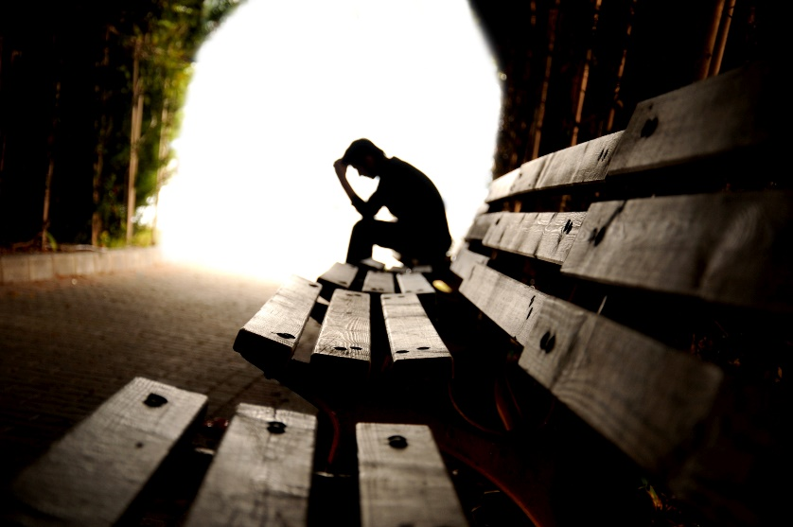
Introduction and “Being Human”
(Handbook, pages 78–80)
We have been made in God’s image, but the effects of sin keep us from loving the way God calls us to love.
© hikrcn /www.shutterstock.com

Slide 7
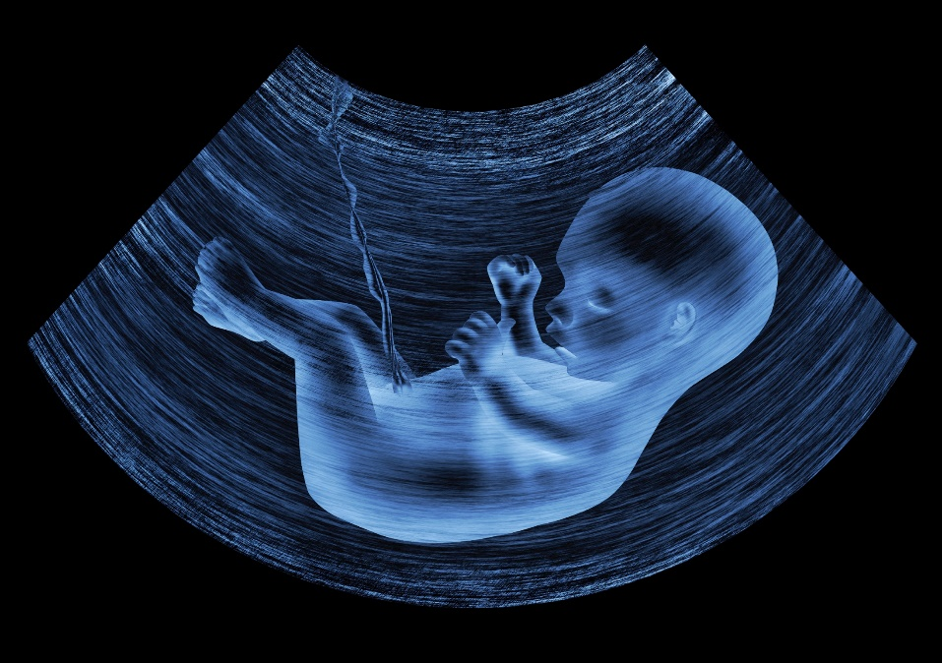
“Body and Soul”
(Handbook, pages 80-82)
The human person is a living being made up of both a physical body and an immortal, spiritual soul perfectly united at the moment of conception.
© Zffoto /www.istockphoto.com

Slide 8
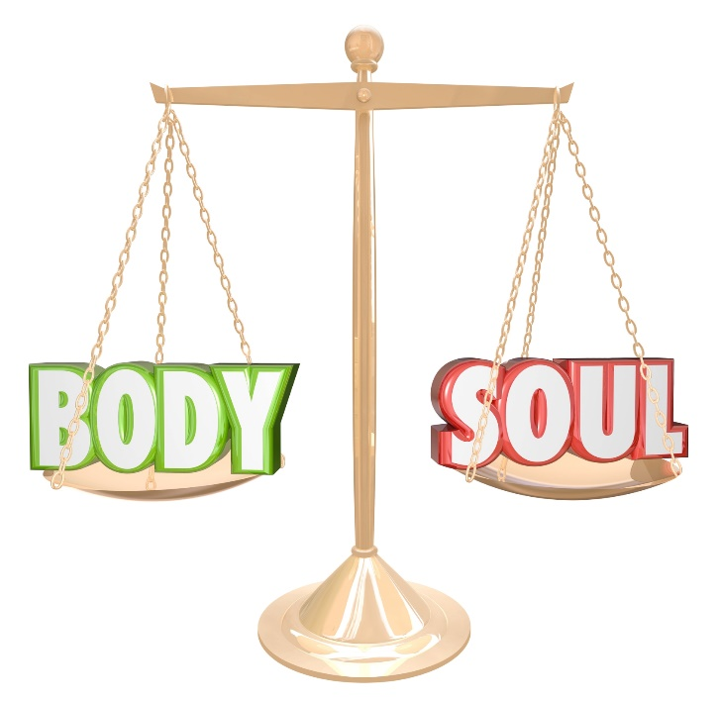
“Body and Soul”
(Handbook, pages 80-82)
The human person is a living being made of both a physical body and an immortal, spiritual soul.
Our soul is created by God at the moment of conception and is perfectly united to our physical body.
© iQoncept /www.shutterstock.com

Slide 9

“Body and Soul”
(Handbook, pages 80-82)
Like the Trinity, we are created to live in loving communion with one another.
God created us so that men and women would need each other and bond together in close relationship.
© Andresr /www.shutterstock.com

Slide 10
“Original Sin”
(Handbook, pages 83–85)
Original Sin resulted from the disobedience of our first parents and created the condition in which humanity finds itself—one in which sometimes we find it hard to say “no” to sin.
© SuslO /www.shutterstock.com

Slide 11
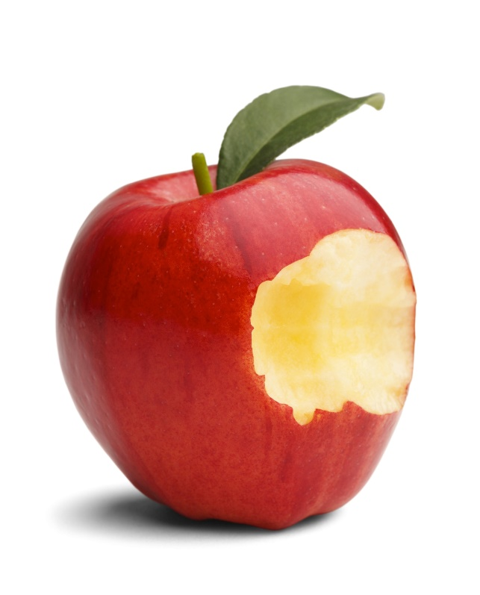
“Original Sin”
(Handbook, pages 83–85)
Adam and Eve, the first humans, had but one command from God to follow, and they still disobeyed God.
Original Sin is the term used to describe the condition of humanity’s separation from God due to disobedience. It refers to both of the following:
  The sin committed by our first parents
  The sinful condition that all human beings have been born into
© MegaPixel/www.shutterstock.com

Slide 12
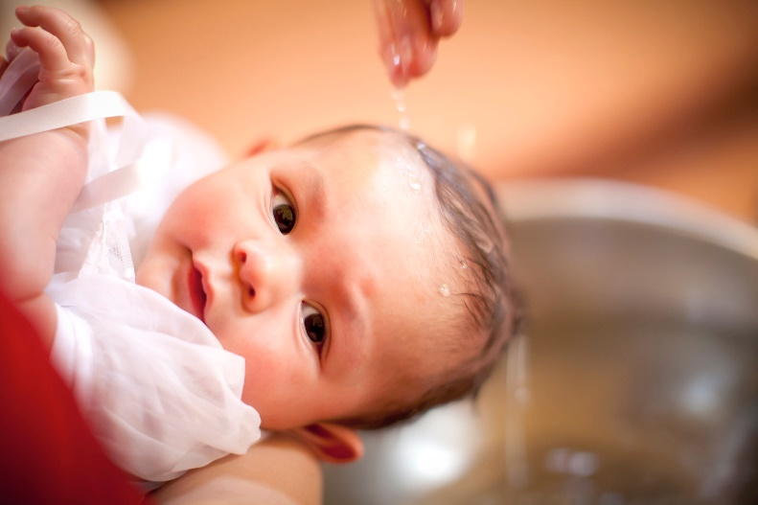
“Original Sin”
(Handbook, pages 83–85)
The grace received in Baptism cleanses us of our sinful condition and makes us children of God.
However, because of the lasting effects of Original Sin, we find it easy to be tempted to sin.
© JasonDoiy /www.istockphoto.com

Slide 13

“Coming from God, Heading Toward God”
(Handbook, pages 85-87)
Human beings are religious beings trying to find our spiritual home with God, and we will experience worry and restlessness until we do.
© Rasica /www.istockphoto.com

Slide 14
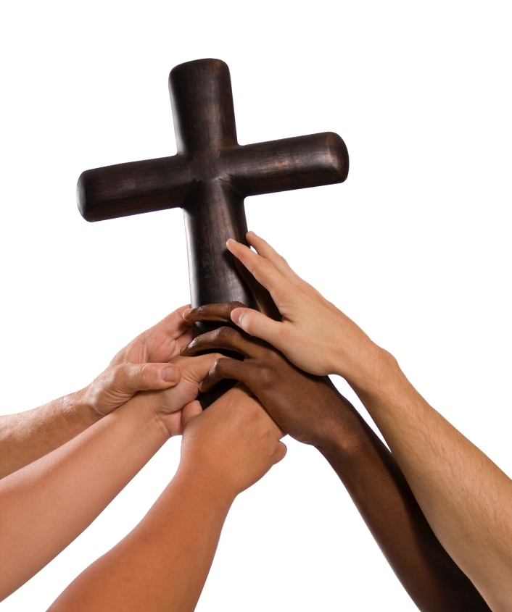
“Coming from God, Heading Toward God”
(Handbook, pages 85-87)
Being with God is our true home, and returning to God is what will make us happy.
Humans are religious in the sense that we are all trying to find our spiritual homes.
Christ is the model of the perfect human being, and by doing God’s will we can become like Christ.
© eyetoeyePIX/www.istockphoto.com

Slide 15
Let’s Review!
True or false?
Being made in God’s image means that we can love and care for one another.
Because we are human, we always know why things happen the way they do.
Even in the darkest times, we are never alone.
Our love for one another is meant to reflect the perfect love and union of the Trinity.
Once you are baptized, you never sin again.
Jesus Christ makes it possible for us to be reunited with God again.
Notes:
True
False
True
True
False
True

