Slide 1
Church Councils and Doctrinal Development
Church History, Unit 2

Slide 2
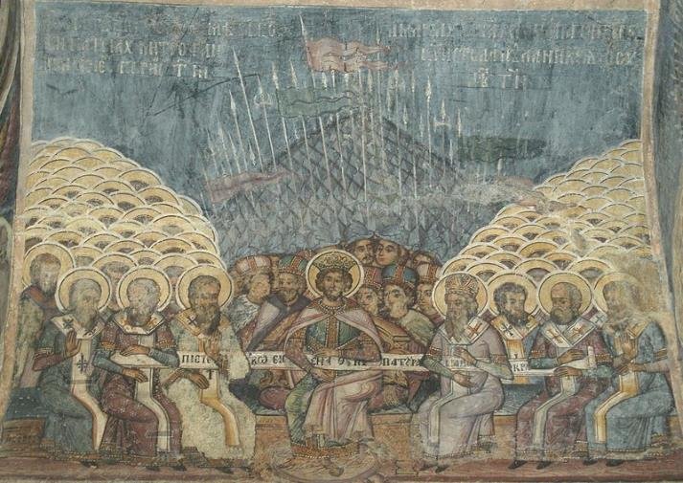
As the Church spread throughout the Mediterranean world, conflicts over important beliefs became more common.
These conflicts threatened the unity of the Church and its faithfulness to Christ’s teachings.
Image in public domain
Notes:
Image: The First Council of Nicaea, wall painting at the church of Stavropoleos, Bucharest, Romania

Slide 3
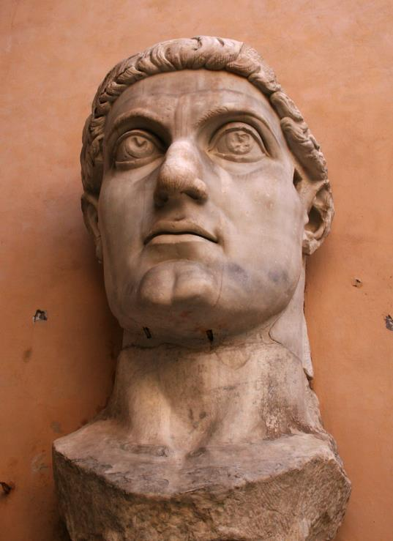
Council of Nicaea (AD 325)
Constantine called the Council of Nicaea, the first Ecumenical Council, to respond to the threat posed by Arianism, a heresy that denied Jesus’ full divinity.
© shutterstock/Kevin H Knuth

Slide 4
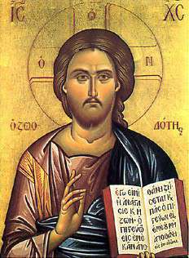
Council of Nicaea (AD 325) (continued)
You Be the Theologian . . .
If Jesus were not fully divine, as Arius argued, what would that imply for our belief in God’s plan of salvation?
Image in public domain
Notes:
Image: Christ oriental - Our Lady of Lebanon Melkite Church, Fortaleza, Brazil

Slide 5
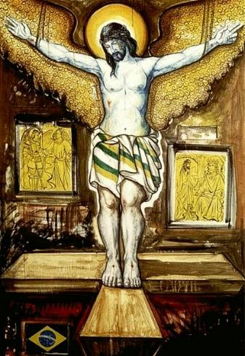
Council of Nicaea (AD 325) (continued)
• Began to spell out key Church teachings about Jesus’ fully divine and fully human natures.
• Developed the Nicene Creed, which professed Jesus’ divinity with these words: “the Only Begotten Son of God . . . Light from Light, true God from true God, begotten, not made, consubstantial with the Father” (Roman Missal).
• Did not end Arianism. Saints Athanasius and Ambrose were instrumental in defending Church doctrine after the Council.
Image in public domain

Slide 6

Council of Constantinople (AD 381)
In 381 the Church called another Council, this time in Constantinople.
• affirmed the teachings of Nicaea and the divinity of Jesus
• affirmed the divinity of the Holy Spirit in response to a different heresy—one that argued the Holy Spirit was not divine but was instead a creation of the Son and served the Father and the Son
Image in public domain

Slide 7
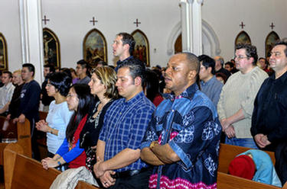
Council of Constantinople (AD 381) (continued)
The Council of Constantinople completed the Niceno-Constantinopolitan Creed. This is the Nicene Creed we know and recite today.
© wpwittman.com

Slide 8
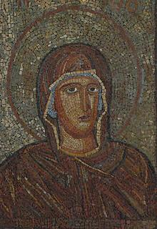
Councils of Ephesus (431) and Chalcedon (451)
The Councils of Ephesus and Chalcedon challenged the Nestorian heresy.
• Nestorius taught that Jesus was two distinct persons—one divine, one human.
• Followers of Nestorianism rejected the title Theotokos (“God bearer”) for the Virgin Mary, instead teaching that Mary gave birth only to Jesus the human being.
Image in public domain

Slide 9
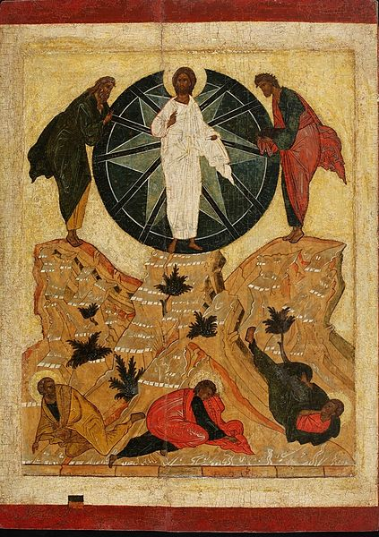
Councils of Ephesus (431) and Chalcedon (451) (continued)
• Both Councils condemned Nestorianism as a heresy.
• The Council of Chalcedon also developed the Church’s doctrine of the hypostatic union—the union of Jesus Christ’s human and divine natures in one Divine Person.
Image in public domain

Slide 10
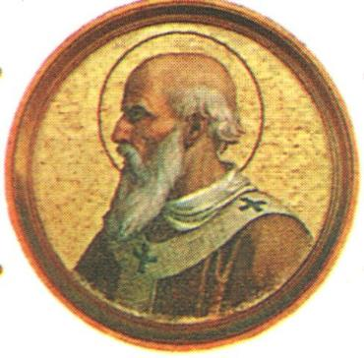
Councils of Ephesus (431) and Chalcedon (451) (continued)
The Council of Chalcedon also made a significant impact on relations between the Eastern and Western Churches.
• The bishops at the Council of Chalcedon stated that the Bishop of Rome, the Pope, was the highest authority in the Church, placing the patriarch of Constantinople second to the Pope.
• This change in custom led to six centuries of disputes between the East and West.
Image in public domain

Slide 11
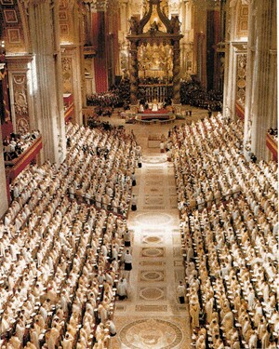
Many of the Church’s teachings have been articulated at Ecumenical Councils—from the early centuries down to our time.
These councils are usually held to respond to the needs of the time.
There have been twenty-one Ecumenical Councils. The most recent was the Second Vatican Council, held from 1962 to 1965.
Image in public domain
Notes:
(The prayer on slide 5 is from the English translation of The Roman Missal © 2010, International Commission on English in the Liturgy Corporation, page 257. All rights reserved. Used with permission of the ICEL.)
All images in public domain.

