Slide 1

Finding God,
Being Found by God
Document #: TX004827

Slide 2



God Desires…
  God constantly calls us to relationship with him.
  We are invited into communion with God in order to experience the grace of his saving love.
© Leigh Prather/Shutterstock.com
Notes:
This PowerPoint presentation is an introduction to what God desires from humans and why God chooses to reveal himself to us.

Slide 3
Finding God or Being Found by God?
“We don’t ‘find’ God, rather we find God finding us.”
– Fr. Larry Gillick, SJ
Quotation is from a free, downloadable audio retreat at onlineministries.creighton.edu/CollaborativeMinistry/AudioRetreat/AudioRetreats.html.
What does this quotation mean?
How does God find us?
Notes:
Often people speak of searching for and then “finding” God. In reality, God, out of his desire for deep, loving communion with us, is relentlessly seeking every person, even if he or she is not aware of this seeking by God. Thus, when we “find” God, it is because God is already revealing himself to us in many ways throughout all of time. The answer to the second question is illustrated on subsequent slides.

Slide 4
God Reveals Himself to Us
  Search for Happiness
  & Meaning
Revelation (from Latin) “to unveil or disclose”
  The Bible
  Love
  Creation
  Thought & Reason
Notes:
This slide presents the five types of revelation that will be expanded on in subsequent slides. It might be interesting to have the students, individually or in groups, draw their own “image” for each. The slide is currently set to reveal “types” of revelation prior to showing the images to better facilitate this exercise.

Slide 5
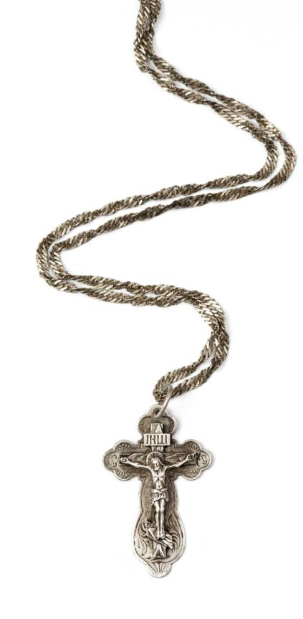
God Reveals Himself to Us
How have you experienced God?
Briefly describe.
Are any of these means of Revelation
unfamiliar to you?
Why do you think these are
unfamiliar to you?
© Bragin Alexey/Shutterstock.com
Notes:
These are reflection questions that students can write about, discuss with a partner, and then share with the larger group.

Slide 6
Encountering God in the
Search for Happiness and Meaning
Songs, art, movies, literature, and poetry often show us that there is more to life than what we experience through the five senses.
  God is our beginning and our destiny.
  Thus happiness is found only in a life fully committed to God.
How do you find God finding you?

Slide 7
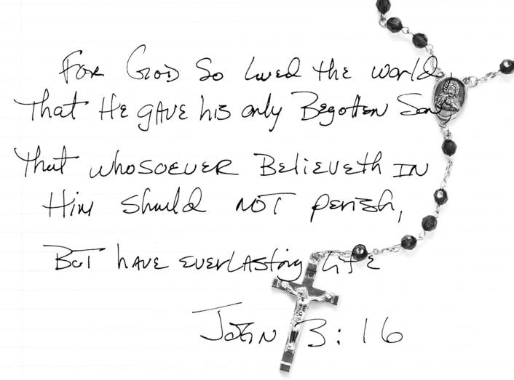
Encountering God in the Bible
The Holy Spirit inspired the Bible’s human authors to write what God wanted to reveal for our salvation.
© Margaret M Stewart /Shutterstock.com
How do you find God finding you?
Notes:
Inspiration from the Holy Spirit means that the writers expressed the truth of God’s salvation message, and the reader of the Bible can understand this truth. Thus the Bible, a written document from a specific time period, is a living document, because the Holy Spirit continues to guide readers in understanding its truths.

Slide 8
Encountering God through Love
Saint Augustine of Hippo (354–430) proposed the following four “objects” that we should love:
  Love of God above all created things.
  Love of our neighbor as inseparable from love of God.
  Love of self as knowledge that God is imprinted on our
  hearts.
  Love of our body as one of God’s masterpieces.
How do you find God finding you?
Notes:
An interesting exercise would be to use a concordance and find Bible passages that use key words such as neighbor, self, self-love, and body to learn what Scripture says about these “four objects.”

Slide 9
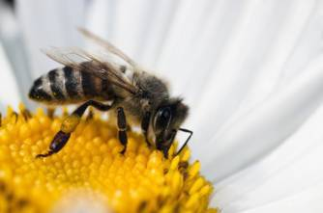
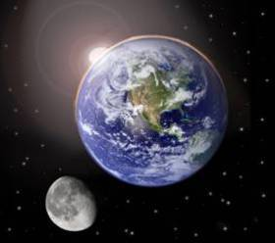
Encountering God in Creation
  How can someone not believe in God when he or she sees this or hears that or looks here?
  Church Fathers saw God through natural revelation with humanity as the summit.
According to Saint Augustine, nothing created by God
is insignificant, not even
the tiniest insect.
© MilousSK/Shutterstock.com
© Beneda Miroslav/Shutterstock.com
How do you find God finding you?
Notes:
The images on this slide demonstrate the “range” of creation from the micro to the macro. It might be interesting to discuss other parts of creation that exist between the micro and macro.

Slide 10
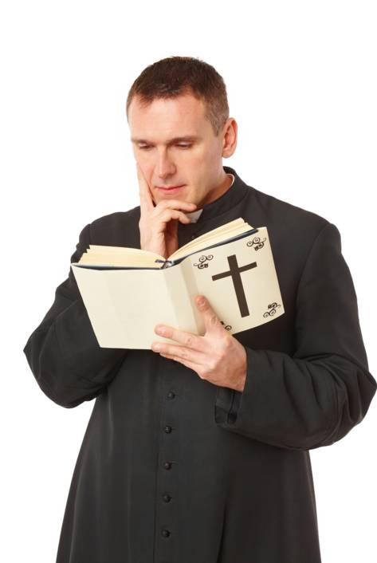
Encountering God through
Thought and Reason
During the Middle Ages, new ways of proving the existence of God emerged.
Great thinkers held that humans could use their minds and logically develop arguments to attain truth and certainty about God.
® Monika Wisniewska/Shutterstock.com
How do you find God finding you?

Slide 11
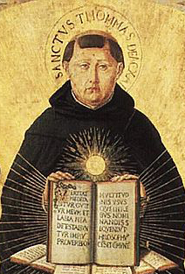
Saint Thomas Aquinas’s
Five Proofs for the Existence of God
First Mover – everything moves in the universe; something started the motion. The First Mover is God.
Causality – everything is caused by something else, but there must be an Ultimate or First Cause. This First Cause is God.
Public Domain
Saint Thomas Aquinas (1225–1274)
Notes:
Helping the students to understand and relate to these logical arguments for God is important. Likely many students have thoughts about these concepts already, but not in these specific words.

Slide 12
Saint Thomas Aquinas’s Five Proofs for the Existence of God (cont’d.)
Contingency – Humans cannot exist without a Necessary Being who creates all but is not created. This Necessary Being is God.
Perfection – We know perfection, because there is one all-perfect being: God. All-perfect God sets the infinite standards for wisdom and truth.
Intelligent Being – There is a remarkable order to all of creation. Because of this order, an intelligent designer must be behind the universe. This Designer is God.
With which of these do you most identify?
Notes:
Helping the students to understand and relate to these logical arguments for God is important. Very likely many students have thoughts about these concepts already but not in these specific words.

Slide 13
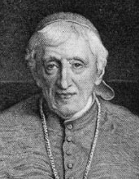
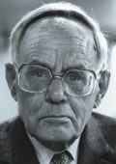
Two Great Thinkers on Natural Revelation
Courtesy of the
University of Texas Libraries, The University of Texas at Austin
Cardinal John Henry Newman
(1801–1890)
Karl Rahner, SJ
(1904–1984)
Public Domain
Convergence of Probabilities: Many “hints” point to the existence of God. When combined, they produce a powerful argument for God.
Anytime humans experience limitations in knowledge, freedom, or perfection, there is an awareness of God as Absolute Mystery.
With which of these do you most identify?

Slide 14
Jesus Christ Is God’s Perfect Revelation
Because God wants a deep relationship with us, the Word became flesh in the person of Jesus the Christ.
Through Jesus Christ, God has “provided the definitive, superabundant answer to the questions that man asks himself about the meaning and purpose of his life” (CCC, 68).
Incarnation: (from Latin)
“to become flesh”
From what you know about Jesus, what do you know about God?
Notes:
This slide introduces the essential concept of the Incarnation. This will be expanded upon later. At this point, it is important that the students understand that though the five previous methods of revelation are extremely important, the fullest Revelation of God is Jesus Christ. The students may have an incomplete answer to the question posed, but their answer can be used now to gauge prior knowledge and to begin to make the connection that to know Jesus is to know the Father. See John 14:8–14.

Slide 15
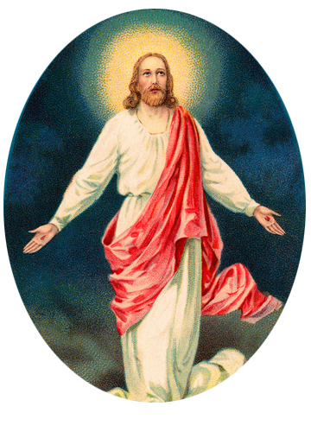
God Reveals Himself to Us
  Search for Happiness
  & Meaning
  The Bible
© Victorian Traditions/Shutterstock.com
  Love
  Creation
  Thought & Reason
How has this lesson changed how you find God finding you?
Notes:
15

Slide 16
Acknowledgment
The quotation on slide 14 is from the English translation of the Catechism of the Catholic Church for use in the United States of America, second edition (CCC), number 68. Copyright © 1994 by the United States Catholic Conference, Inc.—Libreria Editrice Vaticana (LEV). English translation of the Catechism of the Catholic Church: Modifications from the Editio Typica copyright © 1997 by the United States Catholic Conference, Inc.—LEV.
Notes:
16

