Slide 1
The Gospels
The Living Word: The Revelation of God’s Love, Second Edition
Unit 4, Chapter 12
Document#: TX004690

Slide 2


The Heart of Scripture
The four Gospels proclaim that God came to earth to fulfill his promises.
The Gospels are our primary source for all that Christ revealed in his life and teachings.
© Andrii Ospishchev / Shutterstock.com
Notes:
Notes: Explain to the students that God had promised to form a covenant with all people, and to overcome the slavery of sin and the darkness of death.
This slide corresponds to content in the chapter 12 introduction in the student book.

Slide 3
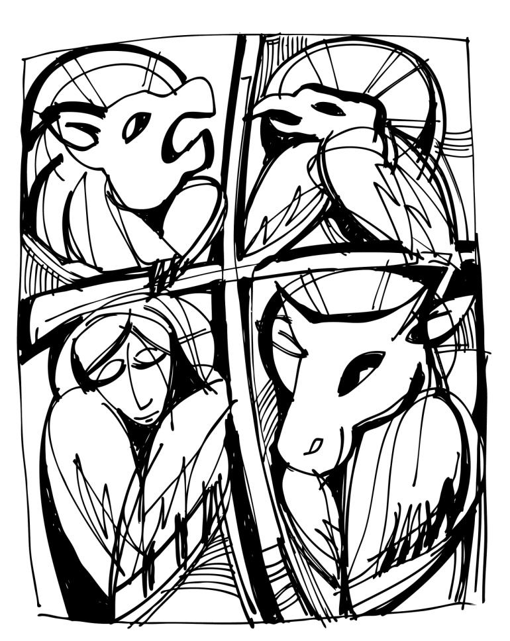
The Central Place of the Gospels
The word gospel literally means “good news.”
The four Gospels differ from one another.
Together they announce the Good News in harmony and without error.
© Maran Garai / Shutterstock.com
Notes:
Notes: Refer to the Faith in Action sidebar in article 57 in the student book, and discuss with students modern methods of evangelization, including social media, which recent popes have used.
This slide corresponds to content in article 57, “The Central Place of the Gospels,” in the student book.

Slide 4
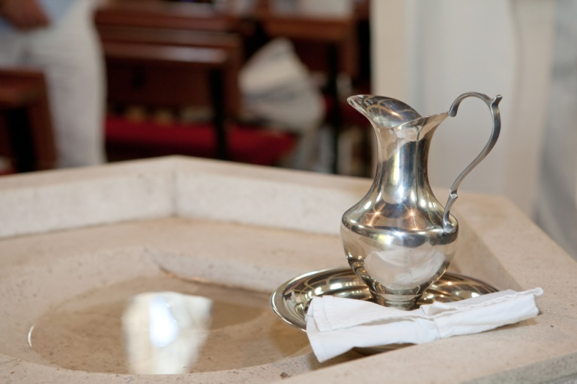
An Invitation to Faith
The overall intent of the Gospel writers is to foster faith.
They invite us to participate in the sacramental life of the Church.
They challenge us to follow Jesus and to apply his teachings.
© Gordana Sermek/Dollar Photo Club
Notes:
Notes: Remind the students that the Gospel writers recorded Jesus’ words and works to help later generations have faith in him. Ask the students these questions: Do you think the Gospel writers succeeded in this goal? Why or why not?
This slide corresponds to content in article 57, “The Central Place of the Gospels,” in the student book.

Slide 5

Three Stages in Gospel Formation
The Life and Teachings of Jesus
Oral Tradition
The Written Gospels
© Vitaliy Krasovskiy / Shutterstock.com
Notes:
Notes: The next three slides expand on each of these stages of Gospel formation. Remind the students that this pattern is similar to the one they learned about the formation of Old Testament texts.
This slide corresponds to content in article 58, “Three Stages in Gospel Formation,” in the student book.

Slide 6
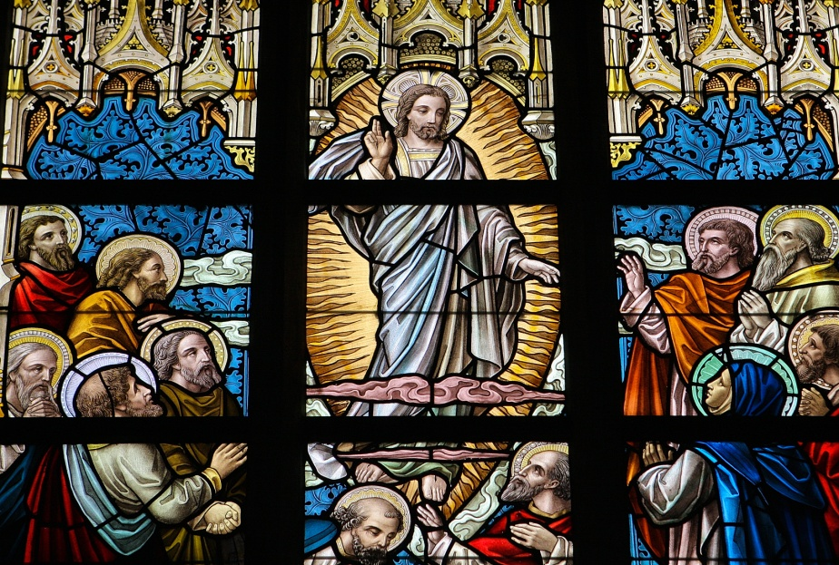
The Life of Jesus
Our ancestors in faith heard Jesus teach, and they witnessed his miracles.
In Jesus’ Passion, Death, Resurrection, and Ascension, they saw the Divine Word of Life.
© jorisvo / Shutterstock.com
Notes:
Notes: Ask the students this question: Which event in the Gospels would you most like to have witnessed in person?
This slide corresponds to content in article 58, “Three Stages in Gospel Formation,” in the student book.

Slide 7
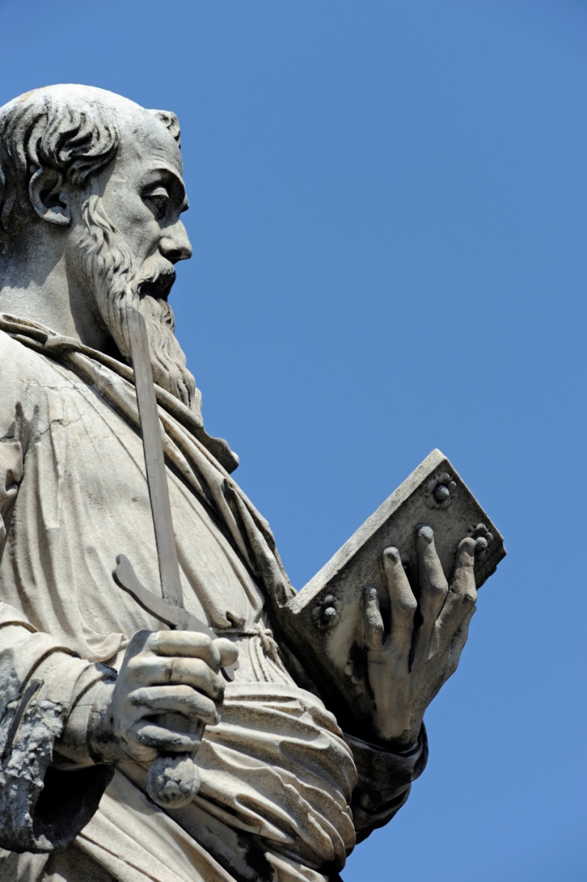
Oral Tradition
Aided by the Holy Spirit, the Apostles and others shared the Good News.
This message is known as the kerygma.
© PaoloGaetano / iStockphoto.com
Notes:
Notes: Remind the students that after his Resurrection, Jesus charged his disciples with the mission to share the Gospel (see Matthew 28:16–20, The Great Commission).
This slide corresponds to content in article 58, “Three Stages in Gospel Formation,” in the student book.

Slide 8
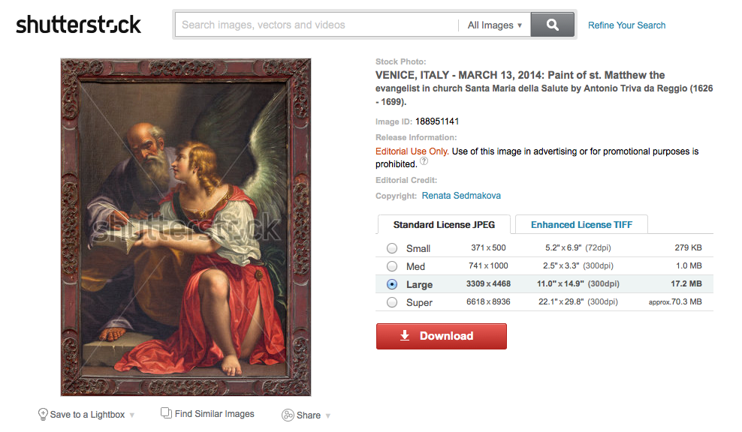
The Written Gospels
The Holy Spirit guided the Gospel writers.
The writings synthesized what the original witnesses had shared.
The goal was to preserve and hand on the Good News for future generations.
© Renata Sedmakova / Shutterstock.com
Notes:
Notes: Explore with students why the Good News was committed to writing (a growing fear that the message of salvation could be distorted or interpreted incorrectly, many eyewitnesses to Jesus’ life were elderly) (see article 58 in the student book).
This slide corresponds to content in article 58, “Three Stages in Gospel Formation,” in the student book.

Slide 9
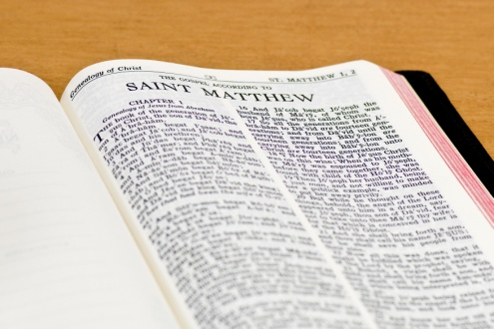
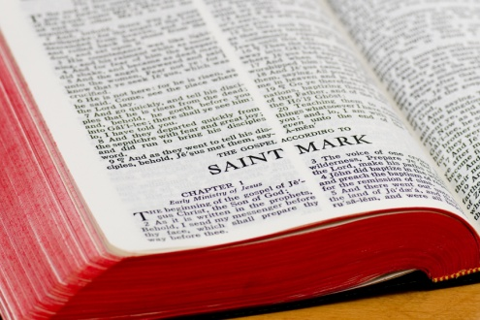
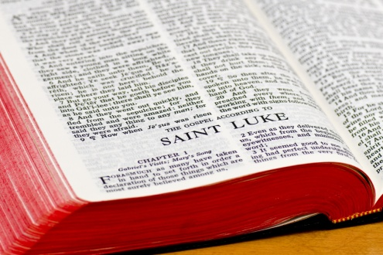
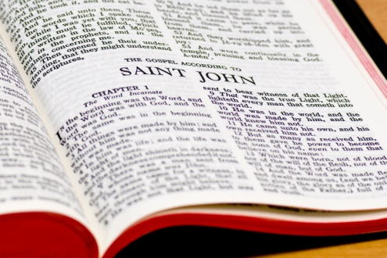
Why Four Gospels?
© Joe Fallico / Shutterstock.com
The early Christian communities were unified by their belief in Christ.
But they were separated by different concerns and challenges.
Each Evangelist proclaimed the Gospel in a unique way to the community to which he belonged.
© Joe Fallico / Shutterstock.com
© Joe Fallico / Shutterstock.com
© Joe Fallico / Shutterstock.com
Notes:
Notes: Direct the students to read the Primary Sources sidebar in article 59 in the student book. Lead a discussion of how content on the same topic may differ in articles, textbooks, and blogs while still offering valuable information and insight.
This slide corresponds to content in article 59, “Why Four Gospels?” in the student book.

Slide 10
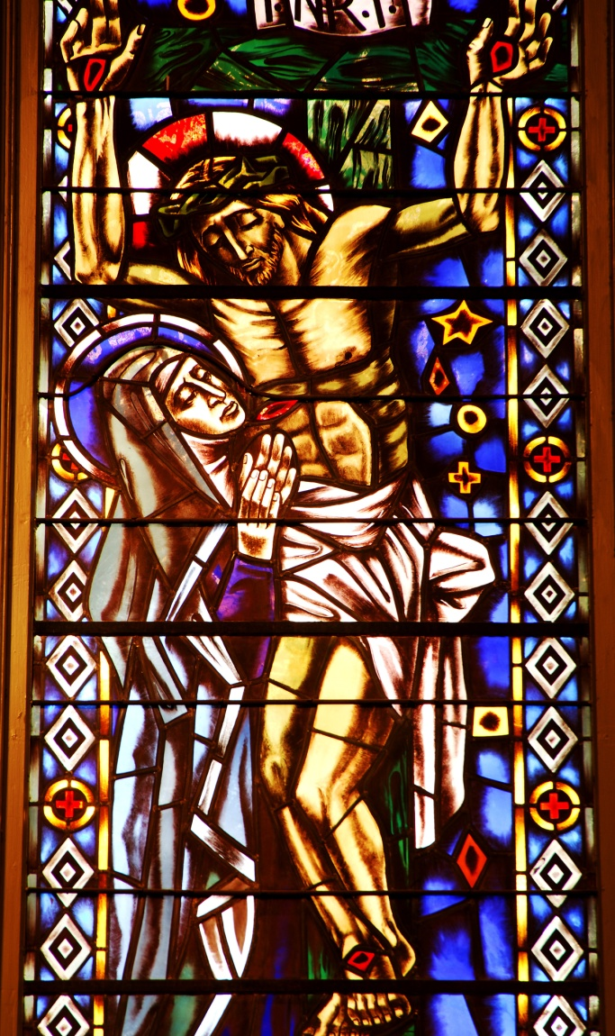
Different Portraits of Faith
The Gospels are a unique literary form, or genre.
They are based in the actual teachings of Christ and the historical events of his life.
Each Gospel writer emphasized the religious truth his community needed.
© Alfred Wekelo / Shutterstock.com
Notes:
Notes: Lead a discussion with the students about how the Gospel might be preached differently in a prison versus a wealthy suburban church; in a community where people have believed for generations versus a place with many new converts.
This slide corresponds to content in article 59, “Why Four Gospels?” in the student book.

Slide 11
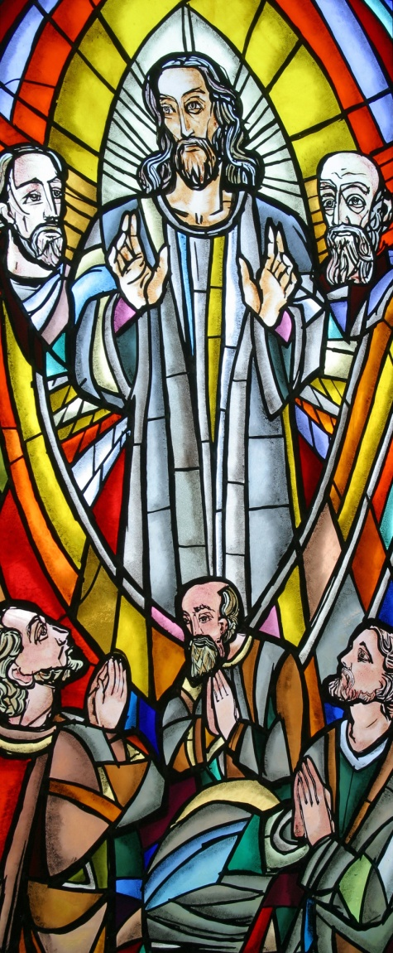
The Synoptic Gospels
The Gospels of Matthew, Mark, and Luke are similar in style and share much of the same content.
They present slightly different images of Jesus that were meaningful to the members of their intended communities.
© Zvonimir Atletic / Shutterstock.com
Notes:
Notes: Direct the students to compare the first few verses of the three synoptic Gospels. Ask these questions: How are they similar? How are they different?
This slide corresponds to content in article 59, “Why Four Gospels?” in the student book.

Slide 12
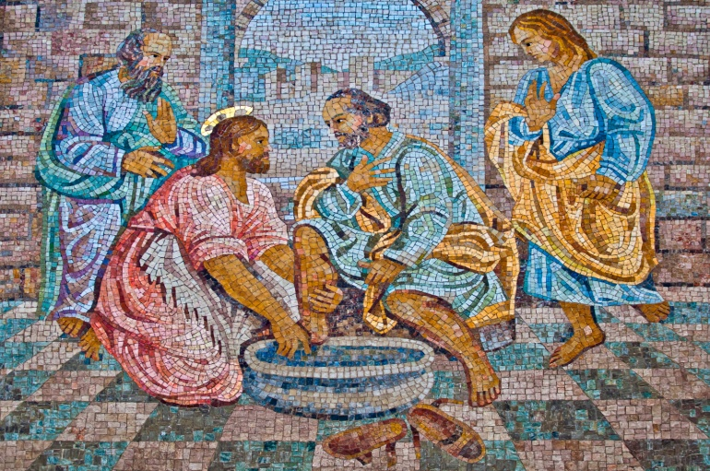
The Gospel of John
The Gospel of John was written much later than the synoptic Gospels.
It uses symbolic language to express that Jesus is the Son of God and Incarnate Word.
© Luis Santos / Shutterstock.com
Notes:
Notes: Direct the students to look at the first few verses of the Gospel of John. Ask how these verses are different from those that open the synoptic Gospels.
This slide corresponds to content in article 59, “Why Four Gospels?” in the student book.

Slide 13
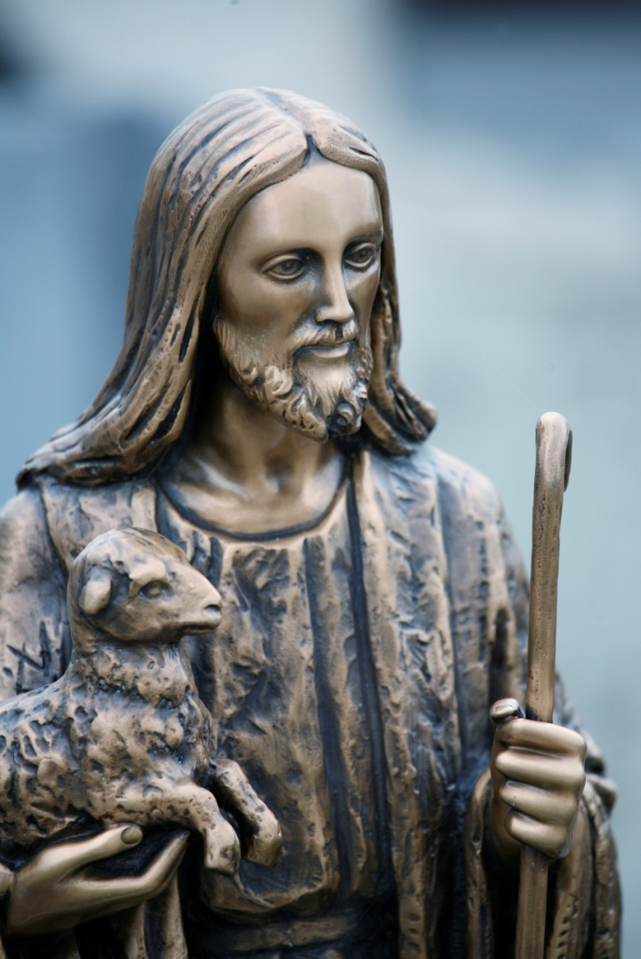
Four Images of Jesus
Teacher and Prophet (Gospel of Matthew)
The Suffering Servant of God (Gospel of Mark)
Compassionate Healer (Gospel of Luke)
Incarnate Word of God (Gospel of John)
© clu / iStockphoto.com
Notes:
Notes: Ask the students about artworks that depict Jesus in different ways. Request examples of favorite visual images of Jesus.
This slide corresponds to content in article 59, “Why Four Gospels?” in the student book.

Slide 14
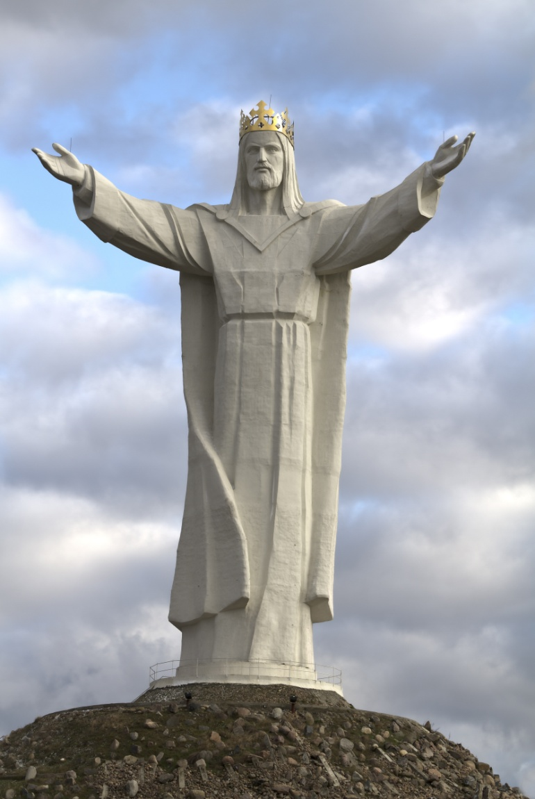
The Same Truth
The Gospels form the heart of Scripture, because they are necessary for us to comprehend God’s saving love.
They point to the one absolute truth—Jesus is the Son of God and the Lord of all creation.
© piotrwzk / Shutterstock.com
Notes:
Notes: Point out to the students that the Holy Spirit guided the Gospel writers to foster and enliven the faith of human beings who come from different backgrounds and have varying needs.
This slide corresponds to content in article 59, “Why Four Gospels?” in the student book.

