Slide 1


Document #: TX005845

Slide 2
The Prophets, Jesus Christ, and the Holy Spirit
Chapter 9
Faith: Responding to God

Slide 3
Chapter Summary
The gift of faith is a belief in God that invites a response to God’s call with trust in God alone.
Faith is believing and accepting that God made himself known to us through words and actions, most fully in the person of Jesus.
Faith is something that guides our entire lives and requires us to live our lives in response to that belief.

Slide 4
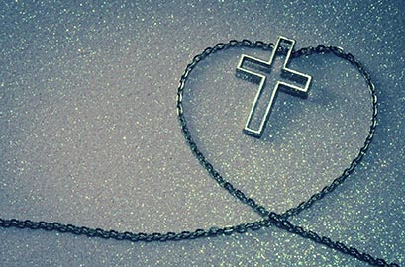
Introduction and “What is Faith?” Handbook, Pages 98–100
Faith is the way people respond to God’s call. It means a belief in God.
Faith is believing that God has made himself known to us most fully through Jesus Christ.
Faith is something that guides our entire lives and requires us to live our lives based on our beliefs.
© KatarinaGondova/iStock.com

Slide 5
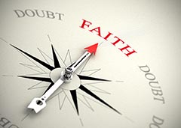
Think About It!
Discussion Questions:
In your own words, what does faith mean?
Two people say they believe that a ladder will hold them. One person uses the ladder to climb to the roof, and the other person won’t even try. Which one has faith and why?
© Olivier Le Moal / Shutterstock.com

Slide 6

“Faith Is a Gift Freely Chosen” and “Faith Is Believing” (Handbook, Pages 100–102)
Faith is necessary for salvation.
Faith is a gift from God but we must freely choose to accept that gift.
Faith often comes to us through the words and examples of our parents.
© bikeriderlondon/ Shutterstock.com

Slide 7
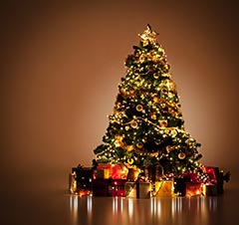
Share It!
Think-Pair-Share
Think: What is the best gift you have ever received? Why is the gift of faith even better than that gift?
Pair: Find a partner.
Share: Discuss your answers to the questions. Be prepared to share your answer to the second question with the class.
© luminaimages/Shutterstock.com

Slide 8
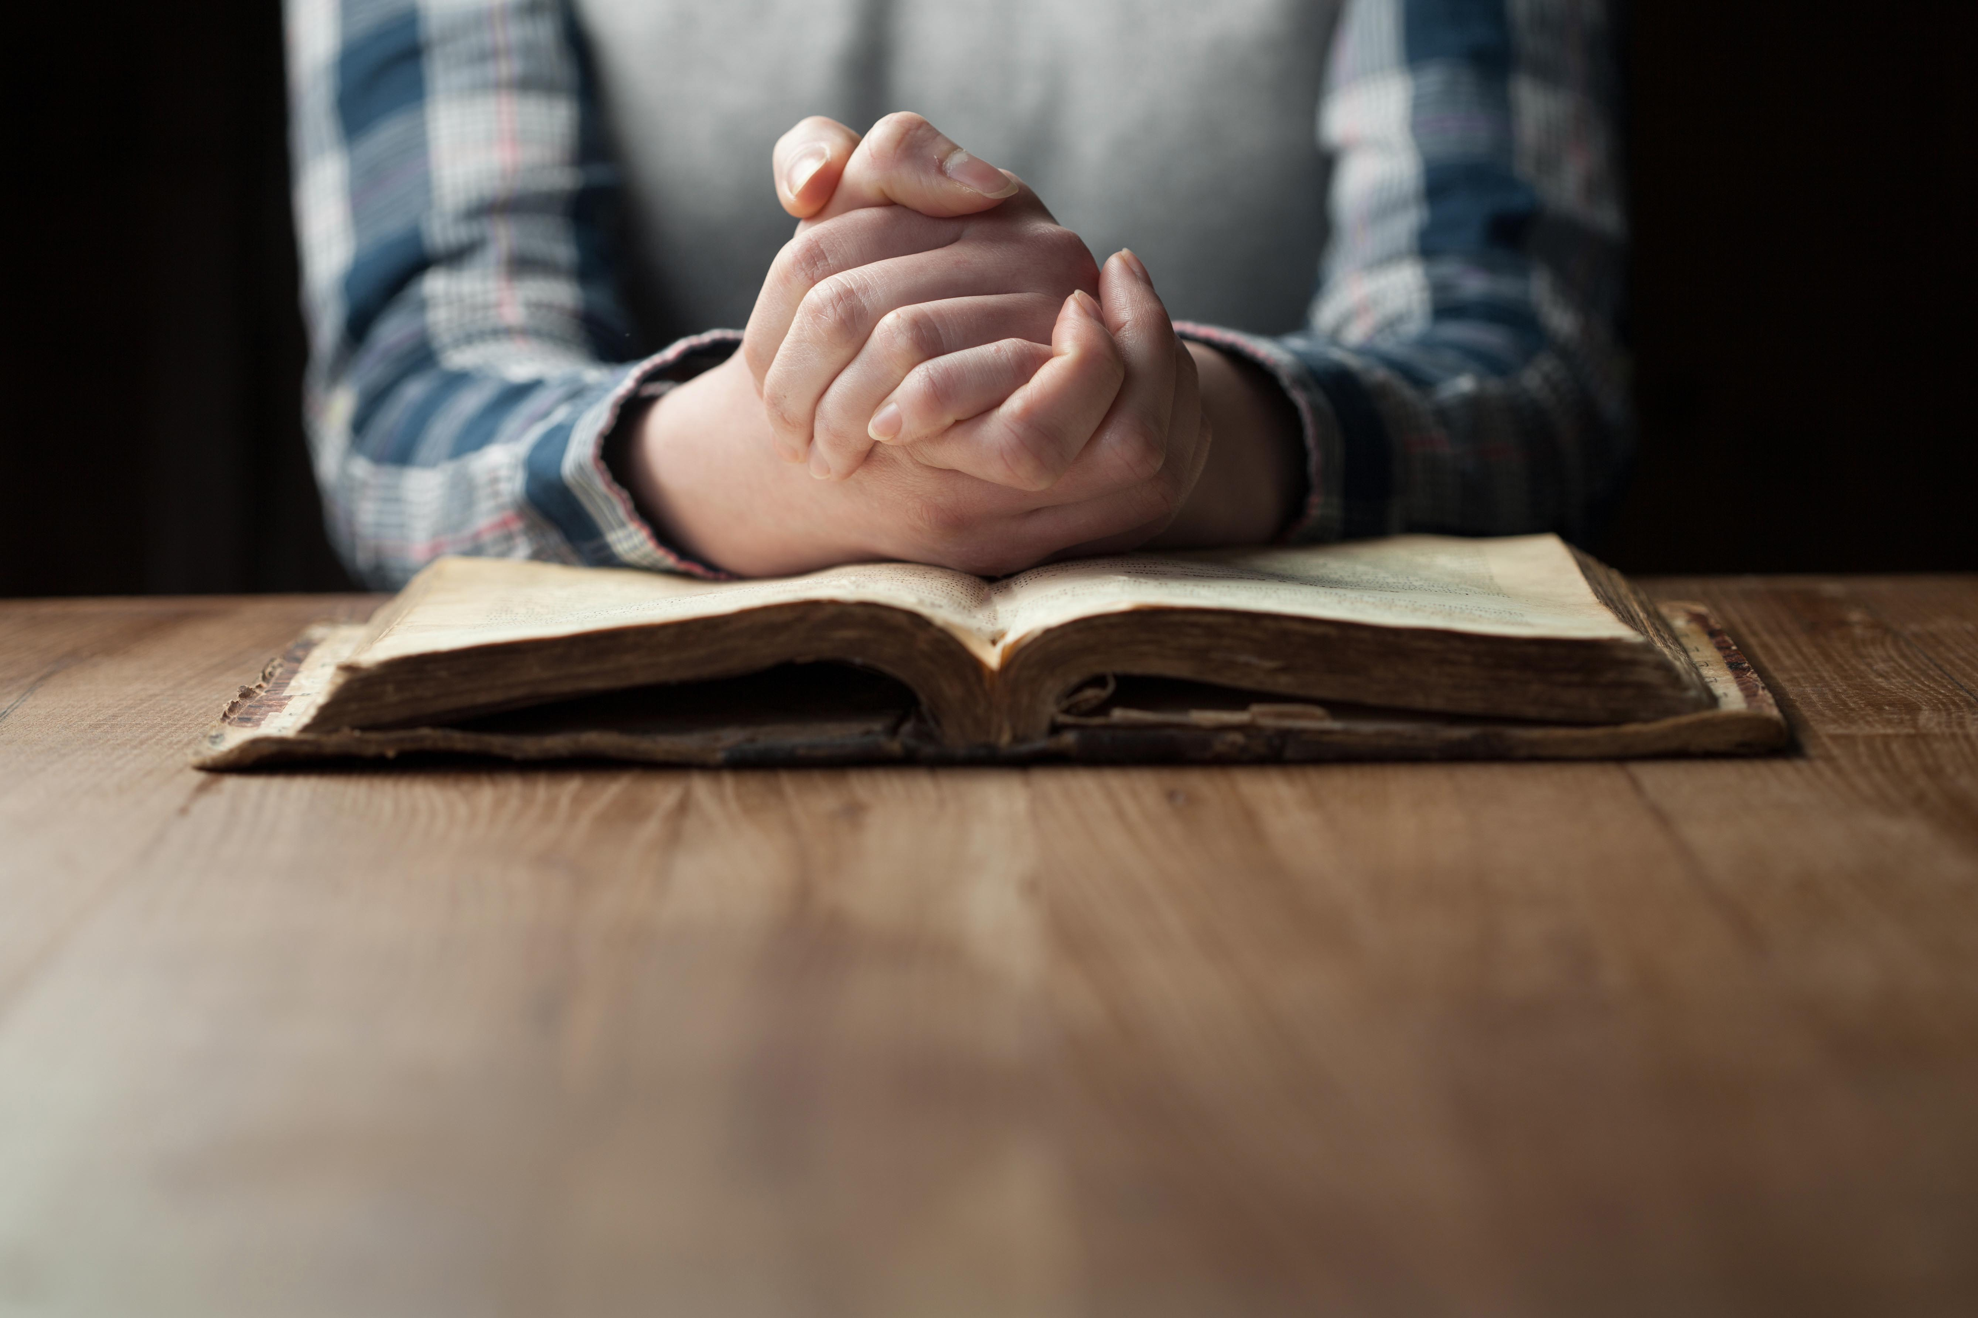
“Faith Is a Gift Freely Chosen” and “Faith Is Believing”
Having faith means believing or accepting something as true.
A creed is an official statement of one’s faith or what one believes and is always both an individual and communal act.
© 4Max/Shutterstock.com

Slide 9
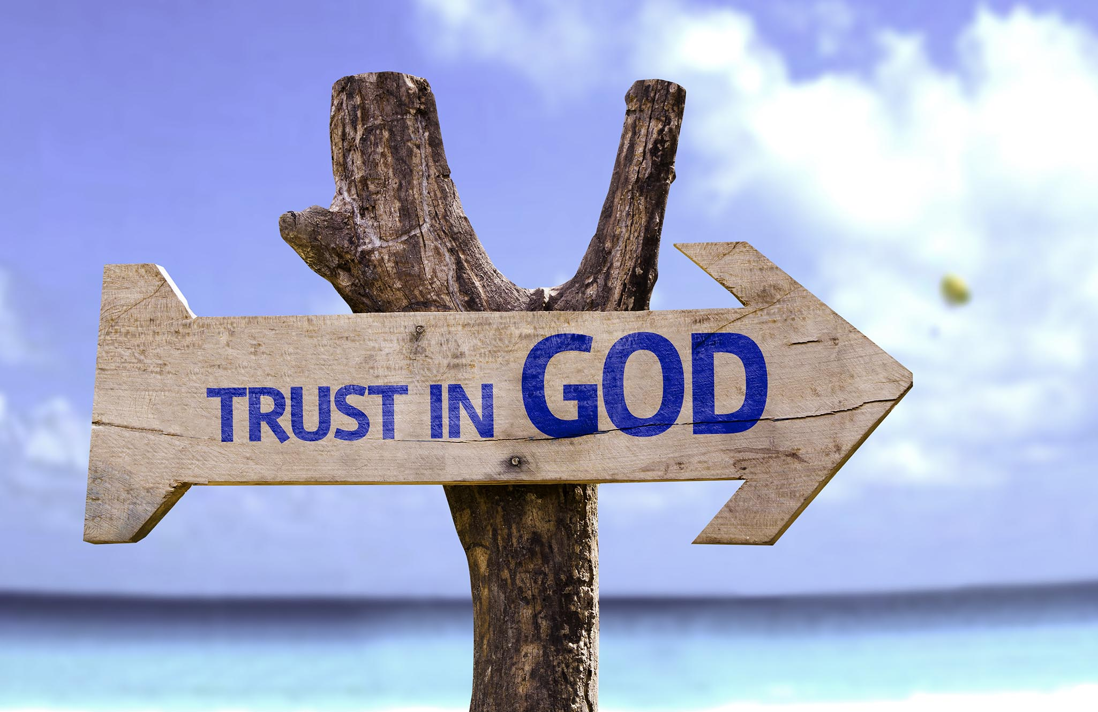
“Faith Is Trusting” (Handbook, Pages 102–103)
Having faith means you trust.
We trust God and acknowledge that we cannot ever be truly happy without him.
Trusting God is an essential ingredient of faith.
By trusting God we will give and receive more joy and happiness in this world and in the next.
© Gustavo Frazao / Shutterstock.com

Slide 10
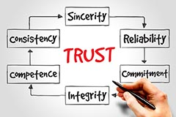
Think About It!
What does it mean to trust someone?
What are the signs that someone trusts another person?
What are some of the risks of putting your trust in people around you?
How is trusting people similar to or different from trusting God?
© dizain/Shutterstock.com

Slide 11
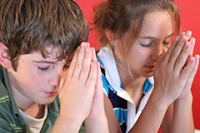
“Faith Is Doing” and “Faith in God Alone” (Handbook, Pages 104–106)
Having faith means you act upon what you believe.
Actions make real your belief and trust in God.
© Andi Berger / Shutterstock.com

Slide 12
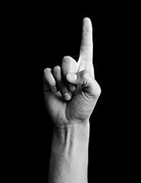
In God Alone
Christianity is monotheistic, meaning we believe in only one God.
God is our true home, and we will be truly satisfied only by doing his will.
Some Christians have chosen to give up all they have to place their faith in God alone.
© Jesus Cervantes / Shutterstock.com

Slide 13

Review It!
Faith Versus Hypocrisy
For each of the following beliefs, identify one faithful action and one hypocritical action.
Example:
Belief or Promise: I am a good student.
Faithful Action: My homework is done on time.
Hypocritical Action: My homework is always late.
© Rawpixel.com/Shutterstock.com

Slide 14
Faith Versus Hypocrisy
For the following belief, identify one
faithful action and one hypocritical action.
Belief or Promise: I am a good friend.
Faithful Action: ?
Hypocritical Action: ?

Slide 15
Faith Versus Hypocrisy
For the following belief, identify one
faithful action and one hypocritical action.
Belief or Promise: I am a good Christian.
Faithful Action: ?
Hypocritical Action: ?

Slide 16
Faith Versus Hypocrisy
For the following belief, identify one
faithful action and one hypocritical action.
Belief or Promise: I am a practicing Catholic.
Faithful Action: ?
Hypocritical Action: ?

