Slide 1
The Social Doctrine of the Church: Papal Social Teachings
Catholic Social Teaching
Document #: TX001964
Notes:
Intended Use: The instructor will present the PowerPoint and students will take notes to complete a chart.
Music: Introduction music with the song “We Are Called to Act for Justice” or another appropriate song indicating Catholic social thought.

Slide 2
The eighteenth and nineteenth centuries (the 1700s and 1800s) were a time of dramatic change in the western world.
By Adamantios (Own work) [CC-BY-SA-3.0 (www.creativecommons.org/licenses/by-sa/3.0) or GFDL (www.gnu.org/copyleft/fdl.html)], via Wikimedia Commons
In Europe and the United States, numerous scientific discoveries and applications led to new developments in exploration, navigation, medicine, communication, and manufacturing.

Slide 3
These developments led to the rise of factories, an increase in international commerce, and the growth of large cities with working-class populations.
WikiMediaCommons
Leading thinkers were proposing new economic and political systems, such as capitalism, socialism, and popular democracies.

Slide 4
Significant changes took place in governments and economics:
WikiMediaCommons
1. Kings and queens were replaced with popularly elected parliaments and congresses.
2. Agricultural economies were replaced by manufacturing economies.
3. Guilds and craftsmen were replaced with factories employing hundreds of people.
These changes led the Church to apply God’s eternal moral truth to these new social challenges, resulting in the development of the social doctrine of the Church.

Slide 5
1891: Rerum Novarum (On the Condition of Labor) Pope Leo XIII
The first social justice encyclical was written in response to the Industrial Revolution.
The economies of the society shifted from a dependence on agriculture to a dependence on products being produced in factories.
In these new workplaces, workers were being overworked, underpaid, and sometimes abused, even beaten. Children were forced to work in some factories, toiling in dangerous conditions under cruel supervisors.

Slide 6
1891: Rerum Novarum (On the Condition of Labor)—Pope Leo XIII (continued)
Pope Leo XIII wrote this historic document as a call to solve modern problems through reason and Divine Law.
Rerum Novarum addressed the idea that workers and business owners must work together and respect each other’s rights.

Slide 7
1891: Rerum Novarum (On the Condition of Labor)—Pope Leo XIII (continued)
Rerum Novarum addressed the following issues:
The right of workers to dignity in the workplace
Just pay for just work
Reasonable hours (including time off on Sundays and holidays)
Safe working conditions and strict limits on child labor
The right to join labor unions to negotiate fair pay and safe working conditions

Slide 8
1891: Rerum Novarum (On the Condition of Labor)—Pope Leo XIII (continued)
Pope Leo XIII also said that social institutions—including corporations and governments—must promote justice:
Workers and business owners must strive for fair distribution of private property.
The wealthy have a moral obligation to share their material wealth to alleviate the lack of material needs of others.
Governments must serve the common good and make the meeting of basic human rights their first priority.

Slide 9
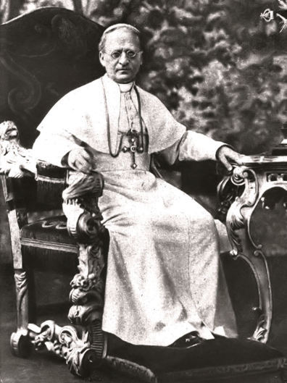
1931: Quadragesimo Anno (The Reconstruction of the Social Order)—Pope Pius XI
This next social justice encyclical, by Pope Pius XI, addresses several important topics still relevant to us today.
Criticizes both capitalism and socialism.
Criticizes the growing gap between those who are rich and those who are poor.
Introduces the concept of subsidiarity.
States that governments must serve the common good and make the meeting of basic human rights their first priority.

Slide 10
Image in shutterstock
1961: Mater et Magistra (Christianity and Social Progress)—Pope Saint John XXIII
Mater et Magistra was written thirty years after Quadragesimo Anno to address both ongoing and new issues relevant to the times.
Expresses concern for workers and women
Criticizes the gap between rich nations and poor nations
Teaches that excessive spending on weapons threatens society

Slide 11
Image in shutterstock
1963: Pacem in Terris (Peace on Earth)—Pope Saint John XXIII
This social justice encyclical espouses issues of peace and warns of the dangers of solving conflict through violence.
Warns against modern warfare, especially nuclear weapons
Teaches that peace can be achieved only through a just social order
Gives a detailed list of the human rights necessary for a just social order

Slide 12
1965: Gaudium et Spes (The Church in the Modern World)—Vatican II
The Second Vatican Council issued a landmark document to respond to the social justice needs of the modern world.
Maintains that peace is not just the absence of war—it is the existence of justice throughout society
Explains that the Church must serve the world and promote the common good
Condemns the use of weapons of mass destruction
Addresses many other specific topics related to social justice

Slide 13
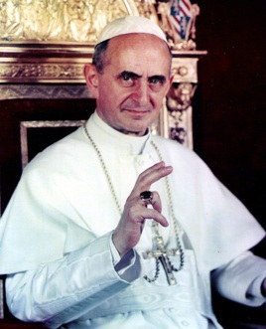
1967: Populorum Progressio (The Development of Peoples)—Pope Paul VI
This encyclical was groundbreaking in many of its themes.
WikiMediaCommons
Calls for true progress toward the economic, social, cultural, and spiritual fulfillment of human potential
Teaches that the economic development of those who are poor and the moral development of those with material wealth are linked
Criticizes unrestrained capitalism in which profit is the primary motive and in which private ownership is an absolute right

Slide 14
1975: Evangelii Nuntiandi (Evangelization in the Modern World)—Pope Paul VI
This encyclical explores the mission of the Church in great detail and links this mission to justice.
Teaches that evangelization is the Church’s central mission and that working for justice is an essential part of evangelization
Teaches that Christians must liberate people from injustice by transforming sinful social structures

Slide 15
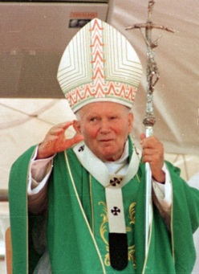
1981: Laborem Exercens (On Human Work)—Pope Saint John Paul II
Pope Saint John Paul II wrote this next document specifically to address the dignity of work.
Teaches that work is at the center of social issues
Explains that all people who are able to work have both the right and the duty to work
Emphasizes the rights of workers—people are more important than profits or the products they make
WikiMediaCommons

Slide 16
1991: Centesimus Annus (The Hundredth Year)—Pope Saint John Paul II
This encyclical was written on the hundredth anniversary of Rerum Novarum.
Explains that communism collapsed because it treated people as objects, not spiritual beings
Teaches that capitalism is efficient, but it is flawed when not oriented toward the common good
Teaches that the right to private property does not take precedence over the just distribution of the world’s resources

Slide 17
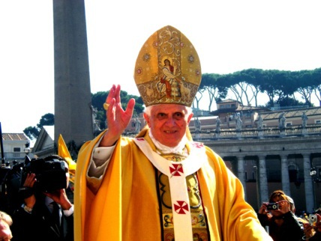
2009: Caritas in Veritate (Charity in Truth)—Pope Benedict XVI
Pope Benedict XVI is the latest to speak out on social justice issues.
WikiMediaCommons
Teaches that justice must be applied to every aspect of economic activity
Explains that religious fundamentalism as well as the exclusion of religion from society are both obstacles to a just society
Warns that technology should not drive our society—it should serve the common good

