Slide 1
Praying with Scripture
The Catholic Faith Handbook for Youth, Third Edition
Chapter 36
Document #: TX003167
Notes:
Use this presentation to introduce the students to lectio divina, inviting them to take part in the prayer as you move slowly through the slides.

Slide 2
The Living Word
All of Scripture is an expression of God’s love for us.
Sacred Scripture brings us into dialogue with God.
Scripture has the power to transform us into the persons God wants us to be.
Copyright: Richard Lowthian / www.shutterstock.com

Slide 3
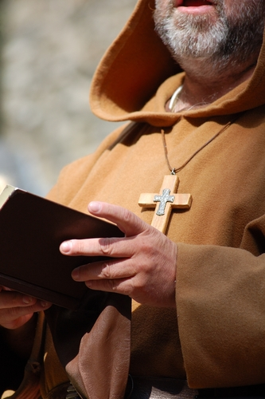
A Method of Reading: Lectio Divina
A prayer method developed in the third century
Refined by monks throughout the Middle Ages
It can be divided into five steps, or movements.
Copyright: Astrid Lenz / www.shutterstock.com

Slide 4
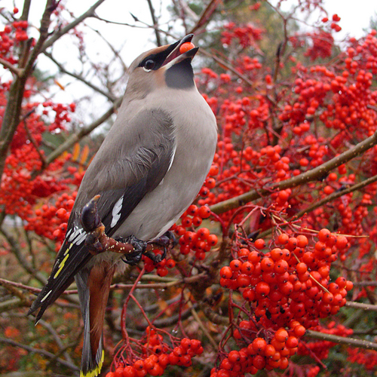
Lectio
Read slowly, allowing God’s words to sink in.
Copyright: Andreas Nilsson / www.shutterstock.com
Reread the passage several times.
Listen carefully for a word or phrase that stands out for you.
Notes:
This term is pronounced lex-ee-oh and means “reading.” Read aloud Matthew 6:25–27. Pause and reread at least once more.

Slide 5
Meditatio
Try to grasp what God is trying to say to you, personally, in this passage.
“What is God saying to me in this passage?”
“Why does this particular word or phrase stand out?”
Copyright: Doug Lemke / www.shutterstock.com
Notes:
This term is pronounced med-it-tots-ee-oh and means “meditation.”

Slide 6
Oratio
Allow yourself to be drawn into conversation with God.
Use one of these prayer forms: blessing, petition, intercession, thanksgiving, or praise.
Copyright: JÃ?Â¡nos NÃ?Â©meth / www.shutterstock.com
Notes:
This term is pronounced or-ot-see-oh and means “prayer.”

Slide 7
Contemplatio
Rest quietly in the presence of God.
Like the moment in a relationship when no words are necessary
Copyright: takayuki / www.shutterstock.com
Notes:
This term is pronounced con-tem-plot-see-oh and means “contemplation.”

Slide 8
Actio
A reminder that God’s Word will have an effect on the way we live our lives.
Consider if God is calling you to some action.
Copyright: Brian Lasenby / www.shutterstock.com
Notes:
This term is pronounced ax-ee-oh and means “action.”

