Slide 1
The Eighth Commandment
Christian Morality
Document #: TX001851

Slide 2
“You shall not bear false witness against your neighbor” (Exodus 20:16).
Shutterstock/Alexander Todorenko

Slide 3
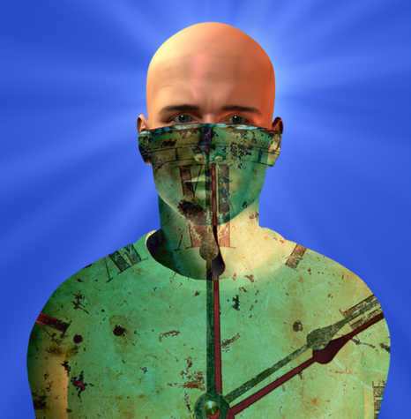
The danger of lies is that the more we use them, the less we live in reality and the more we live an illusion—a false world created by our dishonesty.
Shutterstock/Bruce Rolff

Slide 4
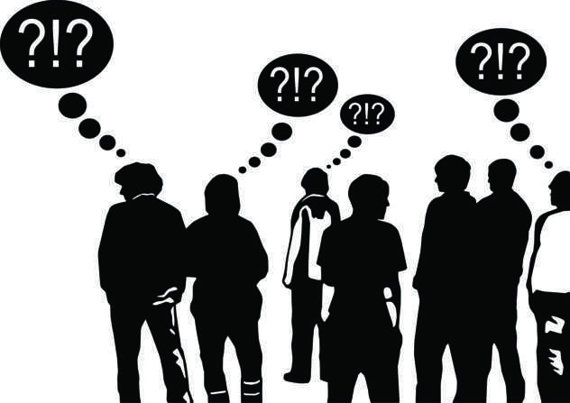
Lies destroy trust. Once we have been discovered in a lie, other people find it harder to trust what we say and do.
Shutterstock/TheGame

Slide 5
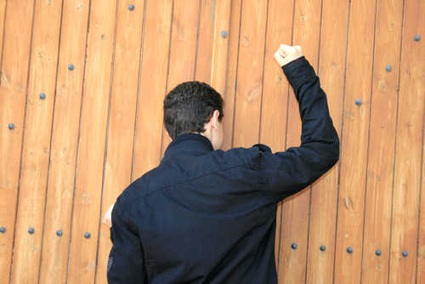
Lies affect not only our relationship with other people but also our relationship with God.
Shutterstock/ruzanna

Slide 6
I’m sorry.
We exercise the virtue of truth through the honesty of our actions and the truthfulness of our words.
Shutterstock/Peter Bernik

Slide 7
To be worthy of another person’s trust, we must be truthful in our words and actions.
Shutterstock/runzelkorn
Notes:
The scriptural quotation on slide 2 is from the New American Bible with Revised New Testament and Revised Psalms. Copyright © 1991, 1986, and 1970 by the Confraternity of Christian Doctrine, Washington, D.C. Used by the permission of the copyright owner. All Rights Reserved. No part of the New American Bible may be reproduced in any form without permission in writing from the copyright owner.

