Slide 1
The Development of Trinitarian Doctrine
Jesus Christ: God’s Love Made Visible, Second Edition
Unit 1, Chapter 2
Document#: TX004807

Slide 2
An Apostolic Faith
Leaders in the early Church needed to state the truth revealed through Jesus.
Church leaders defended the true teachings passed on from the Apostles.
© Christopher Futcher / iStockphoto.com
Notes:
Tell the students that even today, many people have their own theories about who Jesus was and what his life meant. Explain that the task of the early Church Fathers was to extend and pass on the Tradition of the Apostles; this is the same work undertaken today by the bishops and Pope.
This slide corresponds to content in article 6, “The Early Church Faces Challenges to Apostolic Faith,” in the student book.

Slide 3
Trinitarian Language Develops
The Church held a firm belief in the Trinity from the earliest times.
The language of philosophy was used to express the doctrine.
This language, difficult for us to understand, was common at that time.
© Vikram Raghuvanshi / iStockphoto.com
Notes:
Point out that modern-day theologians may draw on current language, just as the Church Fathers did in their time. For example, a bishop may write about “social justice” or “ecumenical dialogue”—terms not found in the Bible, but ones that make sense to people today.
This slide corresponds to content in article 6, “The Early Church Faces Challenges to Apostolic Faith,” in the student book.

Slide 4
Theological Terms
One substance: the divine being in unity
Three Persons: Father, Son, and Holy Spirit, each fully God, yet each distinct
The distinction among the three Persons lies in the relation of each to the others.
© UmbertoPantalone / iStockphoto.com
Notes:
Observe that the Father and Son are one substance; the Son is the Second Person of the Trinity. Point out that these terms have unique meanings when used theologically. Ask for examples of words that have specialized meanings when referring to technology (memory, tag, domain, and so on).
This slide corresponds to content in article 6, “The Early Church Faces Challenges to Apostolic Faith,” in the student book.

Slide 5
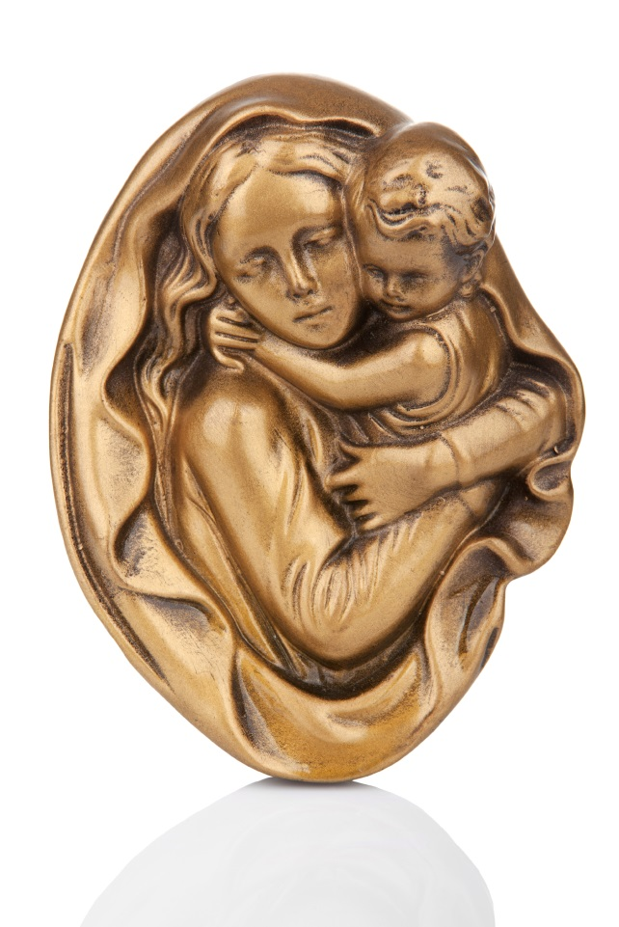
Early Christological Heresies
Some Christological heresies downplayed or denied the divinity of Jesus.
Other heresies downplayed the humanity of Jesus.
Another claimed that Jesus was not a man at all, but a semidivine being.
© gsermek / iStockphoto.com
Notes:
Direct students to use the chart in article 7 in the student book and explain more fully each heresy.
This slide corresponds to content in article 7, “Early Christological Heresies,” in the student book.

Slide 6
The Church Defends the Truth
The Christological heresies caused division within the early Church.
The Church Fathers needed to respond with a clear doctrine of the Incarnation.
Today, we benefit from their writings.
© JerryPDX / iStockphoto.com
Notes:
Explain that modern theologians study the writings of these early Church Fathers to better understand the doctrine of the Incarnation and to ensure that their own teachings remain true to the Apostolic Tradition. Ask why this is important.
This slide corresponds to content in article 7, “Early Christological Heresies,” in the student book.

Slide 7
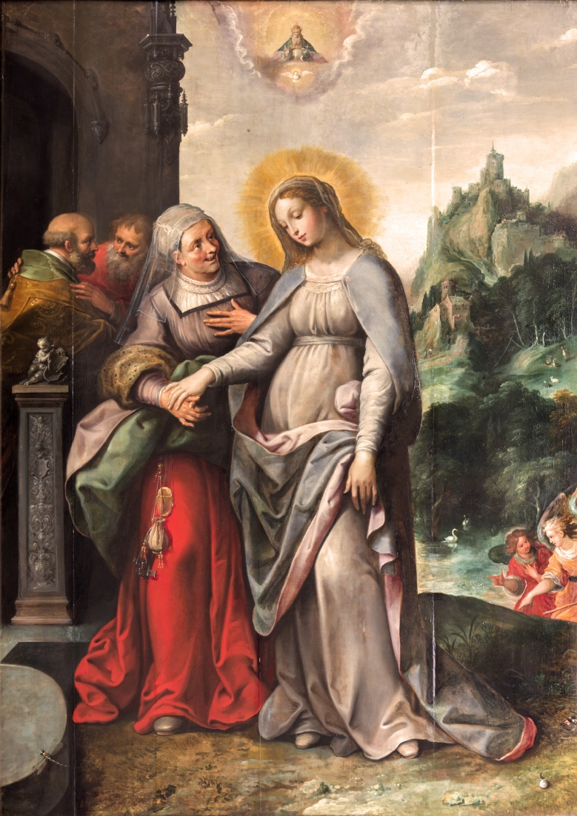
Mary, Mother of God: The Theotokos
From the earliest times, Mary was revered as the Mother of Jesus.
She received the title Mother of God at the Council of Ephesus in AD 431.
Because she is the Mother of Jesus, she is also the Mother of God.
© sedmak / iStockphoto.com
Notes:
Ask for examples of ways that we venerate Mary for her unique role in salvation history (Marian feasts, the Holy Rosary, May crowning, and so on).
This slide corresponds to content in article 7, “Early Christological Heresies,” in the student book.

Slide 8
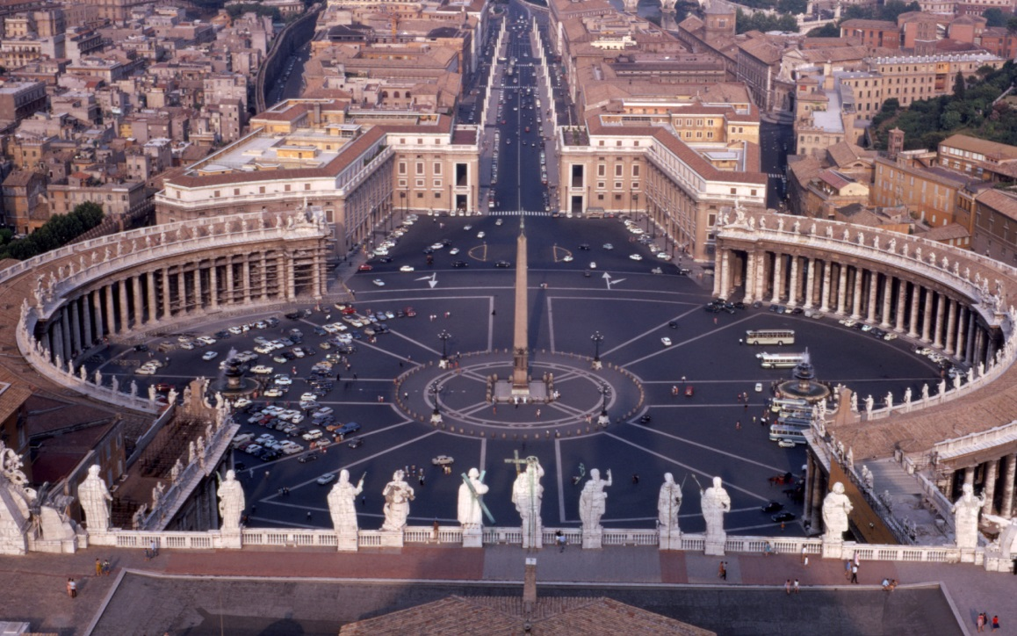
Ecumenical Councils of the Early Church
Throughout history bishops have met to discuss challenges facing the Church.
Seven Ecumenical Councils were held between AD 325 and AD 787.
The two most important of these took place in modern-day Turkey.
© barrand / iStockphoto.com
Notes:
Ask students to name the most recent Ecumenical Council (the Second Vatican Council, 1962–1965). Provide examples of how that council affected modern Catholics (liturgical reforms, revival of the role of Scripture, openness to dialogue with other faiths, and so on).
This slide corresponds to content in article 8, “The Ecumenical Councils of the Early Church,” in the student book.

Slide 9
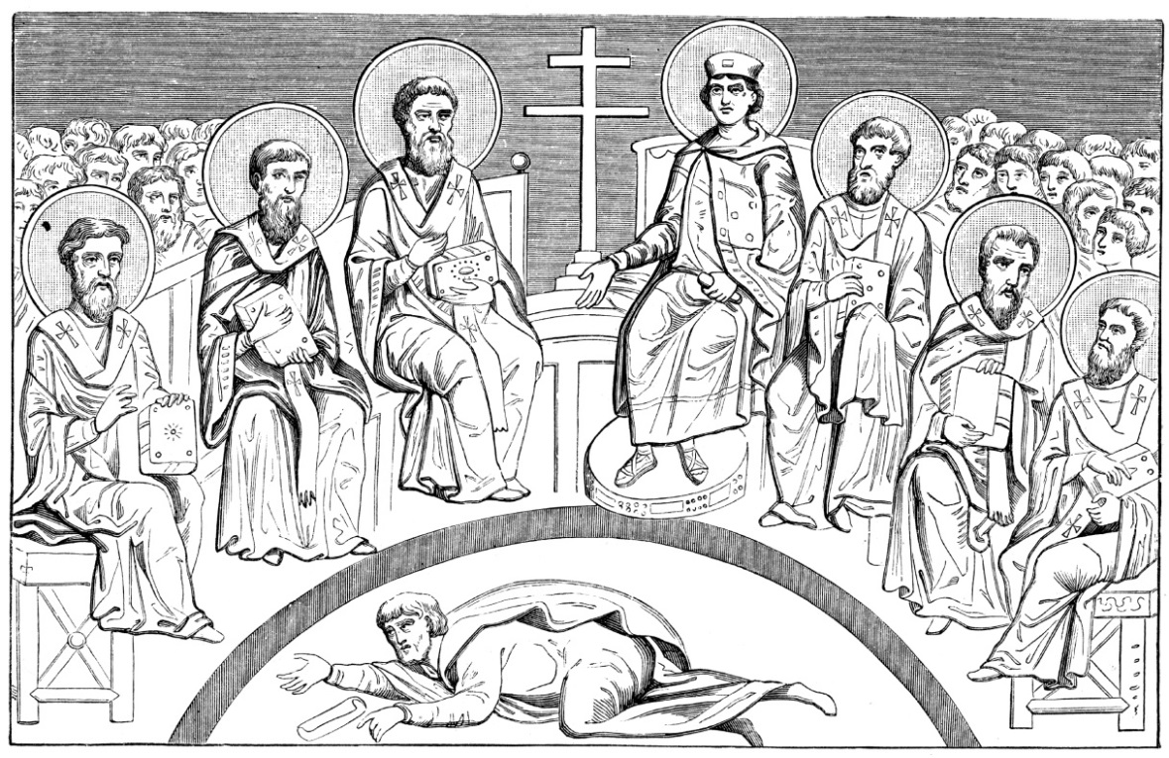
The Council of Nicaea
In AD 325 the Council of Nicaea clarified that Jesus is truly God.
The teachings of this council help us to understand who Jesus is.
This council also produced the first draft of the creed we say at Mass, the Nicene Creed.
© duncan1890 / iStockphoto.com
Notes:
Point out that the description of Jesus as “God from God, Light from Light, true God from true God” dates to the Council of Nicaea. Ask how many years Christians have been professing this phrase (nearly 1,700 years).
This slide corresponds to content in article 8, “The Ecumenical Councils of the Early Church,” in the student book.

Slide 10
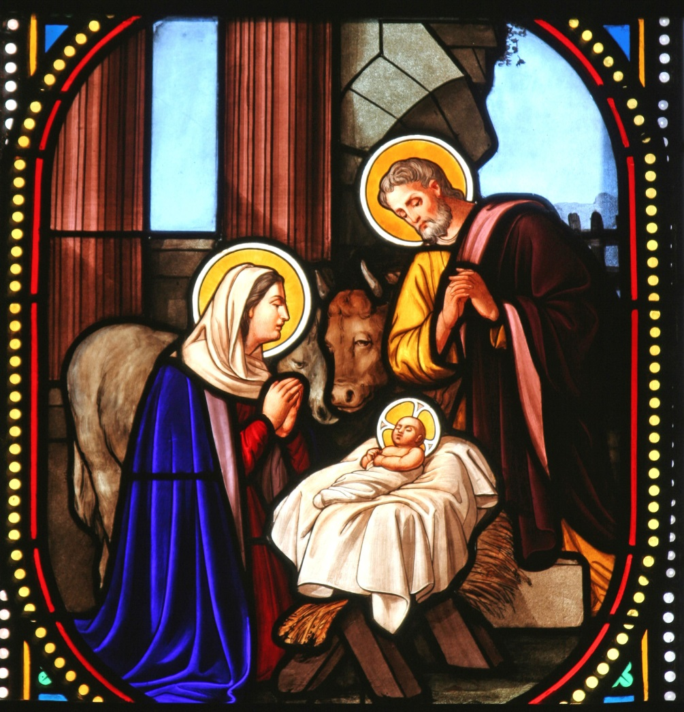
The Council of Chalcedon
In AD 451, this council stated that Jesus is fully man and fully God.
It addressed the relationship between Jesus’ humanity and his divinity.
The council taught that Jesus’ two natures are undivided and inseparable.
© ZvonimirAtleti / iStockphoto.com
Notes:
Explain that a simple way of understanding the last bullet point is to say nature refers to what someone is, while Person describes who he is.
This slide corresponds to content in article 8, “The Ecumenical Councils of the Early Church,” in the student book.

Slide 11
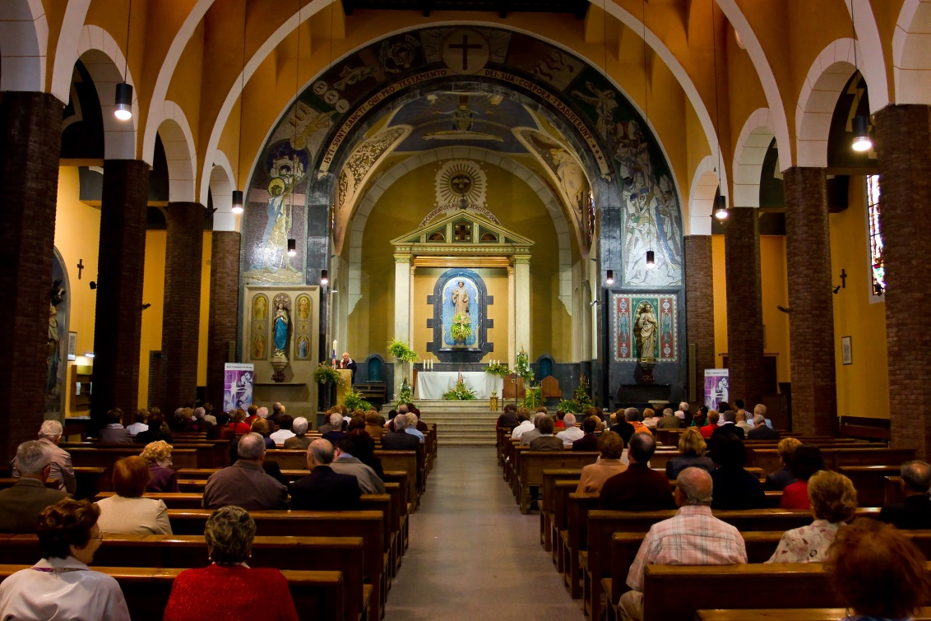
The Nicene Creed
A creed is a summary statement of the beliefs of an individual or community.
At Mass, the creed is a response to the word of God in the readings.
The creed underscores our unity as one community of faith.
© Natursports / Shutterstock.com
Notes:
Explain that when we profess the Creed after the readings and homily, we affirm our belief in the Word we have just heard proclaimed. Ask the question from the end of article 8 of the student book: “In what ways do you respond to the message of the Gospel of Jesus Christ in your own life?”
This slide corresponds to content in article 9, “The Nicene Creed,” in the student book.

Slide 12
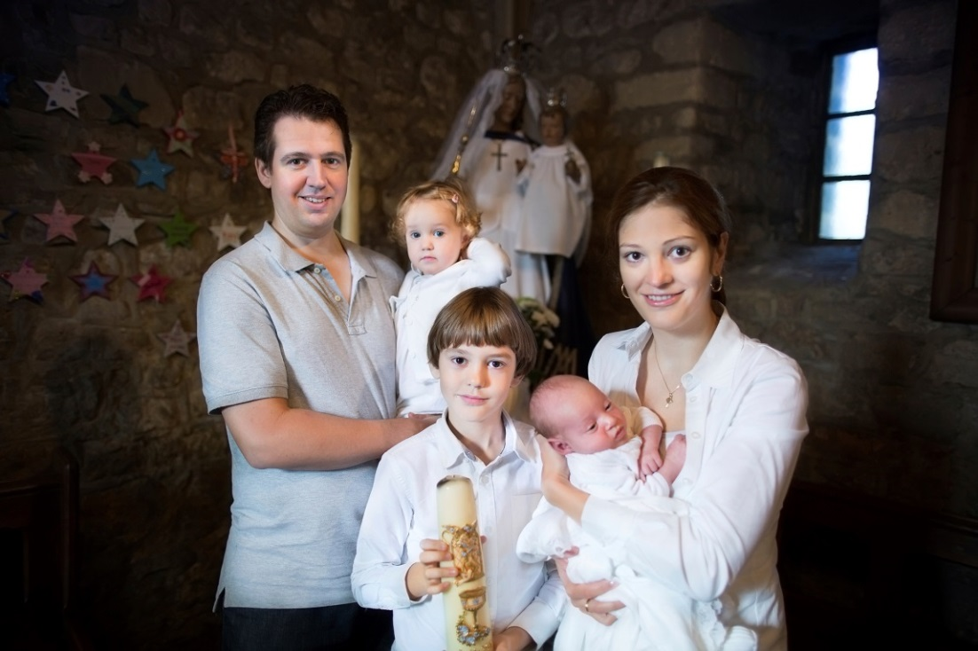
Renewal of Baptismal Promises
When we profess the Creed each Sunday, we dedicate ourselves to the Catholic faith.
We renew the promises made by us, or by others on our behalf, at our Baptism.
© FamVeld / iStockphoto.com
Notes:
Ask why a renewal of baptismal promises is even more important today than it was in the early Church (today most of us were baptized as infants, and we could not commit to the promises ourselves).
This slide corresponds to content in article 9, “The Nicene Creed,” in the student book.

Slide 13
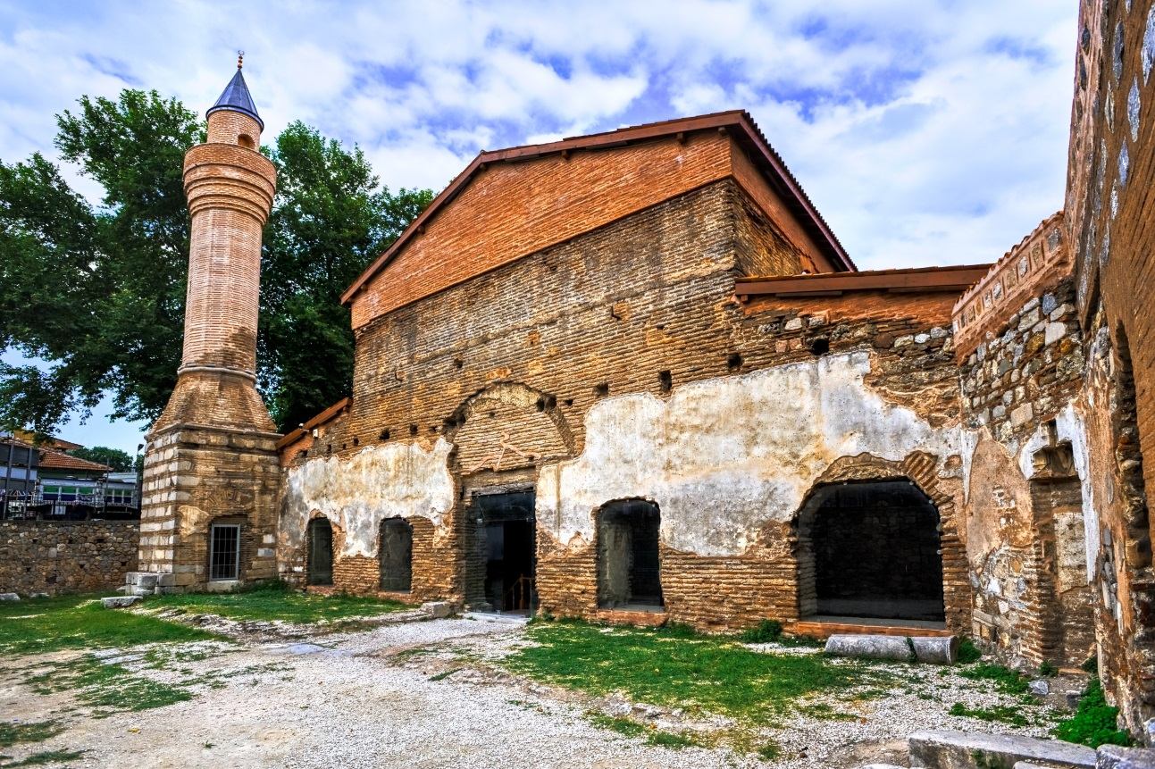
Key Concepts in the Nicene Creed
Trinitarian faith
Jesus’ birth, Death, Resurrection, and Ascension as key events in our salvation
four “marks” or characteristics of the Church
resurrection of the dead and the Last Judgment
© Boris Stroujko / Shutterstock.com
Notes:
Direct the students to read the Creed, at the end of article 9 in the student book, to find where it expresses these key doctrines of our faith.
This slide corresponds to content in article 9, “The Nicene Creed,” in the student book.

Slide 14
A Model for Relationships
Our relationships with others should emulate the unity of the Persons of the Trinity.
The Trinity is a communion of Persons who dwell together in love and unity.
It is a model for relationships built on unity and love.
© skynesher / iStockphoto.com
Notes:
Explain this idea more fully, expanding on the way the Father and Son love each other and how the Holy Spirit unites them. Ask the students to describe relationships based on the Trinity in a family, a school, a parish, and so on.
This slide corresponds to content in article 10, “The Trinity: Model for Human Relationships,” in the student book.

