Slide 1
The Forms of Prayer
The Catholic Faith Handbook for Youth, Third Edition
Chapter 34
Document #: TX003165
Notes:
Use this presentation to show the students how they can incorporate five forms of prayer into their prayer life.

Slide 2
Different Ways to Pray
Copyright: Kirill Kleykov / www.shutterstock.com
God wants to be in relationship with us in every aspect of our lives.
Different forms of prayer connect to different times and situations in our lives.
We do not need to have our lives in perfect order before we pray.
We can bring struggles, imperfections, confusions, and sins to God in prayer.
Notes:
Ask the students to reflect on the things that are difficult for them to bring before God in prayer. Encourage them to explore why they think this is the case.

Slide 3
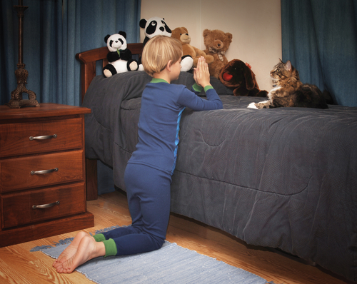
Blessing and Adoration
In blessing, we ask God’s care for a person, place, or activity.
In adoration, we acknowledge God as our Creator.
QUESTION: Which people or situations are most in need of God’s blessing today?
Copyright: James Steidl / www.shutterstock.com
Notes:
Before showing the question, ask the students if they included prayers of blessing in their bedtime prayers as children. Ask for examples of other blessings they’ve witnessed or taken part in. (Baptisms, graduations, and dedication ceremonies; blessings of groups of individuals at Mass, such as those leaving for a mission trip)

Slide 4
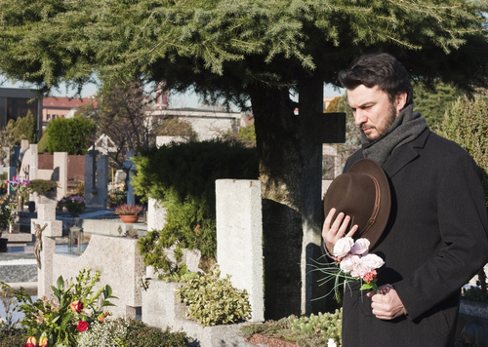
Petition
First we ask for forgiveness, and then we ask God for help.
This is the most usual form of prayer because it is the most spontaneous.
QUESTION: When are you most likely to ask for God’s help?
Copyright: Tatagatta / www.shutterstock.com
Notes:
Before showing the question, point out that when we feel confused, we can ask the Holy Spirit to pray for us.

Slide 5
Intercession
We ask God to help another person or group.
We grow in love for someone when we pray for them.
We are invited to broaden our circle of concern.
QUESTION: Who have you promised to pray for?
Copyright: Apple's Eyes Studio / www.shutterstock.com
Notes:
After the students have had time to write, ask if they would consider asking God’s help to pray for someone who has hurt them. Invite them to add those names to the list.

Slide 6
Thanksgiving
We show gratitude for the gift of life and the gifts of life.
QUESTION: Can you “give thanks in all circumstances,” as Saint Paul encourages?
Copyright: Yuri Arcurs / www.shutterstock.com
Notes:
Ask a volunteer to read “Attitude of Gratitude,” in the Live it! sidebar on page 381 of the student handbook.

Slide 7
Praise
We acknowledge that God is God, giving him glory.
QUESTION: What are some ways you could express praise for God?
Copyright: Dmitriy Shironosov / www.shutterstock.com
Notes:
Before showing the question, comment that we praise God for who he is, not only for what he has done.

