Slide 1
Vatican Council II
Church History, Unit 8

Slide 2
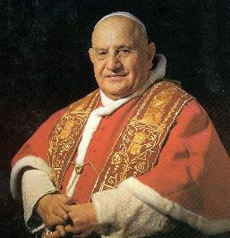
In 1958 Cardinal Angelo
Giuseppe Roncalli was
elected Pope and took the
name John XXIII.
He was a jolly man who
enjoyed people and a good
joke. He was also a serious
student of history.
He realized that the Church needed a new approach to the people of the world that she was called to serve.
Pope Saint John XXIII called Vatican Council II, an Ecumenical Council, to address the role of the Church in the world in light of modern issues.
Image in public domain

Slide 3
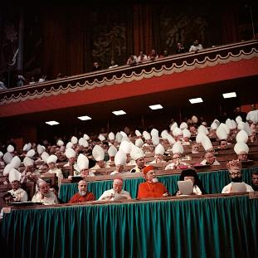
Vatican Council II included 2,450 voting delegates from around the world.
Nonvoting attendees included a broad range of advisers and observers, such as
Protestant church leaders
Orthodox church leaders
Lay theologians, including women
Image in public domain

Slide 4
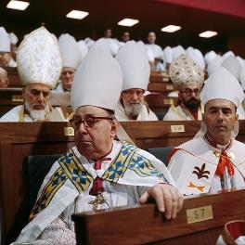
Pope Saint John XXIII called Vatican
Council II to ensure that the Church
would continue to carry the message
of the Gospel into a changing world
in new and pastoral ways:
Our duty is not only to guard this
precious treasure, as if we were concerned only with antiquity, but to dedicate ourselves with an earnest will and without fear to that work which our era demands of us, pursuing thus the path which the Church has followed for twenty centuries. (“Pope John’s Opening Speech to the Council,” in Walter M. Abbott, ed., The Documents of Vatican II, page 715)
Image in public domain

Slide 5
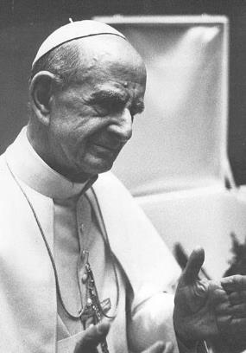
Between the first and second sessions of the Council, Pope Saint John XXIII died.
Cardinal Giovanni Montini was elected Pope Paul VI.
Pope Paul VI guided Vatican Council II to its completion and oversaw the early efforts to implement the Council’s changes and reforms, such as changes in the liturgy.
Image in public domain

Slide 6
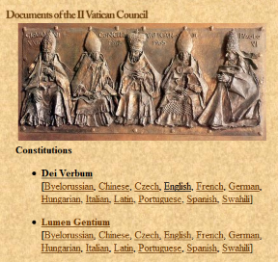
Vatican Council II produced three
types of official documents:
Constitutions—concerned
doctrine and dogma; restated
teachings in modern language
Decrees—concerned renewal
of some aspect of Church life;
required further action
Declarations—provided general instruction on vital topics in the Church and the world, with implementation left up to local bishops
The constitutions provided the foundation for the decrees and declarations.
Image in public domain

Slide 7
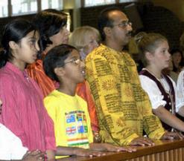
The Four Constitutions of Vatican II
The Council produced four constitutions to restate Church teachings in modern language:
Constitution on the Sacred Liturgy (Sacramentum Concilium)—Reaffirms the liturgy as the source and summit of Christian life and calls for changes to encourage the full and active
participation of the faithful.
Dogmatic Constitution on the
Church (Lumen Gentium)—
Defines the Church as the
People of God.
Image in public domain
Notes:
Wittman image

Slide 8
The Four Constitutions of Vatican II (continued)
Dogmatic Constitution on Divine Revelation (Dei Verbum)—Recalls that God has revealed himself to grant us a share in divine life. Encourages all people to study Scripture, and affirms the role of the Magisterium in its authentic interpretation.
Pastoral Constitution on the Church in the Modern World (Gaudium et Spes)—Expresses pastoral concern for the joys, hopes, grief, and anguish of the modern world. Reiterates the dignity of the human person and the need for social justice and service.

Slide 9

The Nine Decrees of Vatican II
The Council also issued nine decrees
to promote renewal of some aspect
of Church life.
Decree on the Mass Media
(Inter Mirifica)—Explains that journalism has a responsibility to lead people down the path of good, not evil.
Decree on the Catholic Churches of the Eastern Rite (Orientalium Ecclesiarum)—Recognizes the autonomy and liturgical practices of the Eastern Catholic Churches.
Decree on Ecumenism (Unitatis Redintegratio)—Calls Catholics to appreciate Christian values found in other faiths as well as the Catholic Church.
Image in public domain

Slide 10
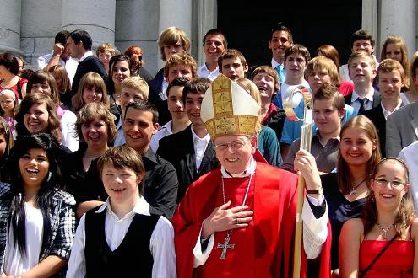
The Nine Decrees of Vatican II (continued)
Decree Concerning the Pastoral Office of Bishops in the Church (Christus Dominus)—Describes a bishop’s role in the universal Church, in his local churches, and in cooperation for the common good.
Decree on the Up-to-Date Renewal of Religious Life (Perfectae Caritatis)—Calls religious men and women to base their lives on the Gospel while adapting to serve modern needs.
Decree on Priestly Training (Optatam Totius)—Encourages priestly vocations and suggests updated seminary structures and ongoing formation programs for priests.
Image in public domain
Notes:
Image: Bischof Kurt Koch 24.5.2009 Firmung Solothurn, vor der St. Ursenkathedrale

Slide 11
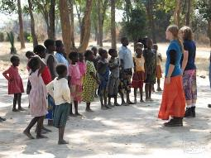
The Nine Decrees of Vatican II (continued)
Decree on the Apostolate of the Laity (Apostolicam Actuositatem)—Encourages laypeople to renew the world as ambassadors of Christ.
Decree on the Missionary Activity of the Church (Ad Gentes)—Provides guidance to those engaged in missionary work throughout the world.
Decree on the Ministry and Life
of Priests (Presbyterorum
Ordinis)—Provides guidance for
priests to adapt to modern
challenges and opportunities.
Image in public domain

Slide 12

The Three Declarations of Vatican II
The Council issued three declarations, or instructions, about important issues in the Church and the world.
Declaration on Christian Education (Gravissimum Educationis)—Reaffirms the universal right to an education and describes Catholic schools for all ages.
Declaration on the Relation of the Church to Non-Christian Religions (Nostra Aetate)—Expresses high regard for non-Christian religions, with special attention to Hinduism, Islam, and Judaism.
Declaration on Religious Freedom (Dignitatis Humanae)—Asserts that each human person is and must be free to make decisions of conscience.
Image in public domain
Notes:
(The excerpt on slide 4 is from “Pope John’s Opening Speech to the Council,” in The Documents of Vatican II, Walter M. Abbott, general editor [New York/Cleveland: Corpus Books, 1966], page 715. Copyright © 1966 by The America Press.)

