Slide 1
Literary Forms in the Bible
The Paschal Mystery
Unit 1, Chapters 1-3
Document #: TX005793
Notes:
Notes: This presentation is a review of different literary forms in Scripture, based on the table in article 24, “Literary Analysis of Scripture,” in The Living Word: The Revelation of God’s Love, Second Edition. Reviewing the material can help students prepare to study the Creation accounts and understand the connection between the story of Adam and Eve and the Fall and the story of the Paschal Mystery. It can also provide a review of salvation history, as the students prepare to study the purpose and events of Jesus’ coming to earth.

Slide 2

Creation Accounts
Explain how something came into existence
Not intended as literal history or science
© kavram / Shutterstock.com
Notes:
Notes: Ask students for examples (Adam and Eve, Noah, Tower of Babel).

Slide 3
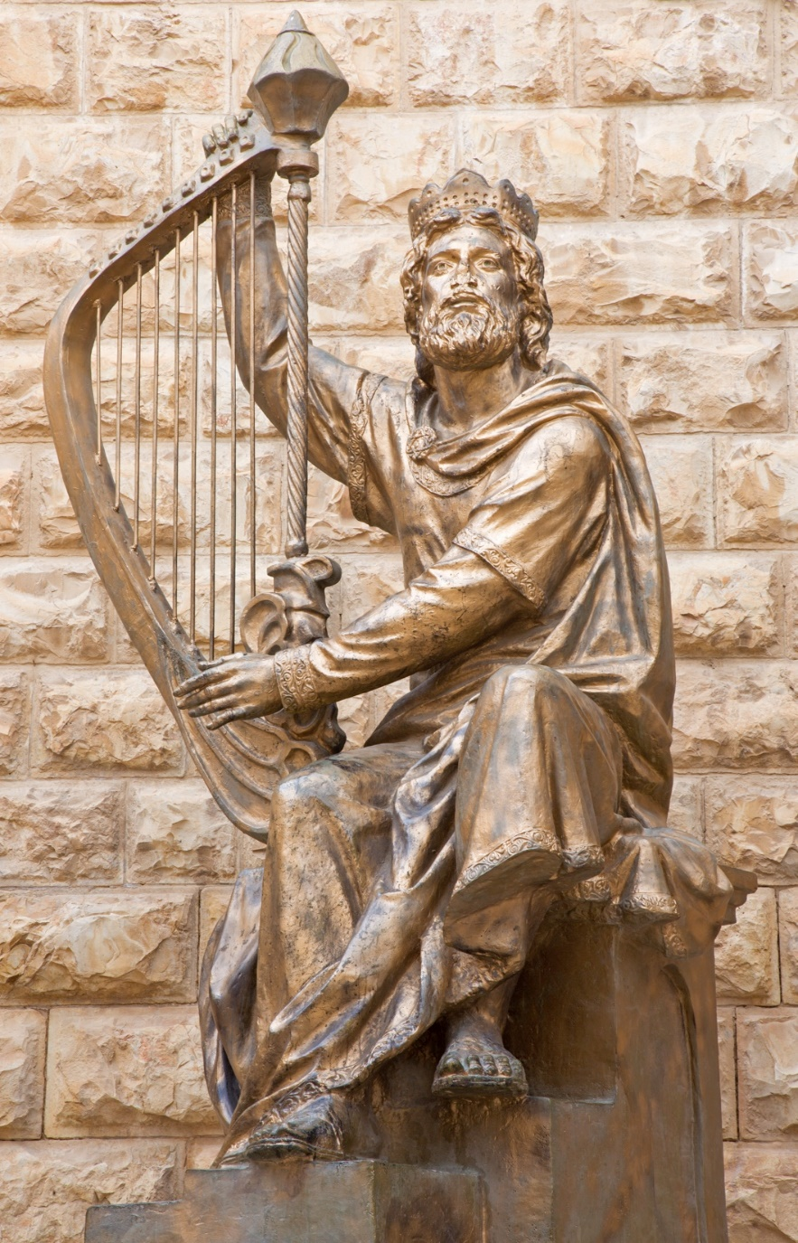
Psalms
Hymns or songs of prayer
Express praise, thanksgiving, petition, lamentation, or historical memory of God’s action on behalf of the Chosen People
© Renata Sedmakova / Shutterstock.com
Notes:
Notes: Ask the students for biblical examples of other hymns or songs of prayer besides the Book of Psalms. Appropriate examples include Exodus 15:1–18 (the Israelites’ song after crossing the Red Sea), Judith 16:1–17 (Judith’s hymn of deliverance), Lamentations, and Daniel 3:26–45 (Azariah’s prayer in the furnace).

Slide 4

Prophetic Oracles
© fotogestoeber / Shutterstock.com
Counsel and wisdom given by God
Prophets told the people how they should act in order to please God and live a good life.
Notes:
Notes: If there is confusion, add that prophets did not foretell the future in the way we usually think of prophecies, but they did warn of negative consequences if the people failed to change their ways. Ask students for examples of prophetic oracles. Appropriate examples could be books, such as Isaiah, Jeremiah, Ezekiel, or Zechariah, or passages, such as 2 Samuel 7:4–17 (the oracle of Nathan regarding the Davidic dynasty) or 2 Kings 19:21–34 (Isaiah’s oracle to Hezekiah).

Slide 5

Historical Books
Accounts of the saving action of God in human history
© MonicaNinker / iStock
Notes:
Notes: Ask for examples (such as Joshua, Judges, First and Second Samuel, First and Second Kings). You may want to note that the biblical novellas (Tobit, Judith, Esther, and First and Second Maccabees) are often categorized as historical books; although the first three were not written as historical records, they provided important lessons and encouragement about God’s care for his people.

Slide 6

Wisdom Literature
Collections of sayings and teachings
Instruct how to live a good and wise life, a life pleasing to God
© Gustavo Frazao / Shutterstock.com
Notes:
Notes: Ask the students for examples: Proverbs, Ecclesiastes, Wisdom, Ben Sira (Job, Psalms, and Song of Songs are also listed in the same category in NABRE).

Slide 7

Parables
Brief stories that exemplify moral or religious lessons
End with an unexpected twist
© marekuliasz / Shutterstock.com
Notes:
Notes: Ask the students for examples (the Mustard Seed, the Prodigal Son, the Sower, the Good Samaritan, etc.). Consider giving the students time to page through the Gospels and identify the lesson and the twist in the parables they find.

Slide 8

Letters (Epistles)
Letters to early Christians
Pass on wisdom, correction, and community information
© Michaelpuche / Shutterstock.com
Notes:
Notes: Ask the students for examples (any of the New Testament books from Romans to Jude).

Slide 9
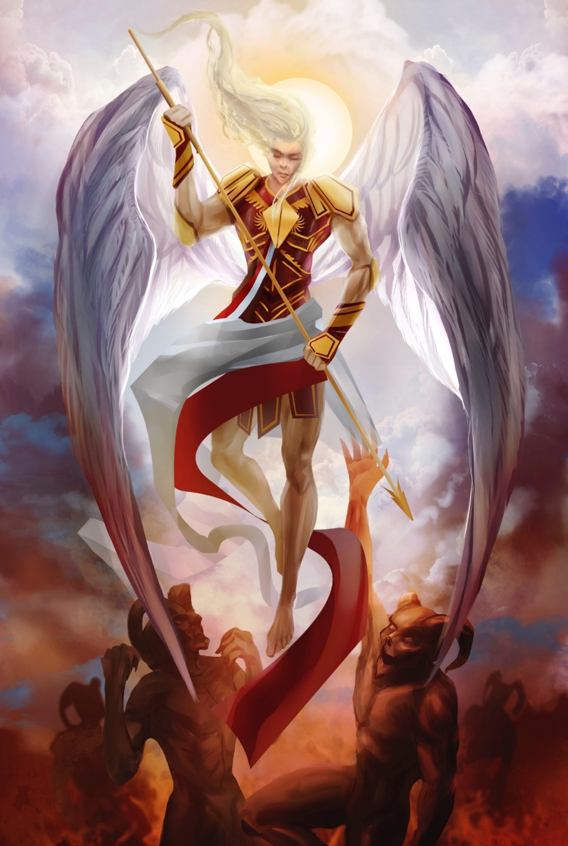
Apocalyptic Literature
Descriptions of the end times
Prophecies of catastrophic upheavals on earth
Promises of a New Creation
© breakermaximus / iStock
Notes:
Notes: Ask the students for examples: Revelation and parts of Daniel and Ezekiel. Remind them that apocalyptic literature does not literally predict what will happen at the end of time (nor does it promise a rapture of believers). Instead, it offers hope and expresses belief in God’s justice and his victory over evil.

Slide 10
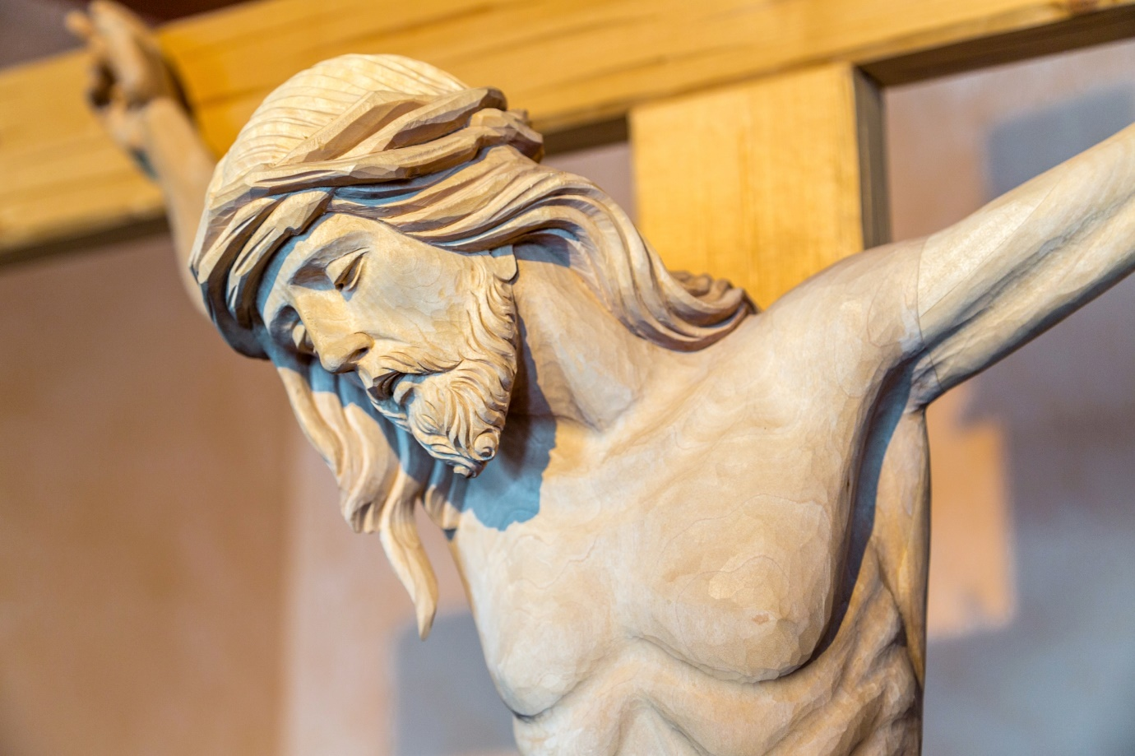
Gospels
Accounts of real events and teachings from Jesus’ life
Give deeper insight into the meaning of Jesus’ life and mission
© GoneWithTheWind / Shutterstock.com
Notes:
Notes: Ask the students to name the four Gospels; hopefully they can all do this together! Consider discussing some of the differences between the synoptic Gospels of Matthew, Mark, and Luke, and the Gospel of John, and conclude by observing that even though all four Gospels don’t have the same details, they all tell us the truth about Jesus as the Son of God and Savior of the world.

