Slide 1
Honoring Family
The Catholic Faith Handbook for Youth, Third Edition
Chapter 27
Document #: TX003158
Notes:
Use this visual meditation as a prelude to a journal exercise where students write about ways they could more fully live out the Fourth Commandment. Consider showing the slides without comment, perhaps accompanied by some quiet music.

Slide 2

Honor Your Father and Mother
The Fourth Commandment is the first one to tell us how we are to love our neighbor.
We begin with those who are closest to us.
Copyright: Yuri Arcurs / www.shutterstock.com

Slide 3

The Commandment to honor our parents is based on the natural love between parent and child that God has placed in our hearts. We are also called to honor and respect coaches, teachers, grandparents, caregivers, and others in authority.
Copyright: SvetlanaFedoseyeva / www.shutterstock.com

Slide 4
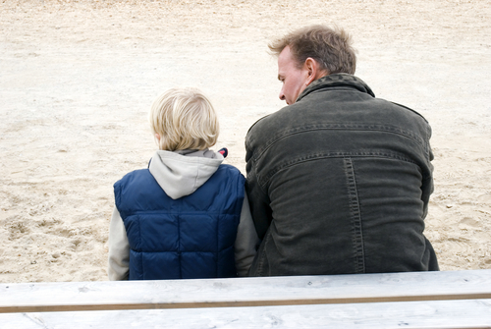
Honoring Our Parents: Respect
We should listen to our mother and father with an open and patient attitude.
We should do our best to try to understand their point of view.
Copyright: Andrew Lever / www.shutterstock.com

Slide 5

Honoring Our Parents: Gratitude
We should thank our parents for the gift of life.
We should show our parents that we appreciate all they do for us.
Copyright: iofoto / www.shutterstock.com

Slide 6

Honoring Our Parents: Obedience
We should trust our parents’ judgment, even when we don’t see the wisdom of their viewpoint.
The only exception to obedience is if a parent (or person in authority) asks us to do something that is morally wrong.
Copyright: Golden Pixels LLC / www.shutterstock.com

Slide 7
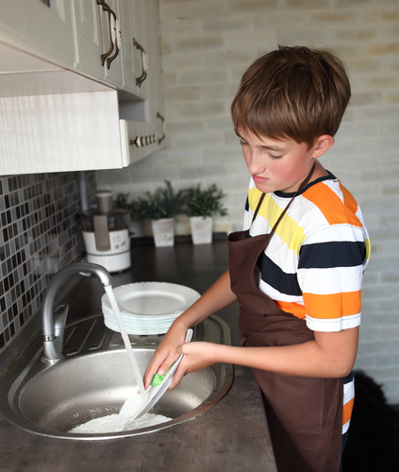
Honoring Our Parents: Assistance
We should help with chores and other family tasks.
Grown children must care for their parents in old age.
Copyright: Denizo71 / www.shutterstock.com

Slide 8

How can I more fully live out the Commandment to honor my parents?
Copyright: Konstantin Chagin / www.shutterstock.com
Notes:
Invite the students to journal on this question. If there is time, invite volunteers to share some ideas for more fully living out the Fourth Commandment.

