Slide 1
Symbols of the
Paschal Mystery
The Paschal Mystery Course
Document # TX001330
Notes:
([Notes:] Note to teacher: Ask the students to take out a notebook or journal if you would like them to respond to the symbols in writing. At the end of the presentation, the students may then share insights they noted about the Paschal Mystery or about the symbols. This method might require that you show the slides again during the discussion. Alternatively, as you show each image, lead a discussion about its meaning. Notes for each slide suggest some themes that may arise.)

Slide 2
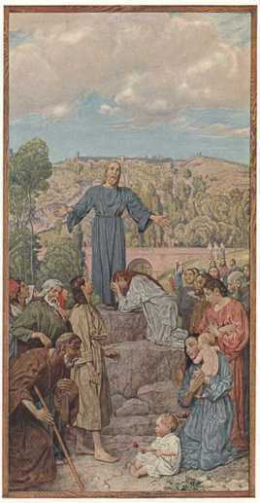
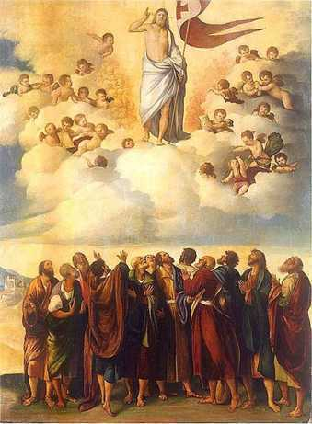
Christ the Teacher
The Risen Jesus
Images in public domain
Notes:
(Notes: The Paschal Mystery refers to the whole reality of Jesus’ saving work on earth, [Click for second image] but especially to his suffering, death, and Resurrection.)

Slide 3
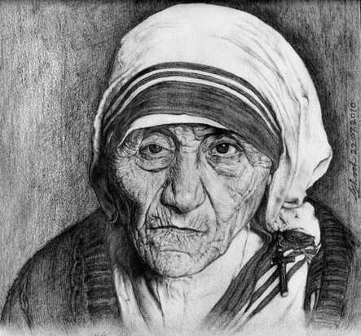
“I have been crucified with Christ; yet I live, no longer I, but Christ lives in me” (Galatians 2:19–20).
Image in public domain
Notes:
(Notes: The Paschal Mystery is not only about Jesus but also about us. What does this image suggest about what it means to be crucified with Christ and to allow Christ to live in us? Note to teacher: The students may note that women like Mother Teresa die to a self-centered life and live in Christ as they serve others. Students may note that service requires sacrifice.)

Slide 4

Image in public domain
Notes:
(Notes: We will look at some visual symbols that Christians have used throughout the ages to represent the Paschal Mystery, to remind believers that God will bring new life, hope, and goodness out of our own experiences of suffering.)

Slide 5
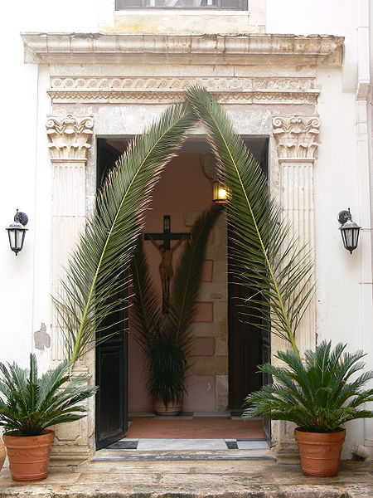
Image in public domain
Notes:
(Notes: Some symbols for the Paschal Mystery, like the cross, derive from the story of Jesus’ Passion. What does this image suggest about the Paschal Mystery? Note to teacher: The students may recall the story of the triumphal entry into Jerusalem and the messianic expectations of the people. They may mention that our own expectations are not always in keeping with God’s plans: sometimes we are disappointed, and sometimes God’s plans for us far exceed our own visions of success.)

Slide 6
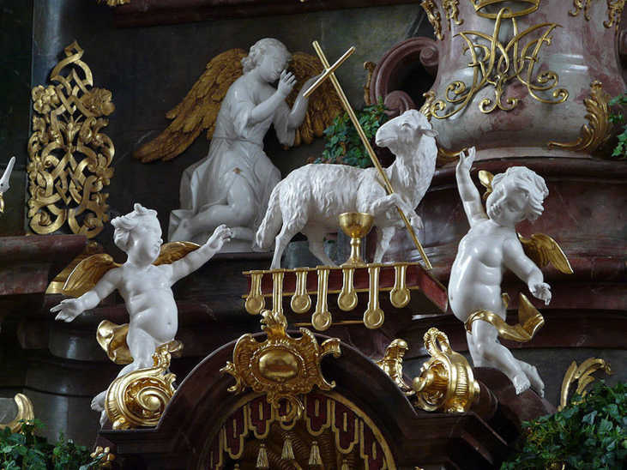
Image in public domain
Notes:
([Notes:] Note to teacher: The students may recall the symbolism of the Seder meal and the Passover lamb, sacrificed in order to protect the people from the angel of death. They may mention Jesus’ sacrifice, and our own sacrifices, as a source of life.)

Slide 7
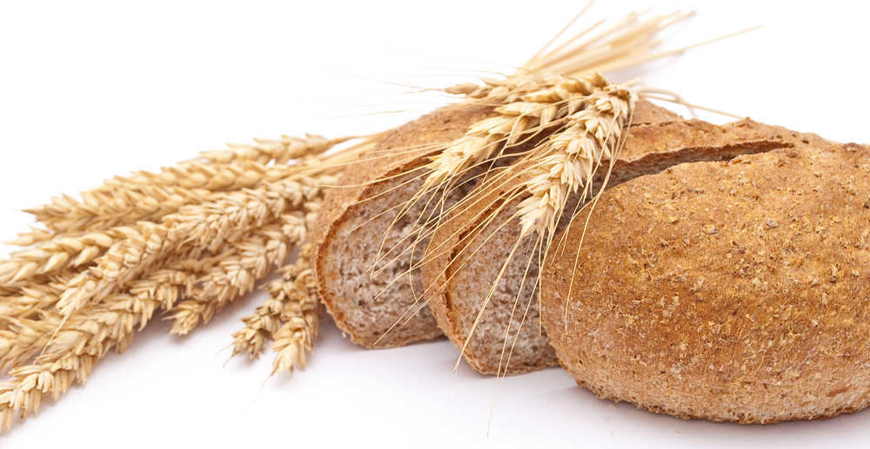
Shutterstock/SeDmi
Notes:
([Notes:] Note to teacher: The students may mention that wheat plants must die and that the grain must be ground before it becomes bread. They may note that bread nourishes us and is known as the staff of life. They may recall John 12:24: “Unless a grain of wheat falls to the ground and dies, it remains just a grain of wheat; but if it dies, it produces much fruit.”

Slide 8
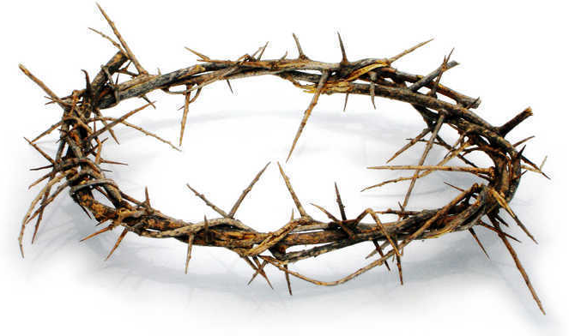
Image in public domain
Notes:
([Notes:] Note to teacher: The students may note the irony of this symbol, combining suffering and glory. They may note that our suffering sometimes brings out our best selves, that suffering sometimes leads us to understand our own mission, or that our mission sometimes involves suffering.)

Slide 9
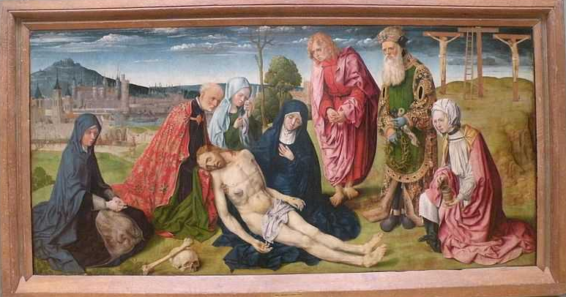
Image in public domain
Notes:
([Notes:] Note to teacher: The students may recognize that suffering takes many forms, and that we all suffer in life. They may also note that Mary does not know the glorious outcome of Jesus’ suffering as she cradles his corpse. They may note that our own suffering may lead to new life, but seeing that outcome may take time.)

Slide 10
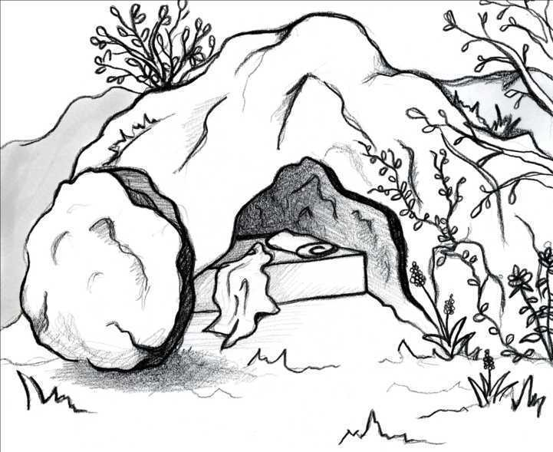
Mara Fenske/Saint Mary’s Press
Notes:
([Notes:] Note to teacher: The students may recognize the stunning reality of the empty tomb, and the hope it offers. They may note that the tomb remains empty to this day. Similarly, God can amaze us with an opportunity for new life, and God also offers us hope for the future.)

Slide 11
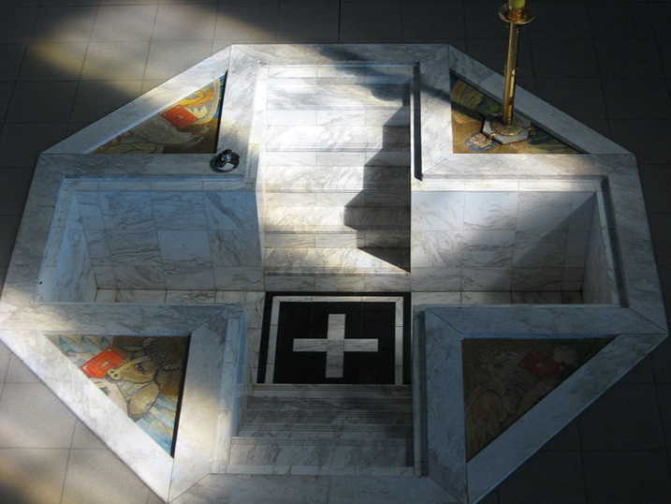
Image in public domain
Notes:
(Notes: Some symbols for the Paschal Mystery come from the Church’s worship and rituals. Note to teacher: The students may recall that Baptism is a sign of dying and rising with Christ and that adults are baptized at the Easter Vigil, following the tradition of the earliest days of the Church.)

Slide 12
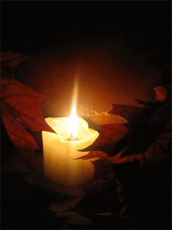
Image in public domain
Notes:
([Notes:] Note to teacher: The students may recognize this as a universal symbol of hope. They may recall that Christ is called the Light of the World and that God guides us through darkness.)

Slide 13
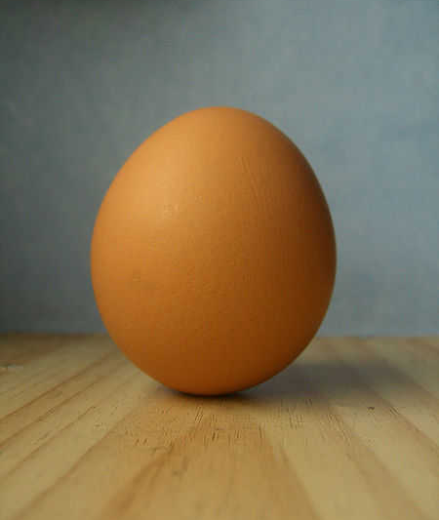
Image in public domain
Notes:
(Notes: Some symbols that were used in the early Church no longer carry their original meanings because the cultural context has changed. We still see Easter eggs, but they are now associated with treats the Easter bunny brings! In earlier times Christians borrowed the symbolism of the egg from local spring festivals. What does this symbol suggest about the Paschal Mystery? Note to teacher: The students may note that an egg symbolizes new life for Christians who are being baptized at Easter. They may mention that an egg appears to be inanimate, but it contains life. They may note that the chick inside has to struggle out of the egg, and that the shell must be shattered.)

Slide 14
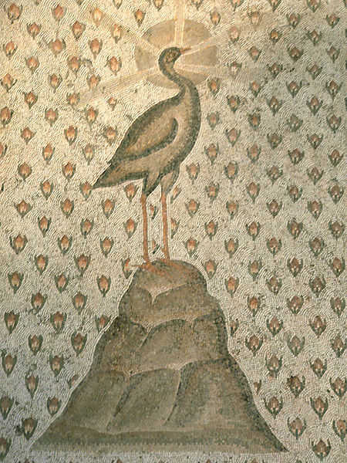
Image in public domain
Notes:
(Notes: Other images were adopted from local religions too. Note to teacher: The students may know that the phoenix was believed to burn to ashes and then regenerate. You may remind students of the phoenix in the Harry Potter stories.)

Slide 15
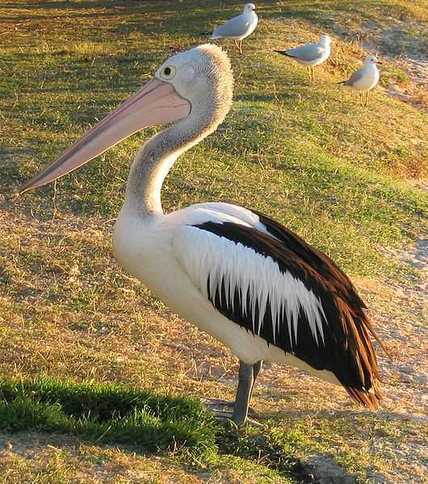
Image in public domain
Notes:
(Notes: Does anyone know why a pelican represented resurrection? Note to teacher: The students will probably not know this one. In ancient legends, the pelican was believed to pluck her own breast to feed her young with her blood, which caused her death. Thus the pelican is a symbol of Christ who died, rose, and now feeds us with his Body and Blood in the Eucharist. )

Slide 16
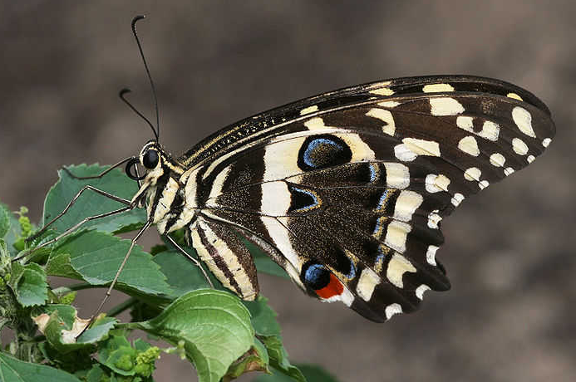
Image in public domain
Notes:
([Notes:] Note to teacher: The students may recognize that a butterfly, a beautiful creature, comes out of a dead-looking chrysalis, which it enters as a caterpillar. They may mention the theme of transformation.)

