Slide 1
Kings
Document # TX004708

Slide 2
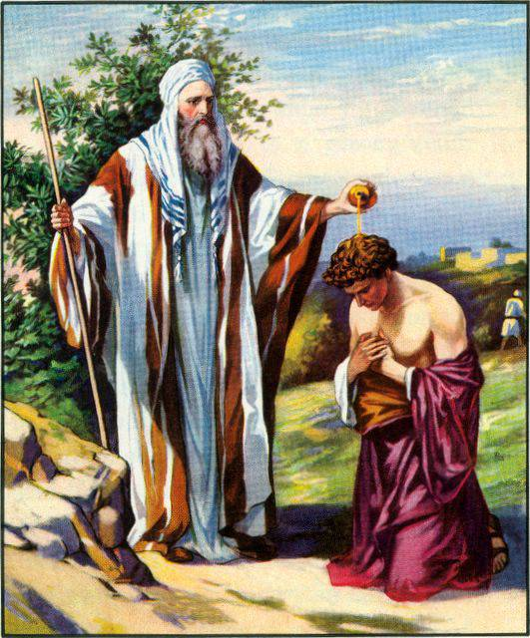
The Call for a King
The Israelites were concerned about the growing division among the Twelve Tribes and the increasing power of other nations.
Samuel, the last of the judges and the first prophet of Israel, anointed Saul as the first king of Israel.
David and then Solomon were the next two kings of Israel.
lavistachurchofchrist.org
Notes:
Notes: Review with students the reasons why the Israelites called for a king and why Samuel resisted the idea. Have students explain the difference between a monarchy and a theocracy.

Slide 3
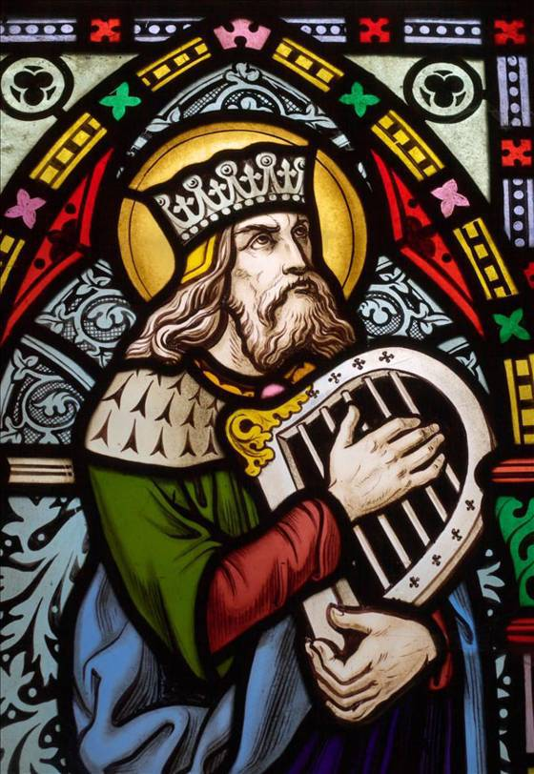
King David (1000–961 BC)
Second king of Israel
Successful military leader
Gifted musician
Savvy politician
United the Northern and Southern Kingdoms of Israel
When he followed the will of God, he accomplished great things
http://maskilledawid.files.wordpress.com
Notes:
Notes: Invite students to share what they know about David. Explain that after Moses, David is arguably the most significant figure in the Old Testament. He accomplished great things when he followed the will of God. He united the Israelites and built a kingdom unlike anything the Twelve Tribes had previously experienced. Next, we will explore how David was a deeply paradoxical man, as he is at once a “man after God’s heart” and a deeply flawed human who commits horrible sins.

Slide 4
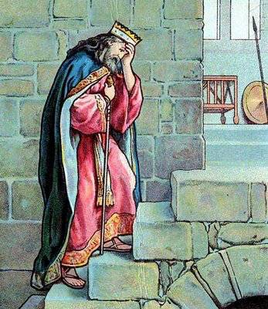
David: A Flawed and Faithful Man
David’s sin made it hard for him sometimes to see or promote the will of God.
Whenever he sinned, David returned to the Lord begging for mercy and promising to change.
2.bp.blogspot.com
Notes:
Notes: Share that though David strived to follow God’s will for him and the nation, he was distracted by his own desires. Upon becoming responsible for Bathsheba’s pregnancy, he created a situation where her husband, Uriah, was killed on the battlefield. One of Sacred Scripture’s most powerful scenes of moral condemnation and deeply sincere repentance occurred when the prophet Nathan confronted David about these related sins and David begged God for mercy, promising he would change (see 2 Samuel 12:1–23). You may wish to have the class read the story of David and Bathsheba (2 Samuel, chapter 11).

Slide 5
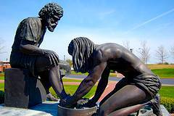
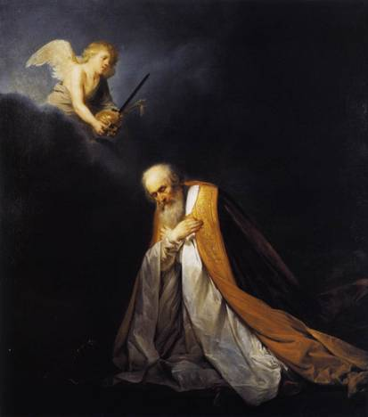
King David: Model of Servant Leadership
Despite his sins and faults, he beckons to God to raise him from the abyss of despair so he may rule with a:
Just Heart
Serving Hand
&
sulphurgrove.files.wordpress.com/2009/06/servant-leader.jpg
Servant leaders recognize their need for forgiveness and reconciliation.
In return they can extend mercy and compassion to all in need.
www.lib-art.com/imgpainting/1/0/5201-king-david-in-prayer-pieter-de-grebber.jpg
Notes:
Notes: This slide is a good opportunity to discuss other figures in the Bible who are examples of servant leaders. You may also ask the students to describe servant leaders they know from their school, church, or community.

Slide 6
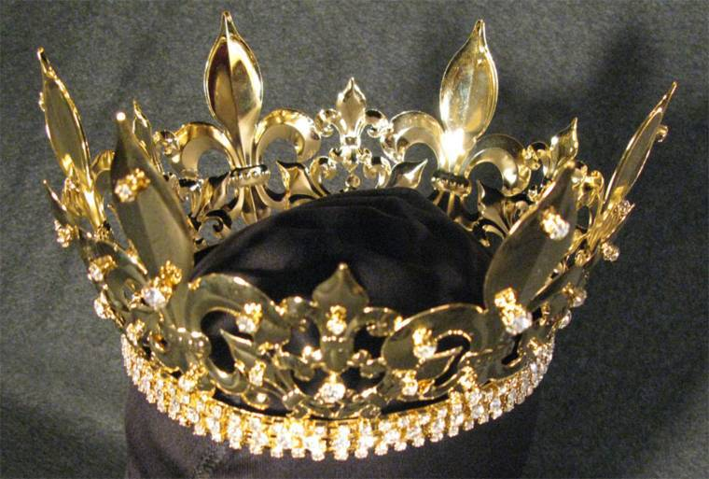
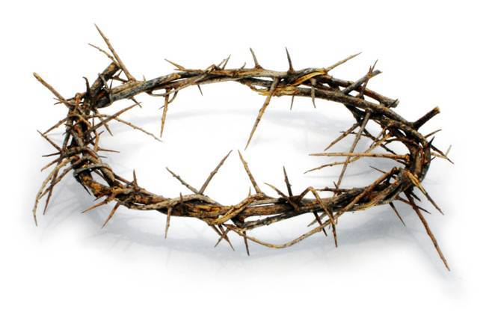
The Messiah to Come Through David’s Descendants
frmarkdwhite.files.wordpress.com/2009/02/crown.jpg
Many people of Jesus’ time did not acknowledge him as a fulfillment of this Old Testament prophecy . . .
www.torchleader.com/tl/crown.jpg
because he did not fit the traditional image of a king.
Notes:
Notes: For the Jewish people, David is the paradigmatic king. As such, it isn’t surprising that it is prophesied that the messiah and liberator of Israel will come through David’s lineage. Even though the Gospel writers carefully show how Jesus of Nazareth is of David’s lineage, many people of Jesus’ time did not see how he could be this promised messiah. This was in large part because Jesus denounced the trappings of royal leadership and wealth by taking on the humility of a man, eventually receiving death on a cross.

Slide 7
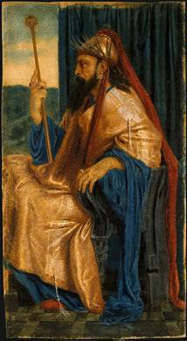
King Solomon
Son of David and Bathsheba
Man of great wisdom and judgment
Builds the Temple of the Lord in honor of his father
Strengthens and modernizes the Israelites’ army
Creates trade alliances with other nations
After his rule, the kingdom divides into the Northern and Southern Kingdoms, with a leader ruling each.
www.ipadrblog.com/solomon_King_Solomon.jpg
Notes:
Notes: Though Solomon was known for his great wisdom and discernment (see the famous story of the “two mothers” in 1 Kings 3:16–28), he was similar to his father, David, as both men were distracted from their rule by their desires. Solomon takes on hundreds of wives, including many who worshipped other gods. Even though Solomon built the grand Temple, he allowed much worship of foreign deities by his wives and others. He also imposed steep taxes and forced labor on the Israelites. Together these actions lead to rebellion, splitting of the kingdom, and the eventual conquest of both parts of the kingdom by foreign powers.

Slide 8
What do Saul, David, and Solomon have in common?
What meaning could Israelites in exile find
in the stories of the kings?
Notes:
Notes: Have the students, either in class discussion or in writing, reflect on these two questions.

