Slide 1
Sacraments at the Service of Communion
The Catholic Faith Handbook for Youth, Third Edition
Chapter 22
Document #: TX003153
Notes:
Use this presentation to help the students reflect on the vocations of ordained ministry and marriage. Invite the students to journal on the questions in the slideshow, or invite discussion.

Slide 2
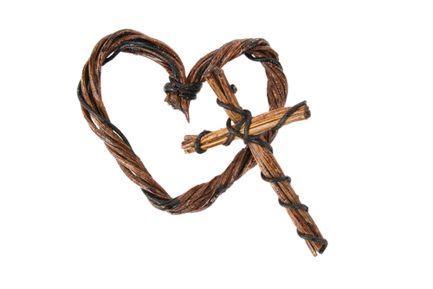
Vocation
The committed state of life that God calls us to
You may be called to be married or single; to become a priest or deacon; to be a member of a religious community.
All vocations are ways in which we serve God and one another.
Copyright: Vanessa Nel / www.shutterstock.com
Notes:
Point out that it isn’t only religious or clergy who are called to serve God and one another: all Christians are called to serve. Tell the students that the Church recognizes two vocations—married life and ordained life—as having a special place in the Church’s mission.

Slide 3
Discerning Your Vocation
What vocational choices attract you at this time?
Copyright: Pavelk / www.shutterstock.com
Notes:
Before showing the question on the slide, direct the students to read the Live It! sidebar “Discerning Your Vocation,” on page 240 of the student handbook, or ask for volunteers to read it. You may direct the students to journal on the questions in the slideshow, or invite discussion.

Slide 4
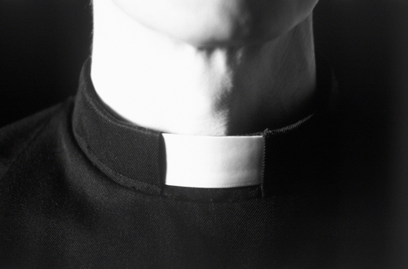
Copyright: AISPIX by Image Source / www.shutterstock.com
The Sacrament of Holy Orders
A bishop leads a diocese as chief shepherd.
A priest is a coworker with the bishop.
A deacon commits himself to works of service and liturgical ministry, as directed by the bishop.
Notes:
Discuss the specific responsibilities of each ministry, as found on pages 241–242 of the student handbook.

Slide 5
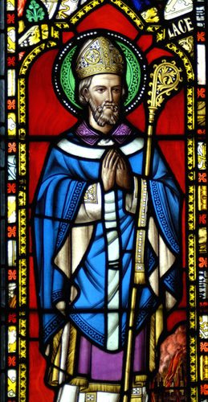
The Responsibilities of the Ordained
Which ones do you think would be most enjoyable?
Which ones do you think would be most difficult?
Copyright: Alistair Scott / www.shutterstock.com
Notes:
If the students are journaling, ask them to share their answers to this question.

Slide 6
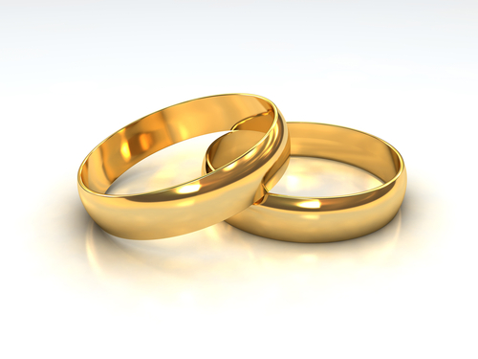
The Sacrament of Matrimony
Marriage signifies the union of Christ and the Church.
It is permanent, symbolizing God’s unending love for all humanity.
The Sacrament gives a husband and wife the grace to love as Christ loves the Church.
The Sacrament is the foundation for the Christian family.
Copyright: Tristan3D / www.shutterstock.com
Notes:
Ask the students how Christ shows his love for the Church. (Christ’s love is constant, eternal, and sacrificial.)

Slide 7
Marriage
Copyright: wavebreakmedia / www.shutterstock.com
Think about two people whom you believe have a good marriage. What makes their marriage a good one?
Notes:
Invite the students to journal about their answers. You may also wish to have volunteers share with the large group.

Slide 8
Sacraments at the Service of Communion
The Sacrament of Holy Orders
The Sacrament of Holy Matrimony
Copyright: Vanessa Nel / www.shutterstock.com
Notes:
Remind the students that the mission of the Church is to spread the Good News of Christ. Ask them why these two Sacraments have a special place in that mission. (The clergy minister to the community; spouses minister to each other, their children, their extended family, and within the parish. Both teach, live out the Gospel, and serve others.)

