Slide 1
Images of Easter
The Paschal Mystery
Unit 5, Chapter 12
Document #: TX005802
Notes:
Notes: This presentation offers images from Easter liturgies to help the students meditate on the meaning of the rituals and symbols. Consider quietly playing Easter hymns or other exultant music such as the “Hallelujah Chorus” as you go through the slides. If possible, add photos from your local parish’s Easter celebrations. Above all, a sense of joy should surround this presentation. Christ is risen!

Slide 2
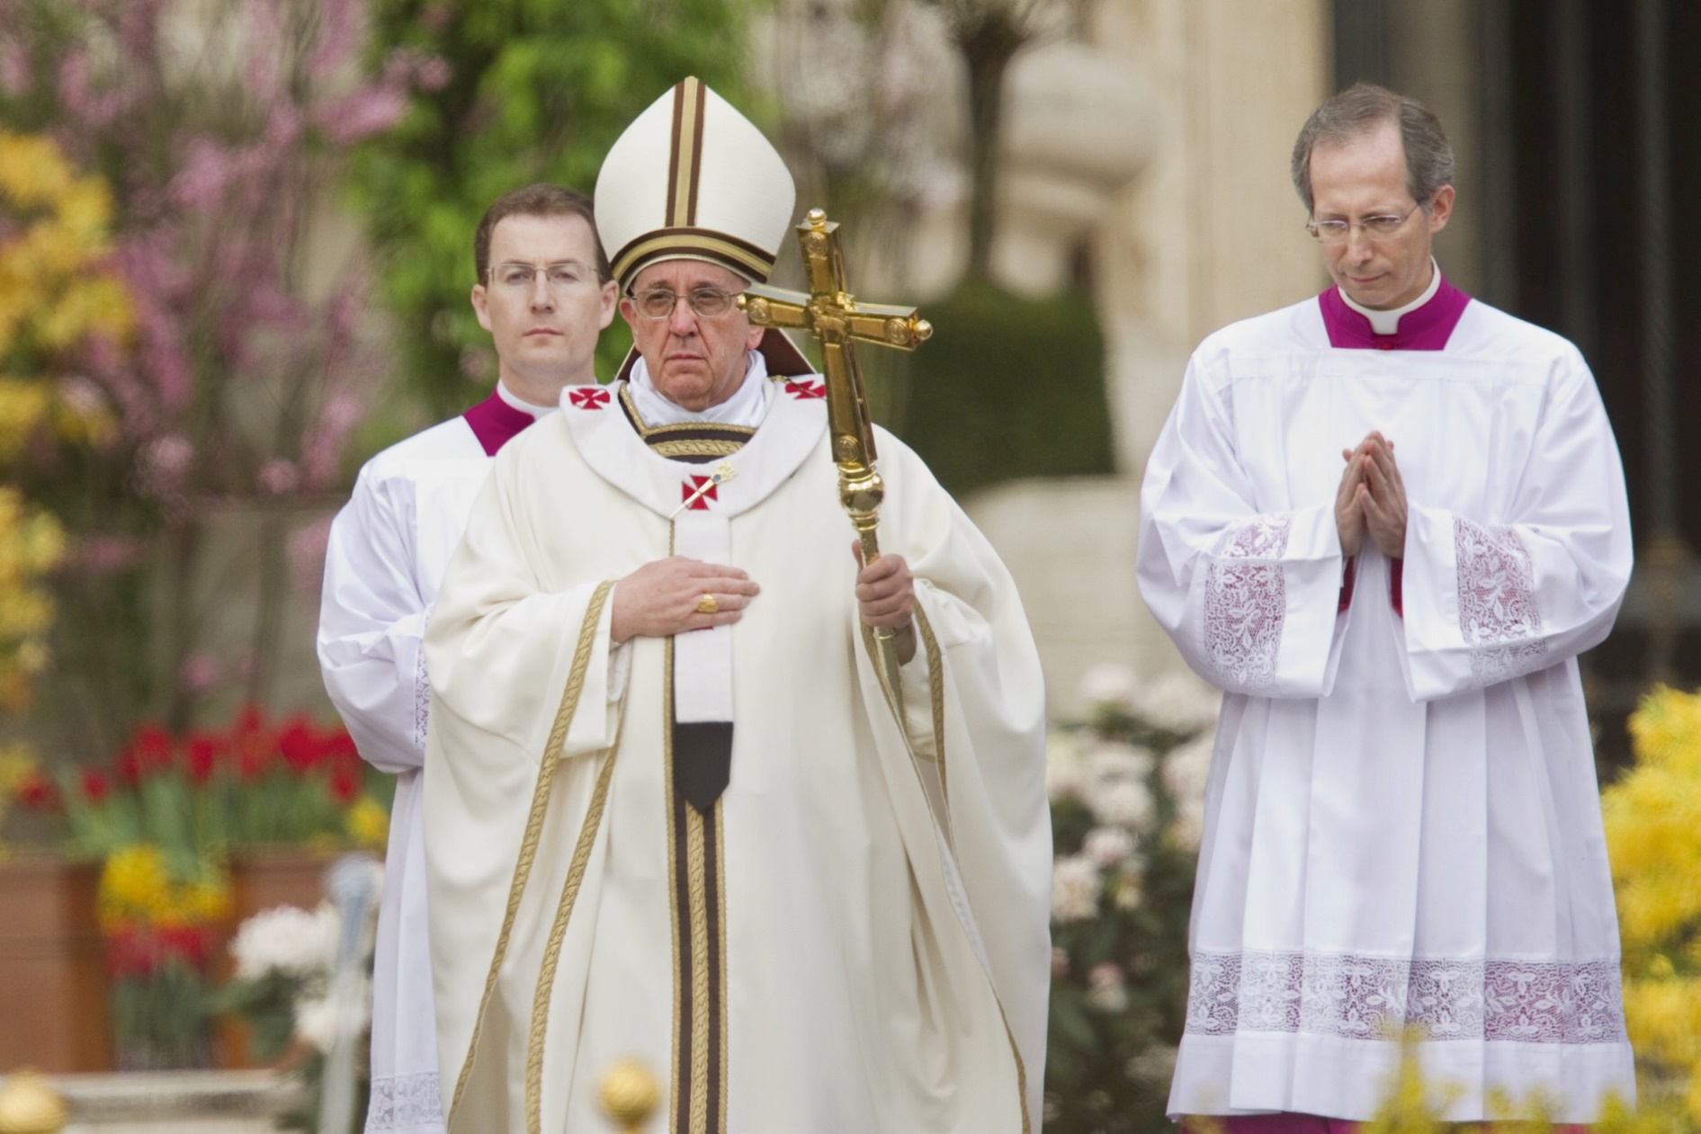
© Philip Chidell / Shutterstock.com
Notes:
Notes: Ask the students to identify what is particular to Easter, or what has changed since Lent and the earlier Triduum liturgies, about each photo. In this case, it is the priest’s white vestments, which symbolize rejoicing and purity of soul. Ask the students how these are relevant to Easter (we rejoice that Christ has conquered death and opened the way for us into Heaven, offering us reconciliation to make our souls clean again).

Slide 3
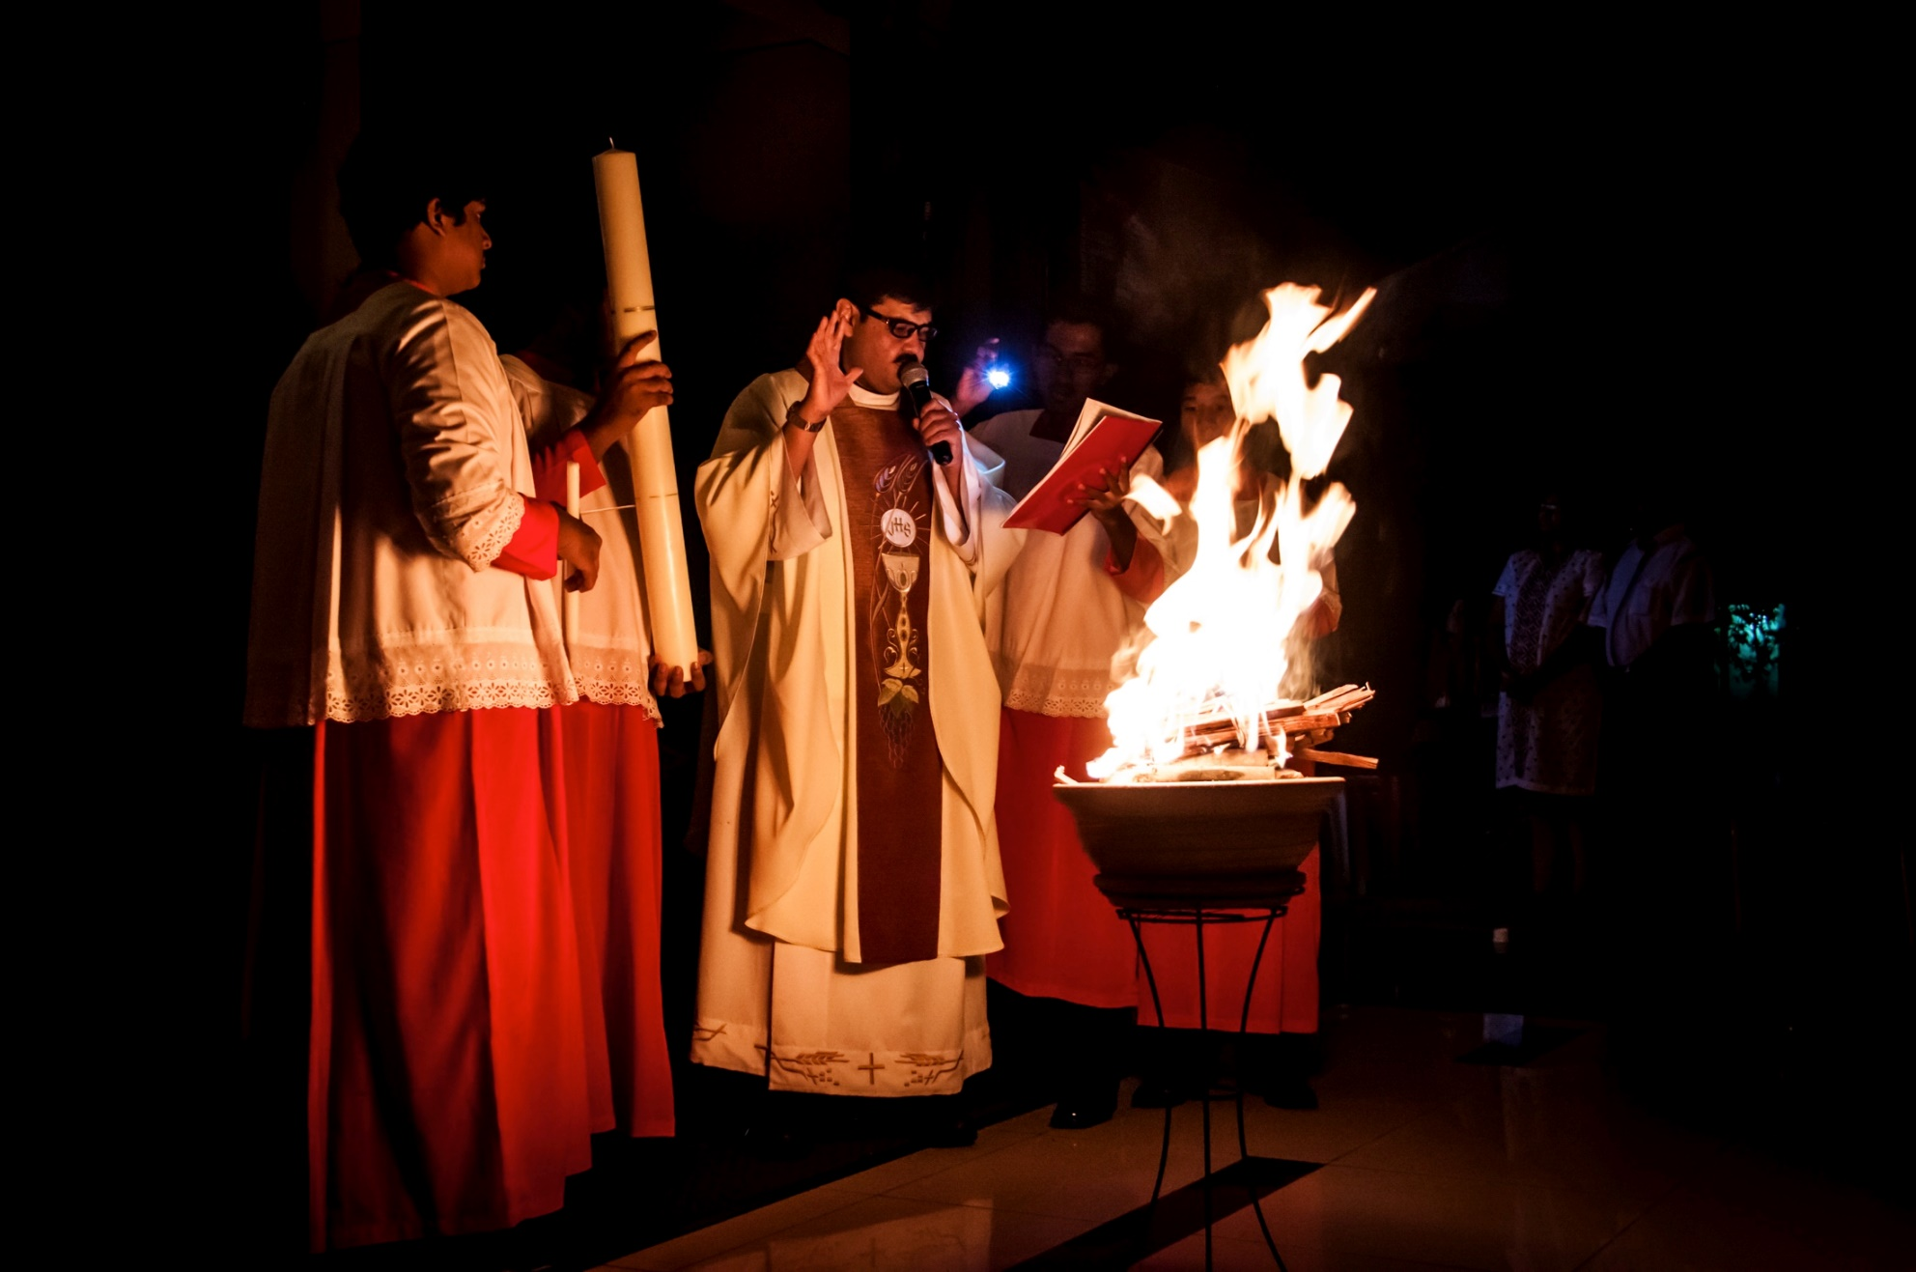
© ThamKC / Shutterstock.com
Notes:
Notes: The Easter or Paschal candle is lit from the blessed fire at the beginning of the Easter Vigil. Ask students to name what the light symbolizes (one appropriate answer is the spiritual light Christ brings into the world by his Resurrection).

Slide 4
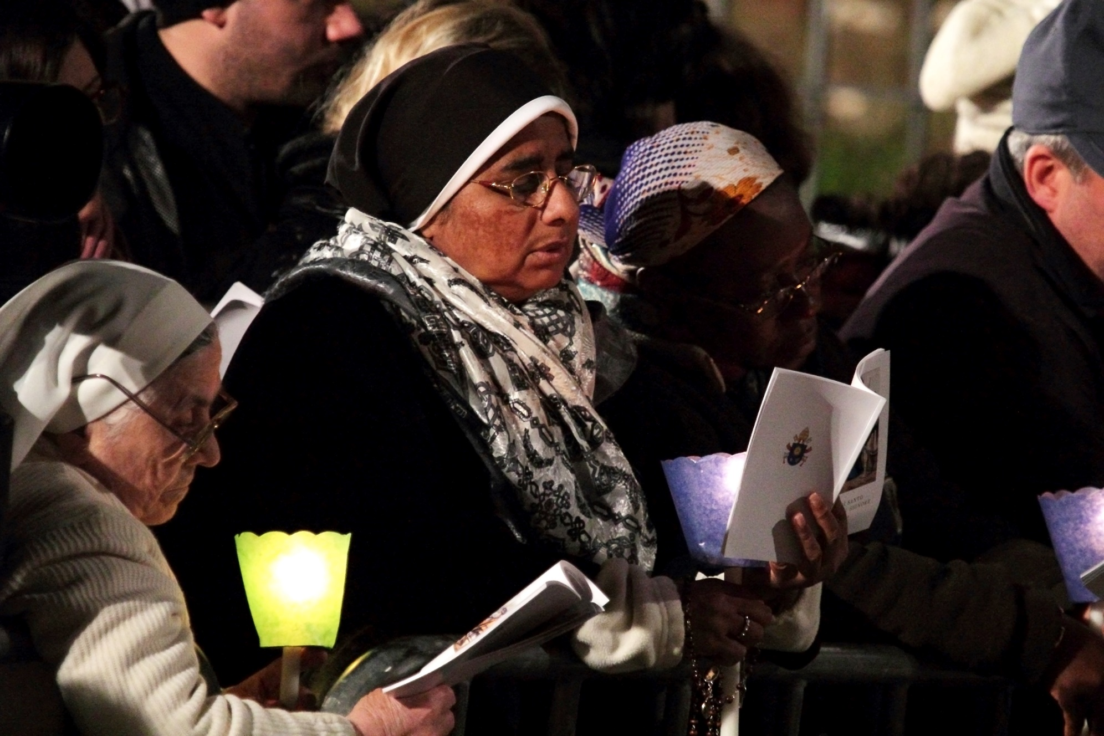
© MattiaATH / Shutterstock.com
Notes:
Notes: The faithful light their candles from the Paschal candle, symbolizing how the light of Christ is shared among the People of God.

Slide 5
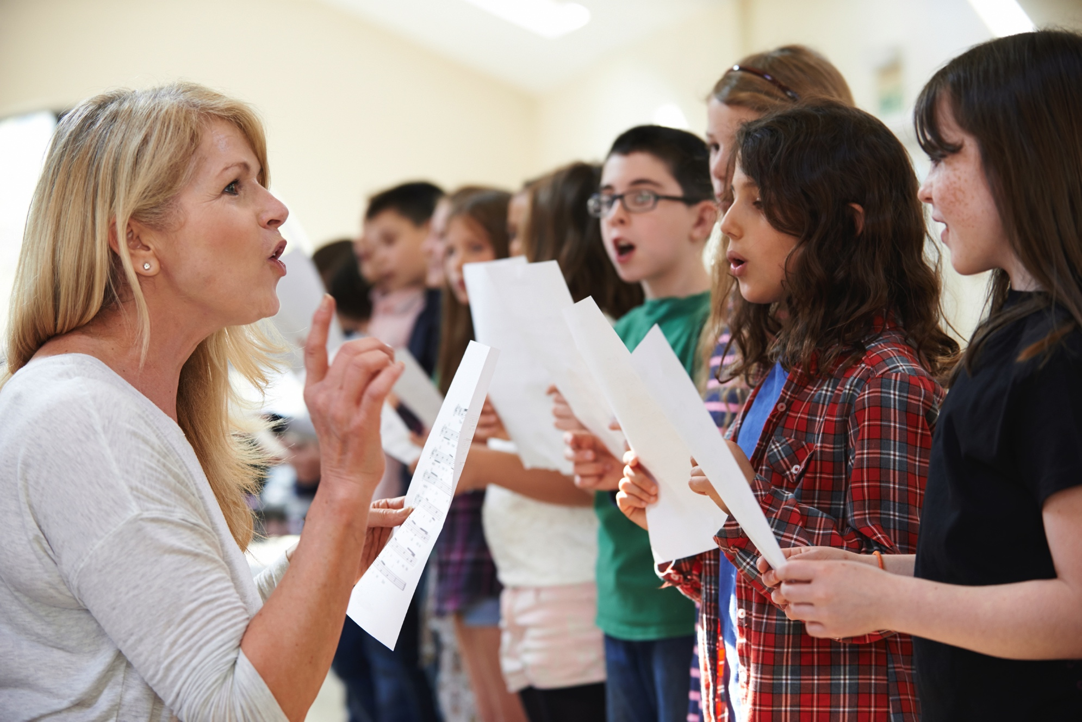
© Highwaystarz-Photography / iStock
Notes:
Notes: Ask the students what the choir and the people now sing that we did not during Lent: Alleluia! Ask if any of the students know what this word means (roughly, “All praise to God!”).

Slide 6
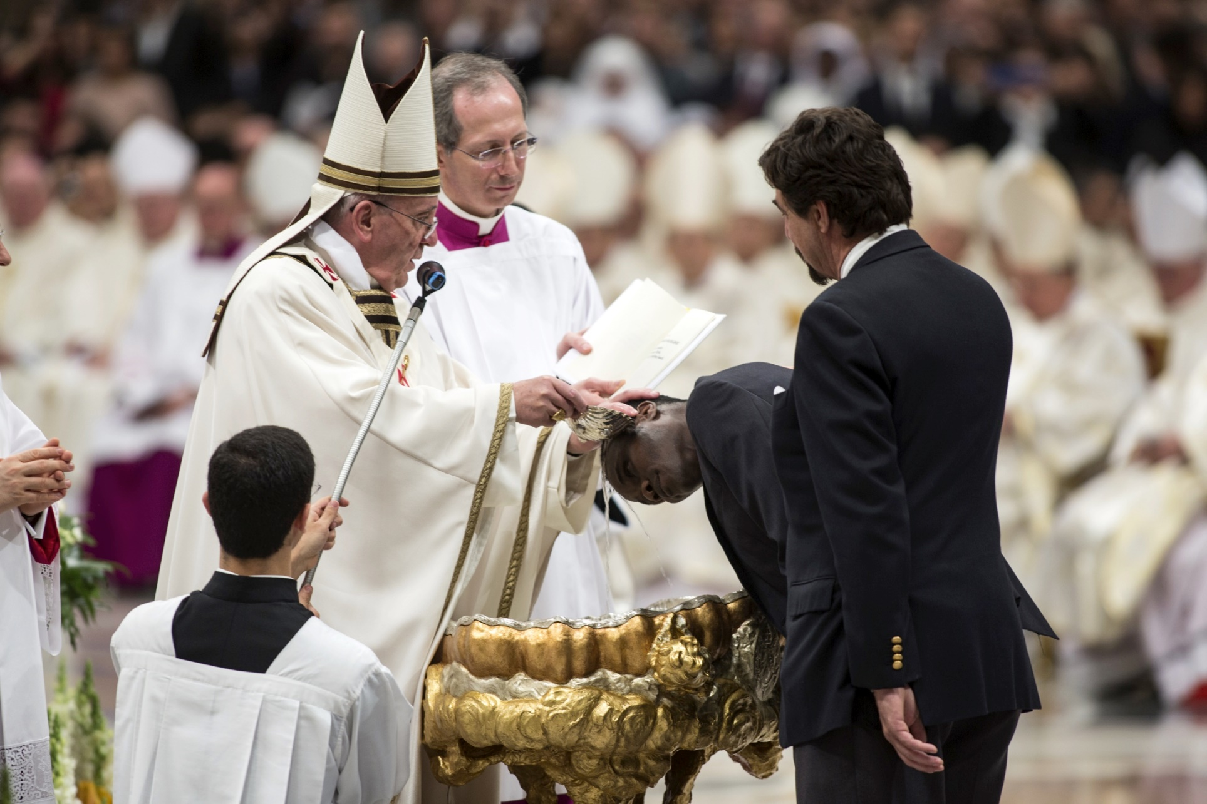
© giulio napolitano / Shutterstock.com
Notes:
Notes: The Rite of Baptism and Confirmation for adults entering the Church at the Easter Vigil is a beautiful ritual in which we welcome new members into the People of God. Remind the students that they are part of this “welcoming committee” too, and encourage them to greet the new Catholics after Mass.

Slide 7
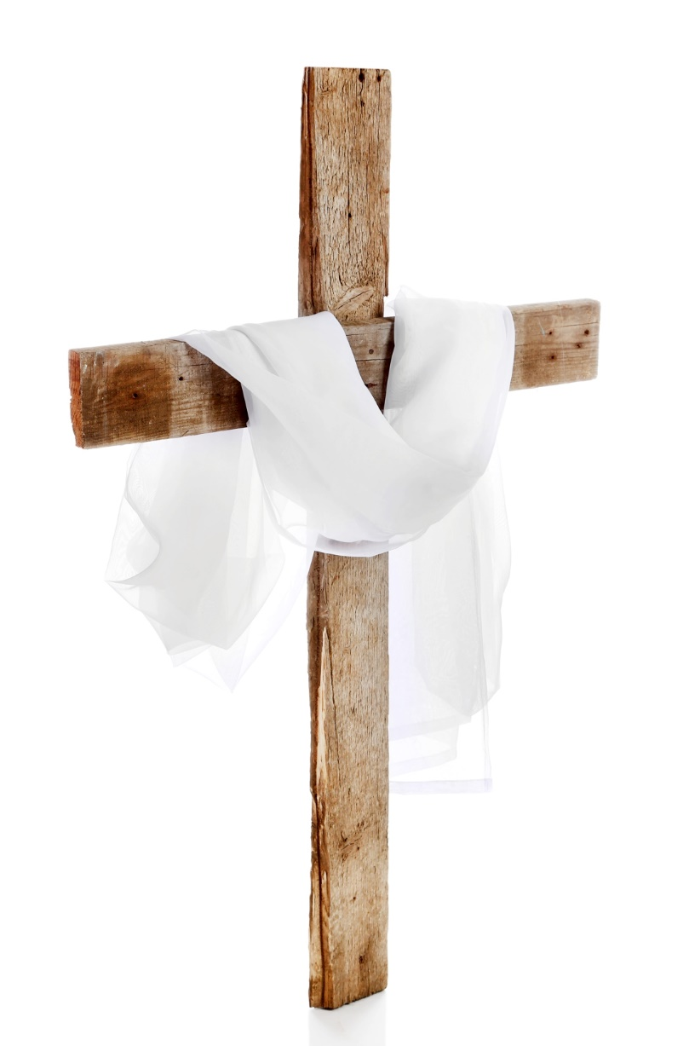
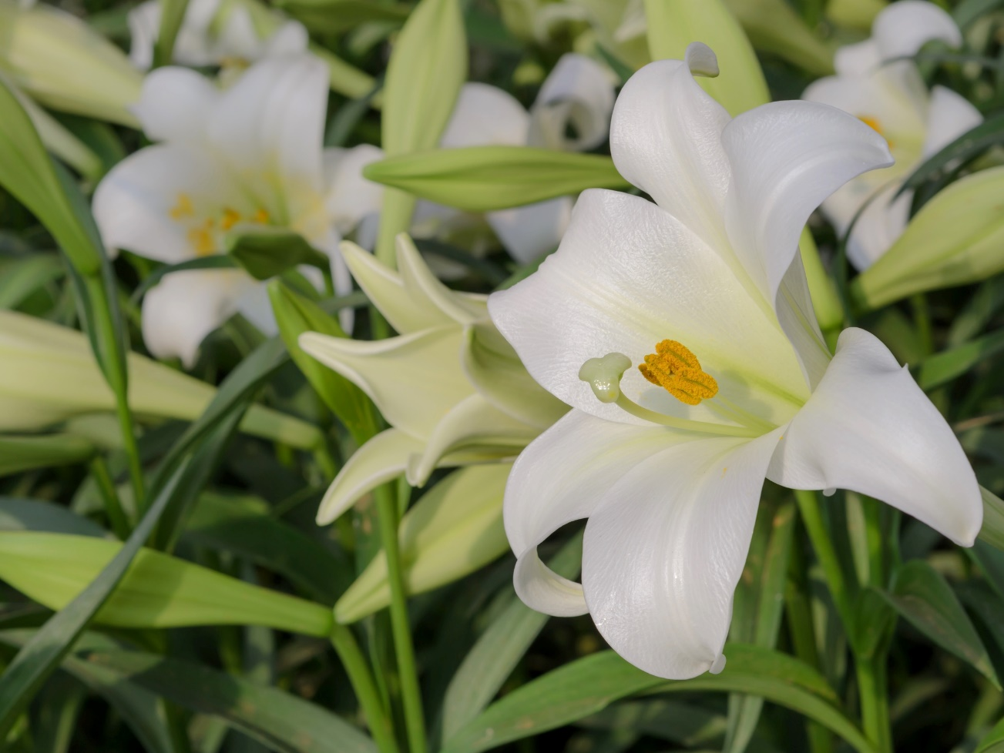
© Boonsom / Shutterstock.com
© Africa Studio / Shutterstock.com
Notes:
Notes: Again, ask the students to note what is special about seeing these items in church for Easter. Many churches have a large cross displayed during Lent, usually draped with a purple cloth (and changed to red for Easter). The white represents our rejoicing in Christ’s victory over death and darkness—which came about through his suffering on the cross. The lilies or other flowers remind us of new life and the beauty of creation, which is also redeemed by Christ’s death and Resurrection.

Slide 8
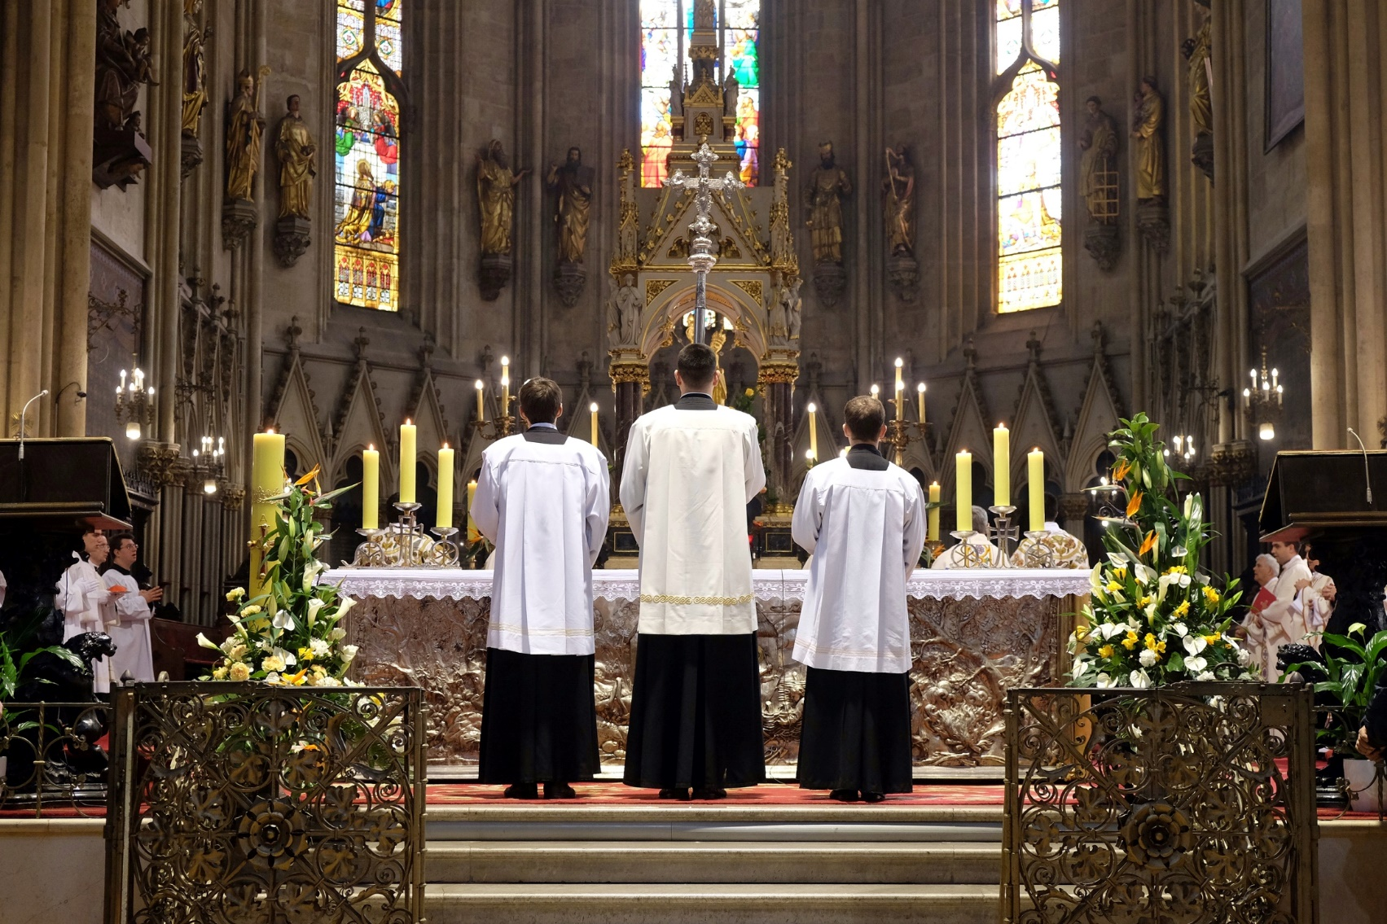
Solemn and Joyful (Communion)
© Zvonimir Atletic / Shutterstock.com
Notes:
Notes: Like any liturgy, the Easter Vigil and Easter Sunday Mass are solemn celebrations of Christ’s life, death, and Resurrection and his gift of himself to us in the Eucharist. And like any liturgy, and even more so, the Easter liturgies are joyful and exultant. In them we take every opportunity—from the use of white garments and other cloths, to flowers to light to music—to celebrate, rejoice, and give thanks to God.

